Slide 1

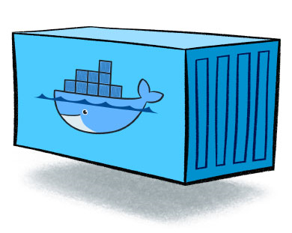
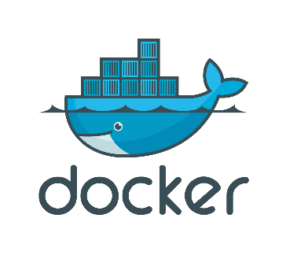
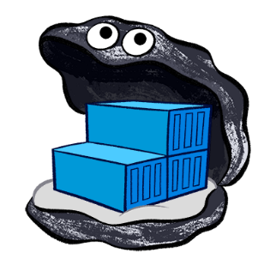
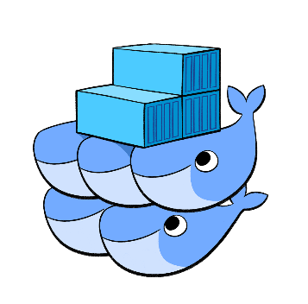
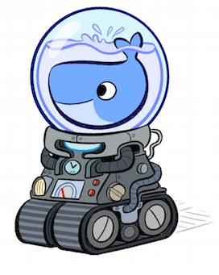
Docker and its Toolchain
Containers
Docker-Compose
Docker – Registry
Docker – Swarm Mode
Docker - Machine

Slide 2
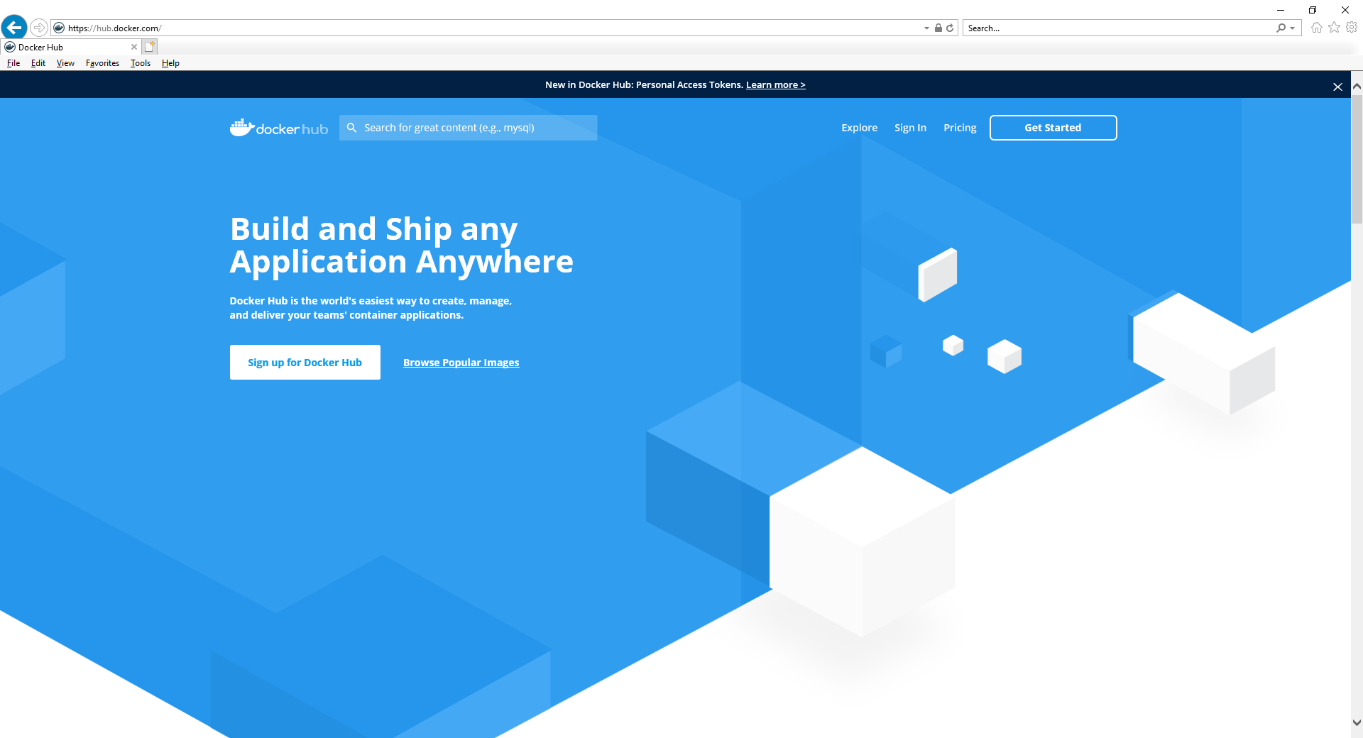
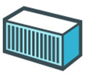
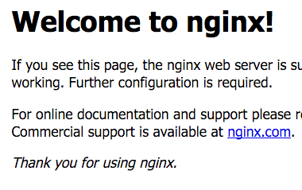
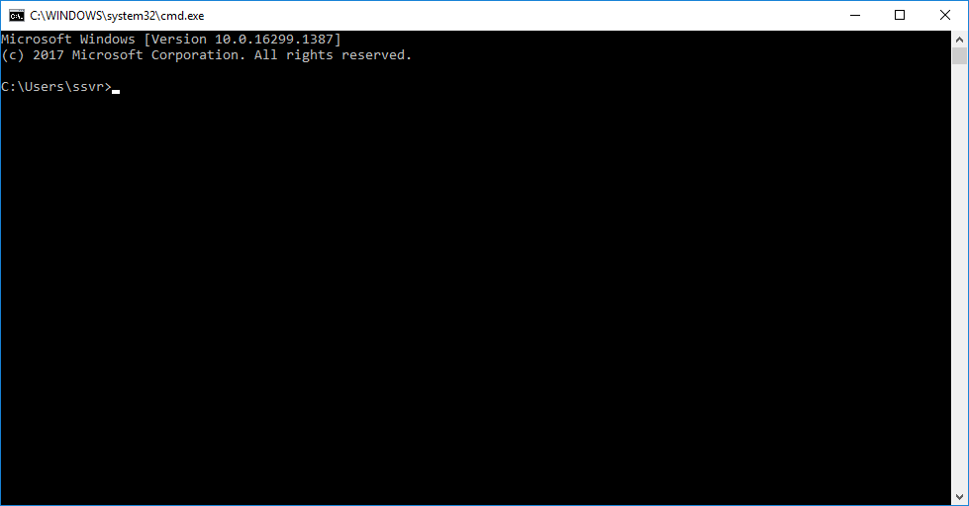
How Docker container works ?
Image
Image
Docker – Registry
2
4
# docker container run -dit --name mynginx
-p 8080:80 ngnix:latest
0
1
Engine/Daemon
Docker CLI or Client
3
5
6
Default Page
Containers
Personal Desktop/Laptop or VM or Cloud virtual machine or physical server

Slide 3
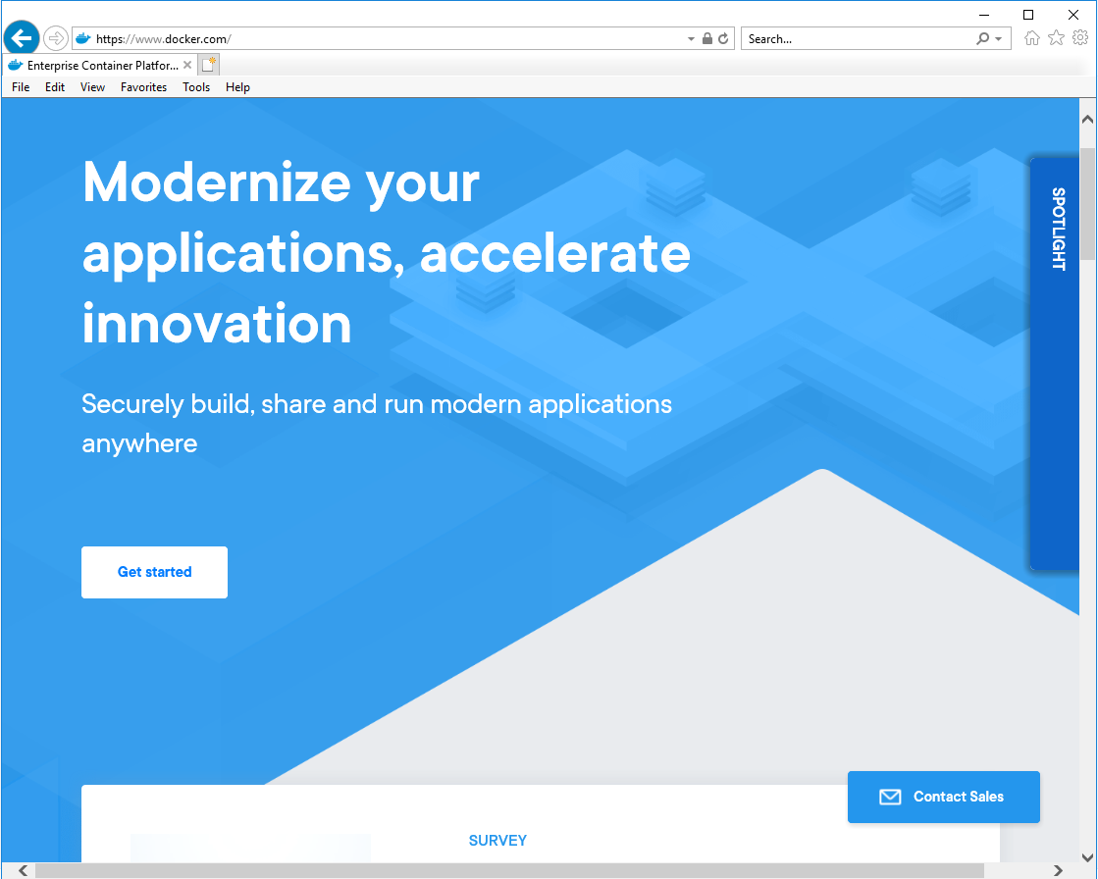


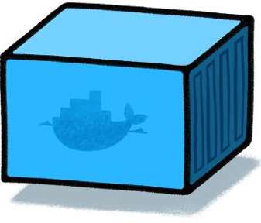

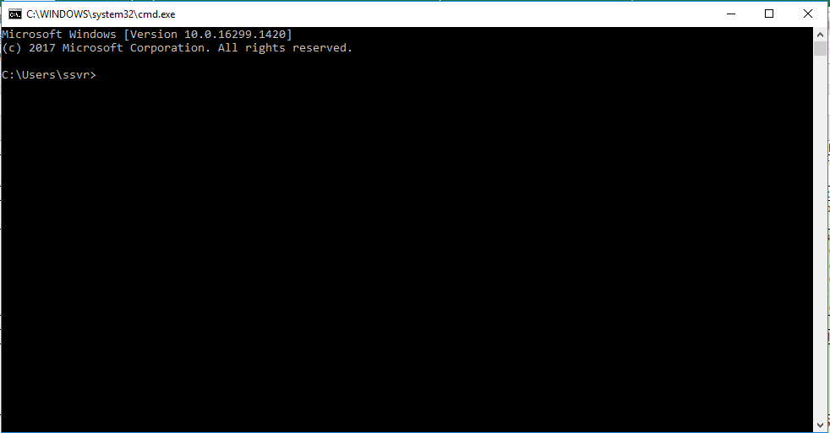
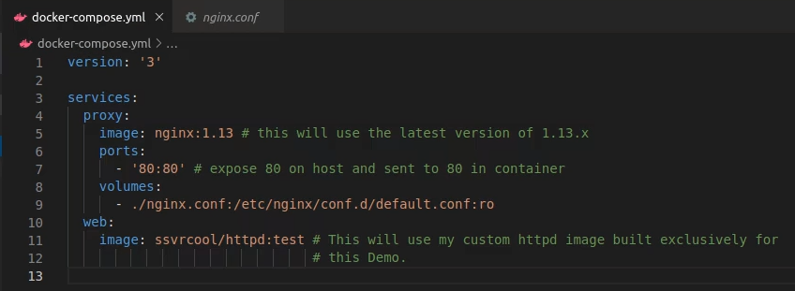
Docker Manual automation with Docker CLI
Design
Selenium Node for Firefox
Selenium Node for Chrome
Selenium application node
docker-compose up
Selenium Hub
0

Slide 4
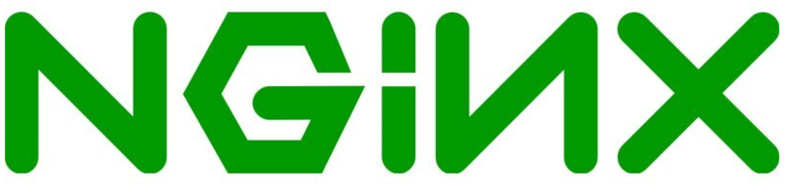


Docker-Compose (Non-Prod Automation)
Architecture
3
5
B
C
A
5
4
0
docker-compose up
2
1

Slide 5


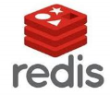

Docker-Swarm (Prod Automation)
3
Architecture
2
0
3
3
Orchestration
2
2
2
1
manager
4
worker
manager
4
node1
node2
node3
4
3
3
3
1
1
1

Slide 6
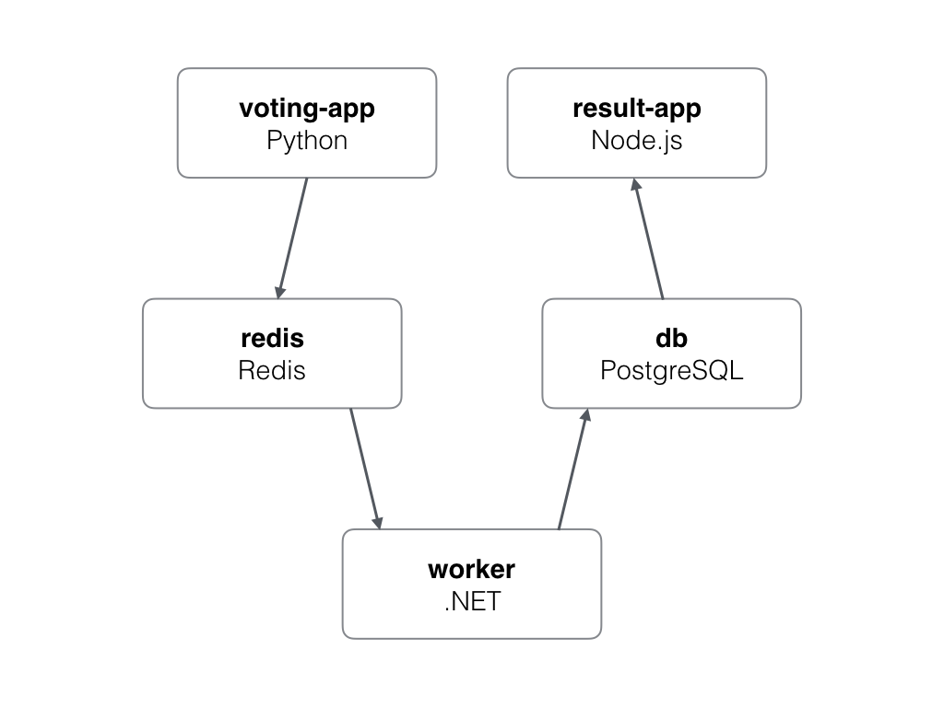
Docker-Swarm (Prod Automation) : Demo
3
Architecture
A front-end web app in Python or ASP.NET Core which lets you vote between two options
Node.js or ASP.NET Core
webapp which shows the results of the voting in real time
Redis (Cache DB) queue which collects new votes
Postgres database storing the results
.NET Core or Java worker
which consumes votes and stores them in…

