Slide 1
Bayesian Networks
CS 470
Ethan Pedersen

Slide 2
Recall
From conditional probability, we know that P(A, B) = P(A | B) * P(B)
P(A | B) = P(A, B) / P(B)
Multiply both sides by P(B)
Can we extend this to know that P(A, B, C) is?
P(A | B, C) = P(A, B, C) / P(B, C)
Multiply both sides by P(B, C)
P(A, B, C) = P(A | B, C) * P(B, C)
But what is P(B, C)?
P(B, C) = P(B | C) * P(C)
So P(A, B, C) = P(A | B, C) * P(B | C) * P(C)

Slide 3
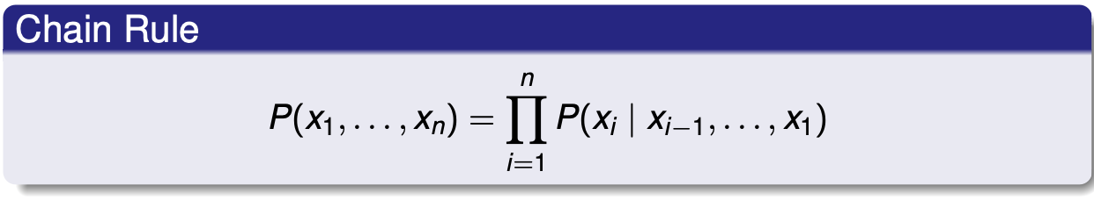
Chain Rule
What we just saw is what we call the chain rule for conditional probabilities
More formally:

Slide 4
Motivation for Bayesian Networks
Random variables help us model uncertainty
Many applications have several RVs
This means that trying to model the joint distribution can get very complicated
Bayesian networks provide a condensed graphical representation of the joint distribution

Slide 5
Bayesian Network
Represents joint distribution over random variables we’re interested in
Use conditional probabilities and the chain rule to accomplish this
Directed acyclic graph (DAG)
Nodes: random variables
Directed edges: conditional dependence
Ex: if there is an edge from Y to X, that means that the random variable X depends on the random variable Y
Each node has a conditional probability distribution that represent the probability distribution of the random variable given its parents

Slide 6
Bayesian Network
In summary, a bayesian network is a graph that represents how random variables influence each other

Slide 7
Example
E | P(E)
T | 0.1
F | 0.9
B | P(B)
T | 0.05
F | 0.95
E
B
A
B | E | P(A | B, E)
T | T | 0.99
T | F | 0.9
F | T | 0.08
F | F | 0.01
E | A | P(J | E, A)
T | T | 0.5
T | F | 0.01
F | T | 0.8
F | F | 0.01
J

Slide 8
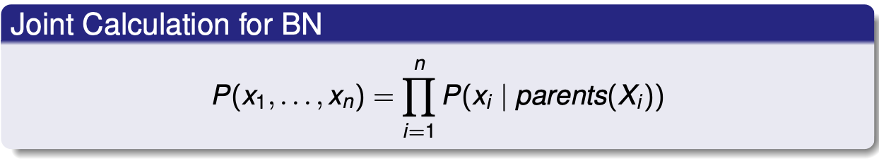
How to Calculate Joint Distribution?

Slide 9
How to Calculate Joint Distribution?
How does this relate to the chain rule?

Slide 10
Example
What is P(~E, ~B, ~A, J)?
E | P(E)
T | 0.1
F | 0.9
B | P(B)
T | 0.05
F | 0.95
E
B
A
B | E | P(A | B, E)
T | T | 0.99
T | F | 0.9
F | T | 0.08
F | F | 0.01
E | A | P(J | E, A)
T | T | 0.5
T | F | 0.01
F | T | 0.8
F | F | 0.01
J

Slide 11
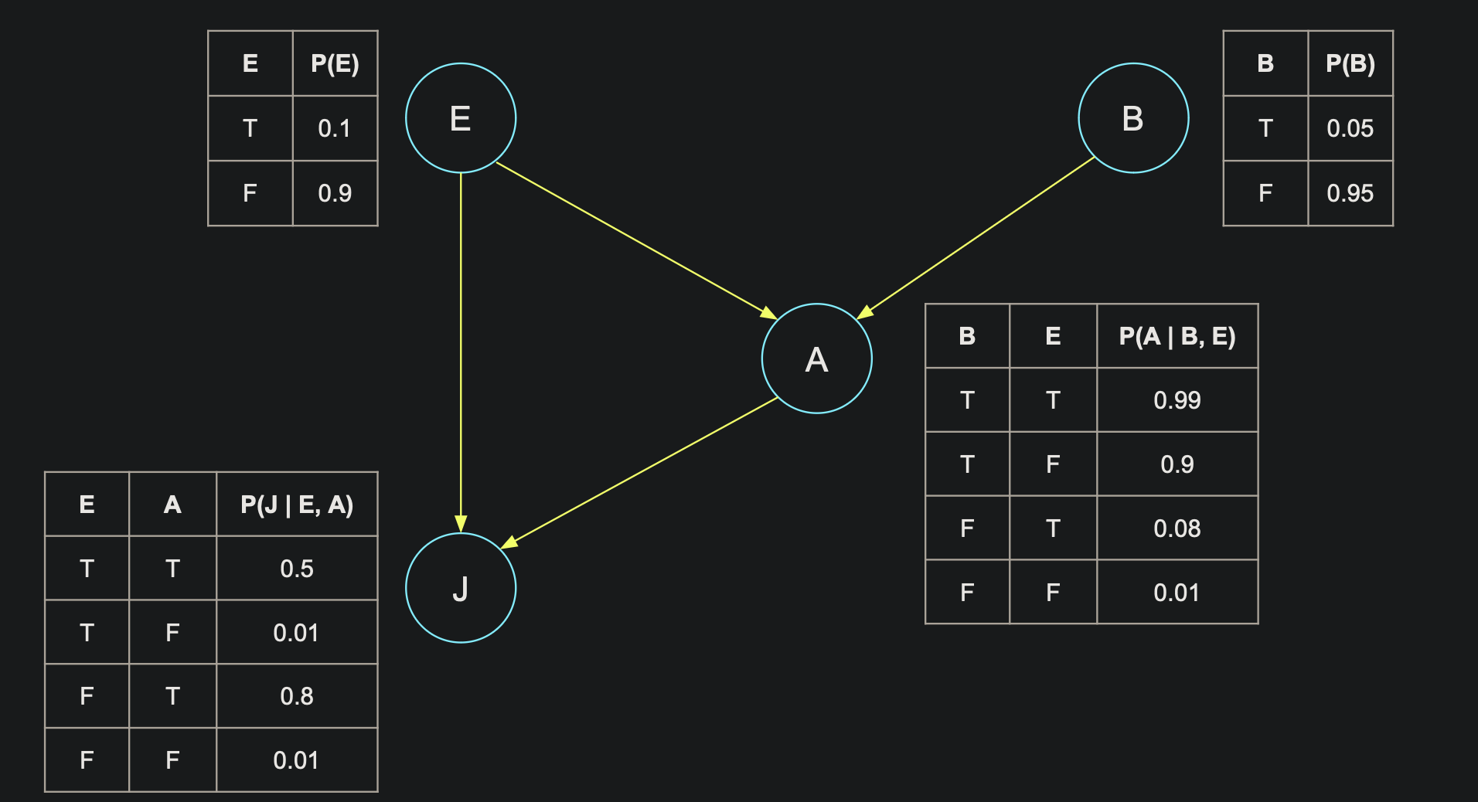
Example
What is P(~E, ~B, ~A, J)?
Four pieces:
P(~E given its parents)
P(~B given its parents)
P(~A given its parents)
P(J given its parents)

Slide 12
Example
First piece: P(~E given its parents)
E’s parents?
None
So P(~E given its parents)
= P(~E)
= 0.9

Slide 13
Example
Second piece: P(~B given its parents)
B’s parents?
None
So P(~B given its parents)
= P(~B)
= 0.95

Slide 14
Example
Third piece: P(~A given its parents)
A’s parents?
E and B
Specifically, we’re interested in ~E and ~B
So P(~A given its parents)
= P(~A | ~E, ~B)
= 1 - 0.01
= 0.99

Slide 15
Example
Fourth piece: P(J given its parents)
J’s parents?
E and A
Specifically, we’re interested in ~E and ~A
So P(J given its parents)
= P(J | ~E, ~A)
= 0.01

Slide 16
Example
What is P(~E, ~B, ~A, J)?
= P(~E given its parents) * P(~B given its parents) * P(~A given its parents) * P(J given its parents)
= 0.9 * 0.95 * 0.99 * 0.01
= 0.0084645

Slide 17
Discussion
Notice that we went in a particular order (E, B, J, A)
Would the result be different if we went in a different order?
Ex: B, A, J, E
As long as we use the equation and use the structure of the network to determine a node’s parents, the order doesn’t matter
This also makes sense because P(E, B, J, A) = P(B, A, J, E)
What if we only wanted the joint distribution of E, B, and A (i.e. P(E, B, A)); can we use the network to calculate it?
Yes, just follow the same process but ignore J

Slide 18
Discussion
Notice that we have P(X | parents of X)
This is what is known as the Markov Assumption
The current state only depends on the previous state, not all of the previous states
Ex: P(J | E, B, A) just becomes P(J | E, A)
In other words, since J just depends on E and A, and we observe E and A, we don’t care about the value of B

Slide 19
Example
P(A | E, B, J)
Use the formula for conditional probabilities:
P(A | E, B, J) = P(A, E, B, J) / P(E, B, J)
Then use the joint calculation for Bayesian networks:
P(A | E, B, J) = P(A, E, B, J) / P(E, B, J)
= (P(A given parents) * P(E given parents) * P(B given parents) * P(J given parents)) / (P(E given parents) * P(B given parents) * P(J given parents))
= P(A given parents)

Slide 20
Discussion
This equation applies for observations
What happens if a value is unobserved (i.e. there is uncertainty around the value)?
We can still use this equation
However, we must account for the uncertainty of the unobserved variable(s)

Slide 21
Example
B | P(B)
T | 0.001
F | 0.999
E | P(E)
T | 0.002
F | 0.998
What is P(J, M | B, ~E)?
E
B
B | E | P(A | B, E)
T | T | 0.95
T | F | 0.94
F | T | 0.29
F | F | 0.001
A
J
M
A | P(J)
T | 0.9
F | 0.05
A | P(M)
T | 0.7
F | 0.01

Slide 22
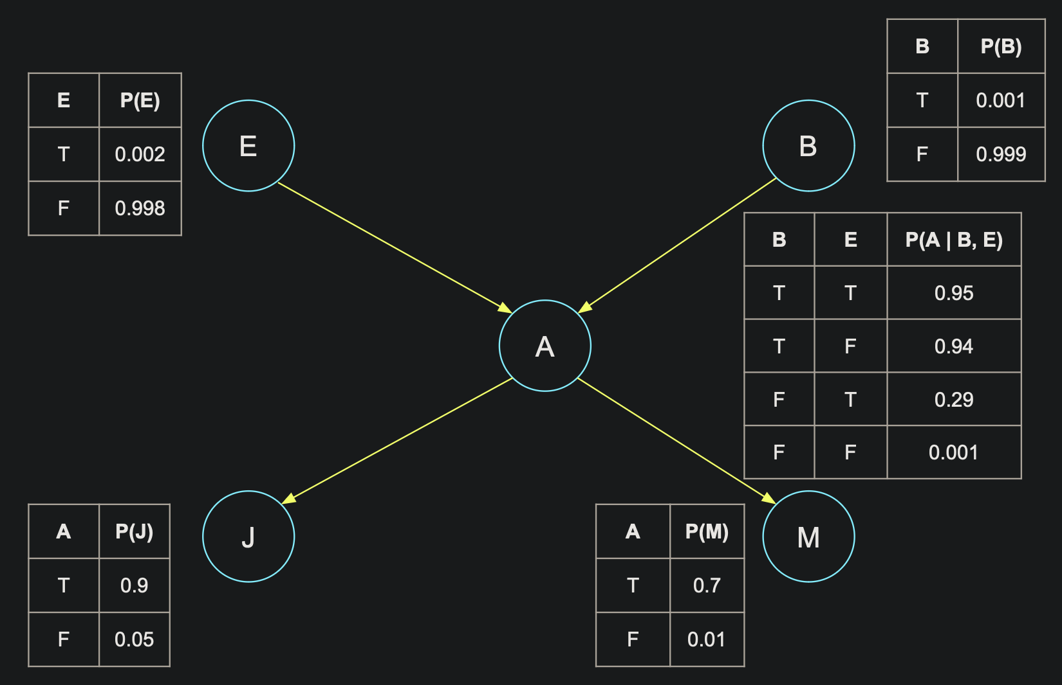
Example
What is P(J, M | B, ~E)?
In other words, we observe the values for B and E but are still unsure what A is

Slide 23
Example
What is P(J, M | B, ~E)?
Two possible values for A:
True
P(J, M | B, ~E, A) * P(A | B, ~E)
False
P(J, M | B, ~E, ~A) * P(~A | B, ~E)

Slide 24
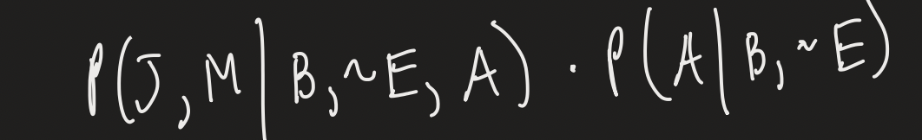
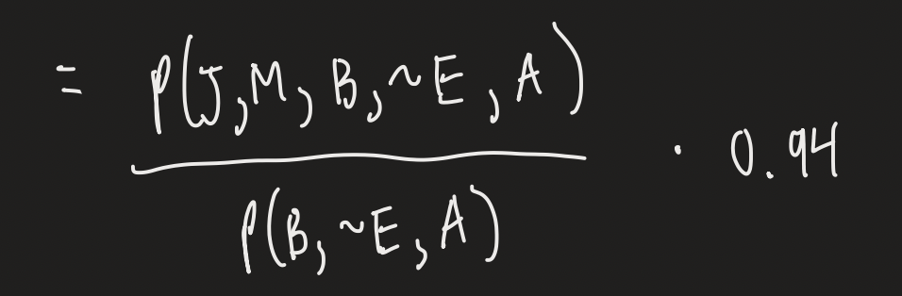
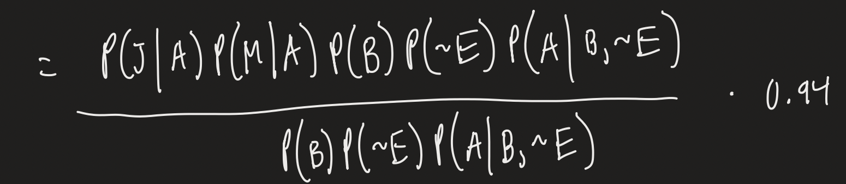
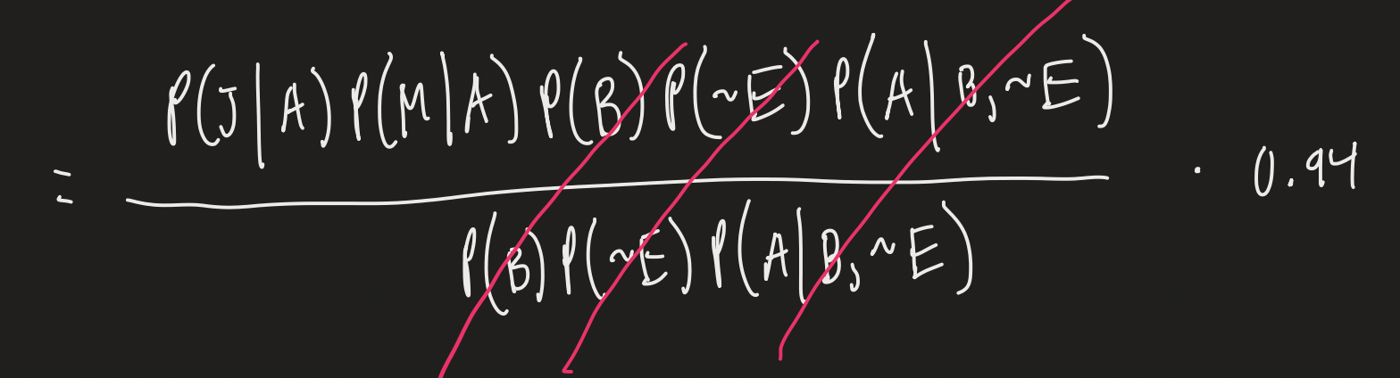
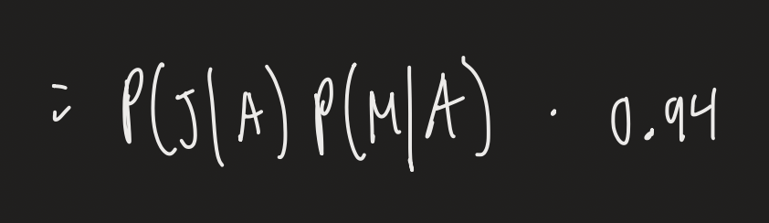
Example
When A is true:

Slide 25
Example
When A is false:
Same process as the previous slide
Finish it as part of the homework

Slide 26
Example
B | P(B)
T | 0.001
F | 0.999
E | P(E)
T | 0.002
F | 0.998
What is P(A)?
E
B
i.e. we don’t observe anything for B and E
B | E | P(A | B, E)
T | T | 0.95
T | F | 0.94
F | T | 0.29
F | F | 0.001
A
J
M
A | P(J)
T | 0.9
F | 0.05
A | P(M)
T | 0.7
F | 0.01

Slide 27
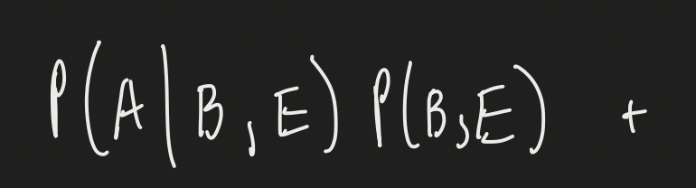



Example
P(A) =

Slide 28
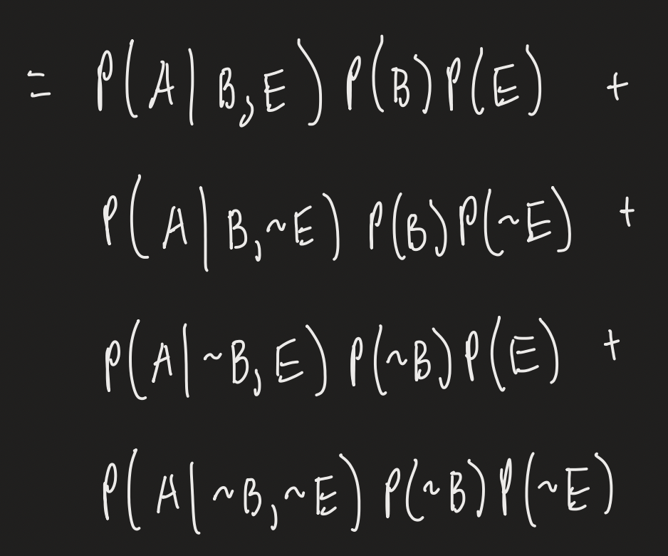
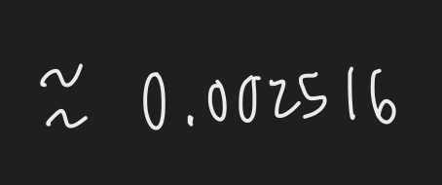
Example

Slide 29

Demo
Let’s double check if P(A) is correct

Slide 30
Example
B | P(B)
T | 0.001
F | 0.999
E | P(E)
T | 0.002
F | 0.998
What is P(J | A, M)?
E
B
i.e. we observe that the alarm went off and Mary called
B | E | P(A | B, E)
T | T | 0.95
T | F | 0.94
F | T | 0.29
F | F | 0.001
A
J
M
A | P(J)
T | 0.9
F | 0.05
A | P(M)
T | 0.7
F | 0.01

Slide 31
Example
P(J | A, M) =
P(J | A) = 0.9
(Markov assumption)

Slide 32
Example
B | P(B)
T | 0.001
F | 0.999
E | P(E)
T | 0.002
F | 0.998
What is P(J | M)?
E
B
i.e. we only observe that Mary called
B | E | P(A | B, E)
T | T | 0.95
T | F | 0.94
F | T | 0.29
F | F | 0.001
A
J
M
A | P(J)
T | 0.9
F | 0.05
A | P(M)
T | 0.7
F | 0.01

Slide 33
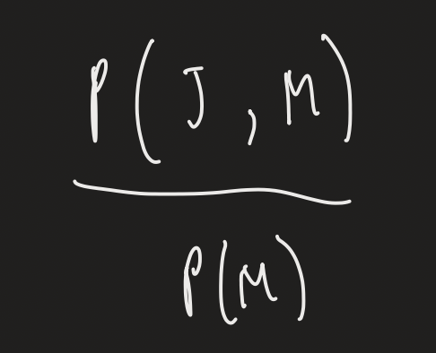
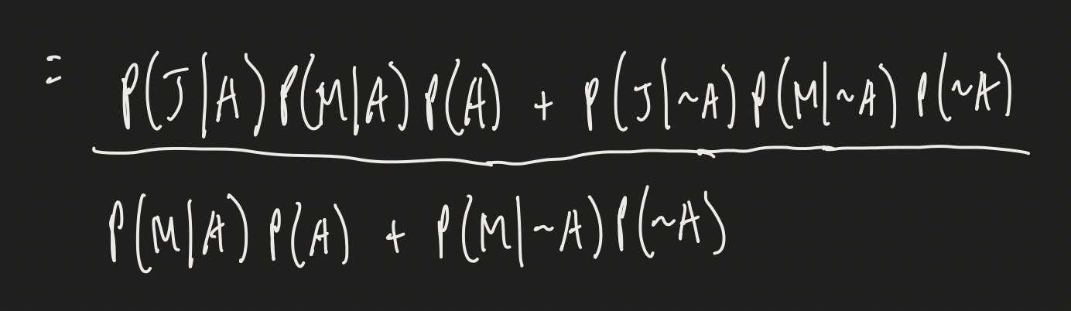

Example
P(J | M) =
Let’s check this in the code

Slide 34
Discussion
Notice that when we observed both A and M, M had no effect on J
In other words, P(J | A, M) = P(J | A) (Markov assumption)
However, when we only observed M, P(J | M) was not the same as P(J | A)
M had an effect on J
So even though there isn’t an immediate edge between J and M, they were dependant when we hadn’t observed A

Slide 35
How to Determine Conditional Independence/Dependence
Analogy: water through pipes
Nodes will pump the water
Edges are pipes
Each node has an outlet (if there isn’t one, we imagine there is one)
Observed nodes are block outlets
If water can flow from one node to the other, then they are dependent
If not, then they are independent
Blockages can either separate or connect nodes

Slide 36
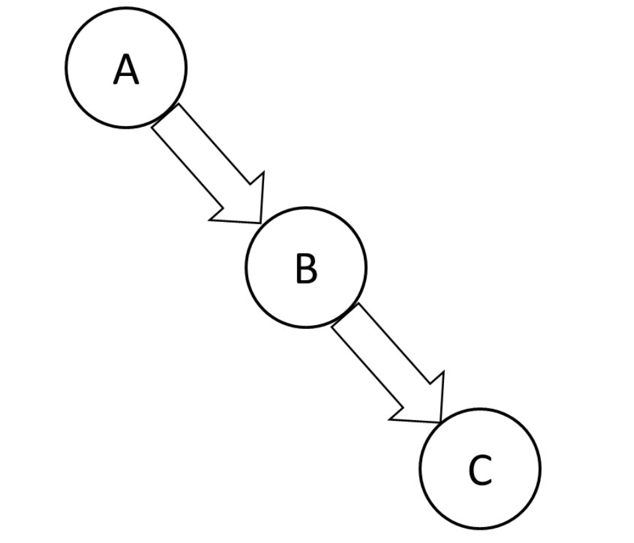
Example

Slide 37
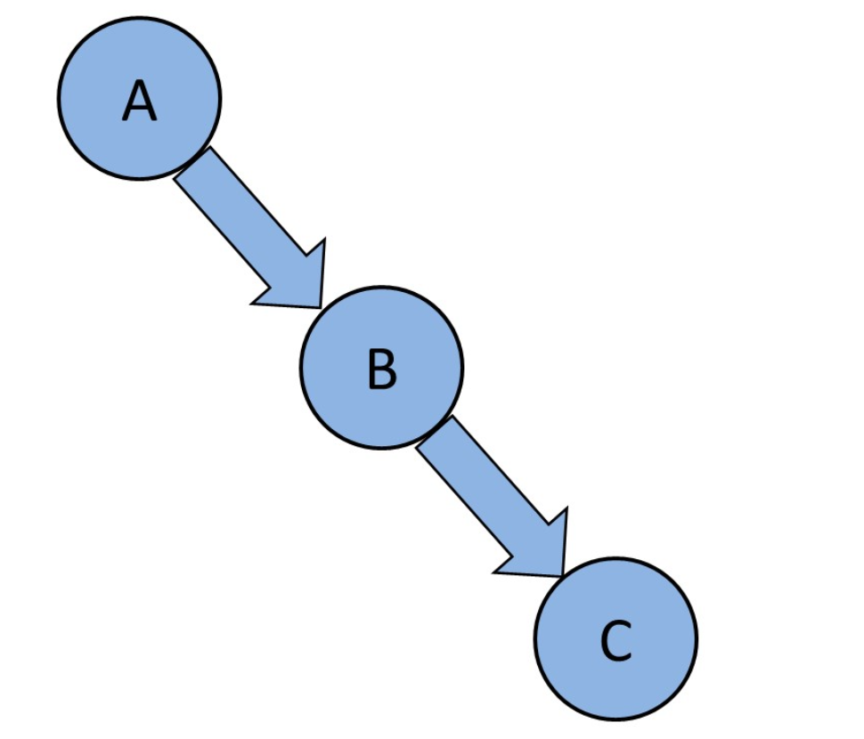
Example

Slide 38
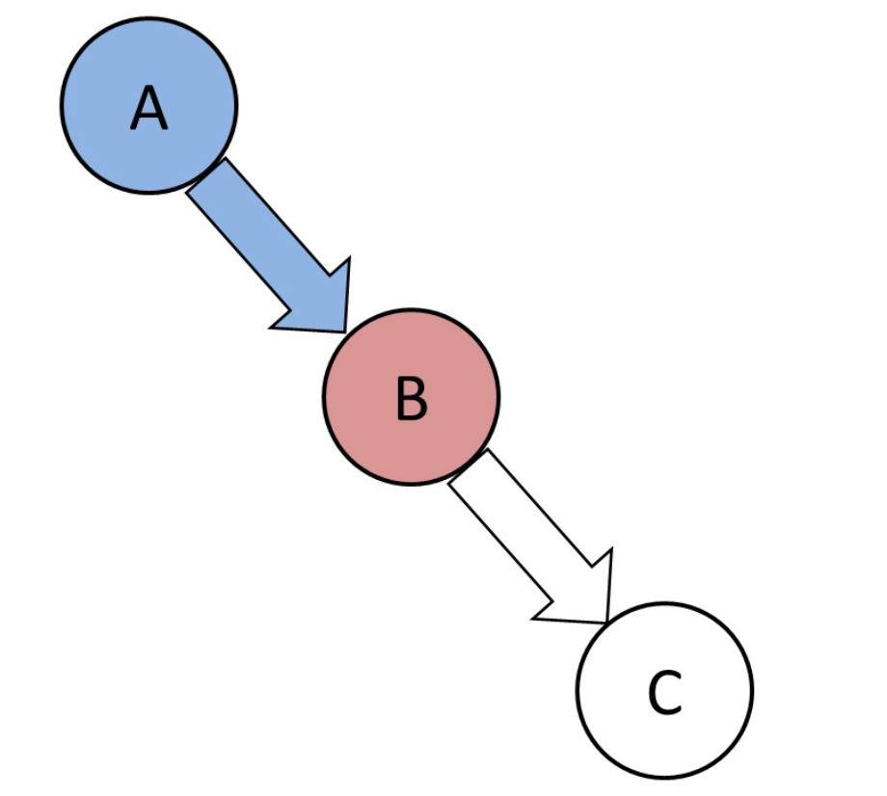
Example

Slide 39
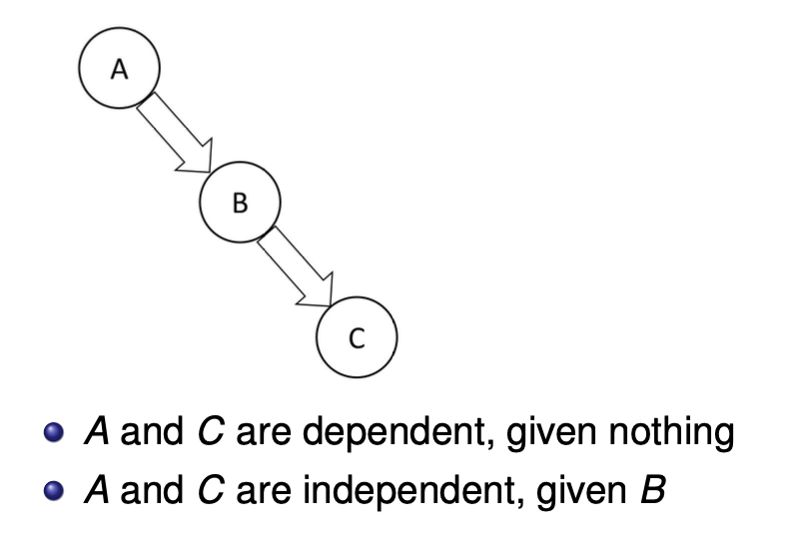
Example

Slide 40
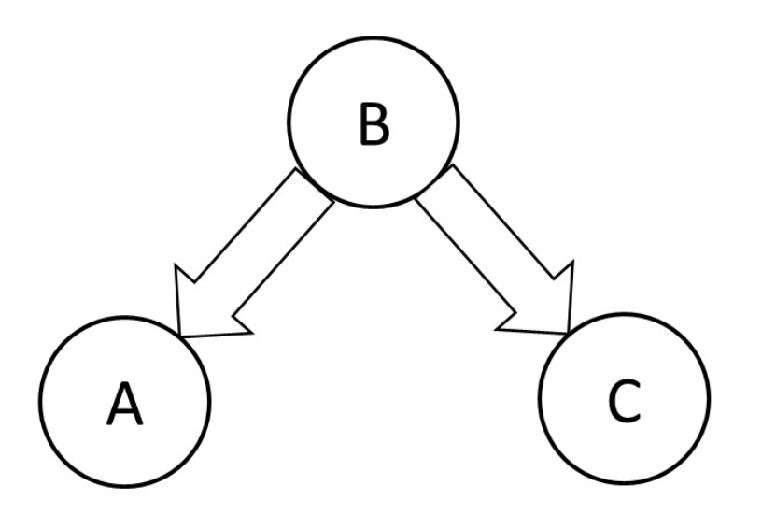
Example

Slide 41
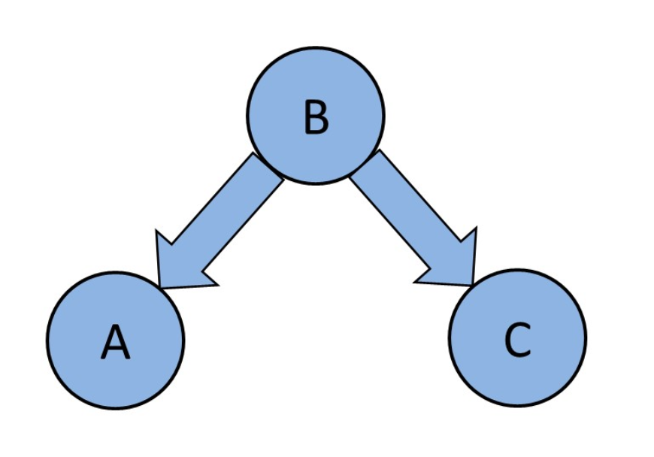
Example

Slide 42
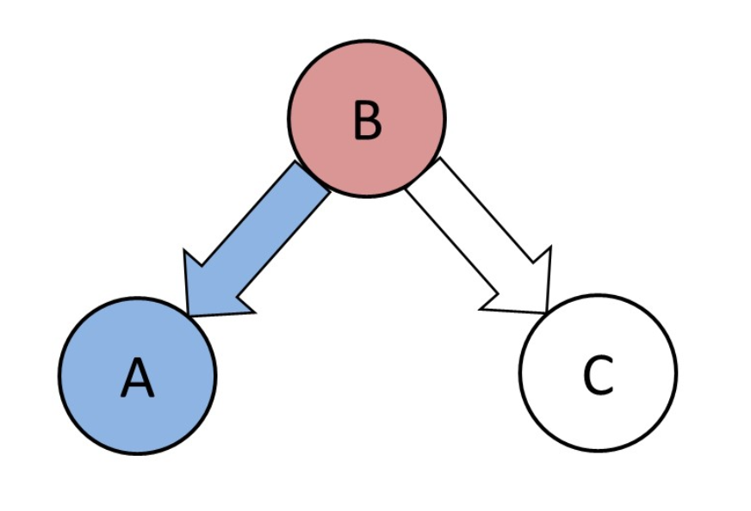
Example

Slide 43
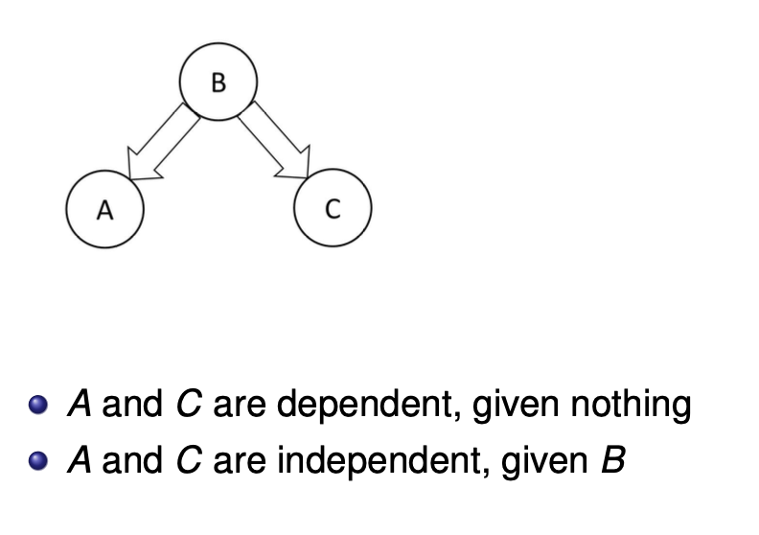
Example

Slide 44
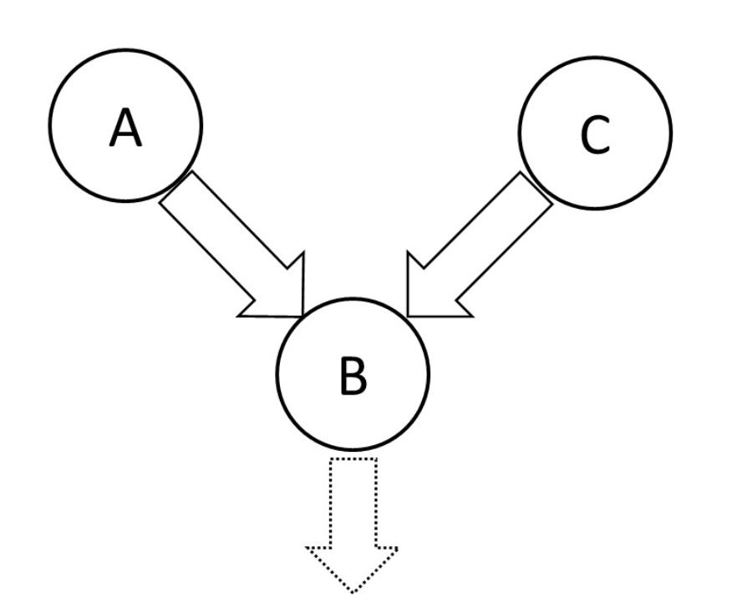
Example

Slide 45
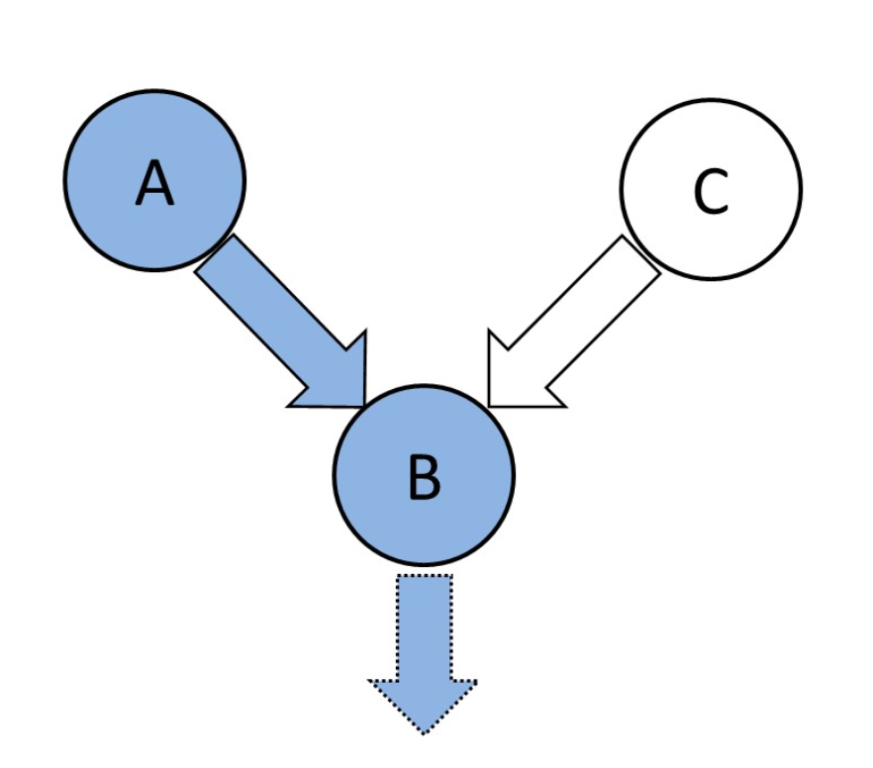
Example

Slide 46
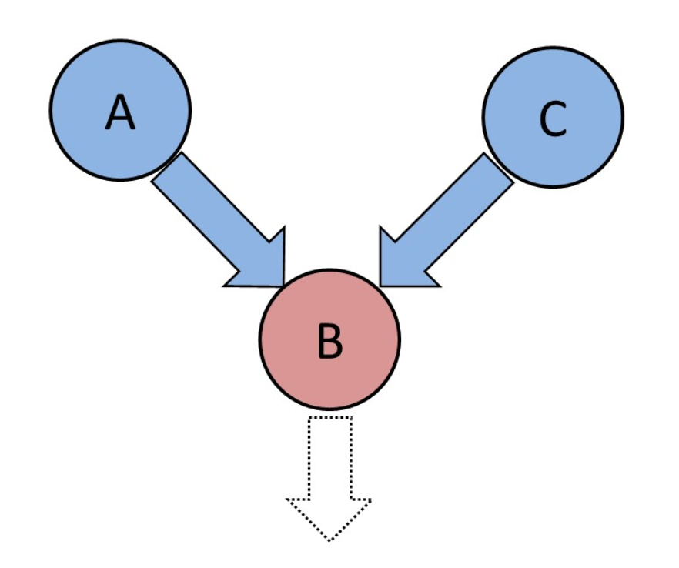
Example

Slide 47
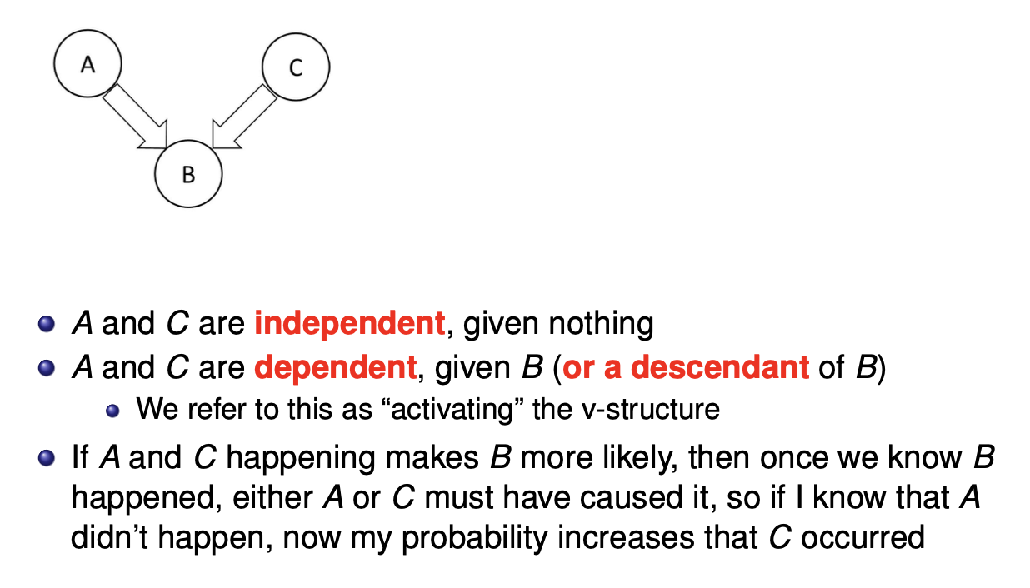
Example

Slide 48
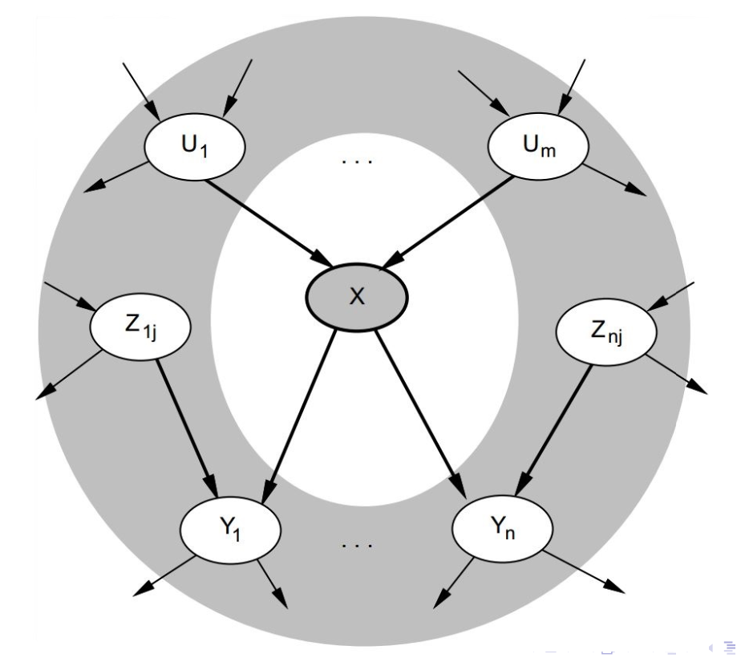
Markov Blanket
Each random variable is conditionally independent of the whole network, given its parents, children, and children’s co-parents

Slide 49
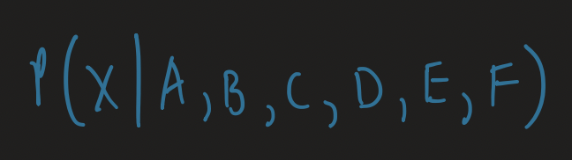
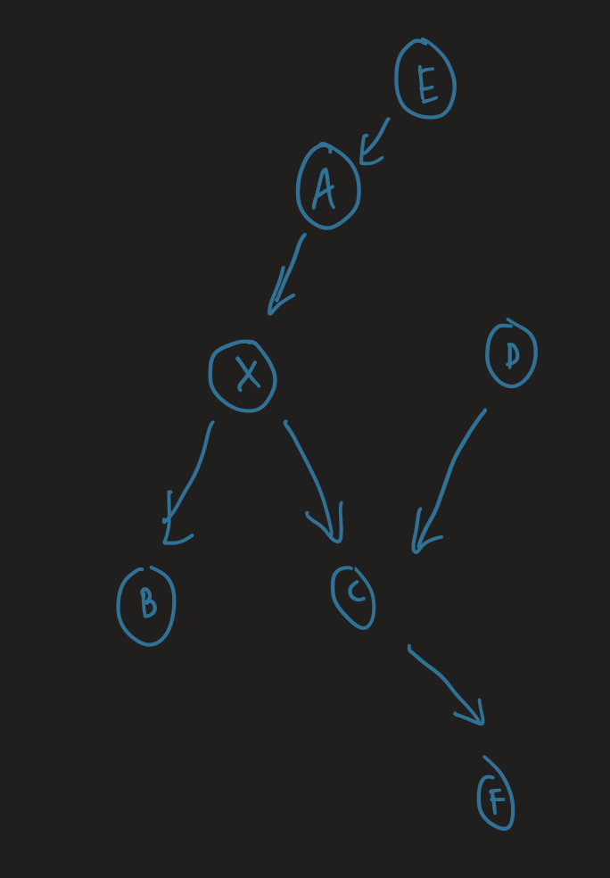
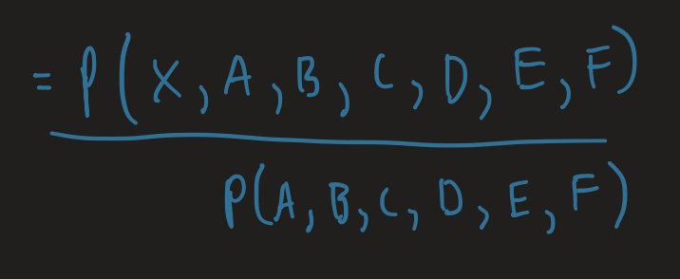
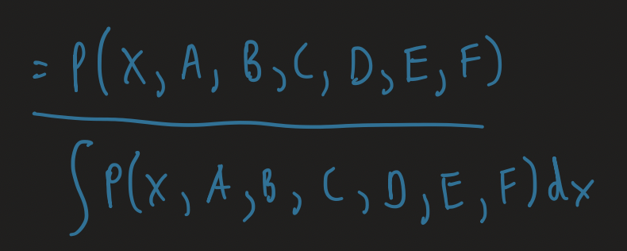
Markov Blanket

Slide 50
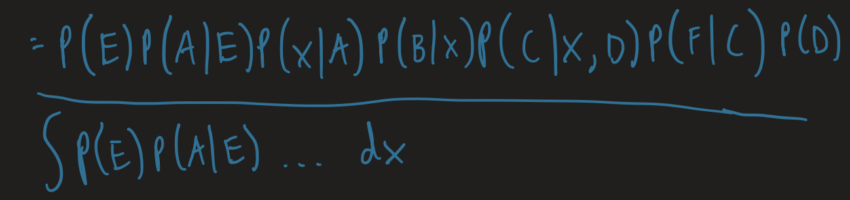

Markov Blanket

Slide 51
How to Construct a Bayesian Network
Identify the random variables
These will be the nodes
Identify which random variables directly impact other random variables
These will be the edges
Determine the conditional probabilities
Principle
Ask an expert
Sampling
Learn them from data
etc.

Slide 52
Example
If P(A, B, C, D, E) = P(A | B) * P(B) * P(C | B) * P(D | B) * P(E | A, C), what does the Bayesian network look like?
Random variables:
A, B, C, D, E
Edges:
B to A
B to C
B to D
A to E
C to E

Slide 53
Example
P(A, B, C, D, E) = P(A | B) * P(B) * P(C | B) * P(D | B) * P(E | A, C)
Random variables:
A, B, C, D, E
Edges:
B to A
B to C
B to D
A to E
C to E
B
A
C
D
E

Slide 54
What Do We Use Bayesian Networks For?
We can perform inference with them
Inference: use a model to make predictions or draw conclusions
Ex:
Doctor recommends cancer treatment
Can construct a Bayesian network of all the numerous factors that might affect a patient’s probability of having cancer
Much more complex and realistic than what we previously saw
Given the observations of different random variables for any particular patient, can have good reasoning on what to do

Slide 55
Inference
Exact inference can be difficult
To calculate a lot of these probabilities we have to sum over every possible value for a particular random variable
Intractable
Approximate inference
How do we estimate probabilities in real life?
Observe and count how often the events we care about occur
However, sometimes this might not work well
What if the events are too infrequent?
Ex: earthquakes, burglaries, alarms going off
We can use computers for sampling/simulation
Different approaches, but we won’t cover them in this class

Slide 56
When to Use a Bayesian Network vs. Some Other Model?
Probably a variety of reasons, but some that I thought of:
Domains where interpretability is important
Domains where a Bayesian way of thinking is valuable
i.e. domains where there is a lot of “prior” knowledge
Domains where we might want to tweak the network structure every so often

Slide 57
Homework
Bayes’ Rule
Joint Distribution
Bayesian network (due Wednesday)

Slide 58
Next Time
Dynamic Bayesian networks
Bayes filter (day after due to holiday schedule)

