Slide 1
Deterministic Search
CS 470
Ethan Pedersen

Slide 2
Search
How to get to a destination
Usually problems dealing with route planning, but other applications exist
We’ve talked about related principles, so a lot of this will look/sound familiar

Slide 3
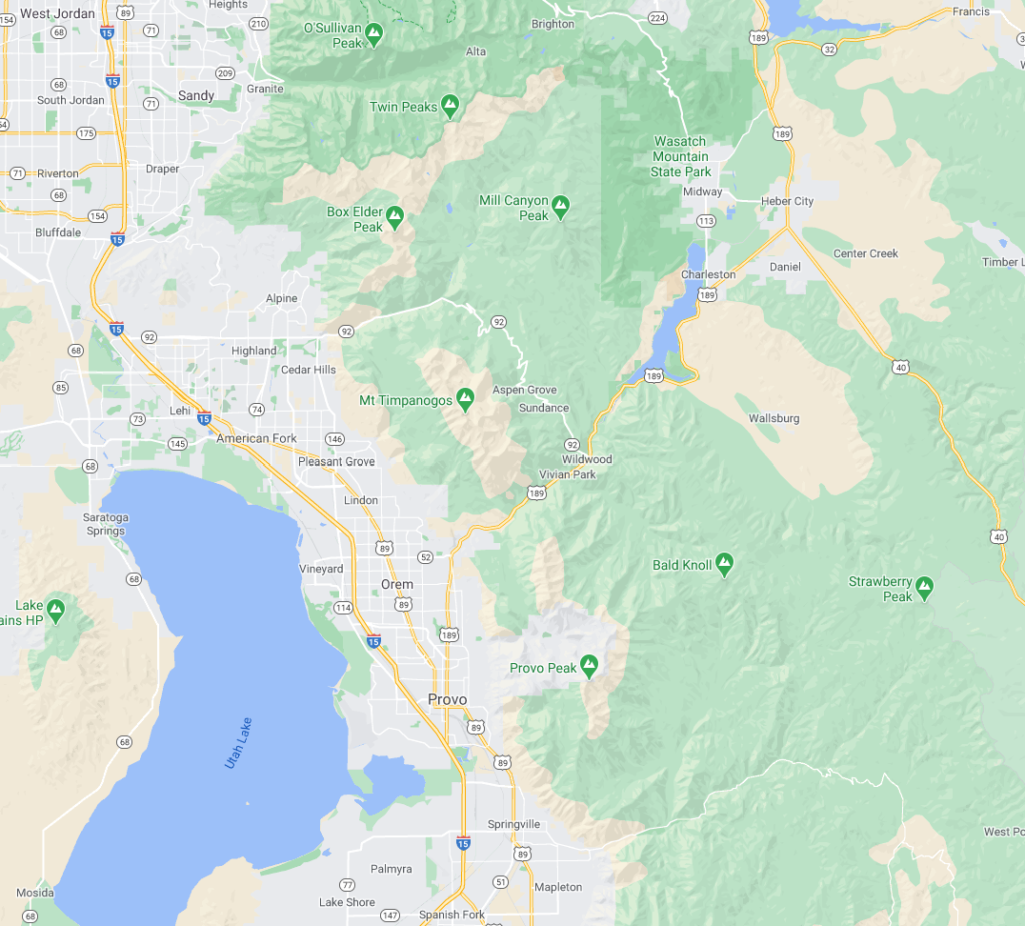
Example
How do we get to Heber City?
We’re here

Slide 4
Search
Goal-based: agent must select a sequence of actions to reach a goal state (usually a destination)
How do we find an answer?
How do we know which answer is the best?

Slide 5
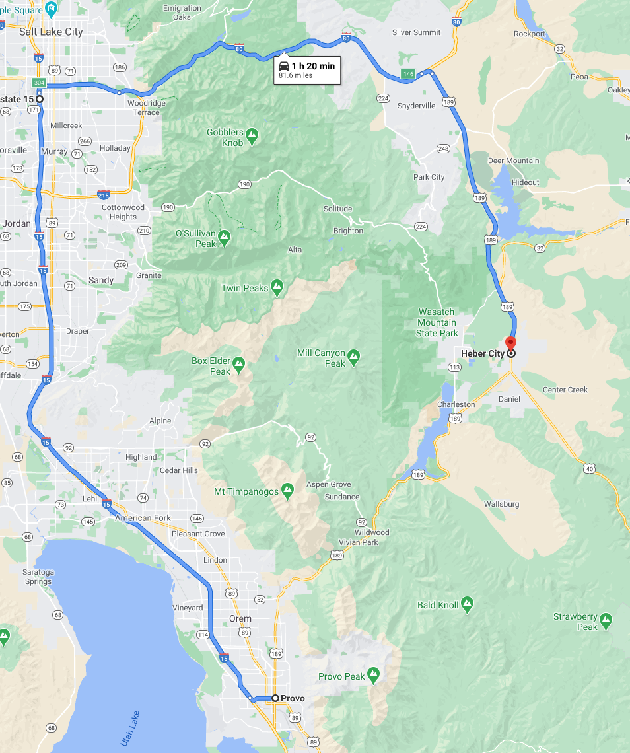
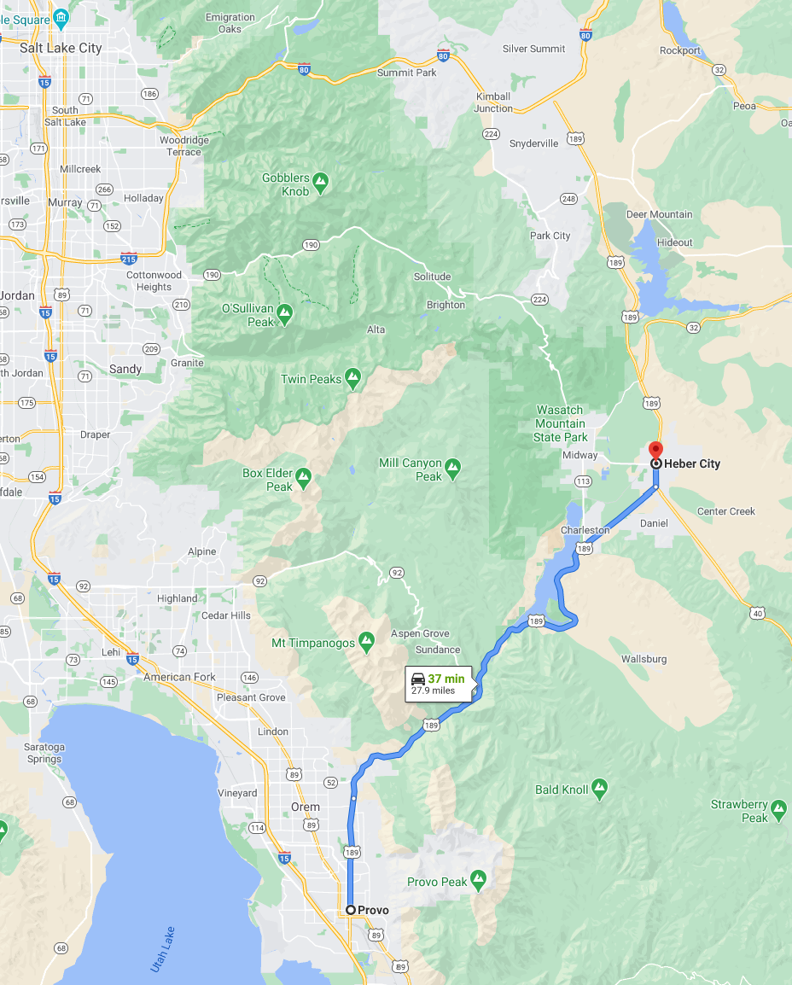
Example

Slide 6
Two Main Types of Search Problems
Deterministic search
No randomness
Nondeterministic search
Randomness - need to deal with it (usually through probability)
Won’t discuss it, but feel free to look into it if you’re curious

Slide 7
Assumptions of Deterministic Search
Solution: sequence of actions that reach goal
Environment:
Observable (the agent has a map and can see where it’s located; one of the reasons it’s common for navigation tasks)
Discrete (finite number of actions to take from each state)
Deterministic (agent knows exactly what will happen when an action is taken)

Slide 8
Components of a Search Problem
Initial state
Set of known actions an agent can take at any state
Knowledge of how actions lead to new states
Does this sound familiar?
Transition model (Bayes filter)
A way to check if a state is a goal
A cost function for taking actions

Slide 9
Cost
Note that we’re now dealing with cost (instead of utility), so we will focus on minimization instead of maximization
Cost is natural/common for search problems because we usually deal with path lengths (and want to find the shortest path to a goal)
We assume that the cost c of any action is greater than 0
Why is it necessary to assume that cost is larger than 0?
Avoid paths with infinite length (especially something like a loop)
As a path becomes arbitrarily long, its cost also becomes arbitrarily large

Slide 10
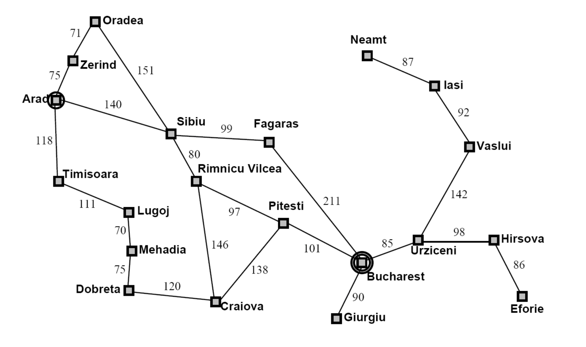
Example: Driving in Romania
Actions?
Goal: drive from Arad to Bucharest
Transitions?
Goal test?
Action cost?

Slide 11
Search Solutions
When looking for a solution to a search problem, an agent should:
Look for solutions to the problem (a solution is better than nothing)
Keep track of path cost (ideally, we would like an optimal solution)
Optimal solution: solution with the smallest path cost of all other possible solutions
Depending on the problem:
There might not be a solution, or
There might be multiple optimal solutions

Slide 12
Representation
Similar to what we saw with game playing algorithms (minimax, alpha-beta pruning, MCTS, etc.), a common approach is to model a search problem as a graph
Graph components:
Nodes: states
Edges: actions from one state that lead to another state
A solution is a path connecting the initial node (represents the initial state) to a goal node (represent the goal state)
Solution cost: sum of the edges in the path
Note: we can have multiple nodes that represent the same state
This is because there might be multiple paths that go through the same state

Slide 13
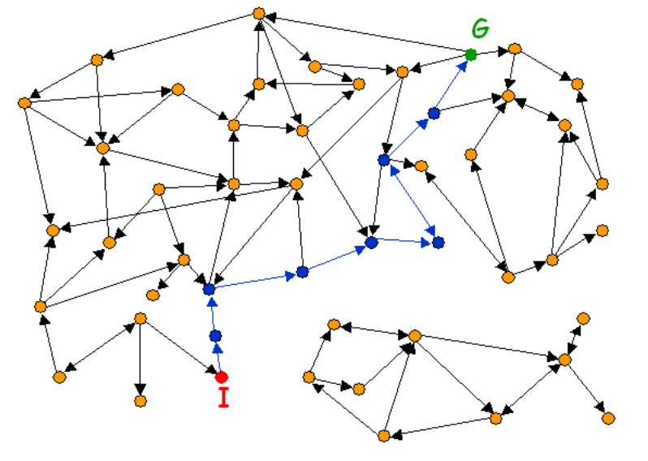
Example

Slide 14
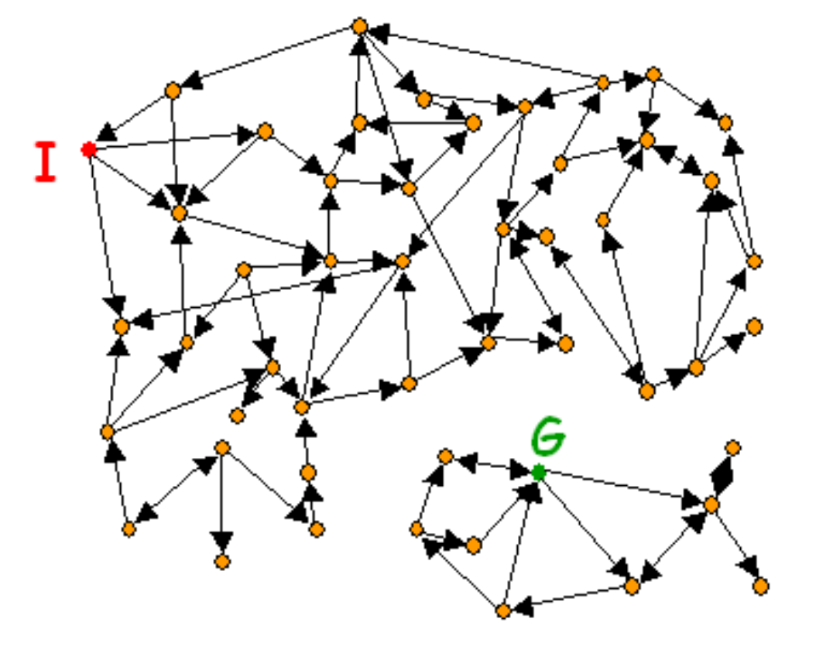
Example
No solution (maybe the goal is on an island, etc.)

Slide 15
Searching the Tree
Also similar to what we discussed with game trees, it is usually not feasible to build a complete representation of the state graph
If Google maps did this, it would probably take hours, days, or maybe even years to get a route to your destination
A problem solver should construct a solution by exploring a small portion of the graph

Slide 16
Measuring Performance
Completeness: will the approach find a solution (if one exists)?
Optimality: will the approach find the optimal solution?
Time complexity: how long?
Space complexity: how much memory?
Factors that can influence these metrics:
Branching factor: b (maximum number of successors of any node)
Depth of the solution: d (number of steps down the tree to find the closest goal)
Maximum path length: m (longest path in the tree)

Slide 17
Simple Process
Choose node we haven’t checked yet
See if it is a goal, if yes, we are done, return path to this state
If not, look at all actions we can do from this state, and add the resulting states to our set of unexplored states
The set of unexplored states is often either called the “fringe” or “frontier”
An element of the fringe is a leaf node in the tree
Common data structures:
FIFO: Breadth-first search
LIFO: Depth-first search
Priority queue: nodes with lowest cost
Repeat until you find the goal or run out of states to check
Note: this is a simple approach because we are not taking cost into consideration (we’re just trying to find a path)

Slide 18
Example
Let’s revisit the driving in Romania example
Let’s use FIFO (breadth-first search)

Slide 19
Example
A
Fringe: [A]

Slide 20
Example
A
Fringe: [T, S, Z]
T
S
Z

Slide 21
Example
A
Fringe: [S, Z, L]
T
S
Z
L

Slide 22
Example
A
Fringe: [Z, L, O, R, F]
T
S
Z
L
O
R
F

Slide 23
Example
A
Fringe: [L, O, R, F, O]
T
S
Z
L
O
R
F
O

Slide 24
Example
A
Fringe: [O, R, F, O, M]
T
S
Z
L
O
R
F
O
M

Slide 25
Example
A
Fringe: [R, F, O, M, Z]
T
S
Z
L
O
R
F
O
M
Z

Slide 26
Example
A
Fringe: [F, O, M, Z, P, C]
T
S
Z
L
O
R
F
O
M
Z
P
C

Slide 27
Example
A
Fringe: [O, M, Z, P, C, B]
T
S
Z
L
O
R
F
O
M
Z
P
C
B

Slide 28
Example
A
T
S
Z
L
O
R
F
O
M
Z
P
C
B

Slide 29
Discussion of Example
We used breadth-first search and assumed all actions have the same cost
Completeness?
Yes, as long as b is finite
Optimality?
Yes, since we’re just traversing the tree level by level and we assume each action has the same cost, the first solution path we find will be optimal
Time complexity:
b + b^2 + b^3 + … + b^d = O(b^(d + 1))
Space complexity:
Same as time complexity
Every node must stay in memory because it’s either in the fringe or the ancestor of a fringe node (it’s in the tree)

Slide 30
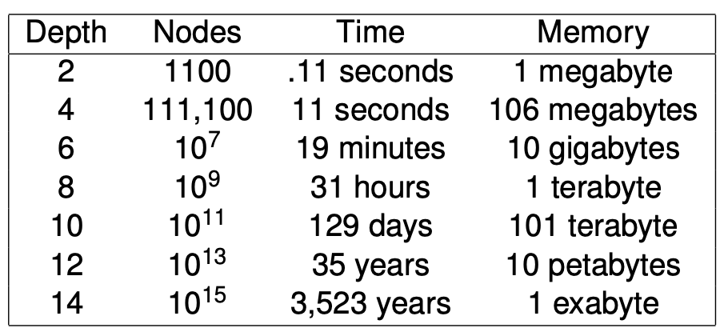
Discussion of Example
Probably the biggest downside to breadth-first search is memory:

Slide 31
Depth-First Search
If we still assume that every action has the same cost, how do things change with depth-first search?
Let’s also assume that we iterate from right to left (otherwise the example will take too long)

Slide 32
Example
A
Fringe: [A]

Slide 33
Example
A
Fringe: [Z, S, T]
T
S
Z

Slide 34
Example
A
Fringe: [O, S, T]
T
S
Z
O

Slide 35
Example
A
Fringe: [S, S, T]
T
S
Z
O
S

Slide 36
Example
A
Fringe: [F, R, S, T]
T
S
Z
O
A
S
F
R

Slide 37
Example
A
Fringe: [B, R, S, T]
T
S
Z
O
A
S
F
B
R

Slide 38
Example
A
T
S
Z
O
A
S
F
B
R

Slide 39
Discussion of Example
We used depth-first search and assumed all actions have the same cost
Completeness?
No, since it goes deep it can go down infinite paths
Ex: Move to the left forever, always thinking that maybe one more step to the left will lead to a goal
Optimality?
No, again because it goes deep (there could be a shallower path somewhere else in the tree)
Time complexity:
O(b^m) in the worst case
Space complexity:
O(bm)

Slide 40
Discussion of Example
So, while depth-first search does not guarantee an optimal solution, or even a single solution, it’s memory is much better than breadth-first search
It turns out that depth-first search is the basis of many popular algorithms
But, how do we improve it?

Slide 41
Depth Limited Search
Let’s set a depth limit of L
Time complexity: O(b^L)
Space complexity: O(bL)
How do we set L?
In general, it’s difficult to come up with a good depth limit
If it’s too small, we probably won’t find a solution
If it’s too large, we’ll probably find a suboptimal solution

Slide 42
Iterative Deepening
Intuition: what if we gradually increase the depth limit until we find a solution?
This seems wasteful because every time we increase the depth limit we have to recalculate things we’ve seen before (we generate new trees, but with larger depths)
However:
Most nodes in a tree with a near-constant branching factor are in the bottom level
Because of this, it turns out that iterative deepening is actually faster than BFS since it doesn’t generate nodes at the d + 1 level
Completeness?
Yes, because it will eventually search the tree at the depth of a solution
Optimality?
Yes, because we assume that all actions have the same cost, so if there was a shorter solution path it would have found it earlier
Time complexity:
O(b^d) in the worst case
Space complexity:
O(bd)

Slide 43
Evaluation Functions
So far, we’ve assumed that actions have the same cost
However, this obviously is a big simplification and likely won’t work well in the real world
Notation: let the evaluation function of a node be f(n)
The value of anode
Notation: let the cost of a node be g(n)
Let f(n) = g(n)
We’ll now use a priority queue to order nodes by their g values

Slide 44
Uniform Cost Search
Fringe is a priority queue
Always select the node with the lowest g(n)

Slide 45
Example
A
0
Fringe: [A]

Slide 46
Example
A
0
Fringe: [Z, T, S]
T
118
S
140
Z
75

Slide 47
Example
A
0
Fringe: [T, S, O]
T
118
S
140
Z
75
O
146

Slide 48
Example
A
0
Fringe: [S, O, L]
T
118
S
140
Z
75
L
229
O
146

Slide 49
Example
A
0
Fringe: [O, R, L, F, O]
T
118
S
140
Z
75
L
229
O
291
R
220
F
239
O
146

Slide 50
Example
A
0
Fringe: [R, L, F, O]
T
118
S
140
Z
75
L
229
O
291
R
220
F
239
O
146

Slide 51
Example
A
0
Fringe: [L, F, O, P, C]
T
118
S
140
Z
75
L
229
O
291
R
220
F
239
O
146
P
317
C
366

Slide 52
Example
A
0
Fringe: [F, O, M, P, C]
T
118
S
140
Z
75
L
229
O
291
R
220
F
239
O
146
M
299
P
317
C
366

Slide 53
Example
A
0
Fringe: [O, M, P, C, B]
T
118
S
140
Z
75
L
229
O
291
R
220
F
239
O
146
M
299
P
317
C
366
B
450

Slide 54
Example
A
0
Fringe: [M, P, C, B]
T
118
S
140
Z
75
L
229
O
291
R
220
F
239
O
146
M
299
P
317
C
366
B
450

Slide 55
Example
A
0
Fringe: [P, C, D, B]
T
118
S
140
Z
75
L
229
O
291
R
220
F
239
O
146
D
374
M
299
P
317
C
366
B
450

Slide 56
Example
A
0
Fringe: [C, D, B, B]
T
118
S
140
Z
75
L
229
O
291
R
220
F
239
O
146
D
374
M
299
B
418
P
317
C
366
B
450

Slide 57
Example
A
0
Fringe: [D, B, B]
T
118
S
140
Z
75
L
229
O
291
R
220
F
239
O
146
D
374
M
299
B
418
P
317
C
366
B
450

Slide 58
Example
A
0
Fringe: [B, B]
T
118
S
140
Z
75
L
229
O
291
R
220
F
239
O
146
D
374
M
299
B
418
P
317
C
366
B
450

Slide 59
Example
A
0
Fringe: [B]
T
118
S
140
Z
75
L
229
O
291
R
220
F
239
O
146
D
374
M
299
B
418
P
317
C
366
B
450

Slide 60
Example
A
0
T
118
S
140
Z
75
L
229
O
291
R
220
F
239
O
146
D
374
M
299
B
418
P
317
C
366
B
450

Slide 61
Discussion of Uniform Cost Search
Completeness?
Yes - there’s a proof (but we won’t go through it)
Optimality?
Yes - there’s a proof (but we won’t go through it)
Time complexity?
Basically O(b^d)
Space complexity?
Same as time complexity
So, this is similar to breadth-first search, except we no longer assume that every action has the same cost

Slide 62
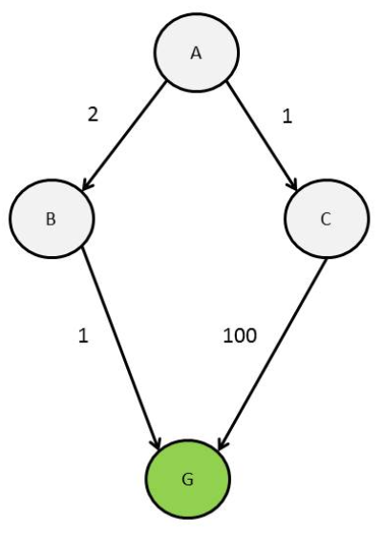
Discussion of Uniform Cost Search
With the example, we saw that we had multiple goal nodes in the fringe, but only stopped when a goal node was pulled from the fringe
This is important; consider the following example:

Slide 63
Blind Search
All of the examples we have seen so far are blind searches
We only use information from the problem description
We don’t use the structure of the search space
There are disadvantages to this

Slide 64
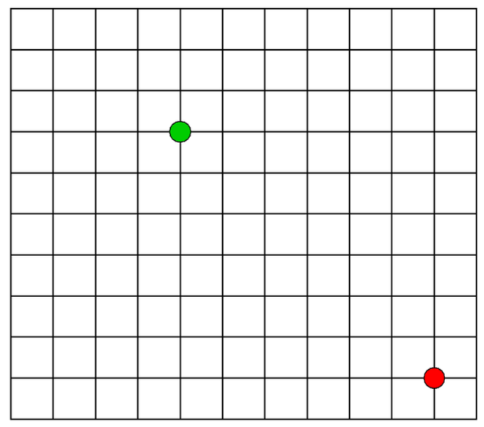
Example: Blind Search Shortcomings (BFS)

Slide 65
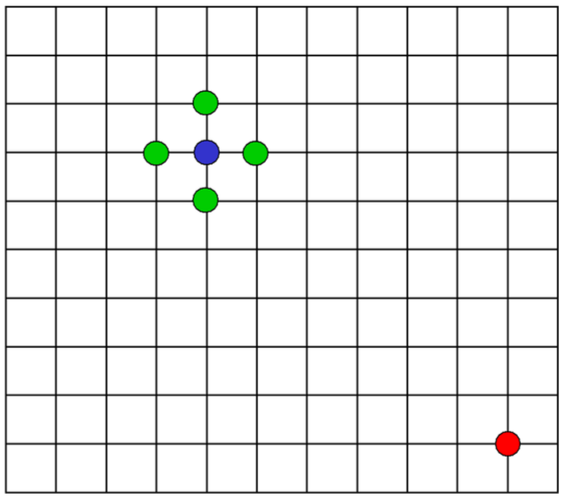
Example: Blind Search Shortcomings (BFS)

Slide 66
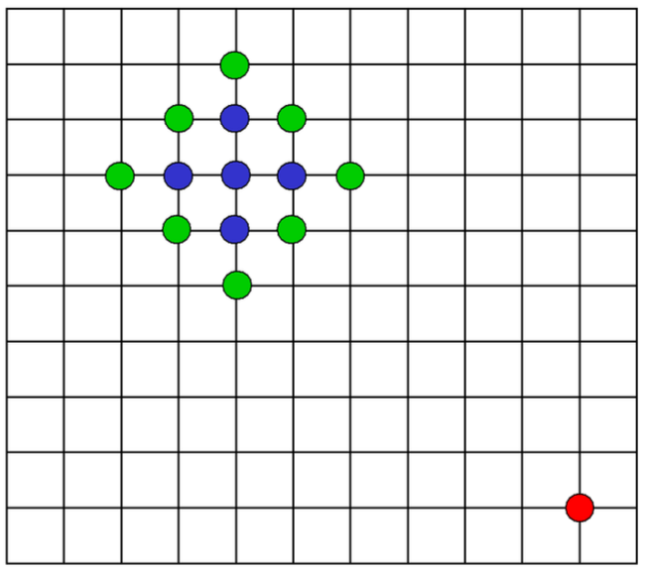
Example: Blind Search Shortcomings (BFS)

Slide 67
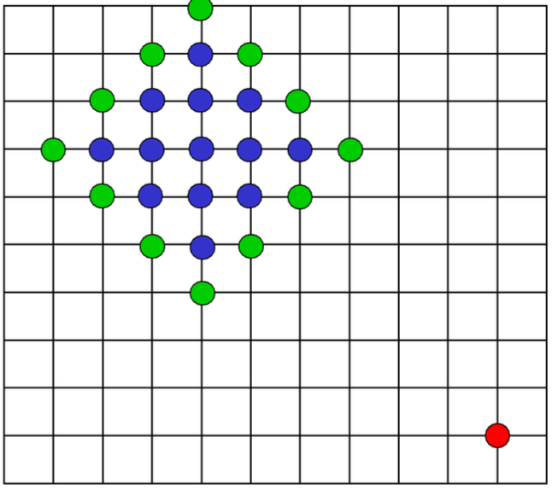
Example: Blind Search Shortcomings (BFS)

Slide 68
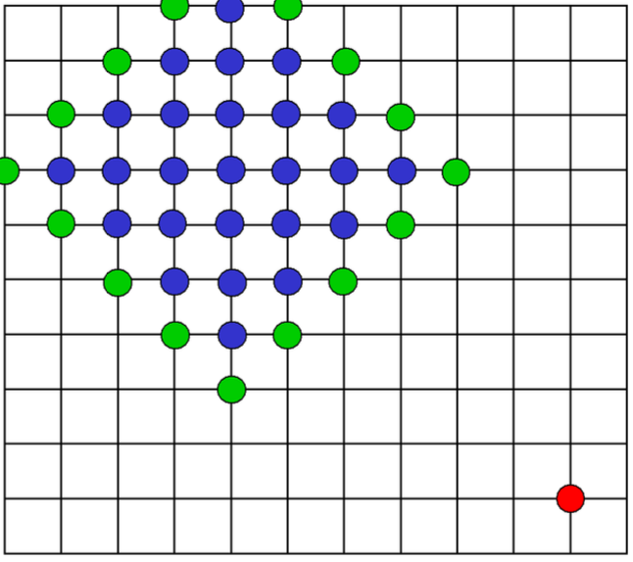
Example: Blind Search Shortcomings (BFS)

Slide 69
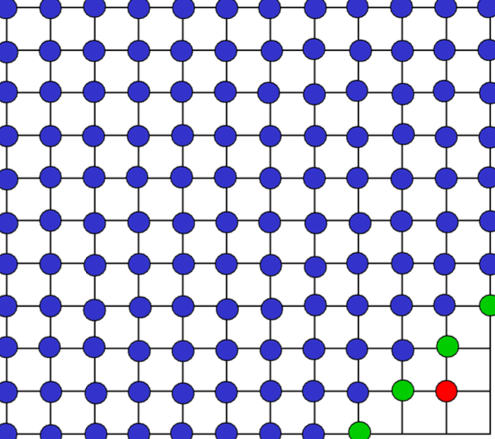
Example: Blind Search Shortcomings (BFS)

Slide 70
Beyond Blind Search
The most common way to incorporate search space structure is through a heuristic function
What is a heuristic function?
A way to estimate the value of a state (Reversi project)

Slide 71
Heuristic Functions For Search Problems
Let n represent a node
h(n) >= 0
h(n) > 0 if n is not a goal node
h(n) = 0 if n is a goal node
In the context of the Romania navigation problem, h(n) can just be the Euclidean (straight line) distance from n to the goal
What if we just let f(n) = h(n) (instead of f(n) = g(n))?
This is called “greedy best-first search”
It’s ok (we won’t go into detail about it for the sake of time), but definitely not the greatest

Slide 72
A Better Solution
What if we use both g(n) and h(n)?
g(n) = cost of a node
h(n) = heuristic/estimate of a node
Let f(n) = h(n) + g(n)
This is called “A star”, a very famous/popular search algorithm

Slide 73
Example
A
366 + 300 = 366
Fringe: [A]

Slide 74
Example
A
366 + 0 = 366
Fringe: [S, T, Z]
T
329 + 118 = 447
S
253 + 140 = 393
Z
374 + 75 = 449

Slide 75
Example
A
366 + 0 = 366
Fringe: [R, F, T, Z, A, O]
T
329 + 118 = 447
S
253 + 140 = 393
Z
374 + 75 = 449
A
366 + 280 = 646
O
380 + 291 = 671
R
193 + 220 = 413
F
176 + 239 = 415

Slide 76
Example
A
366 + 0 = 366
Fringe: [F, P, T, Z, C, A, O]
T
329 + 118 = 447
S
253 + 140 = 393
Z
374 + 75 = 449
A
366 + 280 = 646
O
380 + 291 = 671
R
193 + 220 = 413
F
176 + 239 = 415
P
100 + 317 = 417
C
160 + 366 = 526

Slide 77
Example
A
366 + 0 = 366
Fringe: [P, T, Z, B, C, A, O]
T
329 + 118 = 447
S
253 + 140 = 393
Z
374 + 75 = 449
A
366 + 280 = 646
O
380 + 291 = 671
R
193 + 220 = 413
F
176 + 239 = 415
P
100 + 317 = 417
C
160 + 366 = 526
B
0 + 450 = 450

Slide 78
Example
A
366 + 0 = 366
Fringe: [B, T, Z, B, C, A, O]
T
329 + 118 = 447
S
253 + 140 = 393
Z
374 + 75 = 449
A
366 + 280 = 646
O
380 + 291 = 671
R
193 + 220 = 413
F
176 + 239 = 415
B
0 + 418 = 418
P
100 + 317 = 417
C
160 + 366 = 526
B
0 + 450 = 450

Slide 79
Example
A
366 + 0 = 366
T
329 + 118 = 447
S
253 + 140 = 393
Z
374 + 75 = 449
A
366 + 280 = 646
O
380 + 291 = 671
R
193 + 220 = 413
F
176 + 239 = 415
B
0 + 418 = 418
P
100 + 317 = 417
C
160 + 366 = 526
B
0 + 450 = 450

Slide 80
A Star Discussion
Why does this work?
g(n) tells us how much it costs to get to node n
h(n) estimates how much it will cost us to get to the goal from n (i.e. how much further we have to go)
So f(n) = h(n) + g(n) estimates the cost of a solution that goes through node n
At each iteration, A star expands the nodes that could be part of the cheapest solution
f(n) = h(n) + g(n) is somewhat similar to the Bellman equation

Slide 81
A Star Discussion
Completeness?
Yes - the proof is very similar to the completeness proof for uniform cost search (we won’t go through it)
Optimality?
Yes - the proof is also similar to the optimality proof for uniform cost search (we won’t go through it)
Optimally efficient
Expands the fewest nodes possible while still finding the optimal solution
Time complexity?
A lot of factors affect it, but in practice it is usually polynomial (a lot of times it is close to linear)
Space complexity?
Same idea as the time complexity (a lot of factors affect it, but it’s usually pretty efficient in practice)
There are various versions of A star that can improve the time and/or space complexity
Ex: iterative deepening A star (cutoff is on f(n) values instead of depth)

Slide 82
Homework
Final project
Final exam

Slide 83
Next Time
Dr. Crandall will give a guest lecture

