Slide 1
Dynamic Bayesian Networks
CS 470
Ethan Pedersen

Slide 2
Markov Process
Stochastic process
Iterate through states over time
Uncertainty when transitioning from one state to the next
Ex: random walk
Imagine a drunk person leaving a bar
Can think of each physical step they take as a time step
At each time step, there is uncertainty as to where they will go next
They might keep going straight, stagger to the left or right, etc.
So, we have a set of states that differ over time, and the future only depends on the current state (not the previous states)
What does “the future only depends on the current state” sound like?
Markov assumption
If we think of this as “observing” the current state, then this is similar to a Bayesian network, except now the network is changing over time

Slide 3
Example
Let’s use probability to reason about COVID-19 spread in our community
Random variables?
Number of people who currently have the virus (V)
Number of people with other illnesses (I)
Number of people with symptoms (S)
Number of people who get tested (T)
Number of positive/negative tests (N)
Number of deaths from the virus (D)
How good people’s habits are (H)
Social distancing, masks, etc.

Slide 4
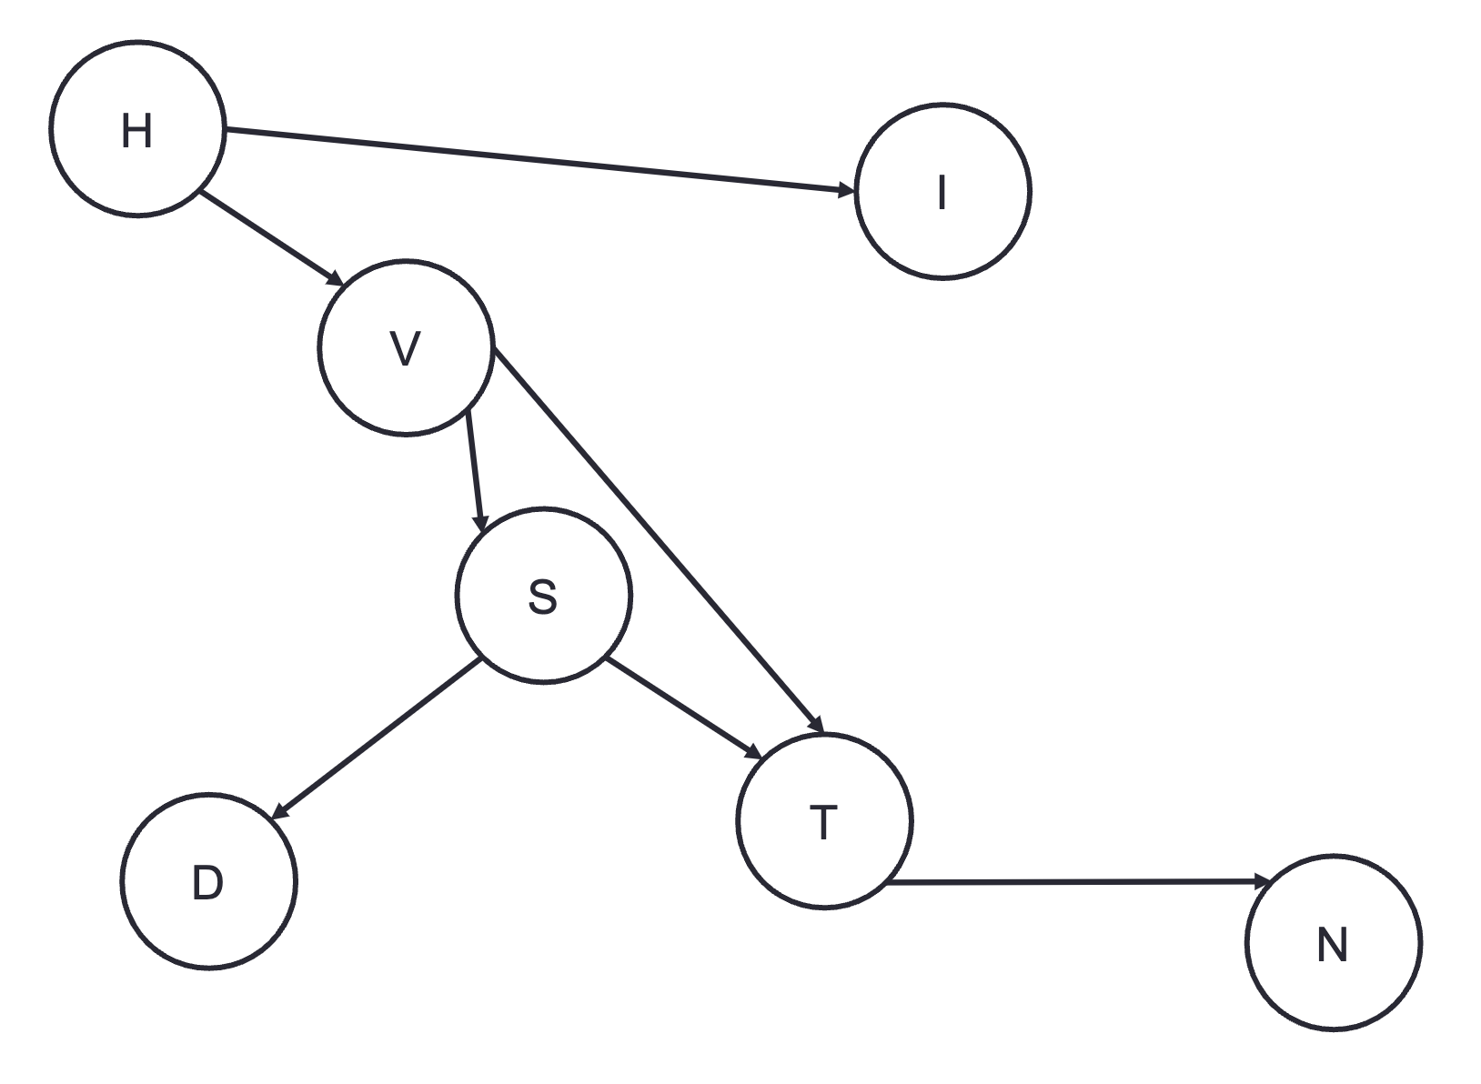
Example

Slide 5
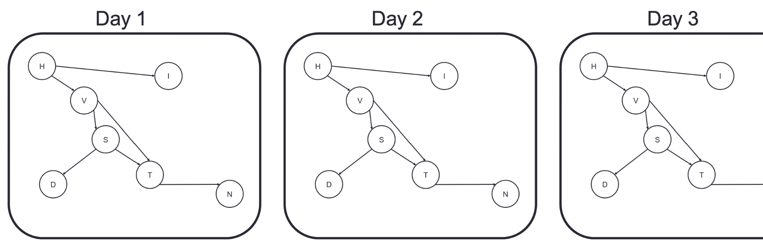
Example

Slide 6
Dynamic Bayesian Network
Can help us model Markov processes
More complex model because we can model the relationship between numerous random variables
Main ideas:
Network structure is the same at each time step
Network at any particular time is a “state”
We have a “transition model” that determines the probability of transitioning from one state to the next
At each time step, we can (at least partially) observe the current state of the environment through sensors -> “sensor model”
Ex: Navigating through Washington DC
Allows us to perform probabilistic reasoning about random variables over time

Slide 7
Partially-Observable Stochastic Process
Model the state of the environment as a set of random variables (could be a Bayesian network)
It changes over time, following some stochastic process
Model the output of our sensors as a random variable that is influence by the current state of the environment
Sensors give us information about the state, but probably not exact information
We will represent our belief about what state we’re in as a probability distribution over every possible state
So, this is still a Markov process, we just can’t directly observe the state

Slide 8
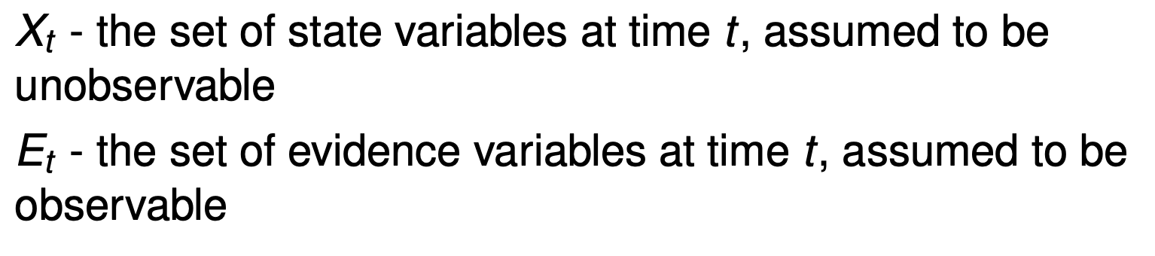
Notation

Slide 9
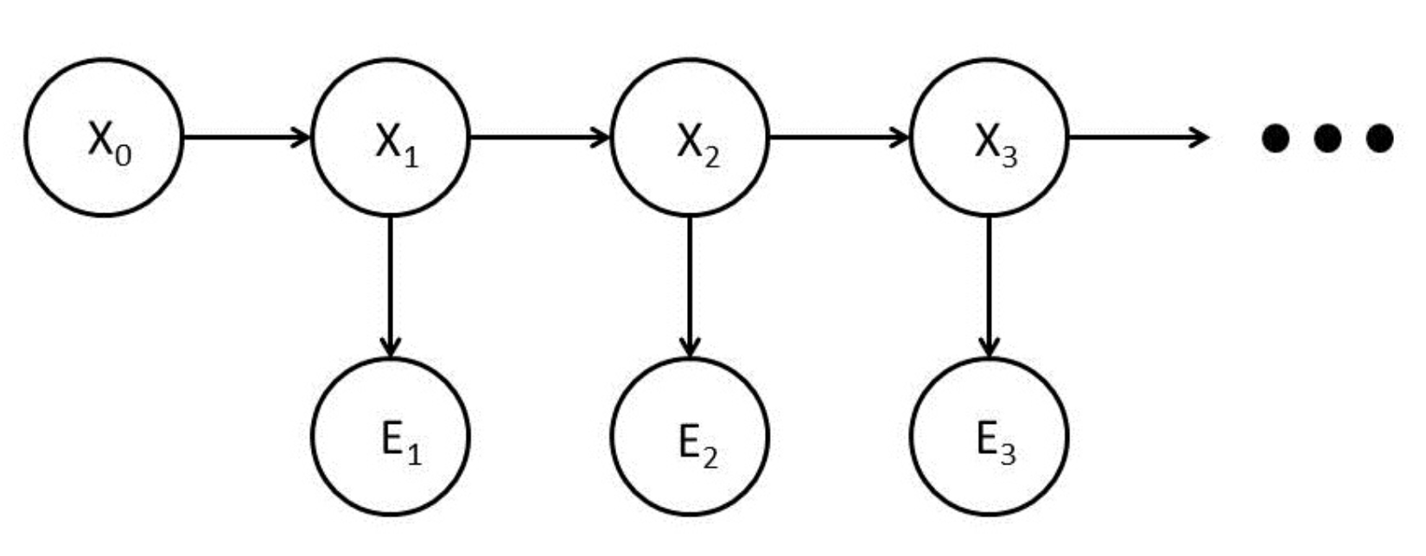
Structure

Slide 10
Structure
Once we know/observe X_2, does X_3 depend on X_0 and/or X_1?

Slide 11
Structure
No - Markov assumption (this is still a Markov process)

Slide 12
Discussion
Again, there are 2 key pieces to this:
We’re stochastically transitioning from one state to the next
Transition model
Still a Markov process
Once we’re in a state, we observe some partial information/evidence about the state from our sensors
Sensor model

Slide 13
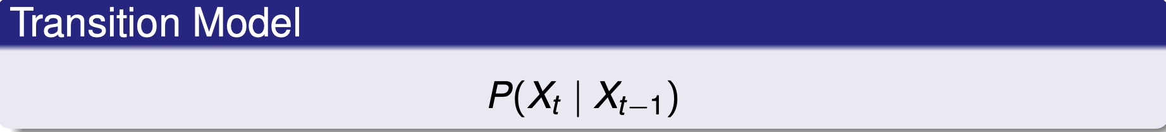
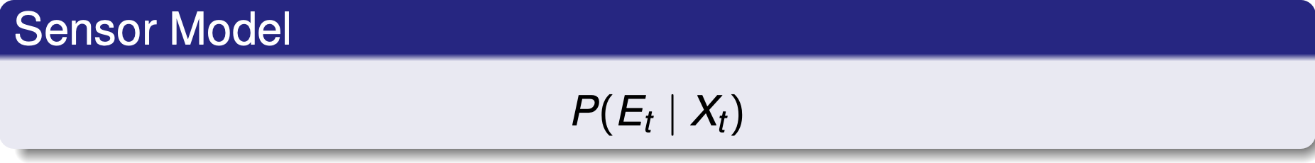
Models

Slide 14
Example
A security guard at a shopping mall loves his job so much that he never goes home
Every day, there can either be rain or no rain outside
Since the security guard never leaves the mall, he cannot directly observe the true state of the environment
However, on any given day, he can observe whether the majority of patrons bring an umbrella
This gives an estimate as to whether it is raining outside

Slide 15
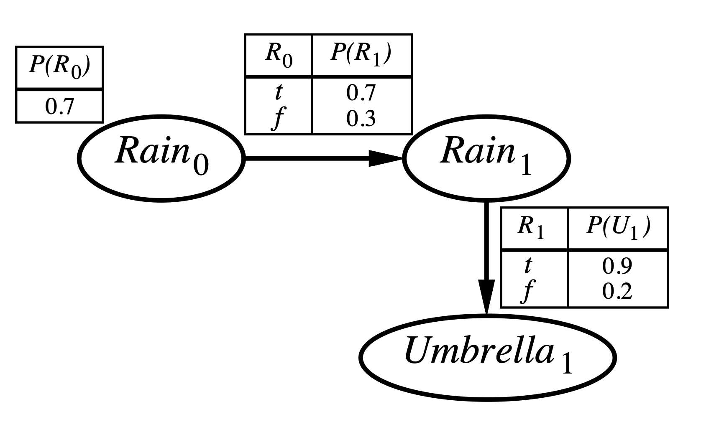
Example
What is this?
Sensor model
What is this?
Transition model

Slide 16
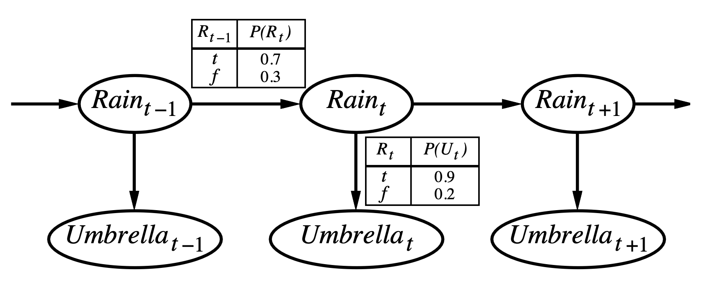
Example

Slide 17
Inference
Filtering
Given past observations, determine belief about the current state (probability distribution over all possible states)
We’ll discuss this more next time
Bayes filter lab
Prediction
Given past observations, predict future distribution over states
Explanations
Given the current state, determine the most likely sequence of events that resulted in this state

Slide 18
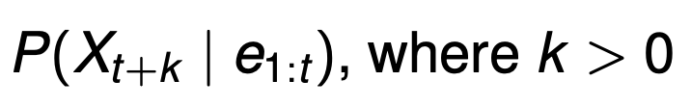
Practice With Notation
What inference task does the equation represent?
Prediction

Slide 19
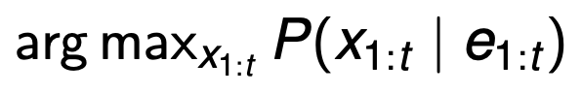
Practice With Notation
What inference task does the equation represent?
Most likely explanation

Slide 20
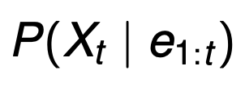
Practice With Notation
What inference task does the equation represent?
Filtering

Slide 21
Homework
Bayesian networks
Due Wednesday by 11:59 pm

Slide 22
Next Time
Tomorrow
Bayes filter
Skim the linked pdf file
Lab

Slide 23
Midterm
10% of your grade
Opens Thursday at 12:05 am
Due March 8 by 11:59 pm
PDF file on LS contains the exam questions
IGNORE QUESTION 15
Answer the questions from the file on a separate piece of paper (or write them down digitally, etc.)
Once you have your answers, take the quiz on LS
You will enter your answers in the quiz
You will only have 45 minutes (this is why it’s important to answer everything before taking the quiz)
YOU ONLY GET ONE CHANCE, NO REDOS
The exam is open everything, except Jared and I will not give any answers
We can help clarify, if needed

