Slide 1
Machine Learning
CS 470
Ethan Pedersen

Slide 2
Supervised Learning
Goal: accurate predictions
Models learn by example:
We have training data that we repeatedly feed to our model
For each data point, we have a “label”:
What we would like our model to output for a particular data point
During each training iteration, the model outputs what it thinks the labels should be for each data point
We use a loss function (we’ll discuss this later) to tell the model how far off it is
The model uses the loss to change its parameters
We’ll see examples in a few slides

Slide 3
Tips for Supervised Learning
Split your data into a train set and test set
Train set is used to train/teach the model
Test use is used to determine how good the model is at generalizing (making predictions on data it has never seen before)
This process is useful to prevent what we call “overfitting”
A lot of times, especially for neural networks, it’s good to further split the train set into a train set and validation set
Validation set is used for early stopping:
After each training iteration, see how well the model performs on the validation set
If the validation performance doesn’t improve after several iterations, we can stop the training process
This also helps prevent overfitting, while decreasing training time (which can be useful for very large neural networks or other models)

Slide 4
Unsupervised Learning
We just talked about supervised learning; what do you think unsupervised learning is?
Goal: uncover hidden patterns or structure in our data
Model still uses training data
However, there are no longer any labels
Examples:
Clustering
PCA

Slide 5
Regression
Method used to model the relationship between numerous independent variables (i.e. data features) and a dependant variable (what we’re trying to predict)
The independent variables can be categorical or continuous
The dependant variable is continuous
Examples:
Age
Height
Dollar amounts
etc.

Slide 6
Classification
Method used to model the relationship between numerous independent variables (i.e. data features) and a dependant variable (what we’re trying to predict)
The independent variables can be categorical or continuous
The dependant variable is categorical
Examples:
Color
Social status
Type
etc.

Slide 7
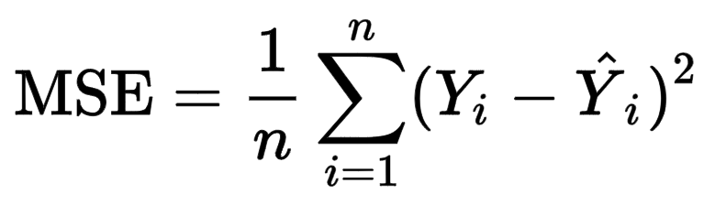
Loss Functions
A loss function quantifies the difference between a predicted value and the true value
Examples:
Mean squared error (MSE)
Mean absolute error (MAE)
Categorical cross entropy

Slide 8
Bias and Variance
Describe different sources of error in a model
Bias: measures the systematic error in predictions
Usually oversimplifies the underlying data patterns
Underfits the training data:
Poor performance on both training data and test data
Variance: measures how sensitive a model is to changes in the data
Usually too complex
A high variance model tends to overfit the training data:
Performs well on the training data but poorly on test data
Both are bad because they lead to poor test performance
Tradeoff between bias and variance: if we increase model complexity then bias decreases while variance increases, and vice versa
Want to find a sweet spot between the two

Slide 9
Data
In machine learning, the more data we have, the better (usually)
How do we collect data?
Surveys
Mechanical Turk
Record data as people use products
Simulation/synthesis
etc.
What features should we collect?
Depends on the problem
A lot of time we collect as much data as possible and then perform feature engineering:
Use our existing data to craft features
Ex: split house prices into a categorical “expense” feature
Something like inexpensive, intermediate, expensive

Slide 10
Data Representation
A lot of times we have categorical data
However, our models need to work with data on a mathematical/numerical level
So, how do we convert categorical data to numeric data?
One-hot encoding
Ex:
Let’s say I have a “color” feature with three possible values: red, green, blue
How would I represent a green value?
[0, 1, 0]
Embeddings
A lot more effective, but harder to achieve
Very common with neural networks
You can have embedding layers that get trained as your entire network is trained
Ex:
word2vec

Slide 11
Data Representation
Another problem that we face: different data features have different numeric scales
Ex:
An “age” feature might have values between ~0 to ~100
At the same time, an “income” feature might have values of ~40000 and larger
Since the values for the “income” feature are larger, our model might place a lot more weight/importance on that feature, even if that feature maybe isn’t the best indicator for what we’re trying to learn
How do we combat this?
We usually scale our data:
Min-max scaling
Scales data to be between 0 and 1
Standard scaling
Scales data to a standard normal distribution (mean of 0, standard deviation of 1)

Slide 12
PCA
Principal component analysis
We might have several data features that we either don’t need (they aren’t useful for learning) or give us minimal information
In other words, we have high-dimensional data
Because of this, we would like to somehow reduce the dimensionality of our data
Benefits:
Less data storage
Less computation
Data visualization (if we reduce from 5 dimensions to 2 or 3, we can now visualize our data)

Slide 13
PCA
Process:
Find a smaller-dimension vector to project our data on to
We want to find a vector such that we preserve as much variance from our original data as possible
Can think of this as preserving as much information as possible

Slide 14
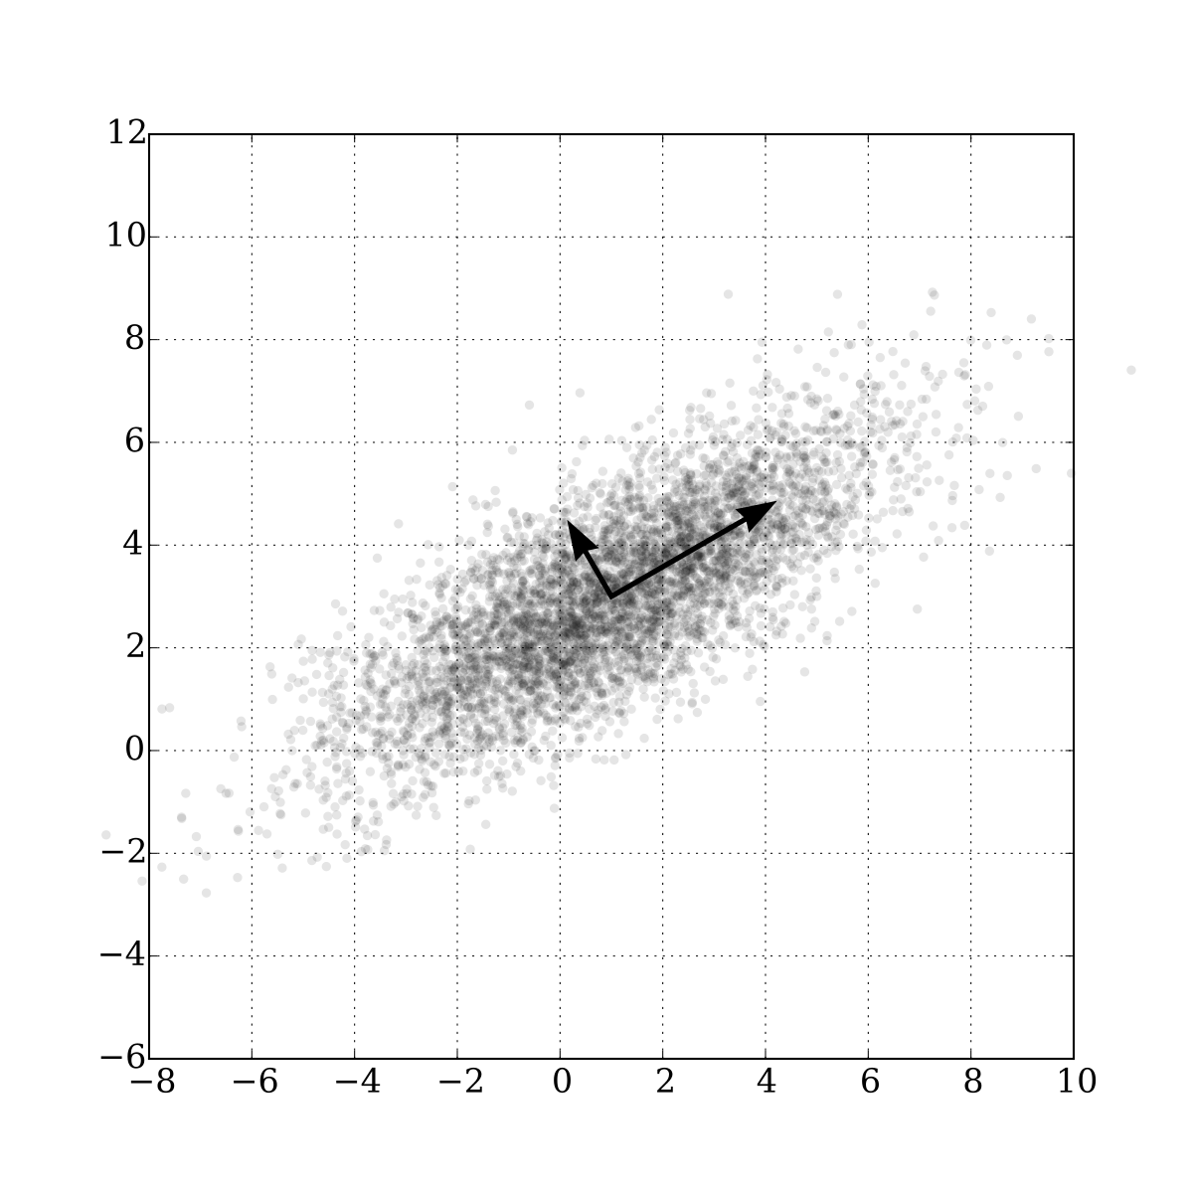
PCA
Find a vector to project our data on to:

Slide 15
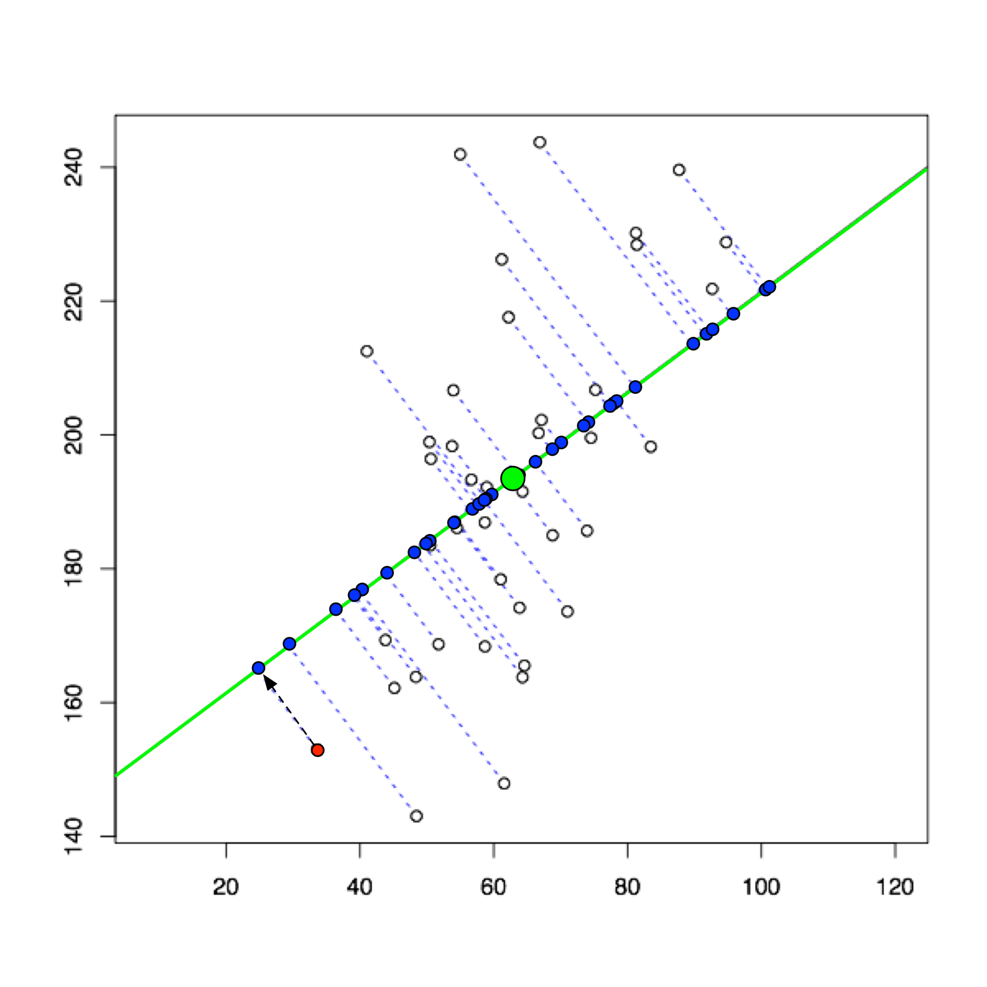
PCA
What a projection looks like:

Slide 16
PCA
It turns out that the vector that maximizes variance is the principal eigenvector of the covariance matrix
Covariance matrix: square matrix that shows the covariance between each feature in the dataset
The diagonals are the variances of each feature
Principal eigenvector: vector corresponding to the largest eigenvalue
We won’t go through the math, but if you’re familiar with the covariance matrix and eigenvectors/eigenvalues then this will hopefully be fairly intuitive:
Eigenvectors don’t rotate, they just scale
We want this to preserve our original data
Covariance matrix is used for variance and covariance
Since we want to maximize the variance of our original data, we want the largest eigenvalue of the covariance matrix

Slide 17
PCA
A form of unsupervised learning
We’ve already talked about strengths (less data storage, better computation and visualization, etc.)
Weaknesses:
Lose information
Ideally we lose as little as possible (retain as much variance as possible), but we’re still losing information
Assume linear relationships between features
If relationships are not linear, PCA can lead to suboptimal performance

Slide 18
Linear Regression
Our model is a line
Try to find the line of best fit
Simple and interpretable

Slide 19
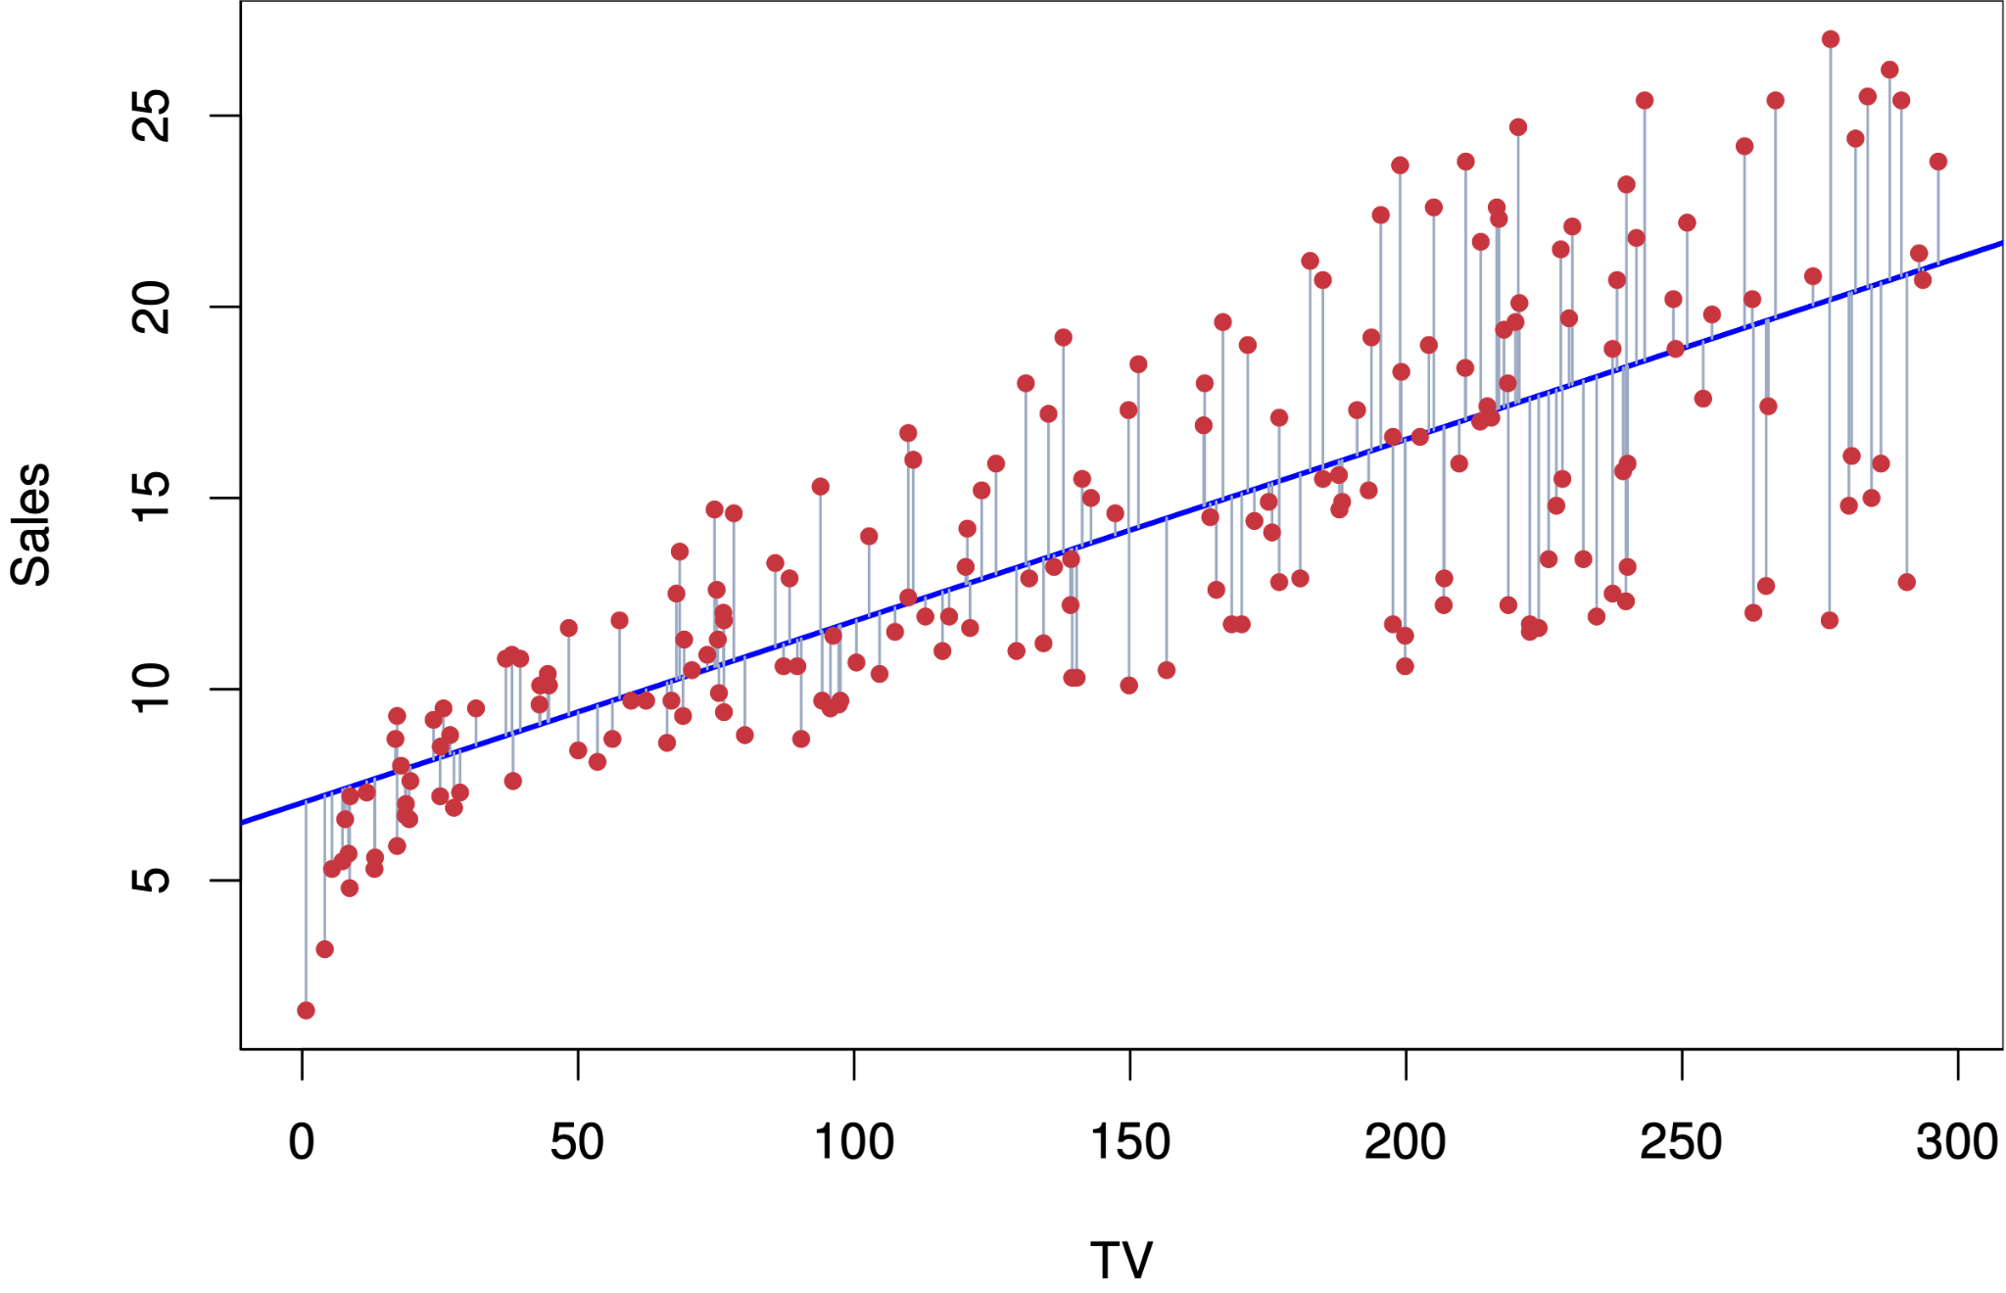
Linear Regression

Slide 20
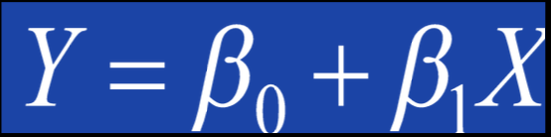
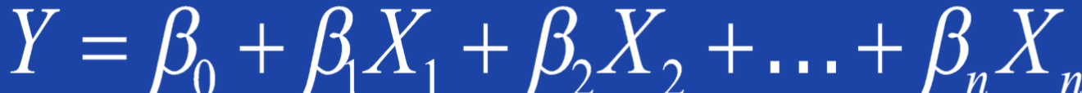
Linear Regression

Slide 21
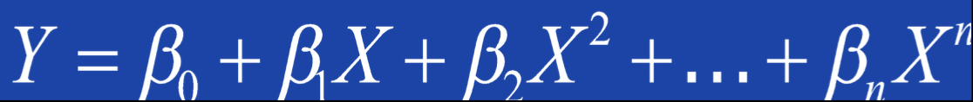
Linear Regression
If our data isn’t linear, we can try to introduce non-linearity:

Slide 22
Logistic Regression
Used for binary classification (0 or 1, true or false, etc.)
Similar approach as linear regression:
Use log to transform the data
Perform linear regression
Fits a logistic curve instead of a line and outputs an approximation of the probability of the output given the input

Slide 23
KNN
K-nearest neighbors
Use local information near the current data point to make a prediction
Can be used for regression or classification
Process:
Store all (or at least an informative subset) of the training data
When predicting on a new data point, measure the distance from the data point to every other point in the training data
The k-nearest neighbors vote on what the predicted value should be:
For classification, use a majority vote
For regression, use the average
For either, you can weight by distance (i.e. neighbors that are very close to the data point have more weight to what they think)

Slide 24
KNN
Very simple, but it can still represent very complex decision surfaces
Very easy to implement
Great for interpretation (i.e. why did the model predict what it did?)
Fast learning (don’t really need to train/tune anything, just need to store the training data)
Doesn’t require a loss function, so it doesn’t make any assumptions about the underlying data distribution (“non-parametric”)
K is a tunable parameter (i.e. how many nearest neighbors should we use in our predictions?)
However, storage can be an issue and execution can be slow if the training set is large
There are ways to combat this (use a subset of training data, use indices on the data set, etc.), but it still can be a problem

Slide 25
Neural Networks
Inspiration from the human brain
~100 billion neurons that are connected to each other in different ways
Signals are passed from neuron to neuron
Most basic case:
2 layers of neurons:
Input layer (where we pass our input data)
Output layer (prediction)
We can also have what are called “hidden layers”, which are simply layers of neurons between the input and output layers

Slide 26
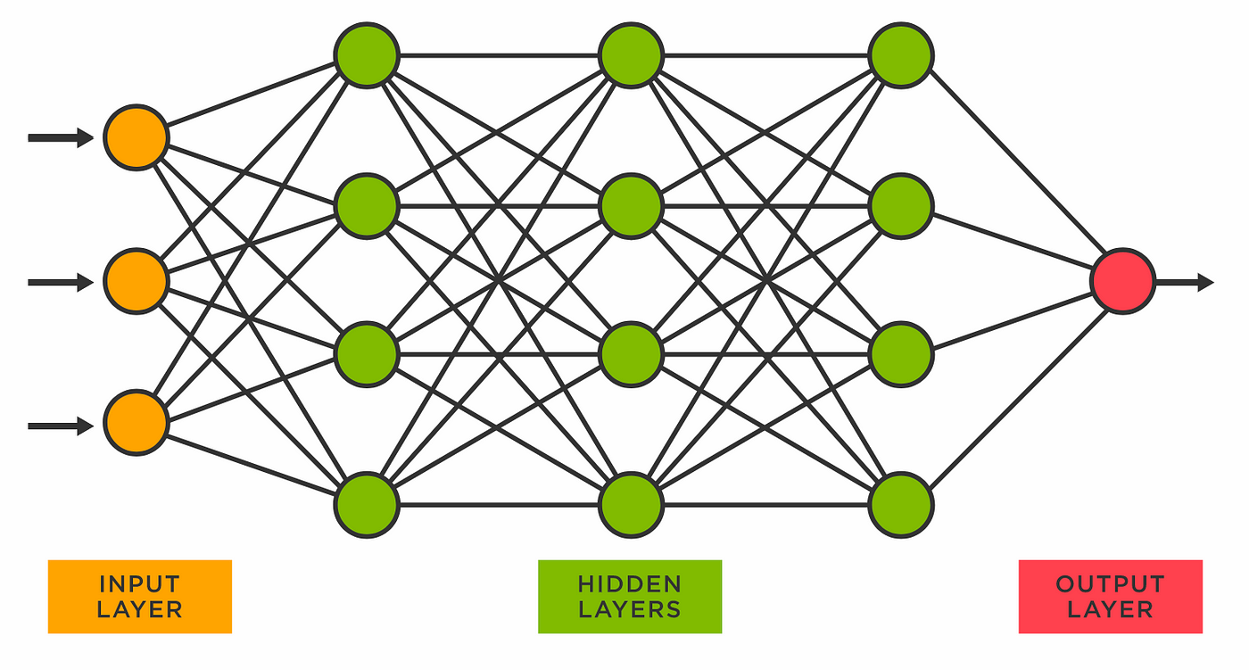
Neural Networks

Slide 27
Neural Networks
Deep learning is the use of several hidden layers
So, the network looks “deep”
You can this of this as increasing model complexity, which allows us to handle very complex problems
After each layer, we usually pass data through “activation functions”; does anyone know what these are?
Functions that introduce non-linearity
If we didn’t have these, you could think of a neural network as a bunch of matrix multiplication, which make them linear models
However, many problems are non-linear in nature, so activation functions are very important
In fact, if a neural network uses non-linearity, it is a universal function approximator
In other words, it can estimate any function, no matter how complex
There are other factors that can improve performance, such as the number of hidden layers, the amount of training data, hyperparameters, etc., but non-linearity is a hard requirement

Slide 28
Neural Networks
Effective in numerous problems, especially very complex problems
Data hungry
Depends on the problem, but usually we need a lot of training data
Can require a lot of time and/or computational power to train

Slide 29
SVM
Support vector machine
Can be used for classification (most common) and regression
Intuition: find the hyperplane with largest margin that separates our data

Slide 30
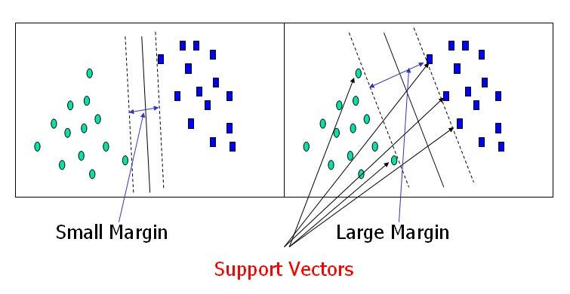
SVM

Slide 31
SVM
Robust to overfitting
Effective on small to medium-sized datasets
Computationally expensive, so not very useful on big data
Work best on binary classification
Can still be used for multi-class classification or regression, but not as effective
Has been used a lot in finance (I’m guessing because finance has a lot of binary classification problems, i.e. buy or sell)

Slide 32
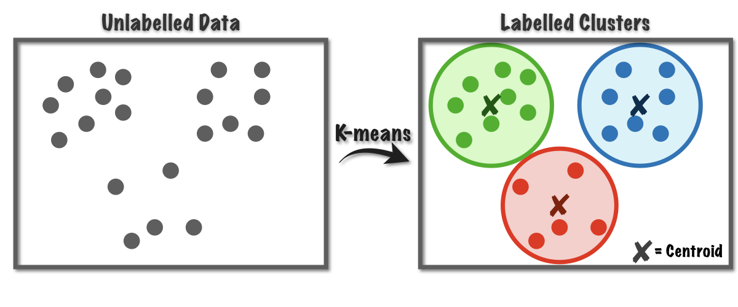
Clustering
What do you think clustering means?
We try to find natural groups (or “clusters”) within our data
Unsupervised learning (we don’t have labels)

Slide 33
K-Means
Use for clustering (unsupervised learning)
Steps:
Choose k
Choose a number of iterations to run
For each iteration:
Randomly select k distinct data points - these are the initial clusters
Initialize the average value for each cluster (they will just be the values of the k distinct points)
While the average value for each cluster changes:
For each data point:
Measure the distance to each cluster mean
Assign the point to the nearest cluster
Re-calculate the average value of each cluster
Calculate the variation within each cluster
Update the best clustering
This is the clustering with the smallest variance
Return the final clustering

Slide 34
K-Means
Simple
Interpretable
Guaranteed to converge
However, it can converge to a local optimum
Sensitive to outliers
Need to choose a value for k
Though, there are some methods one can use to automatically find the best value of k
Basically just add an extra outer loop that tries different values of k

Slide 35
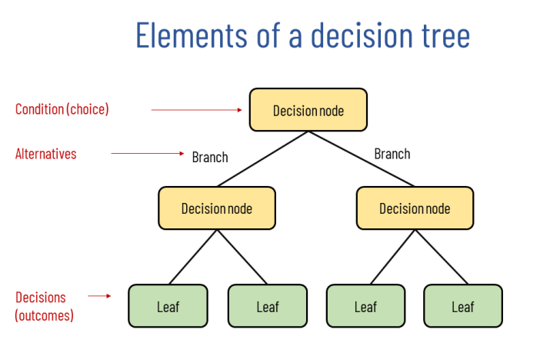
Decision Trees
Create a tree where nodes represent features and branches represent partitions of features
Uses information gain

Slide 36
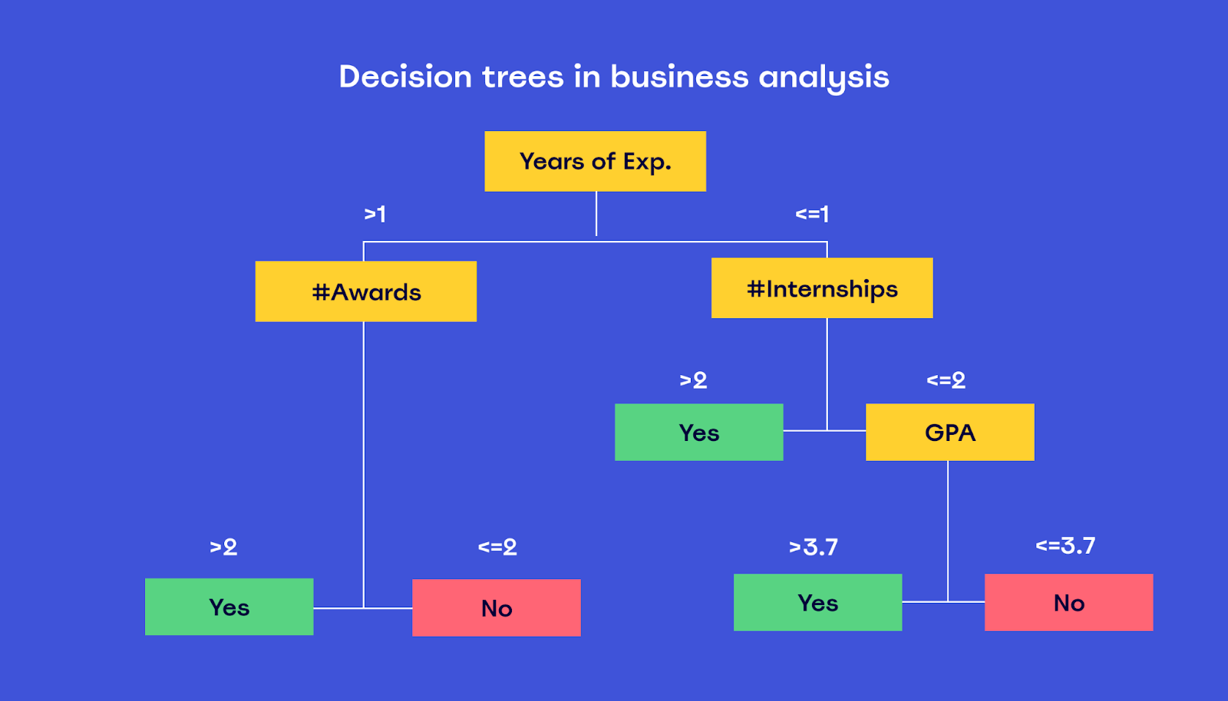
Decision Trees

Slide 37
Decision Trees
Similar to KNN, decision trees are non-parametric (don’t make any assumptions about the underlying data distribution)
Additionally, since decision trees look at data on a feature-by-feature basis, they don’t require any data preprocessing (converting categorical data to numeric data and normalizing numeric data)
Interpretable
Feature importances (i.e. which nodes are towards the top of the tree)
Efficient and scalable
However, they are more prone to overfitting
Additionally, they are greedy (might not result in a global optimum)

Slide 38
Ensemble Models
Hopefully you have noticed that there are strengths and weaknesses for each model
Since no individual model is perfect, maybe we could combine models
Ensemble models take multiple individual models and combine their output to create a single final model
Random forest, XGBoost, and other ensemble tree models combine multiple decision trees
Very effective and popular, especially XGBoost
A lot of ways to combine models, but one common way is just to have the individual models vote
Two popular ensemble methods are boosting and bagging

Slide 39
Boosting
A way to combine several models (ensemble)
“Boosting” = we gradually boost performance of individual models
Steps:
While the number of trained models is less than the number of models we would like to have:
Train a new model on the dataset
Keep track of data points where predictions were incorrect
In the dataset, give more weight to the incorrect data points
For a new data point, aggregate the predictions from every model
For classification, we use a majority vote
For regression, we use an average
In both cases, we weight model predictions by how accurate they were during training (so the later models usually receive a larger weight)
Builds models sequentially

Slide 40
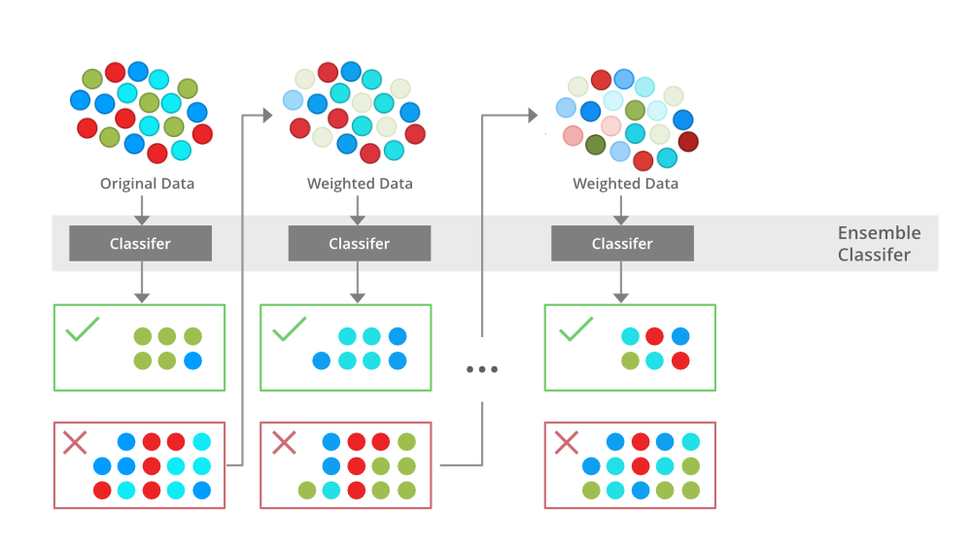
Boosting

Slide 41
Bagging
Another way to combine several models (ensemble)
“Bagging” = “bootstrap” + “aggregation”
Steps:
For each model:
Create a dataset via bootstrapping
Sample with replacement from original dataset
Train the model on the bootstrap dataset
For a new data point, aggregate the predictions from every model
For classification, we use a majority vote
For regression, we use an average
Builds models in parallel
Can train faster than boosting, but usually not as accurate as boosting

Slide 42
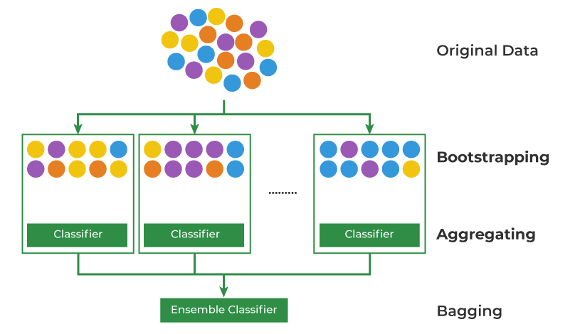
Bagging

Slide 43
Genetic Algorithms
Optimization algorithms
Typically used when we want to find optimal combinations
Estimate optimal choices
Very useful when we want to optimize over something but we can’t really do it with traditional methods
Complex search space
Non-linear relationships
A lot of possible combinations
etc.
A single genome represents one particular combination of values

Slide 44
Genetic Algorithms
Basic implementation:
Identify the different variables we would like to combine
Create an array of possible values for each variable
Identify how large each population of genomes should be (N)
Create an initial population of N genomes
In the initial population, each genome just uses a random combination of values
For a specified number of iterations:
Create a new empty population (population that will be used in the next iteration)
Calculate the performance (usually just utility) of each genome
Add the top-two genomes to the new population
For the remaining genomes:
Randomly select two parents
Create two new genomes that use the parent’s features, but where the features are randomly swapped
Randomly mutate (change) some of the features for the two children
Add the two children to the new population
Use the best genome in the population as the combination of values

Slide 45
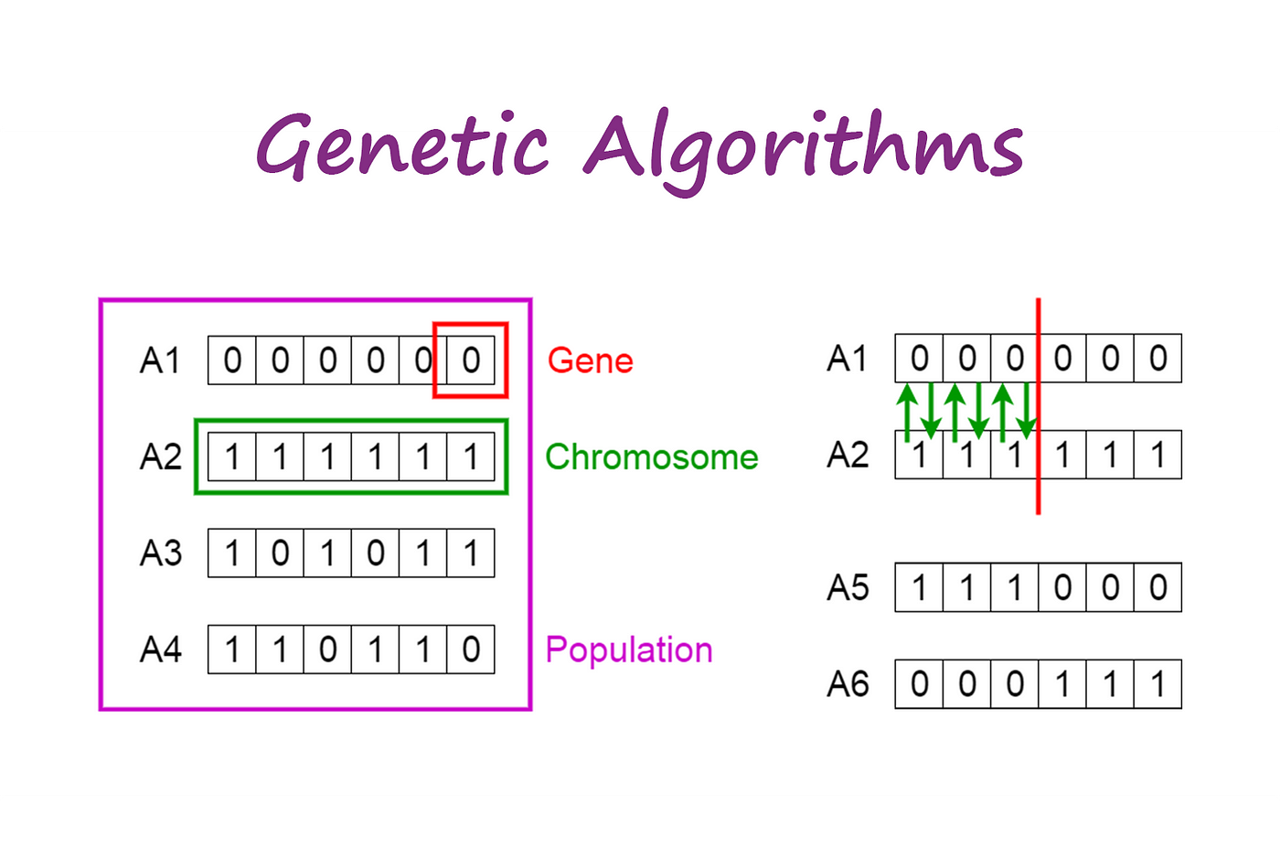
Genetic Algorithms

Slide 46
Genetic Algorithms
Examples:
Knapsack problem
A thief is stealing items
Thief has a bag (knapsack) that can hold a maximum weight
Each item has:
A value
A weight
Which items should the thief steal?
In other words, we’re trying to find the best combination of items that fit in the bag and maximize value
There exist algorithms to solve this, but in general it’s an NP-hard problem
We can use a genetic algorithm to quickly solve for this and find a good estimate
Find the best combination of hyperparameters for a model

Slide 47
No Free Lunch
Each model has strengths and weaknesses
No Free Lunch Theorem:
Proven theorem that says:
No single model will outperform every other model on every task
There are a lot of “it depends” answers to questions in the field of AI, because there are numerous specific details that can affect how certain models/approaches perform

Slide 48
Homework
Value iteration project
Due tonight by 11:59 pm

Slide 49
Next Time
Searching algorithms (deterministic search and optimization search)
Big picture discussion: AI bias in socially-relevant challenges
Spend some time reading about this topic
Come prepared with a thought to share

