Slide 1
Making Decisions
CS 470
Ethan Pedersen

Slide 2
Review
Uncertainty in environments:
Uncertainty about which state we are in
Uncertainty about what new we’ll enter once we select a particular action
Utility function:
Based on our agent’s preferences, we can create a utility function that will give us utility for any particular state we’re in

Slide 3
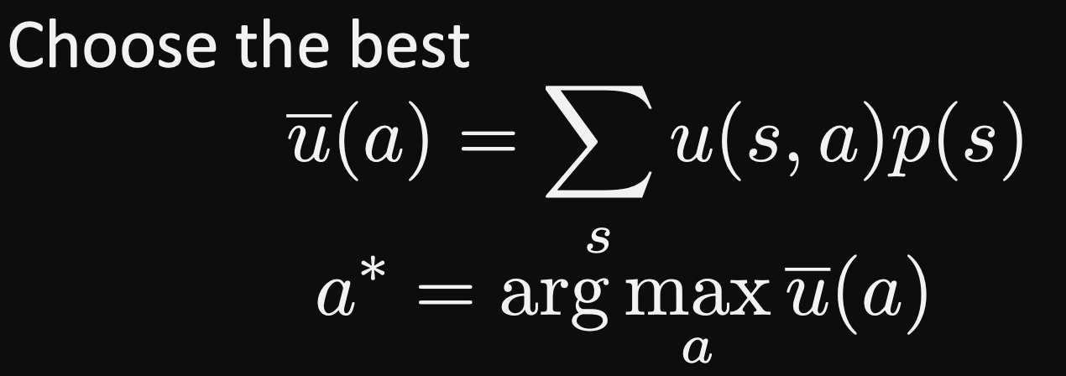
Review

Slide 4
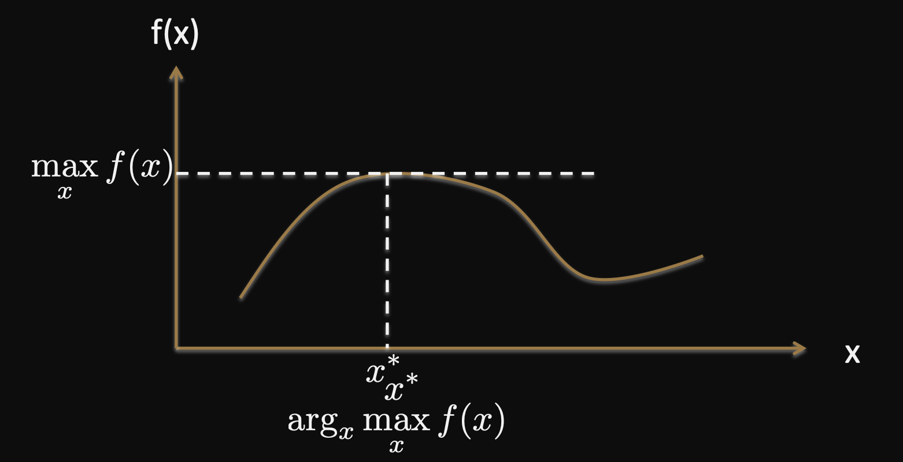
Review

Slide 5
Maximum Expected Utility (MEU)
Choosing the action that maximizes the expected utility is what the book calls the maximum expected utility (MEU) principle
A prescription for a rational agent
However, this principle does not solve our AI problems; why?
Computing utilities can be difficult
We need to create probability models
To do these things, we need perception, learning, knowledge representation, inference, etc.

Slide 6
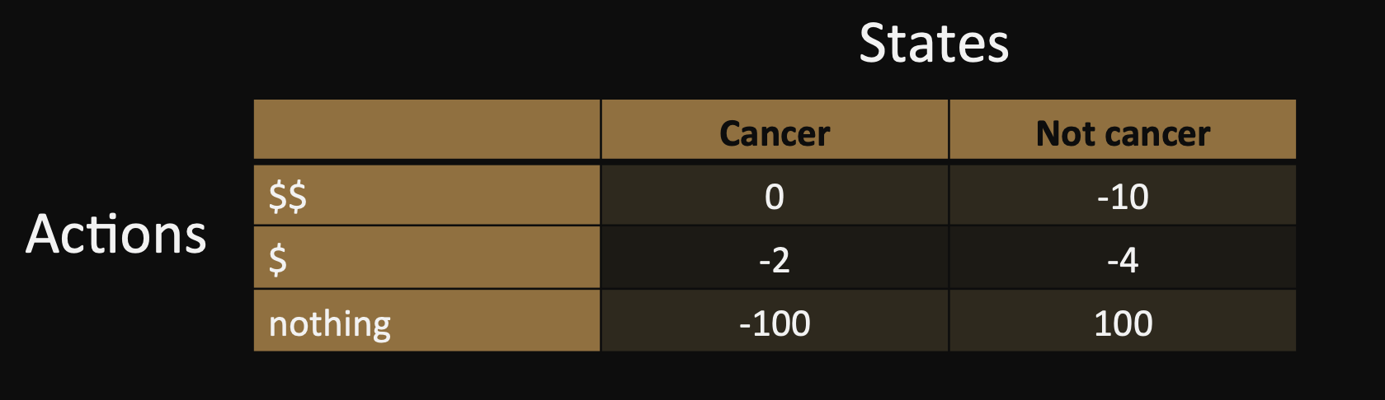
Problem with MEU
Do you think the MEU is reasonable?
Do you think every agent should follow the MEU?
Agents can be unique, having specific goals that want to achieve rather than simply maximize expected utility
For example, recall the risk-aversion (minimax) strategy we reviewed towards the beginning of the semester:

Slide 7
Other Challenges
Do you think money is a good utility?
What about placing monetary value on human life (ex: insurance)?
The book argues that failing to place monetary value on life can mean life is undervalued
Ex: A government agency ran a study on removing asbestos from schools. The analysts running the study assumed a particular value for a school-age child, and argued that the rational choice was to remove the asbestos. The agency was morally outraged at their approach and rejected the finding of the study, failing to remove the asbestos.
Do you think people behave consistently (especially with money)?

Slide 8
Thought Experiment
You’re on a game show and have triumphed over the other competitors
The host offers you one of the two choices:
$1,000,000
A coin flip, where if the coin lands on tails you get $2,500,000, but if it lands on heads you get nothing
What would you do, and why?
What the MEU tells us:
The expected value of the first option is simply $1,000,000 (no uncertainty around the first option)
The expected value of the second option is 0.5($0) + 0.5($2,500,000) = $1,250,000
So, under the MEU, people should select the second option
Most people take the $1,000,000, but are they being irrational? Why or why not?

Slide 9
Money and Utility
For most people, utility is not directly proportional to monetary value
Ex: The utility of your first $1,000,000 is probably larger than your second $1,000,000
One study has shown that people’s utility of money tends to be proportional to the logarithm of the amount
So, there are diminishing returns when larger and larger amounts of money are involved

Slide 10
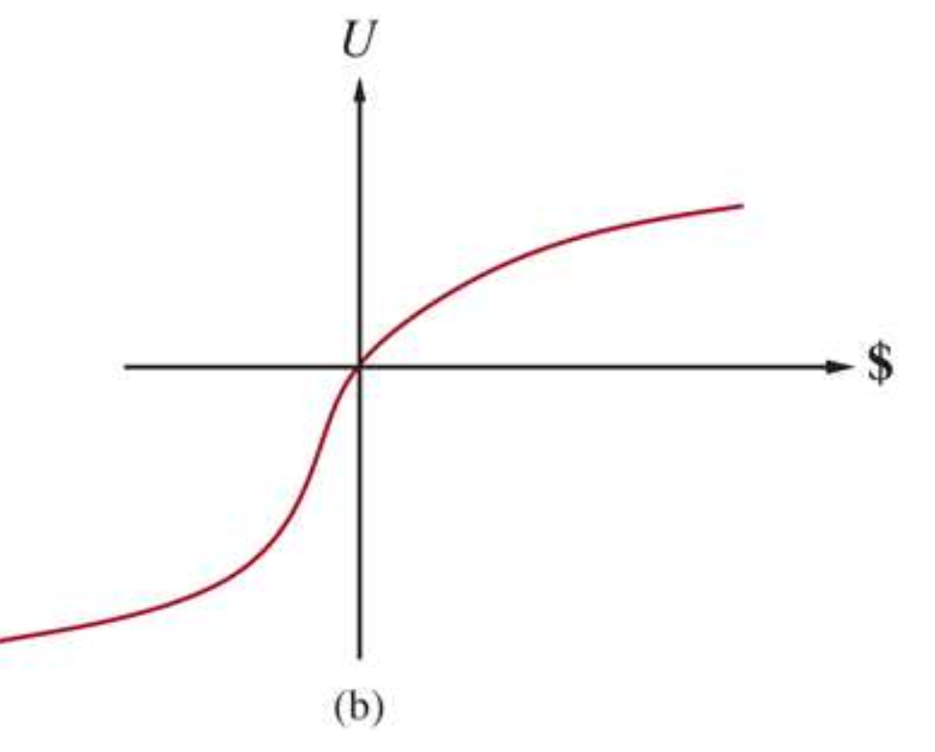
Money and Utility
Risk-averse
Risk-seeking
Risk-averse
Risk-seeking

Slide 11

Money and Utility
The difference between an expected monetary value and its certainty equivalent is known as the insurance premium
Risk aversion is the basis of the insurance industry
People are usually willing to pay an insurance premium, rather than gamble the prices of their valuables (house, car, health, etc.)

Slide 12

Risk-Related Behaviors
In this class, we’ve talked about risk-averse, risk-neutral, and risk-seeking behavior
Risk-averse:
Focus on the worst-case utility (minimax)
Risk-neutral:
Focus on expected utility
Risk-seeking:
Focus on the best-case utility

Slide 13
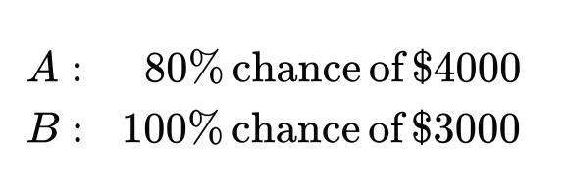
Another Thought Experiment

Slide 14
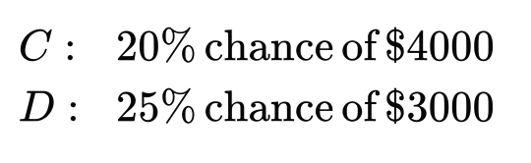
Another Thought Experiment

Slide 15
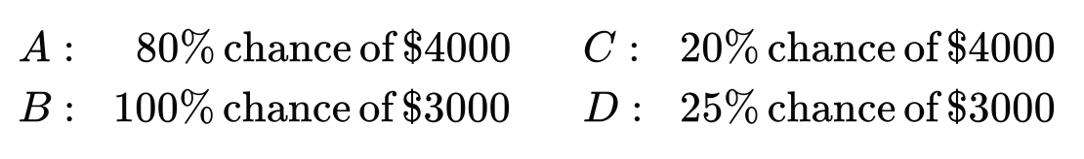
Another Thought Experiment
Most people prefer B over A and C over D
Preferring B over A implies that U($3000) > 0.8 * U($4000)
Preferring C over D implies that 0.2 * U($4000) > 0.25 * U($3000)
-> 0.8 * U($4000) > U($3000)
Contradiction
Similar to what we saw before, money isn’t directly related to utility
This is similar to what we saw before with money, but this time the amounts are the same
Do you think this is reasonable? Why or why not?
There might be a “certainty effect”, or other factors

Slide 16
Human Judgment and Irrationality
Decision theory tells us how an agent should act
Descriptive theory tells us how actual agents (humans, for the most part) act
Evidence suggests that humans are “predictably irrational”
Possible explanations to “irrational” human behavior:
Certainty effect
Reduce computational burden (avoid computing probabilities)
Distrust the legitimacy of the stated probabilities
Emotions
Regret
Framing effect (how something is worded can have an impact on choices)
Ex: People prefer a procedure that has a “90% survival rate” compared to a procedure that has a “10% death rate”, even though they mean the same thing
Anchoring effect (relative utility judgments)
Ex: Restaurant offers a $200 bottle of wine it knows that no one will buy, but it makes the $55 bottle of wine seem like a bargain

Slide 17

Human Judgment and Irrationality
Creating agents that interact with humans or try to replicate human behavior in some way can be difficult due to these factors
Psychology is involved

Slide 18
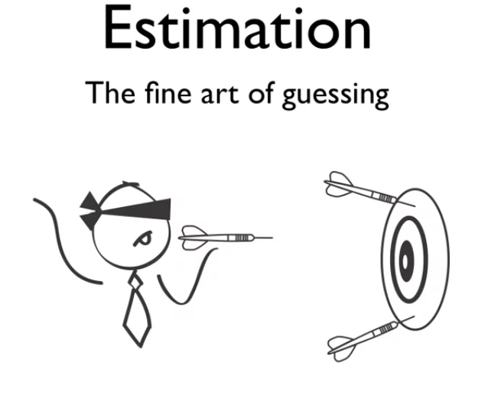
Estimating Utility
In practice, it is difficult to calculate actual utility
We might not know enough (about the environment, the consequences of actions, etc.)
Computation of true utility is very difficult
Environment might be too complex
Could be numerous factors influencing utility
So, we often will estimate utility to the best of our abilities

Slide 19
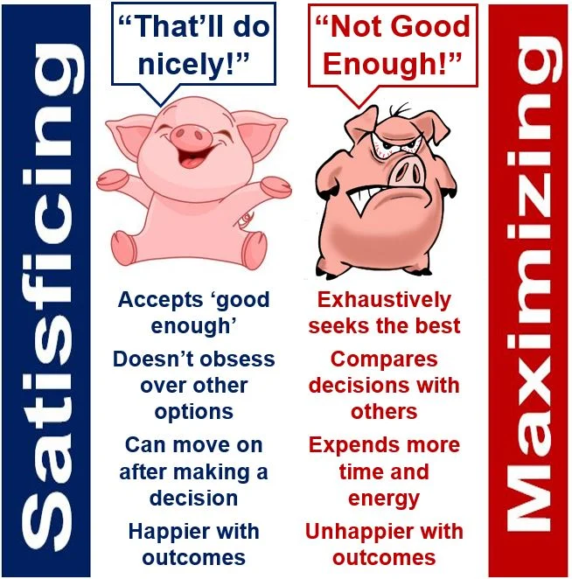
Satisficing
Another decision making strategy
Focuses on finding a “satisfactory” outcome, rather than the optimal outcome
Finding the optimal outcome might require too much time or computational power
Can be viewed as a form of estimation
In practice, we’ll usually do the following:
Set a baseline utility level we think is acceptable
Search for possible outcomes
Accept the first outcome that meets or exceeds our baseline
We may or may not adjust the baseline afterwards
Ex: S++

Slide 20
Example
Player 1: blue (max)
Player 2: yellow (min)
Imagine we’re Player 1, and we would be satisfied with a utility of 2
As soon as we find this outcome in our tree search, we can stop
-1
3
5
1
-6
-4
0
9

Slide 21
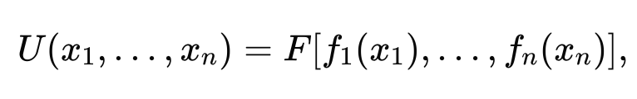
Multiple Variables
In realistic domains, there are usually multiple variables/factors we should take into consideration when calculating/estimating utility
Ex: Making a list of pros and cons when making a decision
If we have a utility function for each variable, then we can do the following:

Slide 22
Multiple Variables
Each f is a utility function for an individual variable
F is a function that combines all of the utilities
We hope that F is simple, such as addition
However, it depends on how the variables relate to each other (dependent or independent)

Slide 23
Homework
Finish the midterm

Slide 24
Next Time
Introduce mini project (COVID policy making)
Ethical decision making

