Slide 1
Markov Decision Processes
CS 470
Ethan Pedersen

Slide 2
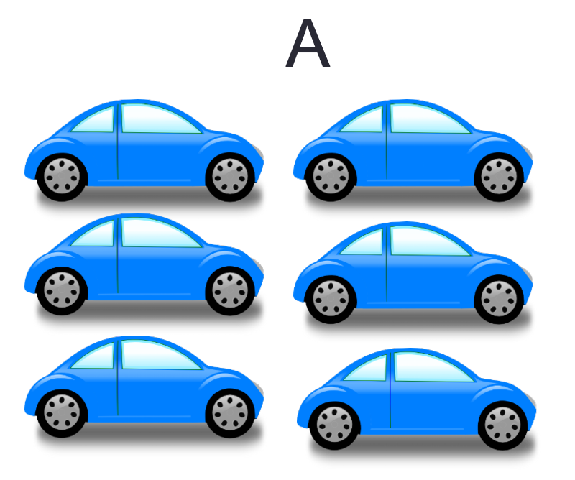
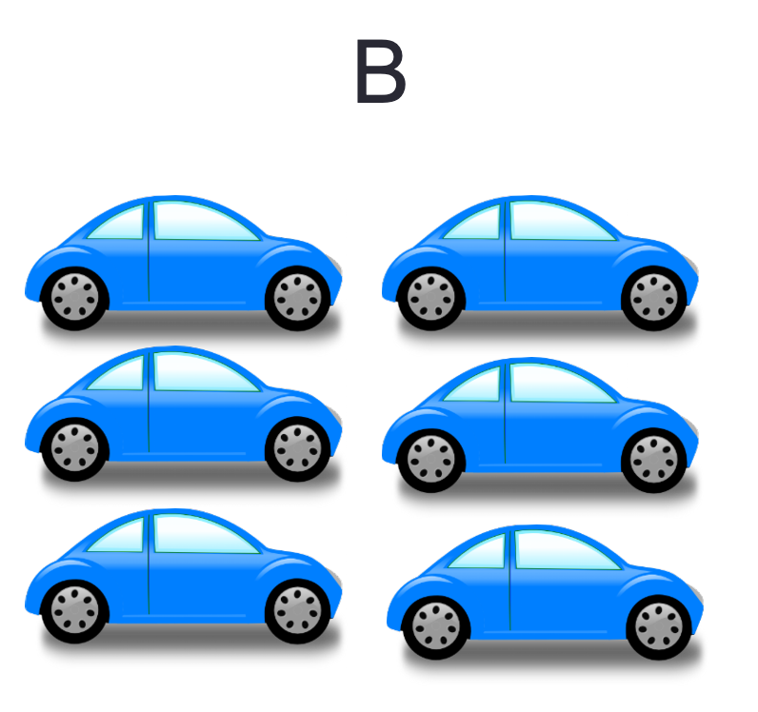
Motivation
Car rental company rents cars at two different locations, A and B
Each day, people rent cars from either location
If no cars are left at one of the locations, that location can’t conduct business
Cars can be returned to either location
After business hours, the company can:
Move cars from A to B
Move cars from B to A
Business question: if there are x cars at location A and y cars at location B, how many cars should we move?

Slide 3
Motivation
Need to plan ahead for the next day of business
Random element (number of rentals and returns)
We might have estimates for the number of rentals and returns (based on historical data, business knowledge, etc.), but there’s still at least a small stochastic element
Our decision today can impact what happens the next day
Goal: maximize profit
In summary, we’re dealing with a stochastic and sequential domain
Does this sound familiar?
Bayes Filter lab

Slide 4
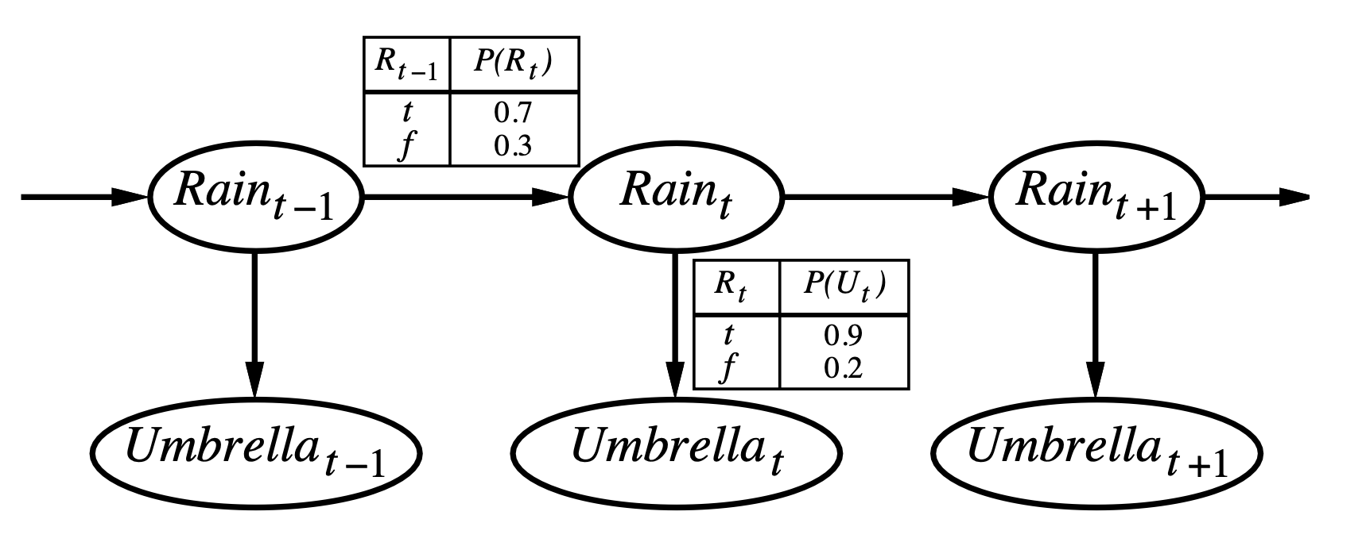
Recall: Markov Process
Stochastic process
Iterate through states over time
Uncertainty when transitioning from one state to the next
So, we have a set of states that differ over time, and the future only depends on the current state (not the previous states)
What does “the future only depends on the current state” sound like?
Markov assumption

Slide 5

Markov Decision Process
Markov process, but with actions
In other words, at each state we “decide” what action to take in order to reach/achieve some goal
Markov assumption still holds
In a way, this is what you were doing in the Bayes Filter lab:
Given the current state the robot was in, you chose an action to move it towards the terminal state
“MDP” is a very common acronym

Slide 6
Markov Decision Process
Stochastic sequential problem
Four main components:
Set of states S
Set of actions for each state s in S
A(s)
Transition model P(s’ | s, a)
Probability of reaching state s’ after performing action a in state s
Does this look familiar?
Bayes Filter
Reward function for specifying the reward for each state s in S
R(s)
MDP = (S, A, R, P)

Slide 7
Notation
Depending on the resource you read, the notation might differ
Ex: R(s, s’) instead of just R(s)
Ex: MDP = (S, s_0, A, R, P) (the tuple includes initial state)
The initial state actually doesn’t really matter, but it can be nice to think about/visualize the problem
Despite differences in the notation, they mean the same thing

Slide 8
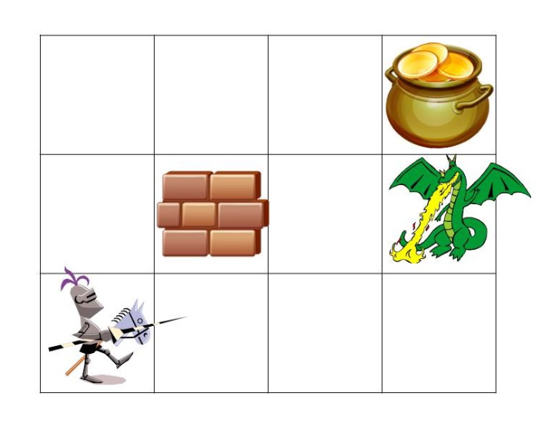
Example
Actions move in the intended direction with probability 0.8, 0.1 to each of the sides

Slide 9
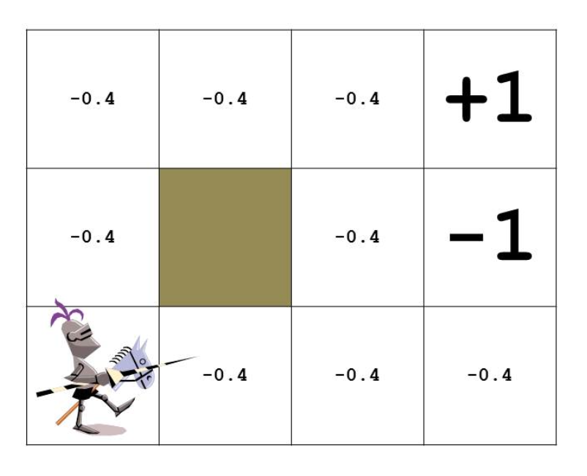
Example
The numbers are arbitrary (as the designers, we can have a say in what the numbers are)
Goal, so we give it a “large” positive number
“Small” negative numbers to motivate the agent to get to the goal as quickly as possible
Danger, so we give it a “large” negative number

Slide 10


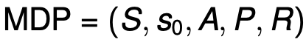
How to Solve an MDP
What does a solution to an MDP problem look like?
Fixed action sequence?
No, because there is randomness (we could potentially end up in any state)
Answer: we need to specify what the agent should do in any reachable state
We call this solution a policy, though it’s sometimes referred to as a strategy
Action that the policy tells us to take in state s

Slide 11
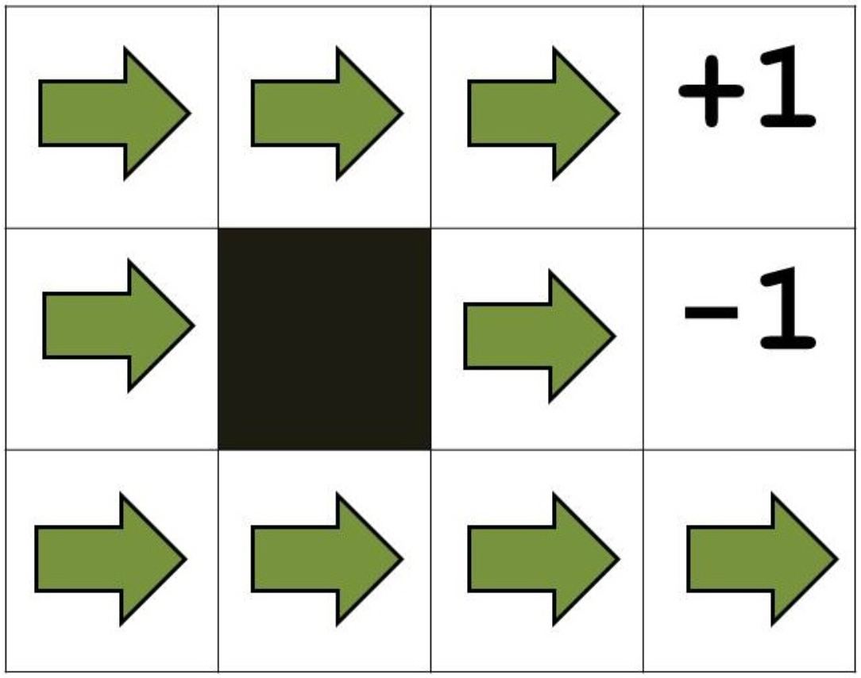
Example

Slide 12
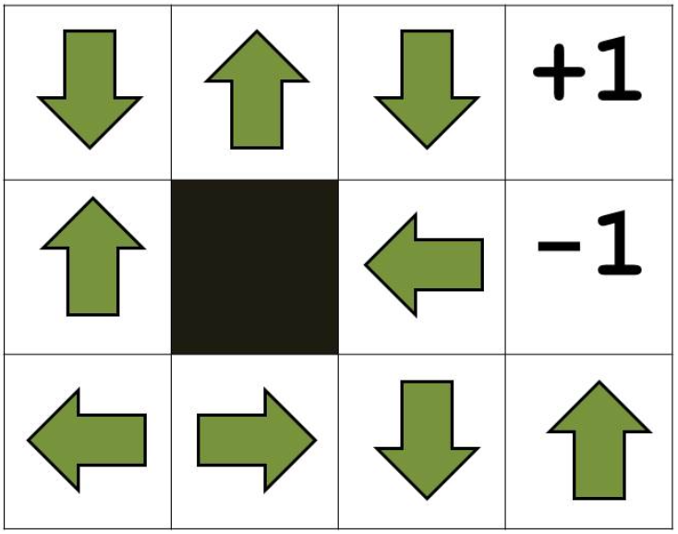
Example

Slide 13
Evaluating Policies
I think we can agree that the previous two policies we saw were not very good
But, what makes a “good” policy?
Hint: Maximum Expected Utility (MEU)
One approach (we’ll cover approaches more in the next two lectures):
For each policy we’re evaluating:
Start in the initial state
Execute the policy several times
Transitions are random
So, this gives us a distribution over state sequences induced by the policy
Each state sequence has an associated utility (ex: sum of rewards from each state)
Each state sequence has a probability of occuring
Use the rewards and probabilities of the state sequences to calculate the expected utility of the policy
Use the MEU principle to choose the policy with the largest expected utility

Slide 14
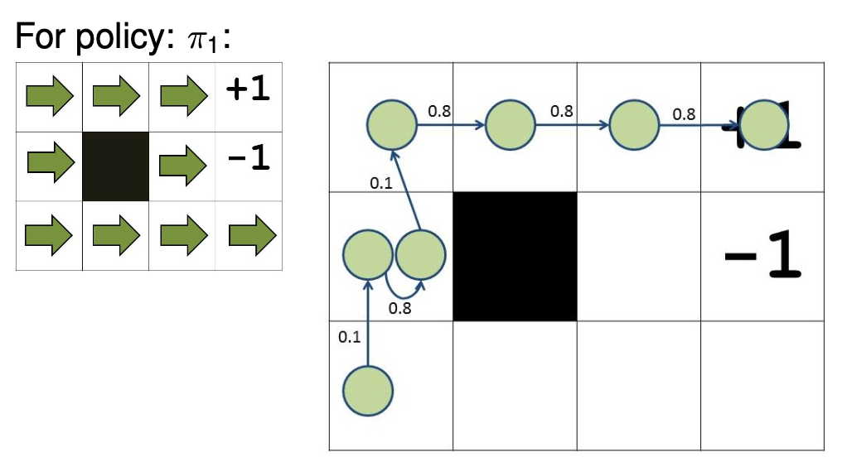
Example
For simplicity, assume the utility of any intermediate state is 0

Slide 15
Example
What is the utility of this sequence?
1

Slide 16
Example
What is the probability of this sequence occurring?
0.1 * 0.8 * 0.1 * 0.8 * 0.8 * 0.8
= 0.004096

Slide 17
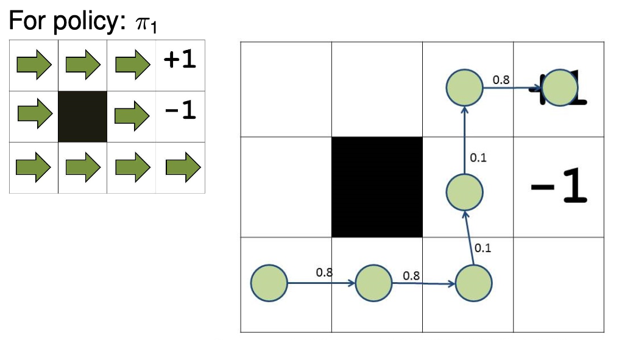
Example
What is the utility of this sequence?
1

Slide 18
Example
What is the probability of this sequence occurring?
0.8 * 0.8 * 0.1 * 0.1 * 0.8
= 0.00512

Slide 19
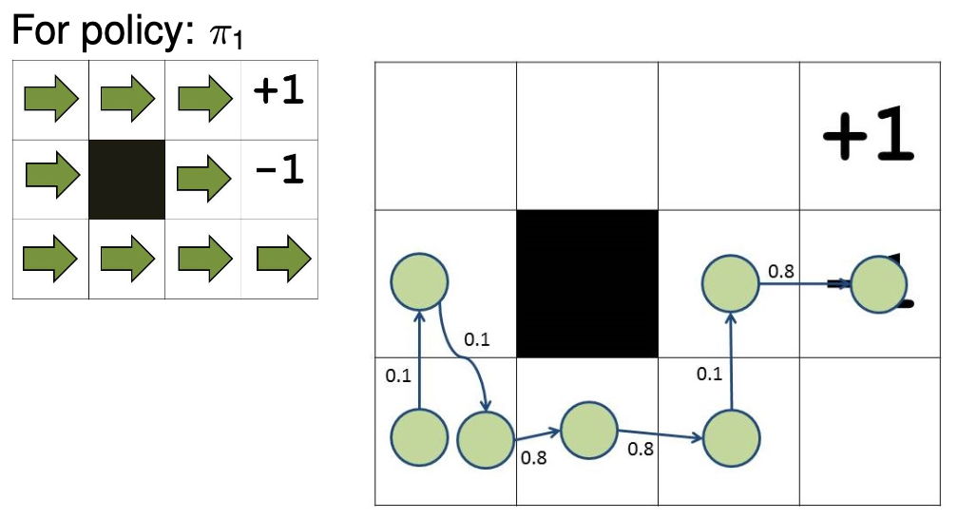
Example
What is the utility of this sequence?
-1

Slide 20
Example
What is the probability of this sequence occurring?
0.1 * 0.1 * 0.8 * 0.8 * 0.1 * 0.8
= 0.000512

Slide 21

Optimal Policy
The policy with the largest expected utility is called the optimal policy
Notation:

Slide 22

Evaluating State Sequences
How do we determine the utility of a state sequence?
Three main approaches:
Sum
We already mentioned this one
Discount future rewards
Probably the most common
Financial aspect (time value of money)
Average reward per time step
Not as common, and we won’t cover it

Slide 23
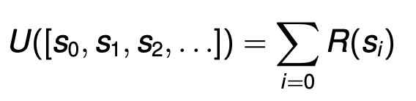
Sum
We simply add up all of the utilities received from each state
Are there any issues with this?
What happens if we’re dealing with an infinite sequence of states?
The sums of multiple policies will approach infinity, making it difficult/impossible to compare them

Slide 24
Discounted Rewards
Main idea: instead of just adding the rewards from each state, we discount the rewards first and then add them
In other words, the sum of discounted rewards
Financial aspect
Time value of money (x amount of money now is worth more than x amount of money in the future)
Perpetuities
Receive payments over an infinite horizon
The further into the future a payment occurs, the more its present value approaches 0
Most common because it is more realistic and it allows us to deal with infinite sequences

Slide 25
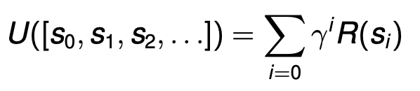

Discounted Rewards
Use a discount factor gamma between 0 and 1
The smaller it is, the less value we get from future rewards
Often something like 0.99 is used

Slide 26
Homework
COVID mini project

Slide 27
Next Time
Value iteration
Skim the value iteration section of the Wikipedia article

