Slide 1
POMDPs
CS 470
Ethan Pedersen

Slide 2
Recall: Markov Decision Process
Stochastic sequential problem
Four main components:
Set of states S
Set of actions for each state s in S
A(s)
Transition model P(s’ | s, a)
Probability of reaching state s’ after performing action a in state s
Does this look familiar?
Bayes Filter
Reward function for specifying the reward for each state s in S
R(s)
MDP = (S, A, R, P)

Slide 3
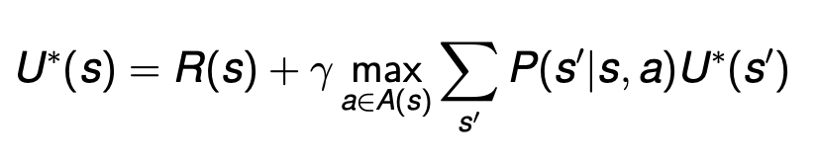
Recall: Bellman Equation
First, we get an immediate reward for entering state s
Then, we get a discounted future reward by following the optimal actions in any future states

Slide 4
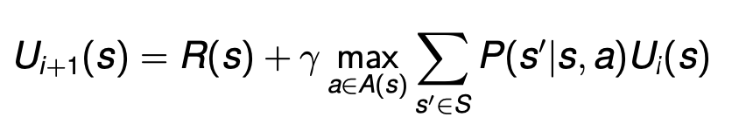
Recall: Value Iteration
Choose some small value of epsilon (ex: 0.001)
Initialize the utility (U(s)) arbitrarily (usually something like 0)
While the maximum U(s) change is larger than epsilon:
Update the utility values:
Update the maximum change in U(s)

Slide 5
POMDP
Partially-observable Markov decision process
In simple terms, it’s an MDP where we don’t know the exact state we’re in (MDP with an extra layer of uncertainty)
However, we get to make observations about where we might be at
What does this sound like?
Filtering
Regular MDP: (S, A, R, P)
POMDP: (S, A, R, P, Z, O)
S, A, R, P are the same as before
Z: set of observations
O: observation model P(z | s, a)
Probability of seeing observation z if we’re in state s and take action a

Slide 6
Example
Crying baby
S = {hungry, full}
A = {feed, ignore}
O = {crying, quiet}

Slide 7
Example
⅓
10
A
B
10
C
D
⅓
⅓

Slide 8
Belief State
In a regular MDP, we want to find an optimal policy that maps states to actions in order to maximize expected reward
In a POMDP, we no longer know the exact state we’re in
So, instead of mapping from states to actions, we want to map from belief states to actions
Belief state: b(s) = probability of being in state s
As we choose actions and make observations, our belief states will change (like what we saw in filtering)
Specifically, we want to use b, a, and z to calculate b’ (new belief state)
Mathematically, b’(s’) = P(s’ | b, a, z)

Slide 9
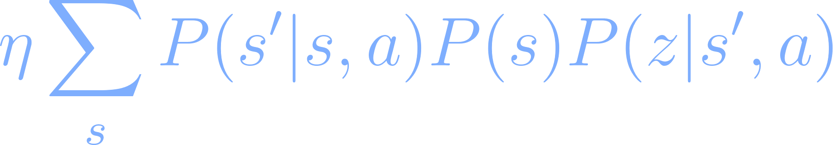
Calculating b’(s’)
b’(s’) = P(s’ | b, a, z), but how do we actually calculate P(s’ | b, a, z)?
Normalization constant
Transition model
Check every possible state
Extra level of uncertainty

Slide 10
Calculating b’(s’)
b’(s’) = P(s’ | b, a, z), but how do we actually calculate P(s’ | b, a, z)?
Normalization constant
Transition model
Observation model
Check every possible state
b(s) (previous belief)

Slide 11
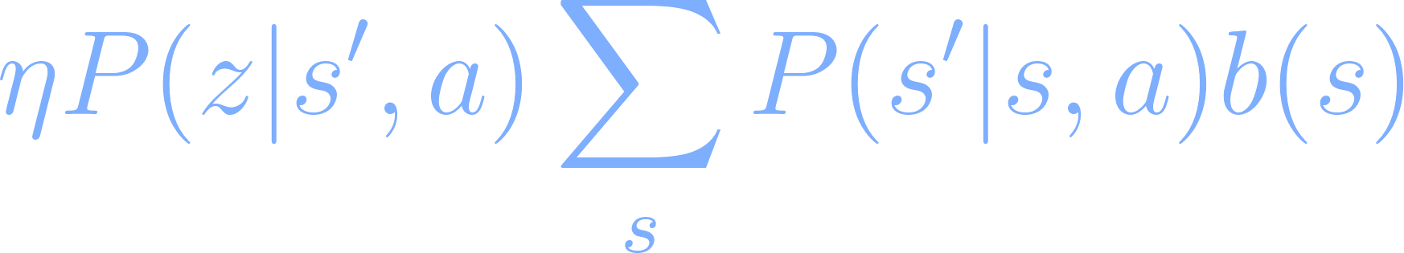
Calculating b’(s’)
b’(s’) = P(s’ | b, a, z), but how do we actually calculate P(s’ | b, a, z)?
=

Slide 12
Problem
So, instead of states like we had with regular MDPs, we now are dealing with belief states
What’s a problem with this?
There are an infinite amount of belief states (because probabilities can be any number between 0 and 1, i.e. uncountably infinite number of belief states)
So, if we have an infinite number of states, how do we run something like value iteration?

Slide 13
Solutions
We won’t explore these for this class, but here are a few approaches that try to estimate the best policy:
Just assume that the state with the highest b(s) is the current state we’re in
Use our distribution of beliefs to select a state, assume that’s the state we’re in
Use our beliefs and Q values from value iteration to calculate the expected utility of each action (algorithm 1 on value iteration lab)
Problem: actions might differ depending on state
Neural networks
Ex:
Input: vector of probabilities for each state (belief vector)
Output: action I should take or
Output: vector of q values for each action -> pick the argmax
Piecewise linear and convex value iteration
Several others

Slide 14
Intro to Reinforcement Learning
CS 470
Ethan Pedersen

Slide 15
Reinforcement Learning
What is reinforcement learning (RL)?
Learning from rewards
In the terminology of Psychology, we say reinforcements
Exact target outputs are not given
Reward is given either immediately or some amount of time steps after an action is chosen
Learns a mapping from states to actions by trial-and-error interactions with an environment
What is this mapping?
Policy

Slide 16
Motivation for RL
In traditional supervised learning, we use several examples to train a model
We have labels for our data
Ex: We could use supervised learning to train a model to play chess
Input: state
Output: action
What is a key problem with this?
The space of all possible states is about 10 to the 40th power
Our model will come across states it has never seen before and not know what to do
Reinforcement learning provides a better solution

Slide 17
Components of RL
Agent
Environment
How do we model environments for a reinforcement learning problem?
MDP
We assume the agent can observe the state it’s currently in, so not a POMDP
However, while RL doesn’t directly handle partially-observable states, we can still use it to approximate
Differs from solving an MDP (what we’ve discussed so far in class):
Agent usually doesn’t know the transition model or reward function
There’s one caveat that we’ll talk about next time
In other words, the agent isn’t given an MDP to solve, it’s in the MDP and must learn an optimal policy
Actions
Rewards

Slide 18
Rewards
Agent receives rewards for actions
Rewards can be 0 or very small (actions in intermediate states)
Rewards are usually larger for terminal states
Ex: self-driving car reaching its destination
Agent would like to learn the best policy to maximize discounted cumulative reward:
What is this?
Sum of rewards, where future rewards are discounted
Non-zero intermediate rewards can make learning easier
Ex: Pong
If all we have are terminal rewards (rewards received for reaching a terminal state), then learning is usually more difficult:
Ex: Chess
Called “sparse rewards”

Slide 19
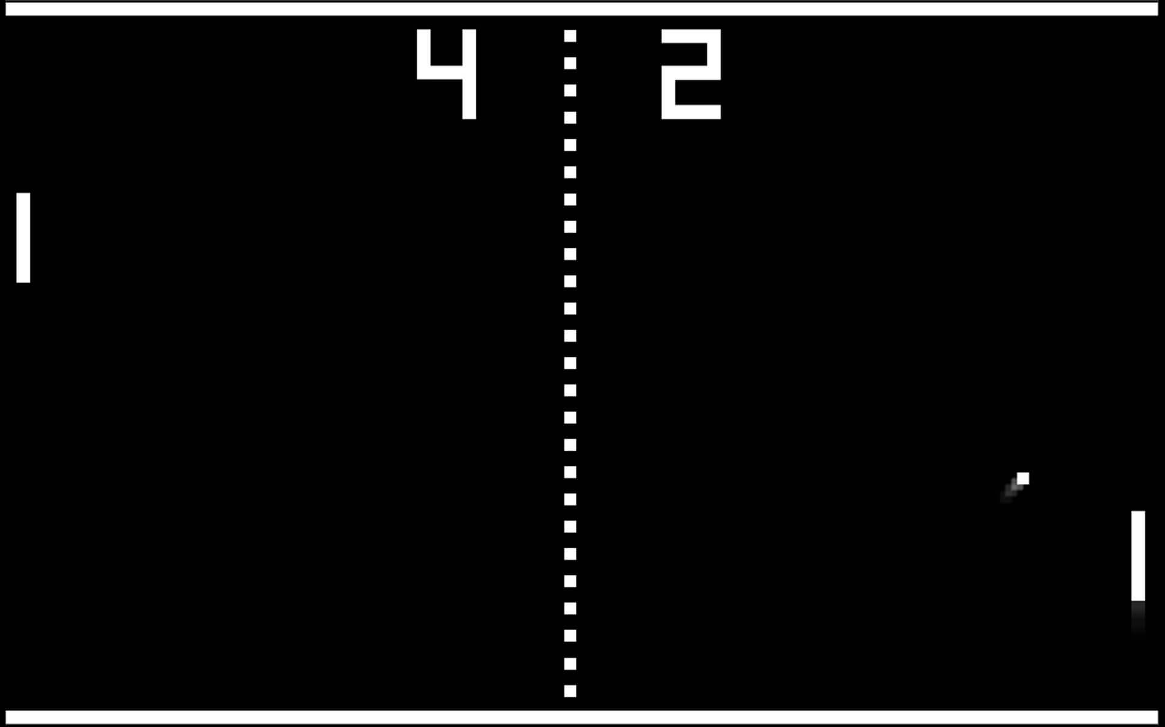
Example

Slide 20
Credit Assignment Problem
If we have sparse rewards, it becomes difficult to recognize which action(s) in a sequence of actions actually led to the reward
“Sample inefficient”
What is this?
Just means that each data sample (in this case, sequences of rewards) doesn’t tell us much
As a consequence, we need to play a lot longer in order to learn something useful

Slide 21
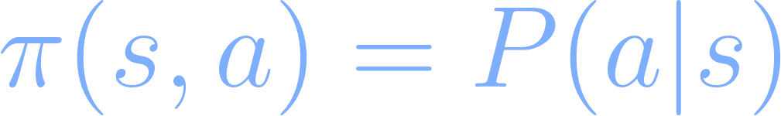
Policy
What is a policy?
Mapping from state to action
In terms of RL, this will basically be the same thing, except now our policy will give us probabilities for actions:
Why is this?
Exploration vs. exploitation

Slide 22
Exploration vs. Exploitation
In RL (and a lot of machine learning problems), there exists this idea of exploration vs. exploitation
What is it? (hint: we briefly discussed it when we went over MCTS)
In simple terms, it’s the idea that if we continually exploit our existing knowledge, we might miss out on better opportunities
So, we should periodically explore other options
They might lead to better outcomes (rare, but why we try it)
They might lead to worse outcomes (more likely)

Slide 23
Example
It’s the weekend and you want to go out to eat somewhere
There’s a restaurant you know you like
There’s a restaurant you’ve heard about but have never tried
You can:
“Exploit” your knowledge of the restaurant you like and guarantee you’ll have a positive experience
“Explore” the other restaurant with the possibility of receiving a better experience
However, you might have a worse experience

Slide 24
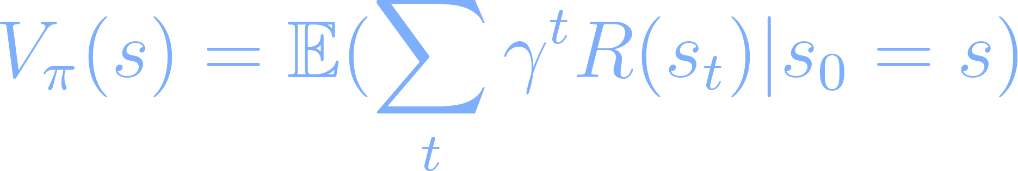
Value Function
Function that tells us the value of being in state s if we follow our policy:
In plain English: how much my discounted cumulative reward will be if I start in state s and execute policy pi
Why is there an expected value?
Our policy now contains randomness (exploit vs. explore)

Slide 25
Approaches to RL
Model-based
There’s a caveat that I mentioned earlier, and we’ll talk about it next time
Model-free
We’ll talk about these next time

Slide 26
Q Learning
What is Q learning?
In several RL approaches, we try to learn the value function and then use that to update our policy
Q learning involves Q values, and Q values are viewed as a richer representation than just regular value
What is a Q value?
Q(s, a) is the quality of taking action a in state s
V(s) is the value of being in a state
So, with Q values, we’re more granular because we’re dealing with individual actions and state
We’ll discuss this more next time

Slide 27
Homework
Value iteration lab

Slide 28
Next Time
More on reinforcement learning

