Slide 1
Reinforcement Learning
CS 470
Ethan Pedersen

Slide 2
Recall: Reinforcement Learning
What is reinforcement learning (RL)?
Learning from rewards
Learns a mapping from states to actions by trial-and-error interactions with an environment
Policy

Slide 3
Recall: Components of RL
What are the key components of RL? (hint: there are 4)
Agent
Environment
MDP
Agent doesn’t know the structure of the MDP (the transition model and reward function)
Actions
Rewards
Rewards can be given either immediately or some amount of time steps after an action is chosen

Slide 4
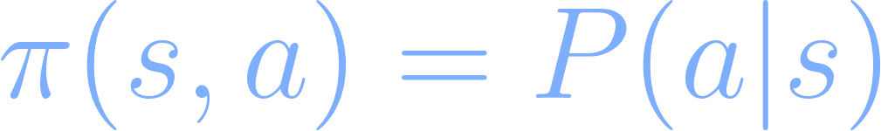
Recall: Policy
Mapping from state to action
In terms of RL, this will basically be the same thing, except now our policy will give us probabilities for actions:
Why is this?
Exploration vs. exploitation

Slide 5
Recall: Exploration vs. Exploitation
What is it?
If we continually exploit our existing knowledge, we might miss out on better opportunities
So, we should periodically explore other options
They might lead to better outcomes (rare, but why we try it)
They might lead to worse outcomes (more likely)
Restaurant example

Slide 6
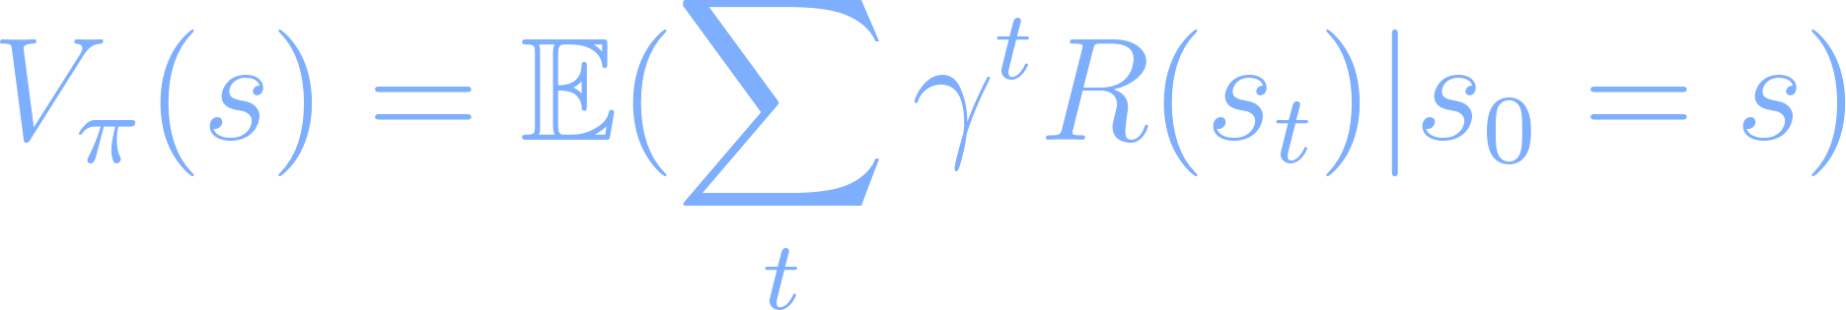
Recall: Value Function
What is it?
Function that tells us the value of being in state s if we follow our policy:
In plain English: how much my discounted cumulative reward will be if I start in state s and execute policy pi
Why is there an expected value?
Randomness in the environment (same as before)
Our policy now contains randomness (exploit vs. explore)

Slide 7
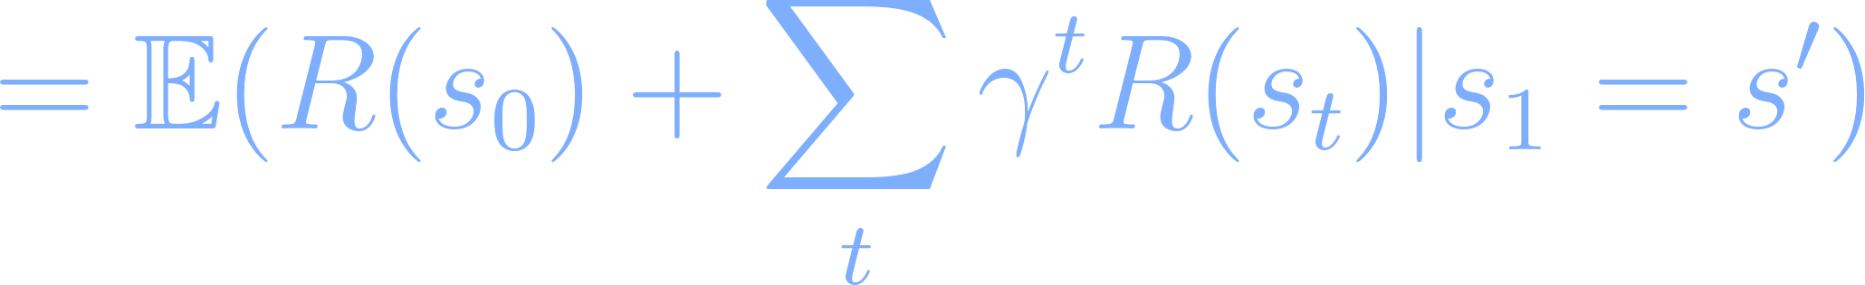
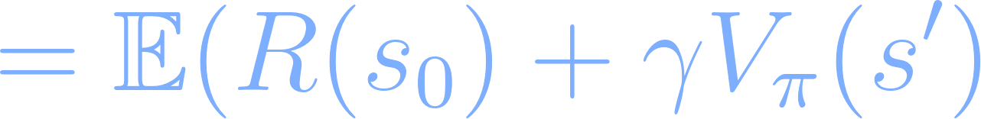
Value Function
Let’s expand the value function:

Slide 8
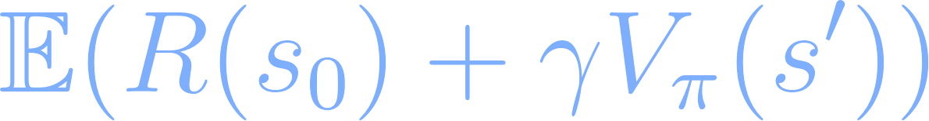
Value Function
What does this equation look like?
Bellman’s equation, except:
Now we have an expected value (again, since our policy has a random exploration aspect to it)
We have this V pi thing, instead of U*
U* was the optimal utility (utility we receive if we follow the optimal policy)
We can translate that over to this equation

Slide 9
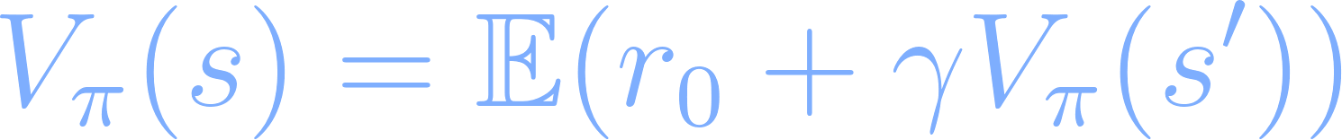
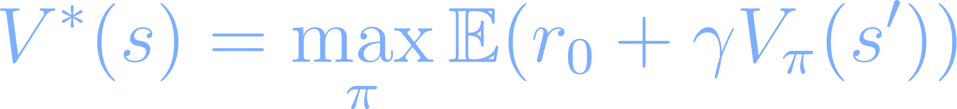
Optimal Value and Policy
Value function (re-written in the form of Bellman’s equation):
Optimal value function (value if we follow the optimal policy):
Optimal policy:

Slide 10
Optimal Value and Policy
This is pretty much what we went over for value and policy iteration, just with slightly different notation

Slide 11

Recall: Approaches to RL
What are they? (hint: there are 2)
Model-based
Model-free
There are a lot of subcategories within these two, but we’ll just maintain more of a high-level focus

Slide 12
Model-Based RL
Recall: there’s a caveat for this category
We said that, in RL, the agent doesn’t know the underlying MDP
However, with model-based RL, we say that the agent does know the underlying MDP
Several people disagree on whether this category should be considered reinforcement learning
Additionally, most focus is placed on model-free RL (we’ll discuss that a little later)

Slide 13
Model-Based RL
So, for model-based RL, we assume that the agent knows the transition model and reward function of the underlying MDP
Transition model: P(s’ | s, a)
Reward function: R(s)
In other words, the agent has a “model” of the environment
Hence the name “model-based”
What are some approaches for learning a policy in this scenario? (hint: we’ve discussed 2 in this class already)
Value iteration and policy iteration
Hopefully this makes sense because we were trying to solve the Bellman equation, and we just saw a few slides ago that the value function for RL is just the Bellman equation (with slightly different notation)
So, you’ve already seen “reinforcement learning” and are working on it with the value iteration lab without realizing it

Slide 14
Model-Free RL
The agent does not know the underlying MDP
So, the agent does not have a “model” of the environment
Hence the name “model-free”
What most people think of when dealing with reinforcement learning
Much more realistic
There are problems where you know the MDP and can use something like value iteration, but in more complex/realistic scenarios we tend to not know that information
Ex: Self-driving car (again)
Ex: Chess (we might know it, but there are so many states that we can’t enumerate everything)

Slide 15
Q-Learning
Model-free
We don’t know anything about the underlying MDP
Probably the most popular/well-known model-free RL algorithm
In approaches like value iteration and policy iteration, we learn the value and policy “separately”
In other words, there are two separate functions we’re keeping track of (the value function and the policy)
Q-learning tries to fuse these two things together so that we only have to keep track of a single function
This function is called the Q function, or “quality” function

Slide 16
Q Function
Quality function
Recall: Q(s, a) is the quality of taking action a in state s
With V(s), we just have a function of state
How good it is to be in a state
With Q(s, a), we now have a function of state and action
How good it is to take action a from state s
Viewed as a richer function than V(s), because we’re now being more granular with individual actions

Slide 17
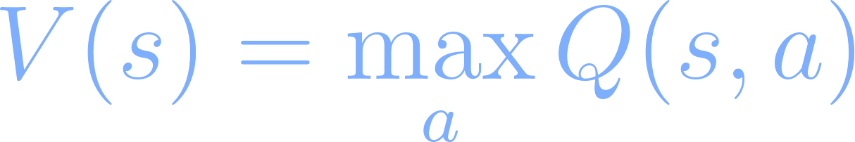
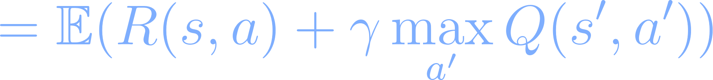
Q Function

Slide 18
Q Function
What does this equation look like?
This is also like Bellman’s equation, but now our reward function deals with states and actions

Slide 19
Q-Learning Algorithm
Instead of learning a value for each state (like what we did with value iteration), we learn values of (s, a) pairs
Similar to what we did for value iteration:
Create a table for every state and (s, a) pair
Initial Q values can be random, zero, etc.
Iteratively try different actions from different states and update the Q values in the table based on the following equation:
Note: this equation is for a deterministic environment, we’ll see the general equation you should use in a few slides
Stop once the Q values don’t change (or only change by a very small amount)

Slide 20
Q-Learning Algorithm
At each iteration of the algorithm, we can either:
Randomly choose a state to start in and just go one step
Randomly choose a state to start in and go as many steps as we need to reach a terminal state
Once a terminal state is reached, you can propagate the discounted Q-values back through the states that were visited (until the initial state is reached)
Called “episode updates”
Each sequence of states is an “episode” of running through the environment
Most common because it usually speeds up learning (and is more intuitive)
However, it might cost a lot of memory because state sequences can be long
I’ll show you an example in a little bit

Slide 21
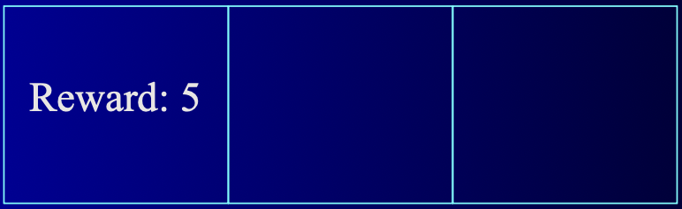
Example
3 state world:
Assume it’s deterministic
Can move left or right
If you move right in the right-most cell, you stay in that cell
Immediate reward for entering all states, except the left-most, is 0
Left-most state is terminal, and reward for entering the left-most state is 5
Let gamma = 0.6
Let the initial Q values be 0

Slide 22
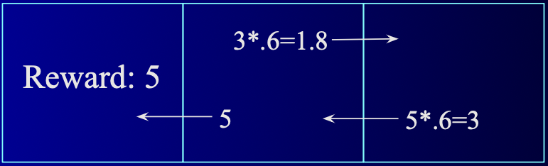
Example
Spend ~5 minutes with people around you to work on this

Slide 23
Non-Deterministic Environments
The equation we just used was for deterministic environments
However, most realistic environments (and most of the ones we’ve talked about in this class) are non-deterministic (there’s uncertainty in the world)
General update equation that should be used (derivation comes from temporal difference learning, but we won’t worry about that for this class):

Slide 24
Discussion
The Q-learning algorithm converges to the true Q values under the following conditions:
The system can modelled as an MDP
R(s, a) < c (reward is bounded)
Each state and action is visited infinitely often
What are some possible issues with the Q-learning algorithm?
The biggest issue is probably the fact that we need some sort of table to keep track of all our Q values
What happens if the environment has a lot of possible states and actions?
Using a table becomes inefficient
So, a solution to this is to somehow estimate the Q function
What is a good function approximator?
Neural network

Slide 25
Deep Q-Learning
Main idea: use a deep neural network to learn the Q function
Loss function that is typically used:
Theta represents the neural network parameters we’re trying to tune
Mean squared error
Recall the update function we saw two slides ago:
So, all we’ve done is taken the update function and turned it into a loss function

Slide 26
Note
For the loss function, we need the predicted Q values for the current state s and the predicted Q values of the next state s’
If we use the same network, learning can be unstable
What is often done in practice:
2 networks
The “main” network that we’re training
A “target” network
Copy of the “main” network that is used for predicting the next Q values (for s’)
We continuously train the “main” network
We periodically update the weights of the “target” network to have the same weights as the “main” network

Slide 27

Demo

Slide 28
Homework
Value iteration lab
Due April 1 (a week from today) at 11:59 pm

Slide 29
Next Time
Machine learning
Bonus material (remaining lectures will be bonus material)
There are some reading ideas to prepare for next time, if you are interested enough

