Slide 1
Utilities
CS 470
Ethan Pedersen

Slide 2
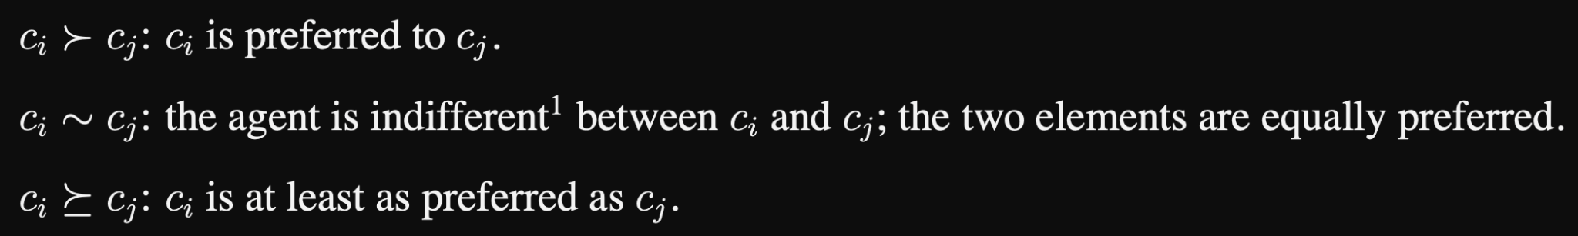
Notation

Slide 3
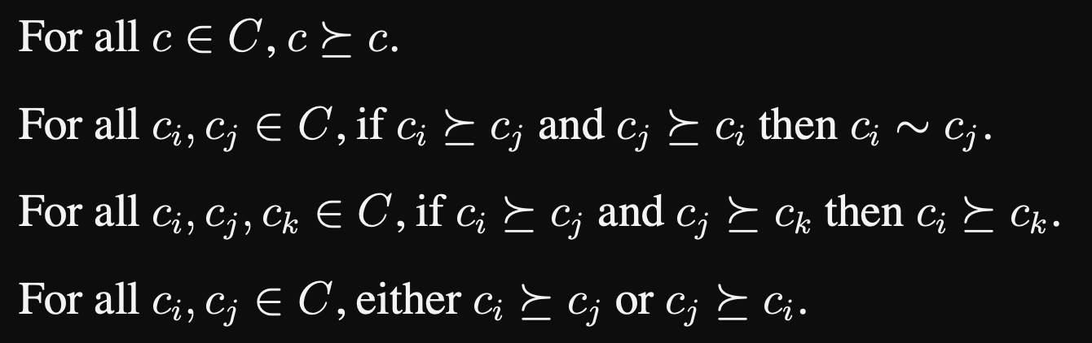
Properties
Implies that every consequence for every action is known beforehand; is this problematic?

Slide 4

Lottery
Sometimes the consequences of our actions are stochastic
Ex: If I order the pasta on an airplane, it could be good or terrible
Call these lotteries

Slide 5
Axioms
What makes an agent rational?
Need to follow 6 axioms
Constraints for utility theory
If any one is violated, we can show that the agent is irrational (at least in some situations)

Slide 6
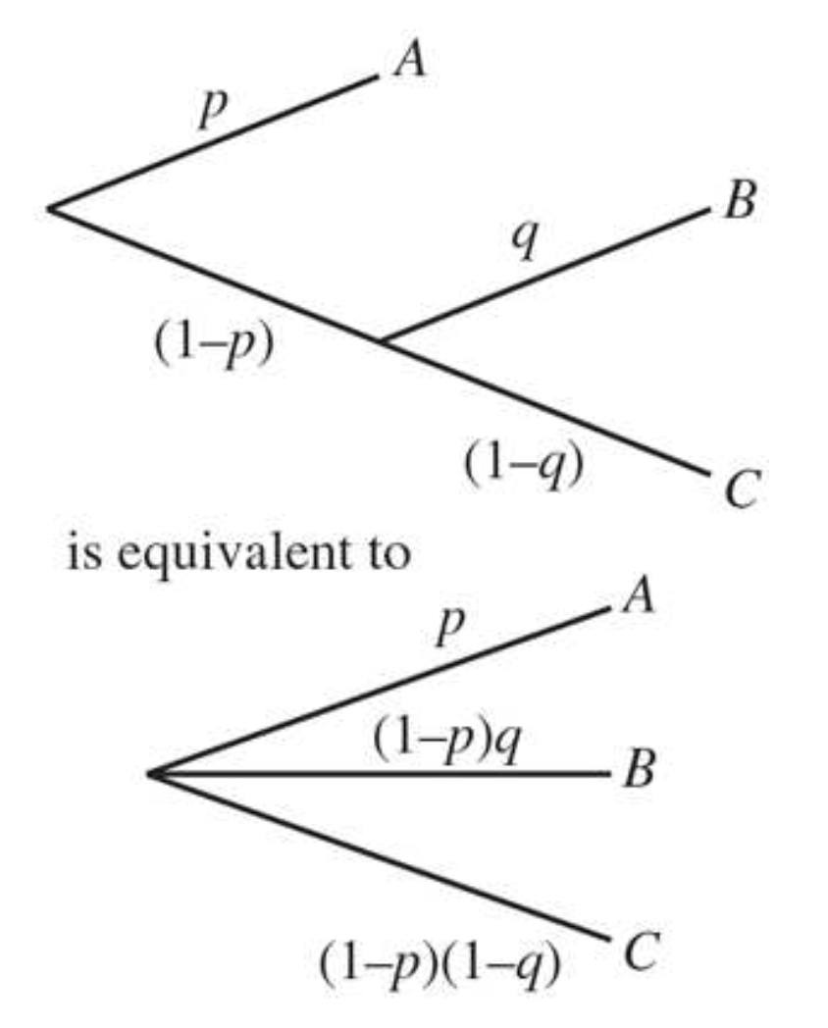
Axioms

Slide 7

Example
Let’s say that the transitivity axiom is not satisfied

Slide 8
Example
If the agent currently has A, we could offer them C for A plus one cent
The agent prefers C over A, so they would make this trade
We could then offer B for C plus one cent, because the agent prefers B over C
Finally, we can offer A for B plus one cent, because the agent prefers A over B
We’re now in a state where the agent has A, which is where we started
However, we were able to make the agent give us 3 cents
This is clearly irrational behavior

Slide 9
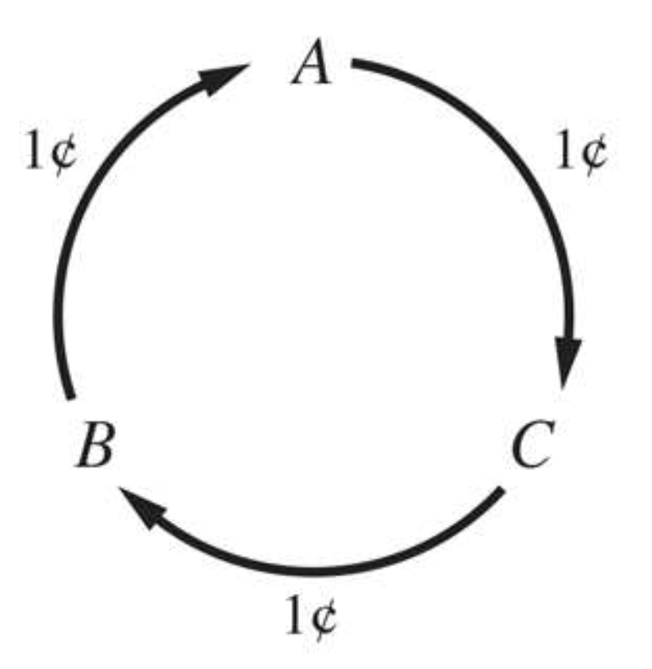
Example

Slide 10
Utility Theorem
If an agent’s preference relations satisfy the axioms of utility, then
there exists a real-valued utility function U such U(A) > U(B) iff A is preferred to B, and U(A) = U(B) iff the agent is indifferent between A and B
There could be multiple utility functions, but we know that at least one exists

Slide 11
Creating a Utility Function
By the Utility Theorem, we know that at least one utility function exists if we follow the axioms
But how do we construct one?
Let’s talk about a step-by-step procedure (algorithm) for doing this, and then we’ll prove that it works

Slide 12
Creating a Utility Function
Algorithm:
Assign a real number to the most and least preferred options
By the continuity property, we know that there exists a p such that the agent is indifferent between an option and the lottery where the most preferred option is received with probability p and the least preferred option is received with probability 1 - p
For all options, identify this p
For each option B, let U(B) = p * U(most preferred) + (1 - p) * U(least preferred)
By identifying p, we are essentially say how strongly we feel about the option

Slide 13

Example
You’re graduating soon, and you have 4 job offers:
Microsoft (software engineer)
McDonald’s (fry cook)
Walmart (clerk)
Oracle (QA)
Your preferences, from most preferable to least preferable, are:
Microsoft, Oracle, Walmart, McDonald’s
Construct a utility function that represents this preference pattern

Slide 14
Example
Step 1: Assign a real number to the most and least preferred options
Most preferred is Microsoft, least preferred is McDonald’s
U(Microsoft) = 100
U(McDonald’s) = 1

Slide 15
Example
Step 2: For all other options (Oracle and Walmart), identify a p and let U(B) = p * U(Microsoft) + (1 - p) * U(McDonald’s)
Oracle: let p = 0.9
So U(Oracle) = 0.9 * 100 + 0.1 * 1 = 90.1
Walmart: should p be greater than 0.9 or less than 0.9?
Let p = 0.2
So U(Walmart) = 0.2 * 100 + 0.8 * 1 = 20.8

Slide 16
Proof
Let’s step through the algorithm we just saw to see if this holds

Slide 17
Proof
Does this satisfy the Utility Theorem?

Slide 18
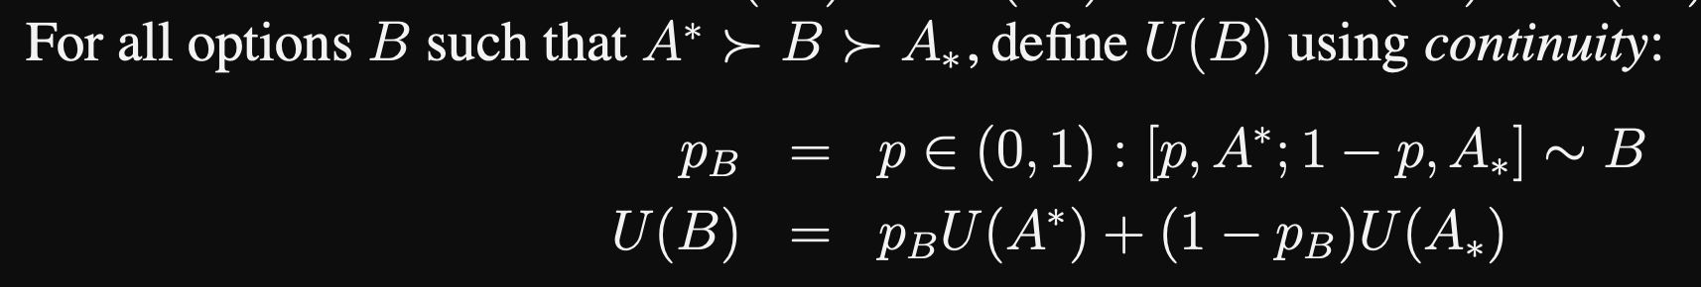
Proof

Slide 19

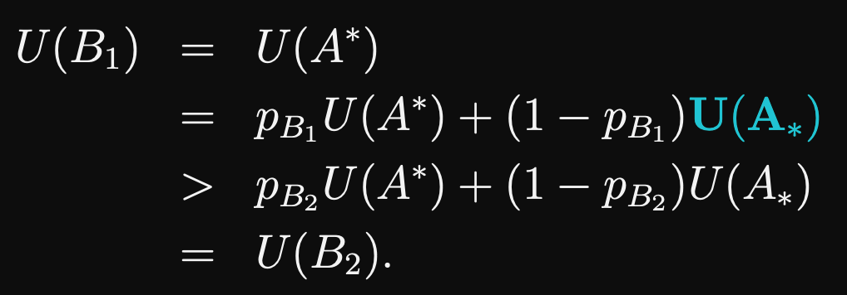
Proof
This satisfies the Utility Theorem

Slide 20

Proof
This satisfies the Utility Theorem

Slide 21
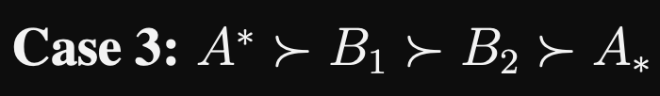
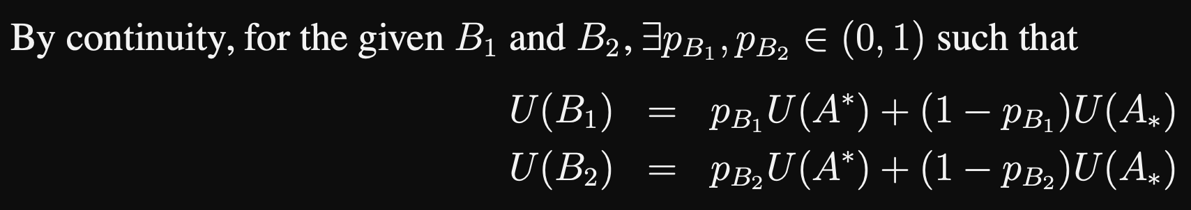
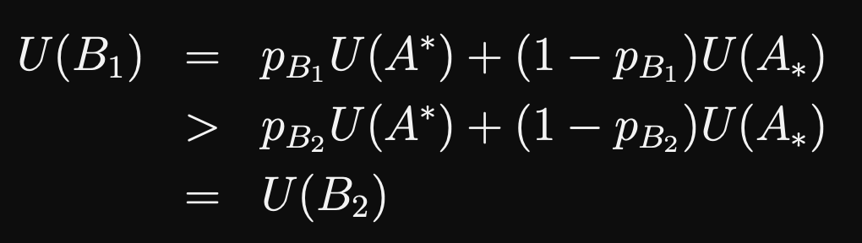
Proof
This satisfies the Utility Theorem

Slide 22
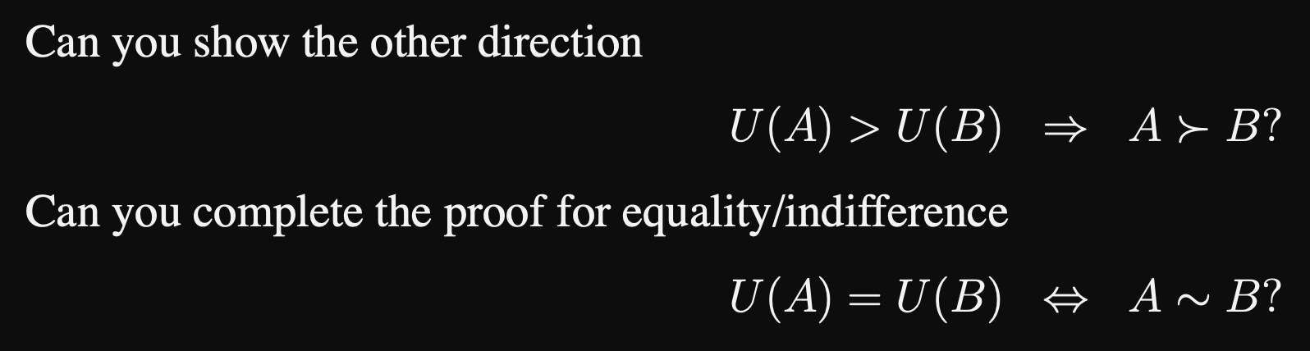
Proof

Slide 23
Homework
Finish your midterm

Slide 24
Next Time
More on decision theory
Skim the linked pdf file

