Slide 1
Value Iteration & Policy Iteration
CS 470
Ethan Pedersen

Slide 2

Recall: Markov Decision Process
Stochastic sequential problem
Markov process, but with actions
In other words, at each state we “decide” what action to take in order to reach/achieve some goal
Markov assumption still holds
In a way, this is what you were doing in the Bayes Filter lab:
Given the current state the robot was in, you chose an action to move it towards the terminal state
“MDP” is a very common acronym

Slide 3
Recall: Markov Decision Process
Four main components:
Set of states S
Set of actions for each state s in S
A(s)
Transition model P(s’ | s, a)
Probability of reaching state s’ after performing action a in state s
Does this look familiar?
Bayes Filter
Reward function for specifying the reward for each state s in S
R(s)
MDP = (S, A, R, P)

Slide 4
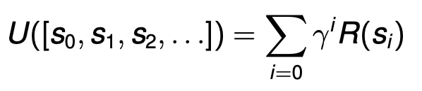

Recall: Discounted Rewards
Use a discount factor gamma between 0 and 1
The smaller it is, the less value we get from future rewards
Often something like 0.99 is used

Slide 5


Recall: How to Solve an MDP
What does a solution to an MDP problem look like?
We need to specify what the agent should do in any reachable state
We call this solution a policy, though it’s sometimes referred to as a strategy
Action that the policy tells us to take in state s

Slide 6

Recall: Optimal Policy
The policy with the largest expected utility is called the optimal policy
Notation:

Slide 7
Recall: Evaluating Policies
One approach:
For each policy we’re evaluating:
Start in the initial state
Execute the policy several times
Transitions are random
So, this gives us a distribution over state sequences induced by the policy
Each state sequence has an associated utility (ex: sum of rewards from each state)
Each state sequence has a probability of occuring
Use the rewards and probabilities of the state sequences to calculate the expected utility of the policy
Use the MEU principle to choose the policy with the largest expected utility

Slide 8
Recall: Evaluating Policies
What are some problems with this approach?
Need to have policies beforehand so that we can compare them
It’s just a way to pick from a set of policies, but none of the policies are guaranteed to be optimal

Slide 9
Finding an Optimal Policy
So, given an MDP, how do we find the optimal policy?
We’ll use expected utility and the Bellman equation

Slide 10
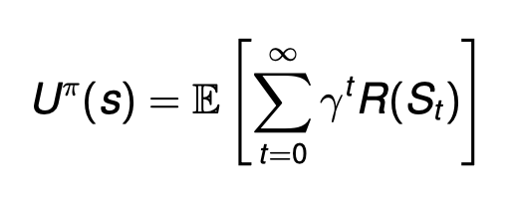
Expected Utility
Iterate through future time steps
State agent is in at time t after using policy pi
Expected utility obtained by executing a policy pi when starting in state s
Discounted reward

Slide 11
Expected Utility
In basic terms, this is how much discounted reward we expect to receive when we start in state s and execute policy pi
When we talked about the approach last lecture, this is what we meant by “Use the rewards and probabilities of the state sequences to calculate the expected utility of the policy”

Slide 12

Optimal Expected Utility
The expected utility we get from using the optimal policy
In other words, the maximum expected utility
Notation:

Slide 13
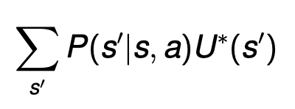
Using Utility
What if we knew what the optimal expected utility was beforehand?
Just select the action that will result in that optimal utility
Let’s assume that we know the optimal expected utility
Using this assumption, what would be the expected utility of an action a in state s?

Slide 14
Optimal Expected Utility of an Action
Probability of moving to state s’ from state s after choosing action a
Iterate over every possible state s’ we could transition to from the current state s
Optimal expected utility we receive once in state s’ (assume we know this)

Slide 15
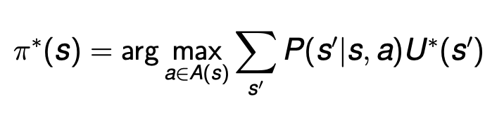
Optimal Policy
Equation we just saw (optimal expected utility of an action)
Iterate through every possible action, choose the best one

Slide 16
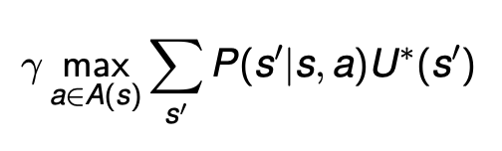
Optimal Policy
This is good and all, but there’s still a missing piece:
We made the assumption that we already know the optimal expected utility
How do we calculate the optimal expected utility?
What does the optimal utility of a state s depend on?
The reward for being in state s: R(s)
The discounted expected utility of the next state:

Slide 17
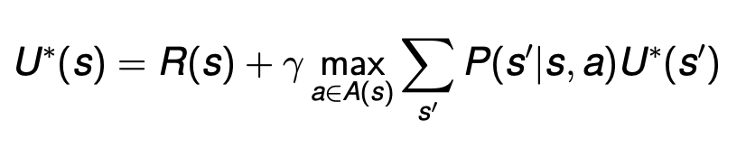
Bellman Equation
If we put these two pieces together, we get the Bellman equation (equation you should remember and be sure to understand):
First, we get an immediate reward for entering state s
Then, we get a discounted future reward by choosing optimal actions in any future states

Slide 18
Bellman Equation
Is there anything in particular you notice about this equation?
Hint: it’s something you probably discussed in CS 312
Recursive -> dynamic programming (start in the final state, work your way backwards)

Slide 19
Bellman Equation
How do we get the optimal policy out of this?
Just keep track of the actions that resulted in the maximum discounted future reward (add an “arg” to the “max”)

Slide 20
Bellman Equation
One important assumption about the Bellman equation:
The agent will act optimally in the future

Slide 21
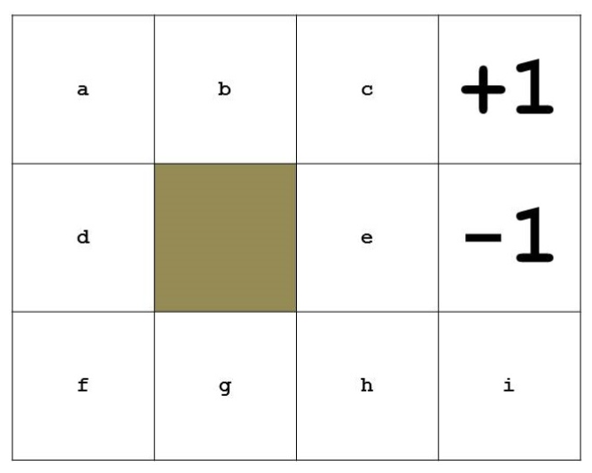
Example

Slide 22
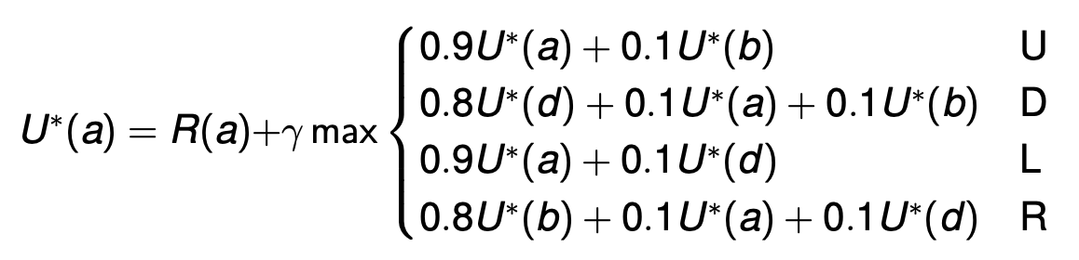
Example

Slide 23
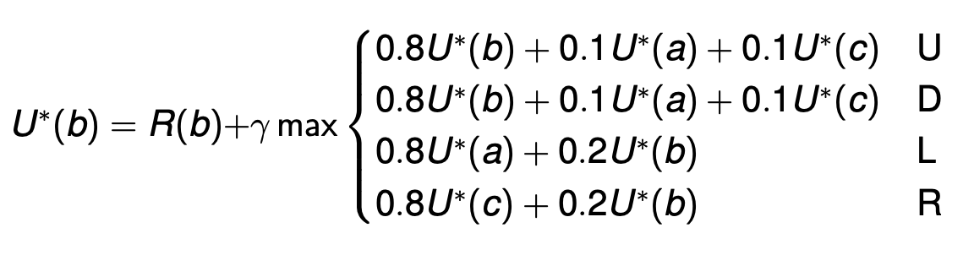
Example

Slide 24
Example
Notice that each equation is a function of the utility of other states (due to the recursive nature of the Bellman equation)

Slide 25
Solving the Bellman Equation
Due to its recursive nature, how do we actually solve the Bellman equation?
System of equations?
Unfortunately no, because the max operator is not linear
One approach we mentioned:
Start in the final states, work backwards (dynamic programming)
Are there any problems with this?
Probabilistic nature can still make the equation very difficult to work with

Slide 26
Iterative Solution
We’ll use an iterative approach to solving the Bellman equation
Basic idea:
Repeatedly update the value for each state until the values converge
When we say “converge”, we mean that when the values of the states only change by some very small amount
“Iterative” because we are repeatedly updating values

Slide 27
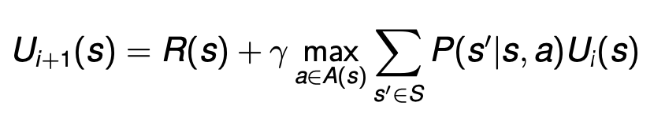
Value Iteration
Choose some small value of epsilon (ex: 0.001)
Initialize the utility U(s) arbitrarily (usually something like 0)
While the maximum U(s) change is larger than epsilon:
Update the utility values:
Update the maximum change in U(s)

Slide 28
Example
Let gamma = 0.99
Assume deterministic world
Salad 5 |  |  |  | Pizza 100
-1 | -1 | -1 | -1 | -1
-1 | -1 | -1 | -100 | -1
-1 | -1 | -1 | -1 | -1
-1 | -1 | -1 | -1 | -1

Slide 29
Example
Salad 5 |  |  |  | Pizza 100
-1 | -1 | -1 | -1 | -1
-1 | -1 | -1 | -100 | -1
-1 | -1 | -1 | -1 | -1
-1 | -1 | -1 | -1 | -1

Slide 30
Example
Salad 5 0 |  |  |  | Pizza 100 0
-1 0 | -1 0 | -1 0 | -1 0 | -1 0
-1 0 | -1 0 | -1 0 | -100 0 | -1 0
-1 0 | -1 0 | -1 0 | -1 0 | -1 0
-1 0 | -1 0 | -1 0 | -1 0 | -1 0

Slide 31
Example
Salad 5 0 |  |  |  | Pizza 100 0
-1 0 | -1 0 | -1 0 | -1 0 | -1 0
-1 0 | -1 0 | -1 0 | -100 0 | -1 0
-1 0 | -1 0 | -1 0 | -1 0 | -1 0
-1 0 | -1 0 | -1 0 | -1 0 | -1 0

Slide 32
Example
Special case:
Only need R(s)
Salad 5 0 |  |  |  | Pizza 100 0
-1 0 | -1 0 | -1 0 | -1 0 | -1 0
-1 0 | -1 0 | -1 0 | -100 0 | -1 0
-1 0 | -1 0 | -1 0 | -1 0 | -1 0
-1 0 | -1 0 | -1 0 | -1 0 | -1 0

Slide 33
Example
Special case:
Only need R(s)
Salad 5 5 0 |  |  |  | Pizza 100 0
-1 0 | -1 0 | -1 0 | -1 0 | -1 0
-1 0 | -1 0 | -1 0 | -100 0 | -1 0
-1 0 | -1 0 | -1 0 | -1 0 | -1 0
-1 0 | -1 0 | -1 0 | -1 0 | -1 0

Slide 34
Example
Salad 5 5 0 |  |  |  | Pizza 100 0
-1 0 | -1 0 | -1 0 | -1 0 | -1 0
-1 0 | -1 0 | -1 0 | -100 0 | -1 0
-1 0 | -1 0 | -1 0 | -1 0 | -1 0
-1 0 | -1 0 | -1 0 | -1 0 | -1 0

Slide 35
Example
Up:
0.99 * 0
= 0
Salad 5 5 0 |  |  |  | Pizza 100 0
-1 0 | -1 0 | -1 0 | -1 0 | -1 0
-1 0 | -1 0 | -1 0 | -100 0 | -1 0
-1 0 | -1 0 | -1 0 | -1 0 | -1 0
-1 0 | -1 0 | -1 0 | -1 0 | -1 0
Left:
0.99 * 0
= 0
Right:
0.99 * 0
= 0
Down:
0.99 * 0
= 0

Slide 36
Example
Up:
0.99 * 0
= 0
Salad 5 5 0 |  |  |  | Pizza 100 0
-1 0 | -1 0 | -1 0 | -1 0 | -1 0
-1 0 | -1 0 | -1 0 | -100 | -1 0
-1 0 | -1 0 | -1 0 | -1 0 | -1 0
-1 0 | -1 0 | -1 0 | -1 0 | -1 0
Left:
0.99 * 0
= 0
Right:
0.99 * 0
= 0
Down:
0.99 * 0
= 0

Slide 37
Example
Up:
-1 + 0
= -1
Salad 5 5 0 |  |  |  | Pizza 100 0
-1 -1 0 | -1 0 | -1 0 | -1 0 | -1 0
-1 0 | -1 0 | -1 0 | -100 0 | -1 0
-1 0 | -1 0 | -1 0 | -1 0 | -1 0
-1 0 | -1 0 | -1 0 | -1 0 | -1 0

Slide 38
Example
Salad 5 5 0 |  |  |  | Pizza 100 0
-1 -1 0 | -1 0 | -1 0 | -1 0 | -1 0
-1 0 | -1 0 | -1 0 | -100 0 | -1 0
-1 0 | -1 0 | -1 0 | -1 0 | -1 0
-1 0 | -1 0 | -1 0 | -1 0 | -1 0

Slide 39
Example
Up:
0.99 * 0
= 0
Salad 5 5 0 |  |  |  | Pizza 100 0
-1 -1 0 | -1 0 | -1 0 | -1 0 | -1 0
-1 0 | -1 0 | -1 0 | -100 0 | -1 0
-1 0 | -1 0 | -1 0 | -1 0 | -1 0
-1 0 | -1 0 | -1 0 | -1 0 | -1 0
Left:
0.99 * 0
= 0
Right:
0.99 * 0
= 0
Down:
0.99 * 0
= 0

Slide 40
Example
Up:
0.99 * 0
= 0
Salad 5 5 0 |  |  |  | Pizza 100 0
-1 -1 0 | -1 0 | -1 0 | -1 0 | -1 0
-1 0 | -1 0 | -1 0 | -100 0 | -1 0
-1 0 | -1 0 | -1 0 | -1 0 | -1 0
-1 0 | -1 0 | -1 0 | -1 0 | -1 0
Left:
0.99 * 0
= 0
Right:
0.99 * 0
= 0
Down:
0.99 * 0
= 0

Slide 41
Example
Up:
-1 + 0
= -1
Salad 5 5 0 |  |  |  | Pizza 100 0
-1 -1 0 | -1 -1 0 | -1 0 | -1 0 | -1 0
-1 0 | -1 0 | -1 0 | -100 0 | -1 0
-1 0 | -1 0 | -1 0 | -1 0 | -1 0
-1 0 | -1 0 | -1 0 | -1 0 | -1 0

Slide 42
Example
After the first iteration, our estimates should just be the immediate rewards
Salad 5 5 |  |  |  | Pizza 100 100
-1 -1 | -1 -1 | -1 -1 | -1 -1 | -1 -1
-1 -1 | -1 -1 | -1 -1 | -100 -100 | -1 -1
-1 -1 | -1 -1 | -1 -1 | -1 -1 | -1 -1
-1 -1 | -1 -1 | -1 -1 | -1 -1 | -1 -1
Max change: 100

Slide 43
Example
Salad 5 5 |  |  |  | Pizza 100 100
-1 -1 | -1 -1 | -1 -1 | -1 -1 | -1 -1
-1 -1 | -1 -1 | -1 -1 | -100 -100 | -1 -1
-1 -1 | -1 -1 | -1 -1 | -1 -1 | -1 -1
-1 -1 | -1 -1 | -1 -1 | -1 -1 | -1 -1

Slide 44
Example
Up:
0.99 * 5
= 4.95
Salad 5 5 |  |  |  | Pizza 100 100
-1 -1 | -1 -1 | -1 -1 | -1 -1 | -1 -1
-1 -1 | -1 -1 | -1 -1 | -100 -100 | -1 -1
-1 -1 | -1 -1 | -1 -1 | -1 -1 | -1 -1
-1 -1 | -1 -1 | -1 -1 | -1 -1 | -1 -1
Left:
0.99 * -1
= -0.99
Right:
0.99 * -1
= -0.99
Down:
0.99 * -1
= -0.99

Slide 45
Example
Up:
0.99 * 5
= 4.95
Salad 5 5 |  |  |  | Pizza 100 100
-1 -1 | -1 -1 | -1 -1 | -1 -1 | -1 -1
-1 -1 | -1 -1 | -1 -1 | -100 -100 | -1 -1
-1 -1 | -1 -1 | -1 -1 | -1 -1 | -1 -1
-1 -1 | -1 -1 | -1 -1 | -1 -1 | -1 -1
Left:
0.99 * -1
= -0.99
Right:
0.99 * -1
= -0.99
Down:
0.99 * -1
= -0.99

Slide 46
Example
Up:
-1 + 4.95
= 3.95
Salad 5 5 |  |  |  | Pizza 100 100
3.95 -1 -1 | -1 -1 | -1 -1 | -1 -1 | -1 -1
-1 -1 | -1 -1 | -1 -1 | -100 -100 | -1 -1
-1 -1 | -1 -1 | -1 -1 | -1 -1 | -1 -1
-1 -1 | -1 -1 | -1 -1 | -1 -1 | -1 -1

Slide 47
Example
Salad 5 5 |  |  |  | Pizza 100 100
3.95 -1 -1 | -1 -1 | -1 -1 | -1 -1 | -1 -1
-1 -1 | -1 -1 | -1 -1 | -100 -100 | -1 -1
-1 -1 | -1 -1 | -1 -1 | -1 -1 | -1 -1
-1 -1 | -1 -1 | -1 -1 | -1 -1 | -1 -1

Slide 48
Example
Up:
0.99 * -1
= -0.99
Salad 5 5 |  |  |  | Pizza 100 100
3.95 -1 -1 | -1 -1 | -1 -1 | -1 -1 | -1 -1
-1 -1 | -1 -1 | -1 -1 | -100 -100 | -1 -1
-1 -1 | -1 -1 | -1 -1 | -1 -1 | -1 -1
-1 -1 | -1 -1 | -1 -1 | -1 -1 | -1 -1
Left:
0.99 * -1
= -0.99
Right:
0.99 * -1
= -0.99
Down:
0.99 * -1
= -0.99

Slide 49
Example
Up:
0.99 * -1
= -0.99
Salad 5 5 |  |  |  | Pizza 100 100
3.95 -1 -1 | -1 -1 | -1 -1 | -1 -1 | -1 -1
-1 -1 | -1 -1 | -1 -1 | -100 -100 | -1 -1
-1 -1 | -1 -1 | -1 -1 | -1 -1 | -1 -1
-1 -1 | -1 -1 | -1 -1 | -1 -1 | -1 -1
Left:
0.99 * -1
= -0.99
Right:
0.99 * -1
= -0.99
Down:
0.99 * -1
= -0.99

Slide 50
Example
Up:
-1 - 0.99
= -1.99
Salad 5 5 |  |  |  | Pizza 100 100
3.95 -1 -1 | -1.99 -1 -1 | -1 -1 | -1 -1 | -1 -1
-1 -1 | -1 -1 | -1 -1 | -100 -100 | -1 -1
-1 -1 | -1 -1 | -1 -1 | -1 -1 | -1 -1
-1 -1 | -1 -1 | -1 -1 | -1 -1 | -1 -1

Slide 51
Value Iteration
States near terminal states change the most at first, then the changes propagate to other states
Eventually leads to the optimal policy
Issues with this?
Computational complexity: what if our state and/or action space is very large?
Benefits:
Simple
Guaranteed to solve the Bellman equation (i.e. give us an optimal policy) if run infinitely-many times
In practice, using epsilon as a change cutoff is sufficient

Slide 52
Motivation for Policy Iteration
We often know the optimal policy before value iteration converges
In other words, we can know to do (or not do) something without the exact value
Similar to pruning

Slide 53
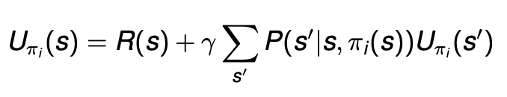
Policy Iteration
Begin with a random policy
While our policy changes:
Use the Bellman equation to determine the utility of each state if our policy is executed
No more max operator, so we can use linear algebra to solve the system of equations:
Update the policy so that it chooses the best action

Slide 54
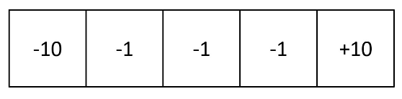
Example

Slide 55
Example
What are the states?
Rooms
What are the actions?
Left, right
Transition model?
Let’s say that the probability of moving correctly is 0.7, the probability of staying is 0.2, and the probability of moving in the unintended direction is 0.1
Reward function?
Shown in the picture
For simplicity, let the discount factor be 1

Slide 56
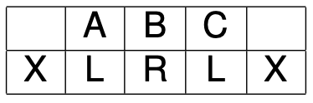
Example
Set an initial policy:

Slide 57
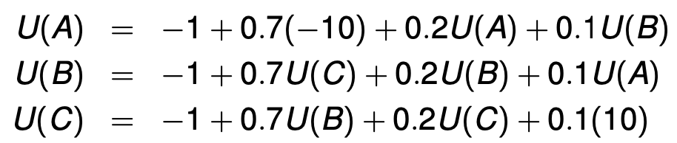
Example
Use the Bellman equation to get the following system of equations:

Slide 58

Example
Use the Bellman equation to get the following system of equations:
Solution:

Slide 59

Example
Update policy:

Slide 60
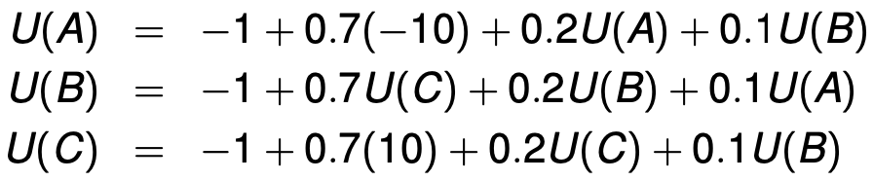
Example
Use the Bellman equation to get the following system of equations:

Slide 61

Example
Use the Bellman equation to get the following system of equations:
Solution:

Slide 62

Example
Update policy:

Slide 63
Example
After the third iteration, the policy doesn’t change, so the algorithm completes

Slide 64
Policy Iteration vs. Value Iteration
When should we use one vs. the other?
Policy Iteration:
Smaller state spaces (the more states, the larger our system of equations will be)
Value Iteration:
Larger state spaces
However, this can still fall apart for extremely large spaces
In these scenarios, we usually use value function approximation
What is a good function approximator?
Neural networks

Slide 65
Homework
COVID mini project
Due Wednesday by 11:59 pm
Value iteration lab
Due April 1 by 11:59 pm

Slide 66
Value Iteration Lab
Do one of the following:
Add value iteration to your Bayes Filter lab so that the robot can run in automatic mode (rather than you manually controlling the robot, your value iteration algorithm helps guide the robot)
Implement the MDP model and value iteration on a paper titled “A Markov Decision Process Model to Guide Treatment of Abdominal Aortic Aneurysms”
Domain of your choice, where you use value iteration to solve a problem
Ask Jared if the domain is acceptable

Slide 67
Next Time
Partially Observable MDPs (POMDPs)
Skim the linked Wikipedia page
Will probably also start talking about reinforcement learning

