Slide 1
Potential Fields
CS 470
Ethan Pedersen

Slide 2
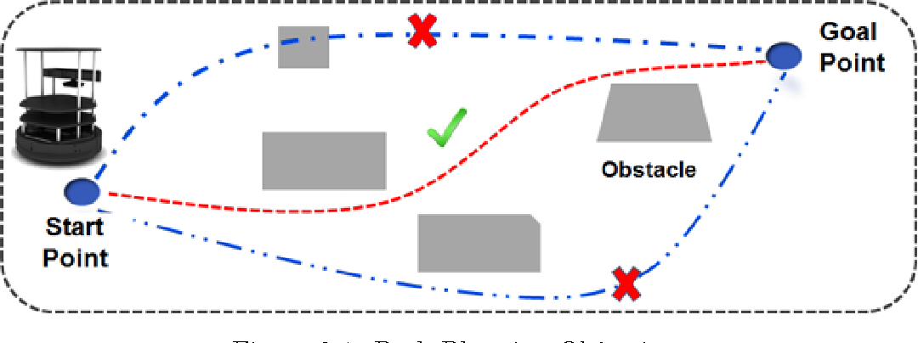
Path Planning
Process of determining a sequence of actions for a robot to move from a start location to a goal location while avoiding obstacles
Essential for autonomous robots and drones to navigate through dynamic environments

Slide 3
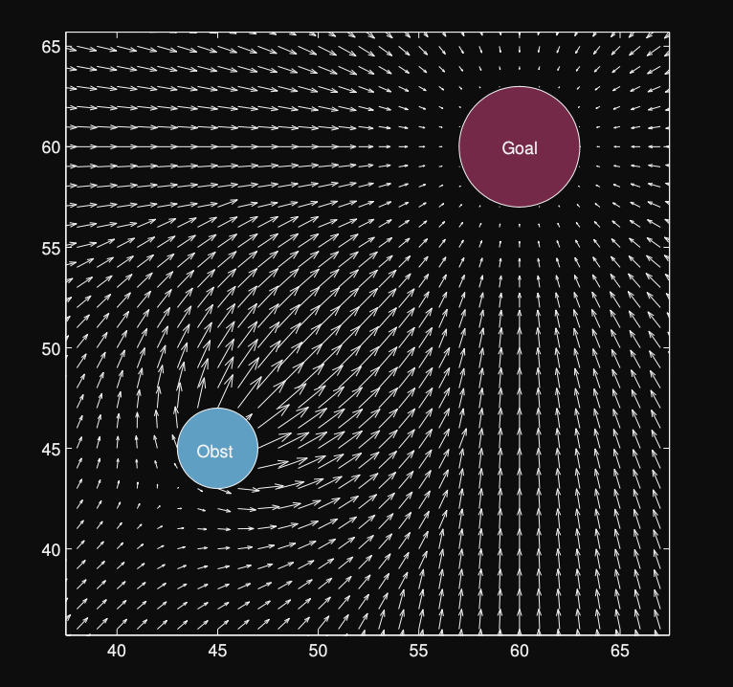
Potential Fields
Inspired by physics
Represent a way to guide a robot using attractive and repulsive forces
Minimize a cost function to find an optimal path based on attractive and repulsive forces

Slide 4
Reflex vs. Utility Agents
Using potential fields to reach a goal while avoiding obstacles is an example of a reflex agent
Reflex agents:
Pre-planning
Respond to environment percepts via a set of rules
Can be thought of as a policy
Utility agents:
Act to optimize a utility function
Ex: Doctor recommending cancer treatment (from last time)

Slide 5
Configuration Space
Represents all possible positions and orientations of the robot
Divided into free space and obstacle space

Slide 6
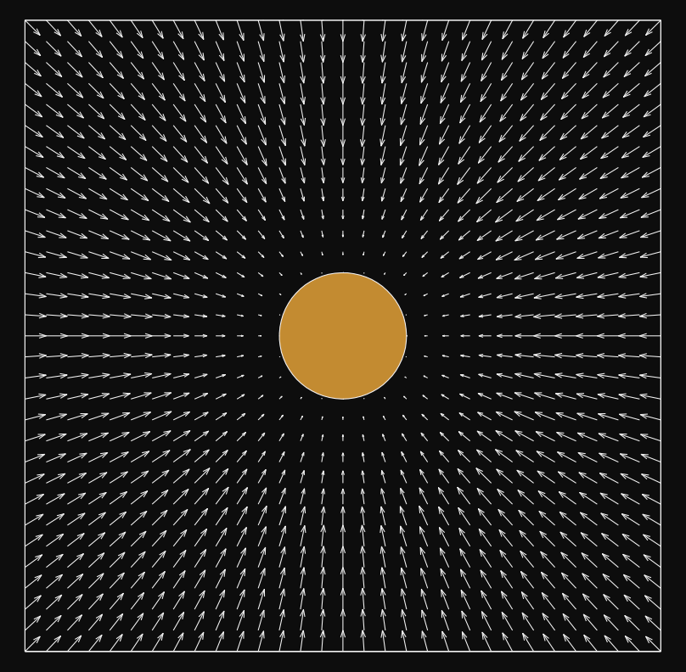
Potential Field Function
Maps elements in the configuration space to vectors
Vectors of (x, y) position coordinates to direction vectors
If we mapped every position to a vector, we would get:

Slide 7
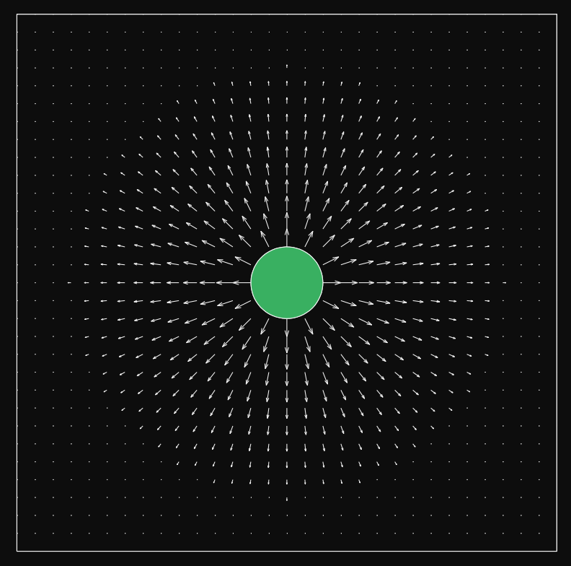
Forces
Attractive and repulsive
Attractive:
Goal
Other elements like recharge stations
Repulsive:
Obstacles
Walls
Holes
Explosive mines

Slide 8


Mapping

Slide 9
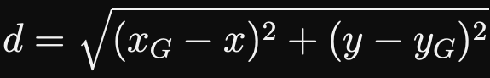
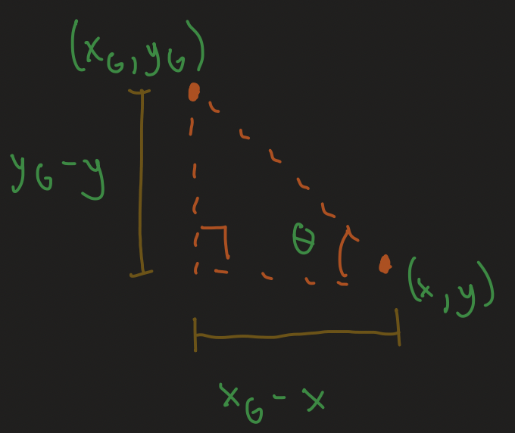
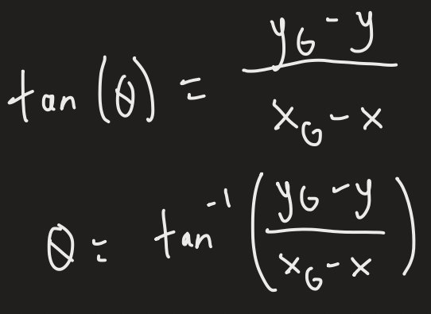
Attractive
Distance:
Theta (angle between position and goal):

Slide 10
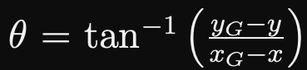
Attractive
Distance:
Theta (angle between position and goal):

Slide 11








Attractive (continued)

Slide 12
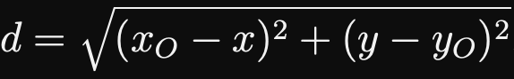

Repulsive

Slide 13





Repulsive (continued)

Slide 14
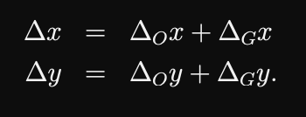
Combine Forces
Sum the attractive and repulsive forces

Slide 15

Algorithm
Initialize:
Set initial and goal positions
Define obstacle positions
Update Potential Fields:
Calculate attractive and repulsive potentials
Compute Total Force:
Sum attractive and repulsive forces
Update Robot's Position:
Move the robot in the direction of the total force
Repeat:
Iterate until the robot reaches the goal or a predetermined condition is met

Slide 16
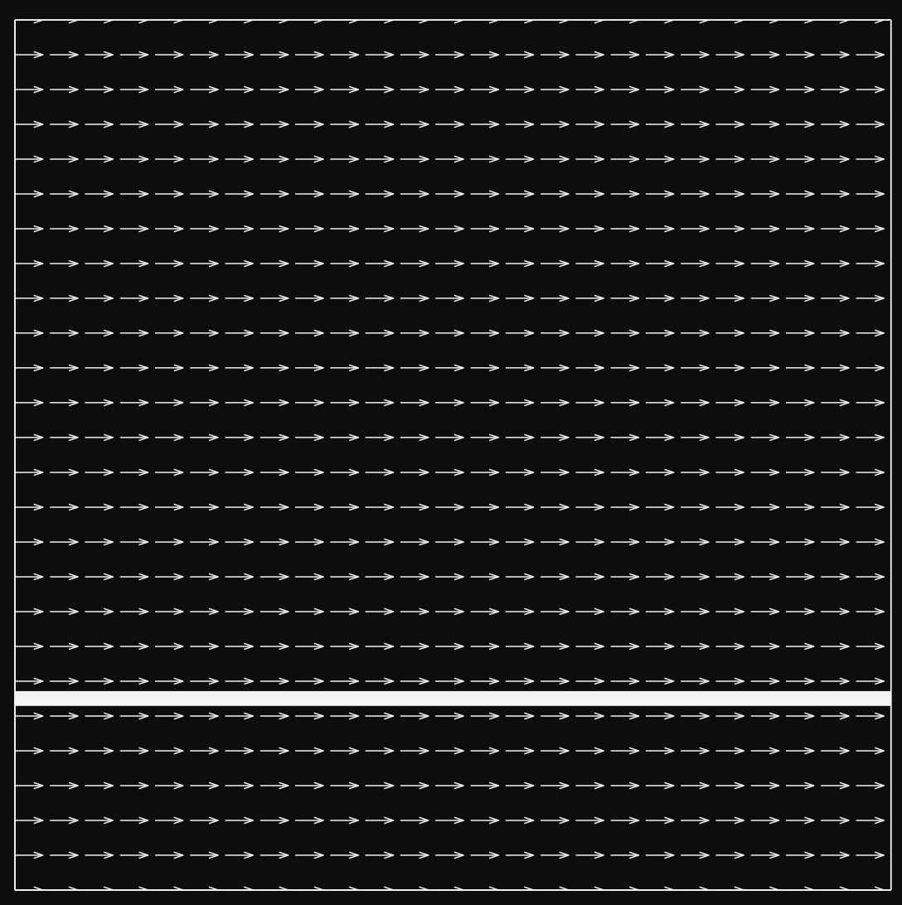
Uniform Potential Field

Slide 17
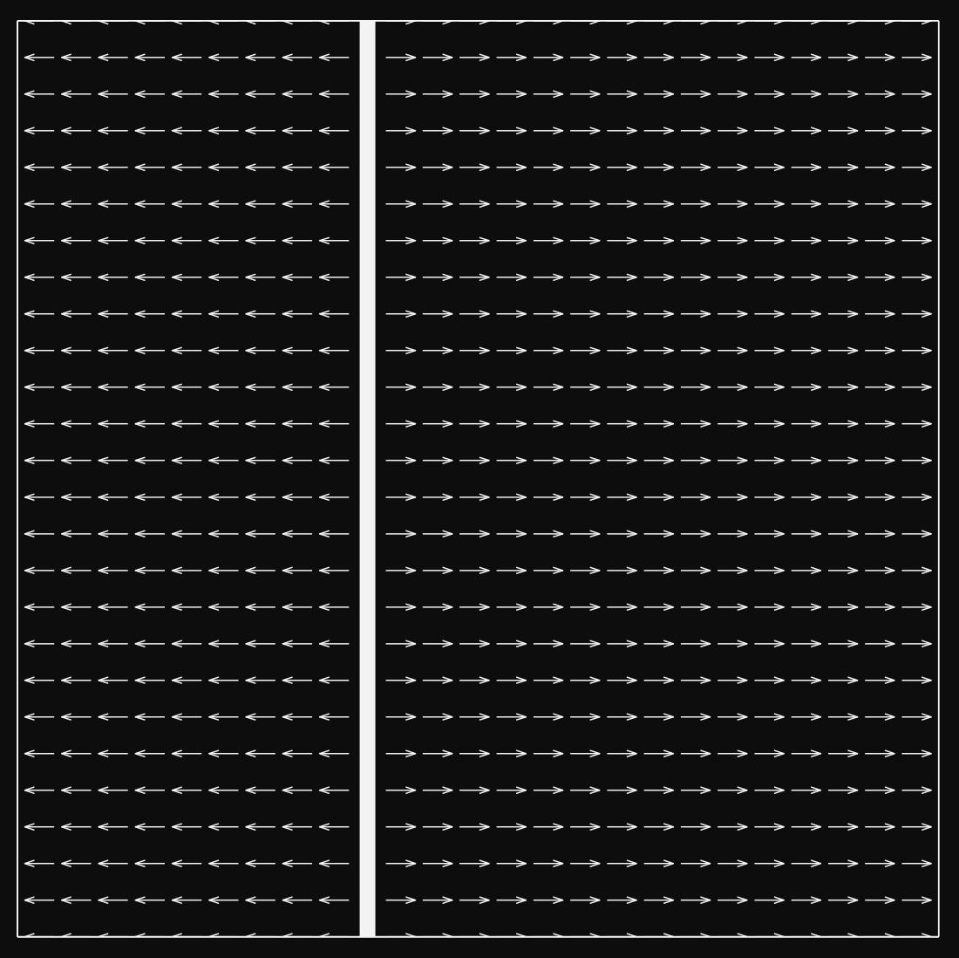
Perpendicular Potential Field

Slide 18
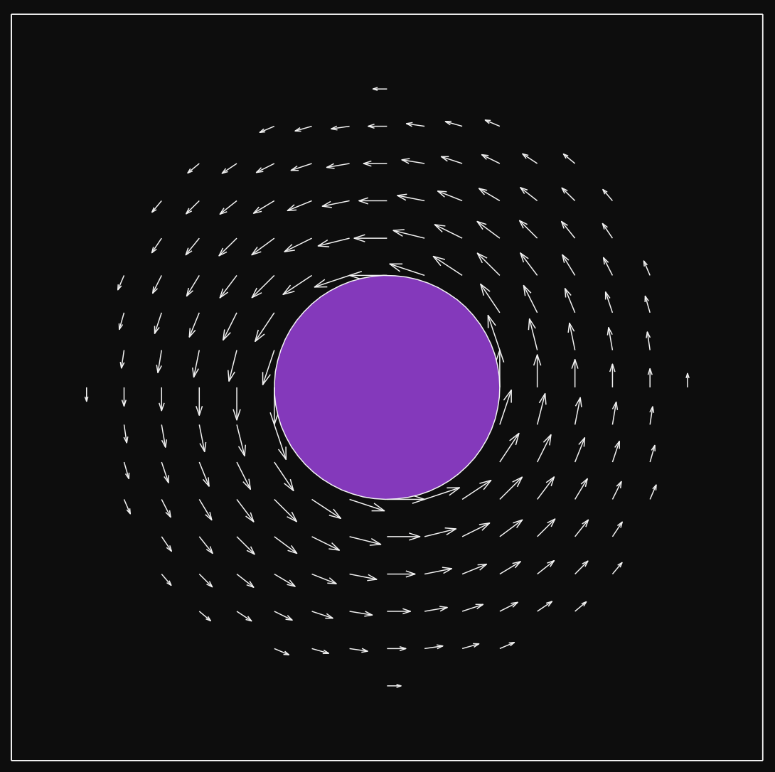
Tangential Potential Field

Slide 19
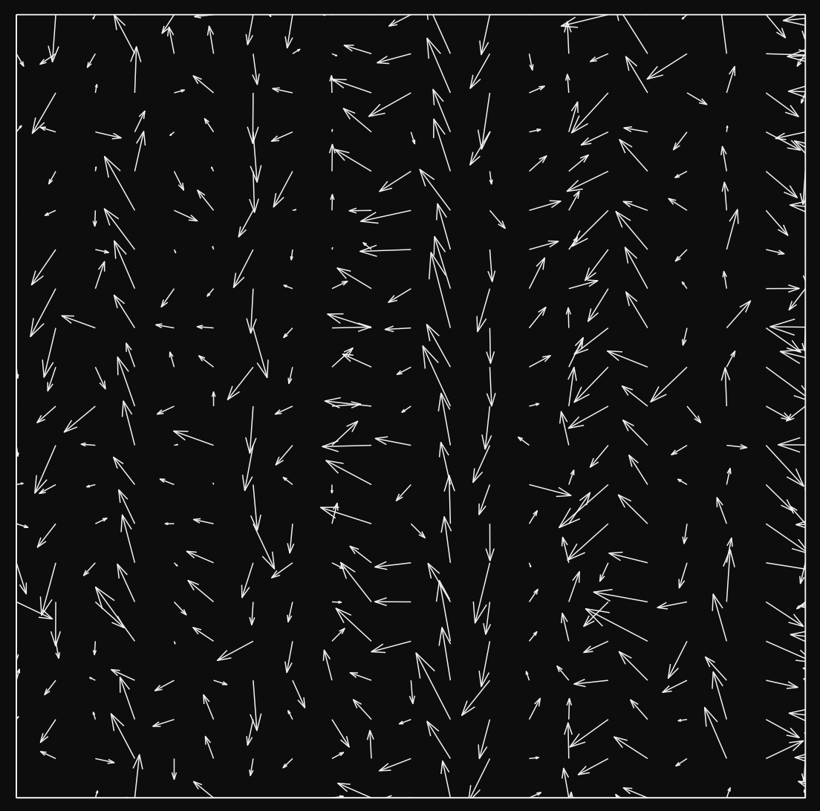
Random Potential Field

Slide 20
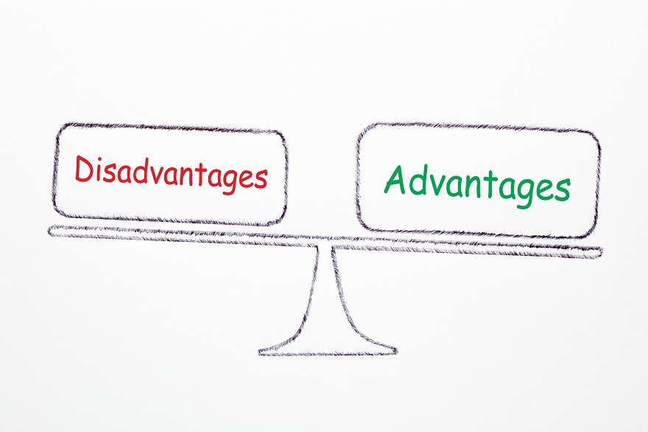
Advantages
Relatively simple
Easy to implement
Very effective in static environments

Slide 21
Disadvantages
Repulsive forces might prevent robot from reaching goal
Ex: Goal is in between a narrow alleyway
Might get stuck in local minima

Slide 22
Common Assumptions When Using a Reflex Agent
Fully observable environment
Deterministic environment
What if we decide to move 90 degrees to the right but we end up moving 85 degrees?
Single-step decisions
Don’t need to worry about long-term consequences
“Myopic”
No learning/adaptation required
Must act quickly

Slide 23
When to Use a Reflex Agent
The environment is fully observable
The environment is deterministic
There is little time for deliberation (i.e. we must act quickly/instantaneously)
No learning or adaptation is required

Slide 24

Lab Demo

Slide 25
Homework
Mini lab due Friday
Can work with other people
Submit brief writeup (instructions on Learning Suite)
Don’t spend more than 3 to 4 hours on it (unless you want to)

Slide 26
Next Time
Game playing with the minimax algorithm
Skim the linked Wikipedia article

