Slide 1
Introduction to Artificial Intelligence
CS 470
Ethan Pedersen

Slide 2
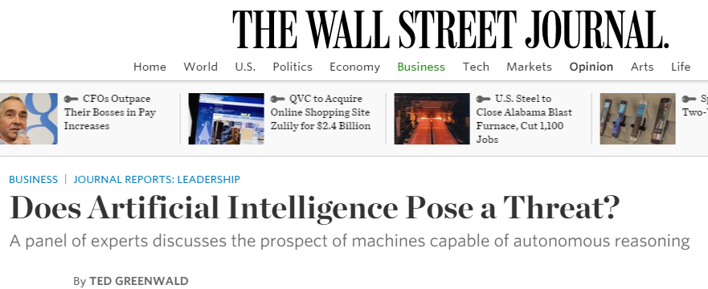
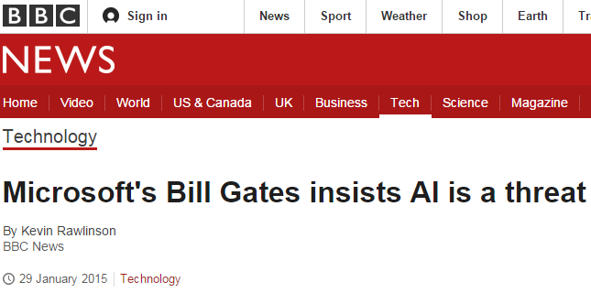
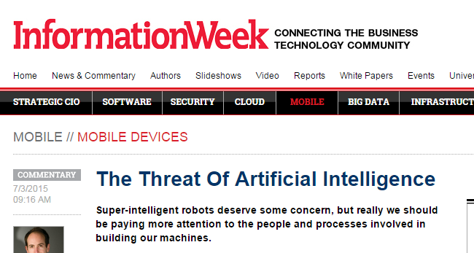
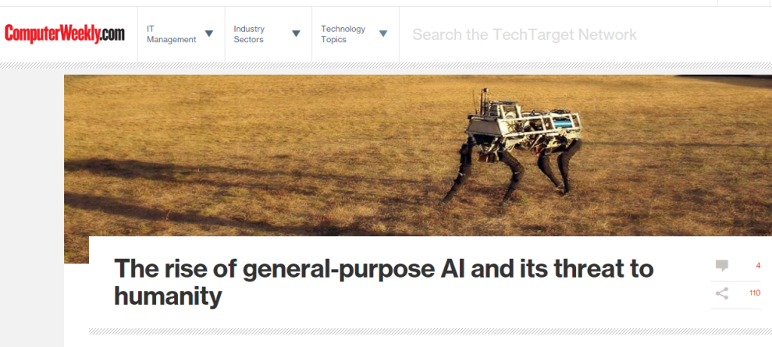
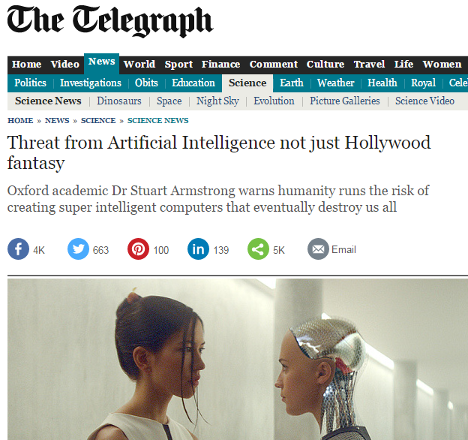
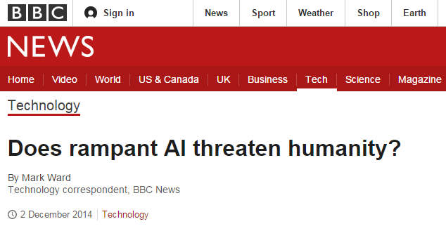
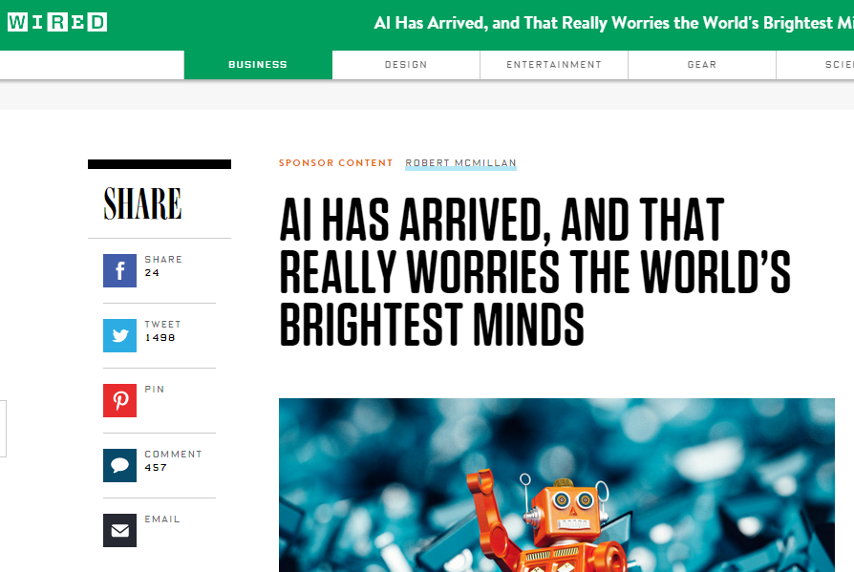
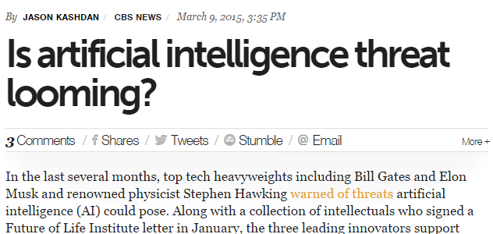

Slide 3
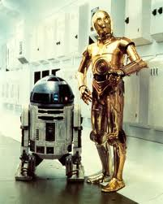
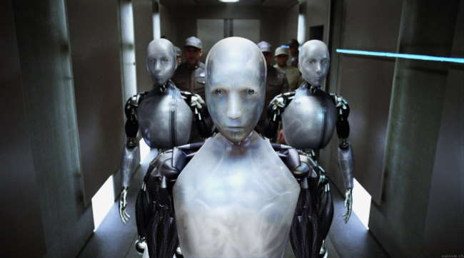
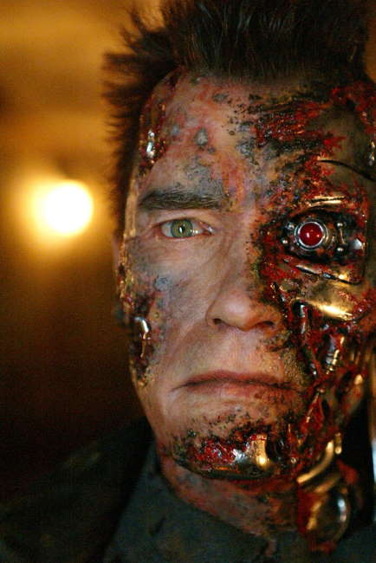
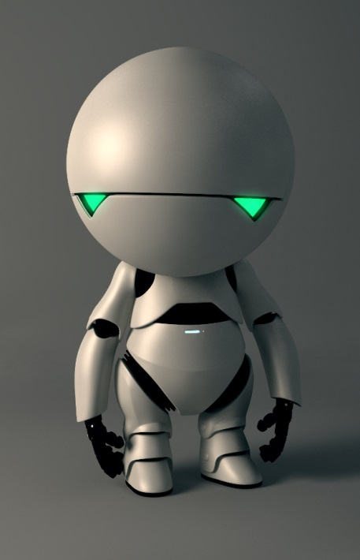
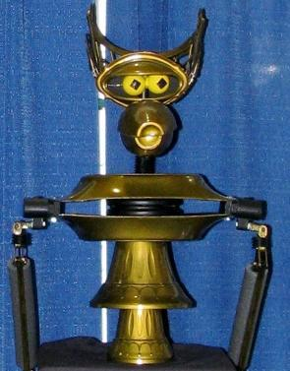
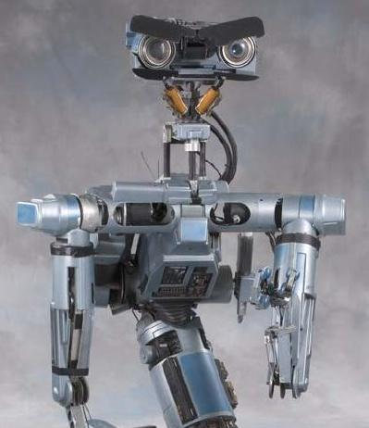
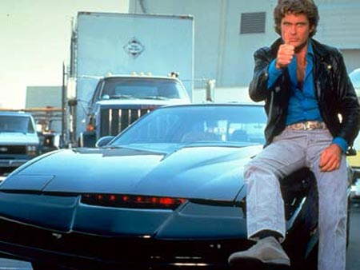
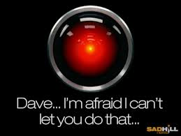

Slide 4
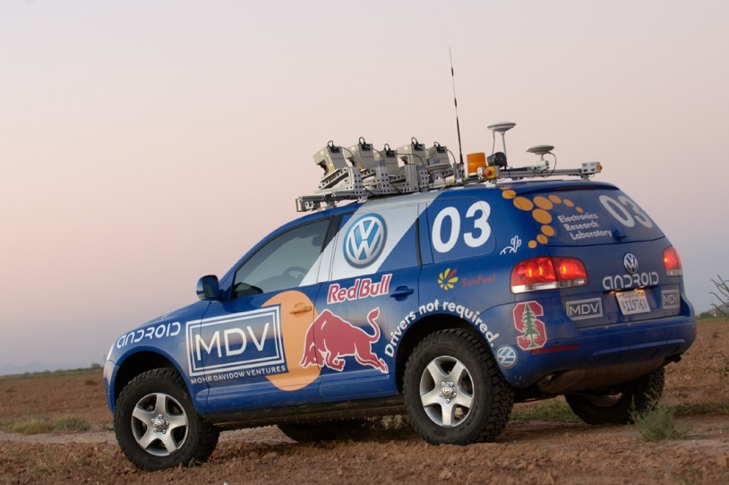
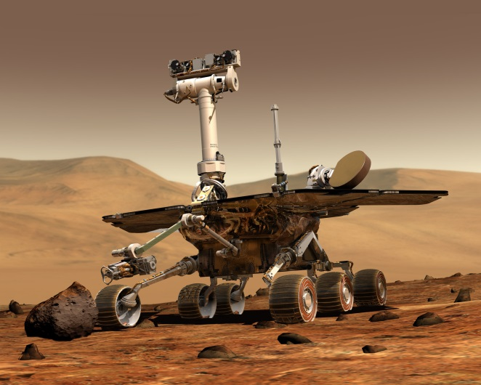
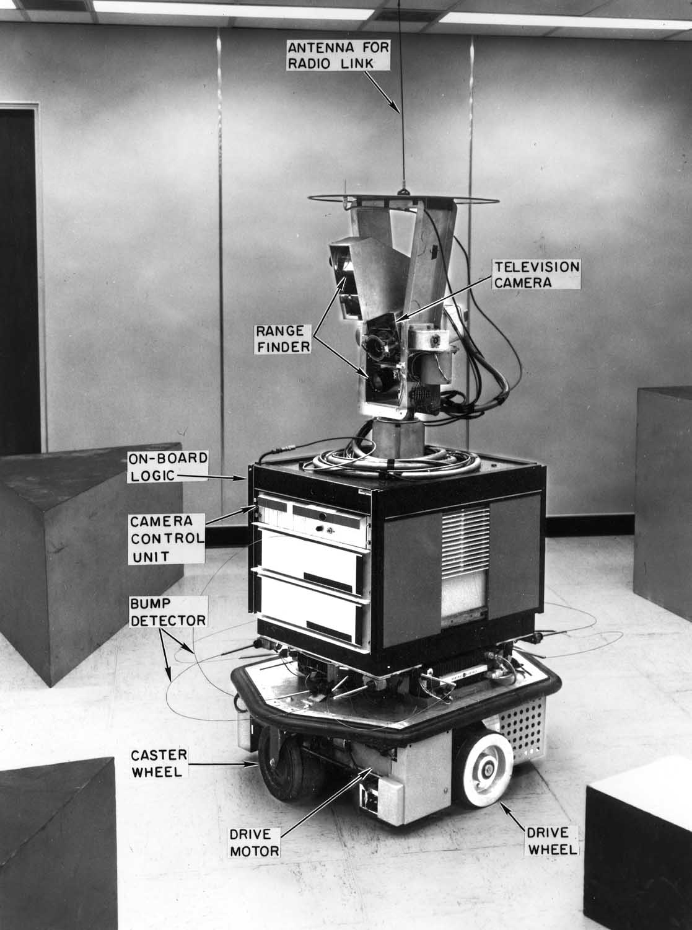
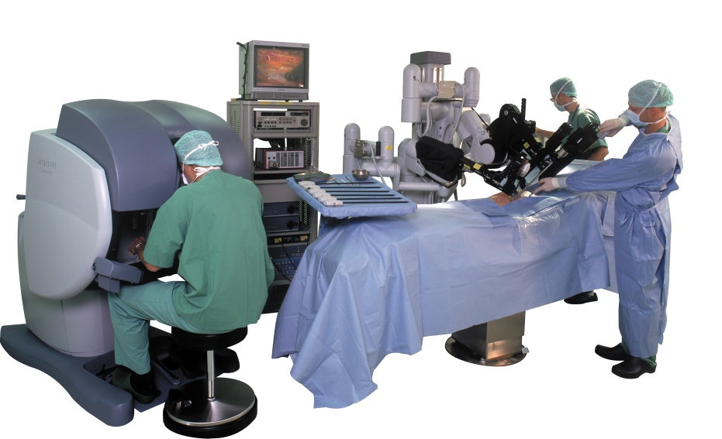
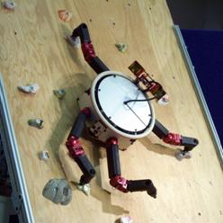
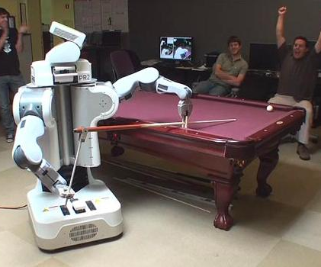
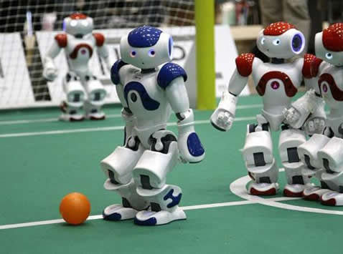


Slide 5
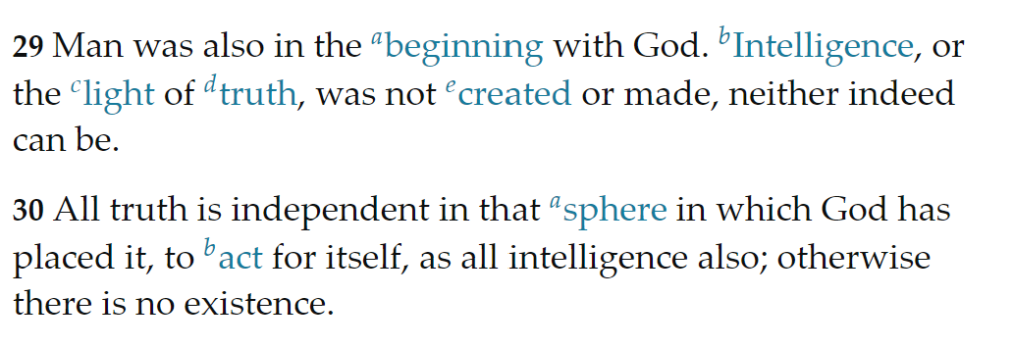
What is Artificial Intelligence?
Perhaps first, what is intelligence?
D&C 93:29-30

Slide 6
Defining AI
“The exciting new effort to make computers think . . . machines with minds, in the full and literal sense.” (Haugeland, 1985) “[The automation of] activities that we associate with human thinking, activities such as decision-making, problem solving, learning. . .” (Bellman, 1978) | “The study of mental faculties through the use of computational models” (Charniak and McDermott, 1985) “The study of the computations that make it possible to perceive, reason, and act” (Winston, 1992)
“The art of creating machines that perform functions that require intelligence when performed by people.” (Kurzwil, 1990) “The study of how to make computers do things at which, at the moment, people are better.” (Rich and Knight, 1991) | “Computational Intelligence is the study of the design of intelligent agents” (Poole et al., 1998) “AI . . . is concerned with intelligent behaviour in artifacts.” (Nilsson, 1998)

Slide 7
Defining AI
Thinking Humanly “The exciting new effort to make computers think . . . machines with minds, in the full and literal sense.” (Haugeland, 1985) “[The automation of] activities that we associate with human thinking, activities such as decision-making, problem solving, learning. . .” (Bellman, 1978) | Thinking Rationally “The study of mental faculties through the use of computational models.” (Charniak and McDermott, 1985) “The study of the computations that make it possible to perceive, reason, and act.” (Winston, 1992)
Acting Humanly “The art of creating machines that perform functions that require intelligence when performed by people.” (Kurzwil, 1990) “The study of how to make computers do things at which, at the moment, people are better.” (Rich and Knight, 1991) | Acting Rationally “Computational Intelligence is the study of the design of intelligent agents.” (Poole et al., 1998) “AI . . . is concerned with intelligent behaviour in artifacts.” (Nilsson, 1998)

Slide 8
Think like humans | Think rationally
Act like humans | Act rationally

Slide 9
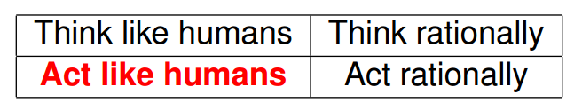
Acting humanly
Take a task people do (intelligently), for example:
Proving a theorem
Playing chess
Planning a surgical operation
Diagnosing a disease
Navigating a building
Identifying objects from a photograph
Driving a car
And build a system that does it automatically
But do we want to duplicate human imperfections?

Slide 10
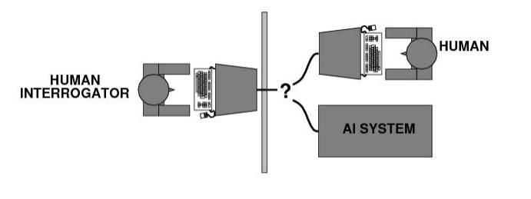
Acting humanly: The Turing Test
Turing (1950) “Computing machinery and intelligence”:
Can machines think? → Can machines behave intelligently?
Test for intelligent behavior: the Imitation Game
Suggested major components of AI: knowledge, reasoning, language understanding, learning, etc.

Slide 11
Acting humanly: The Turing Test
Problem: Turing test is not:
Reproducible
Constructive
Amenable to mathematical analysis
ChatGPT?

Slide 12
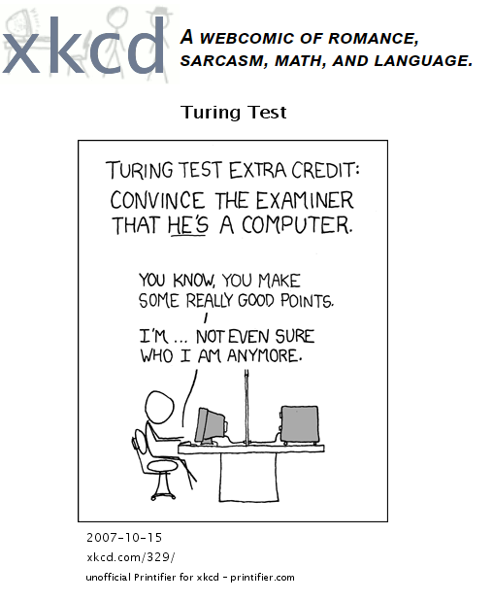

Slide 13
Think like humans | Think rationally
Act like humans | Act rationally

Slide 14
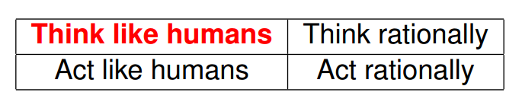
Thinking humanly
How computer performs tasks matters
Reasoning steps are important
Requires ability to create and manipulate symbolic knowledge (definitions, concepts, theorems, . . .)

Slide 15
Thinking humanly
Requires scientific theories of the brain
What level of abstraction?
How do we validate?
Cognitive Science and Cognitive Neuroscience are distinct from AI

Slide 16
Thinking humanly
Questions:
Does “intelligence” require a human-like thought process?
Can we create useful systems before understand exactly how the brain works?

Slide 17
Think like humans | Think rationally
Act like humans | Act rationally

Slide 18
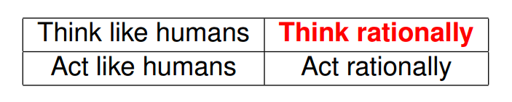
Thinking rationally
What are correct arguments/thought processes?
Aristotle and logic
Correct argument/reasoning structures
If I know A is true, and I know that A → B is true, then I know that B is true

Slide 19
Thinking rationally
Problems:
Not all intelligent behavior is mediated by logical deliberation
What is the purpose of thinking? What thoughts are correct to have?
Not easy to represent informal knowledge in formal logic terms

Slide 20
What we will use:
Think like humans | Think rationally
Act like humans | Act rationally

Slide 21
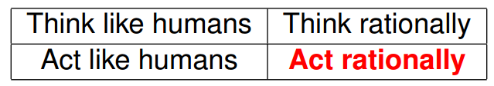
Acting Rationally
Rational behavior = doing the right/best thing
Right thing = thing expected to maximize goal achievement given available information
Connections to economics, control theory, decision theory
Doesn’t necessarily require thinking – (i.e. reflexes), but thinking should be in the service of rational action

Slide 22
Artificial Intelligence ≠ Human intelligence
In the “rational agent” approach to AI, artificial intelligence is not necessarily the same as human intelligence
We should not expect computer intelligence to be the same as human intelligence anymore than we expect airplanes to fly the same as a bird

Slide 23
Can machines act/think intelligently?
AI has made impressive achievements showing that tasks initially assumed to require intelligence can be automated
But each success of AI seems to push further the limits of what we consider “intelligence”

Slide 24
AI: Exciting area of research
AI relatively new (1956), not Physics
We know it is possible
Arguably poses most interesting challenges and questions in CS today
Cited as “field I would most like to be in”
What can we learn from studying AI?
Practical: Techniques for creating intelligent agents and solving problems
Theoretical: Gain understanding of nature of intelligence

Slide 25
Class Goals
Understand many basic tools of AI
Solve problems in any field you end up
Foundation to deepen understanding in areas you might be interested in or need
Deal sensibly with current/future issues
Have fun!

Slide 26
Other BYU AI Classes
CS 450 – Computer Vision
CS 472 – Machine Learning
CS 474 – Deep Learning
CS 601R – Conversational AI
CS 650 – Computer Vision 1
CS 670 – Multi-Agent Systems
CS 673 – Computational Creativity
CS 674 – Advanced Deep Learning
CS 676 – Advanced Topics in Data Mining
CS 677 – Bayesian Inference
CS 704R – Advanced Readings in Handwriting Recognition

