Slide 1
Game Theory
CS 470
Ethan Pedersen

Slide 2
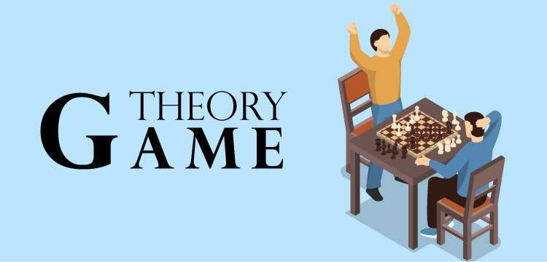
What is Game Theory?
A way to treat problems as games
Specifically:
Create mathematical models of interactions between “players”
Players are usually viewed as rational agents
What is the definition of a rational agent?
Chooses actions to maximize expected utility

Slide 3
Why Game Theory?
Often it is easier to think of a problem in terms of a game
Usually more fun to model problems as a game
We as people tend to like things involving “play”
Long history of mathematical models and results we can use
Especially from fields like Economics
From an engineering perspective, it can provide insight into system design based on how users make decisions

Slide 4
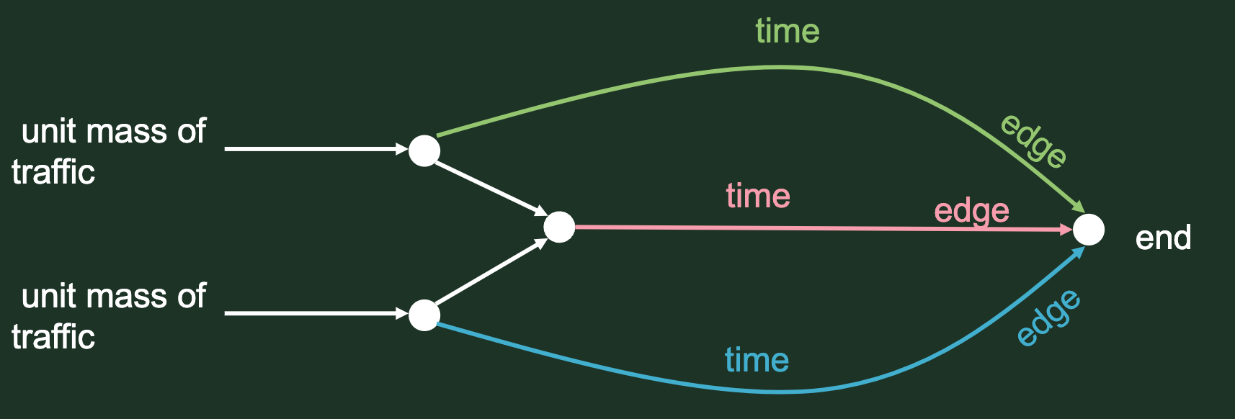
Example

Slide 5
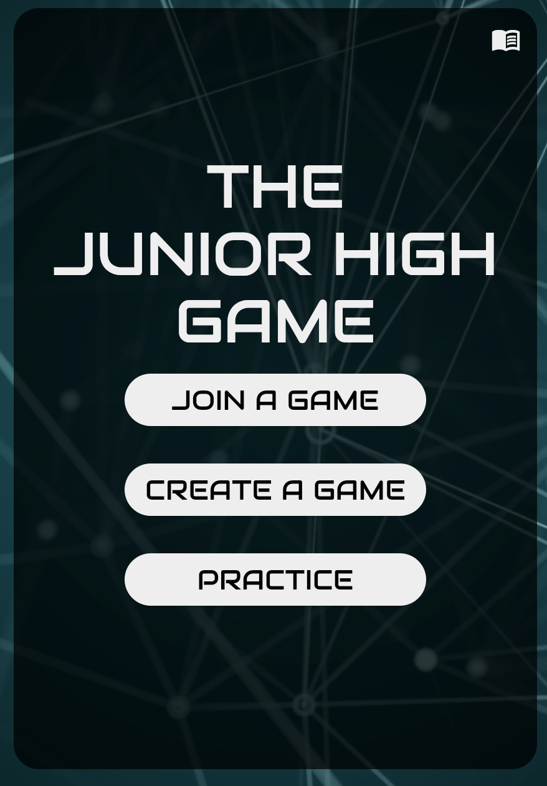
JHG Activity
Website: beta.juniorhighgame.com
Works best on Google Chrome
Groups of ~10 players
1 person will need to host the game

Slide 6
JHG Activity
What are some interesting problems we could study by using this game?
The dynamics of how groups form
Groups could be:
People
Corporations
Countries (ex: alliances)
etc.
How communication affects social interactions
Impact/consequences of government policies
etc.

Slide 7
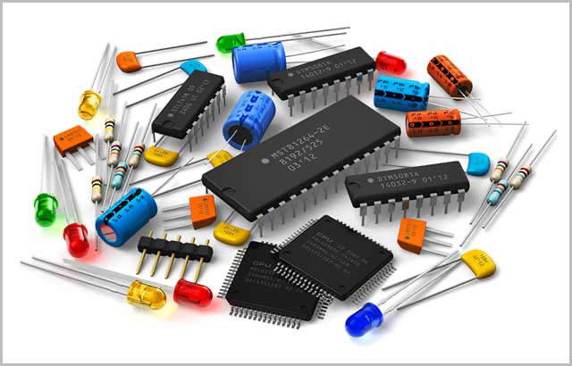
Game Components
Set of players
Assumed to be rational agents
Set of actions
Moves available to agents during the game
Might differ based on current game state
Policy
Decision rule that a player uses to select actions based on available information
Can think of it as a mapping from game state to action
Sometimes called a strategy
Reward function (or cost function)
Measures the reward (or cost) of a policy

Slide 8
Game Outcomes
In games, we usually like to arrive at a “good” outcome
In games with multiple players, these are usually either:
Pareto optimum
Pareto dominated: the utility of all players can be increased
Pareto optimum: not Pareto dominated
Best we can hope to achieve
Nash equilibrium
Best response: given what other players do, a best response maximizes utility for a given player
Nash equilibrium: when everyone is playing a best response to what everyone else is doing
Usually not as a good as a Pareto optimal outcome (though sometimes they are the same)
Usually what players converge to

Slide 9
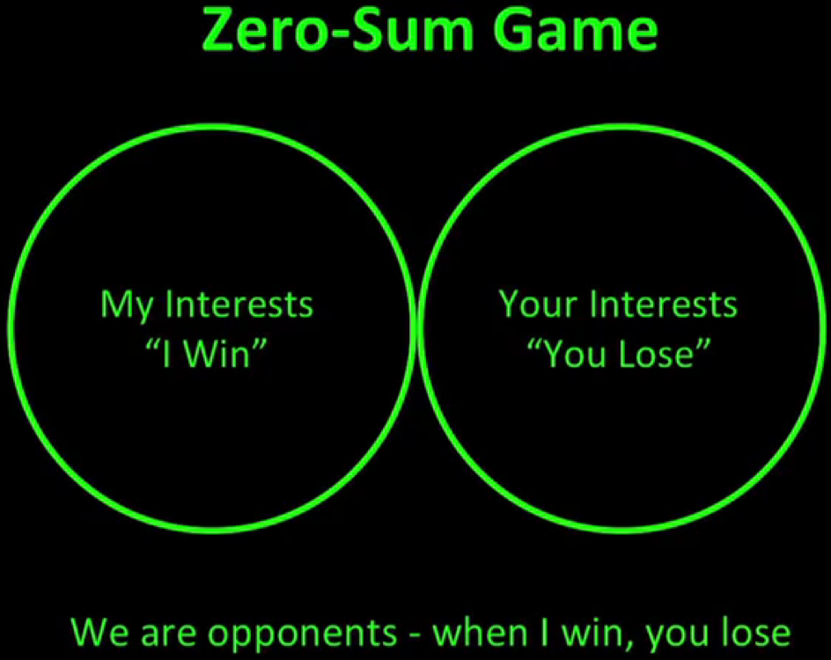
Game Types
Zero-sum
Players have completely opposite goals
This means that their utilities are opposite
So, if we add up everyone’s utility, the sum is usually 0 (or close to 0)
Cooperation is non-existent
Examples?
Financial trading
Non-zero-sum
Players might have similar goals
This means that their utilities are probably similar
So, if we add up everyone’s utility, the sum is usually larger than 0
Cooperation is more common
Examples?
Financial investment

Slide 10

Game Types
Simultaneous
Players choose actions at the same time
Examples?
Rock-paper-scissors
JHG
Sequential
Players take turns when choosing actions
Examples?
Chess
Reversi (project 1)
Negotiation (modelled as a game)

Slide 11
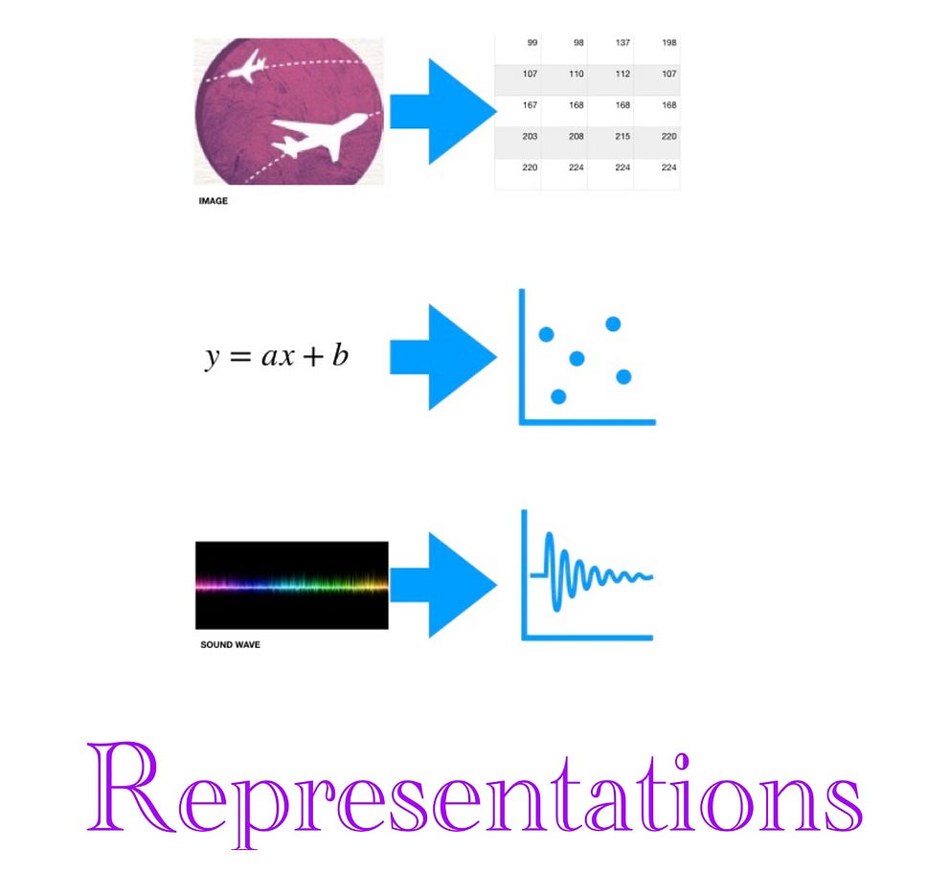
Representations
Simultaneous games:
Matrices (especially with two players)
Sequential games:
Trees
Nodes are game states
Branches are actions

Slide 12
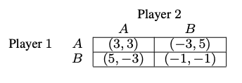
Example (Simultaneous Games)
Prisoner’s Dilemma:
What is the Nash equilibrium?
What is the Pareto optimum?
Funny example: https://www.youtube.com/watch?v=S0qjK3TWZE8

Slide 13
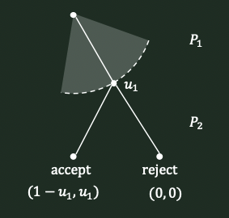
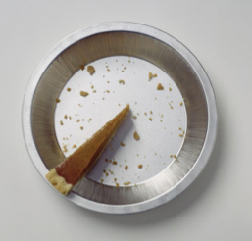
Example (Sequential Games)
Thanksgiving Dilemma:
What is the Nash Equilibrium?

Slide 14
Real-Life Examples
What are some other real-life examples (we’ve mentioned a few already)?
Social interactions (JHG)
Economics, financial markets, etc.
Government policies (JHG)
Factory design
Traffic systems
Cooperation tasks
Fleet of drones
Several search and rescue robots
etc.

Slide 15
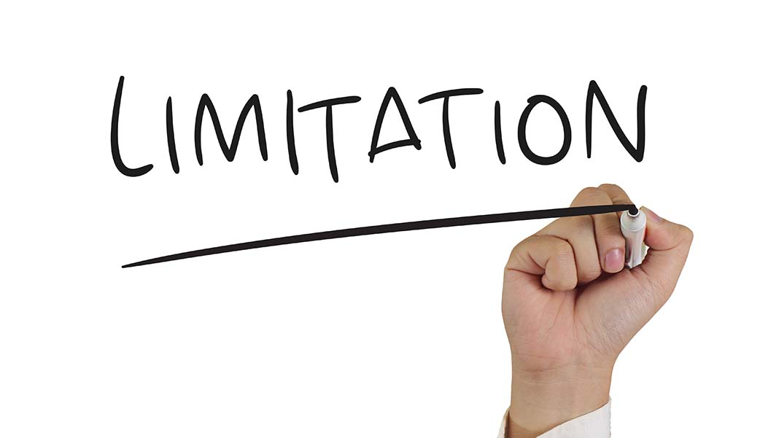
Limitations
What might some of the limitations be?
We assume players/agents are rational
Sometimes not the case in reality
The best models require complete information of the environment and the way other players think, which isn’t possible in every scenario

Slide 16
Homework
Potential fields mini project

Slide 17
Next Time
Minimax and alpha-beta pruning
Skim the linked sources

