Slide 1
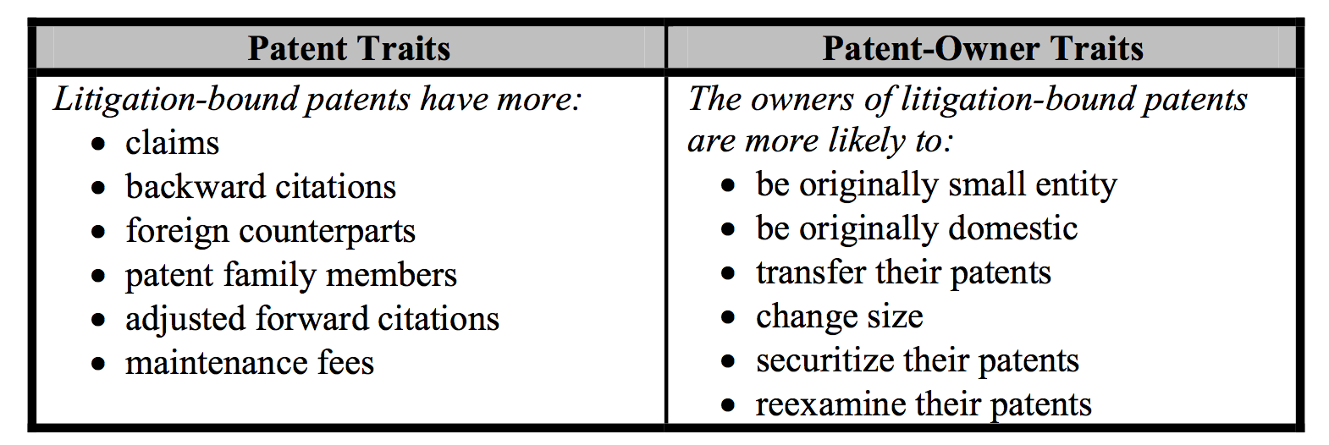
Features Related to Litigation
Chien, Colleen, Predicting Patent Litigation, Santa Clara Law Digital commons , January, 2011

