Slide 1
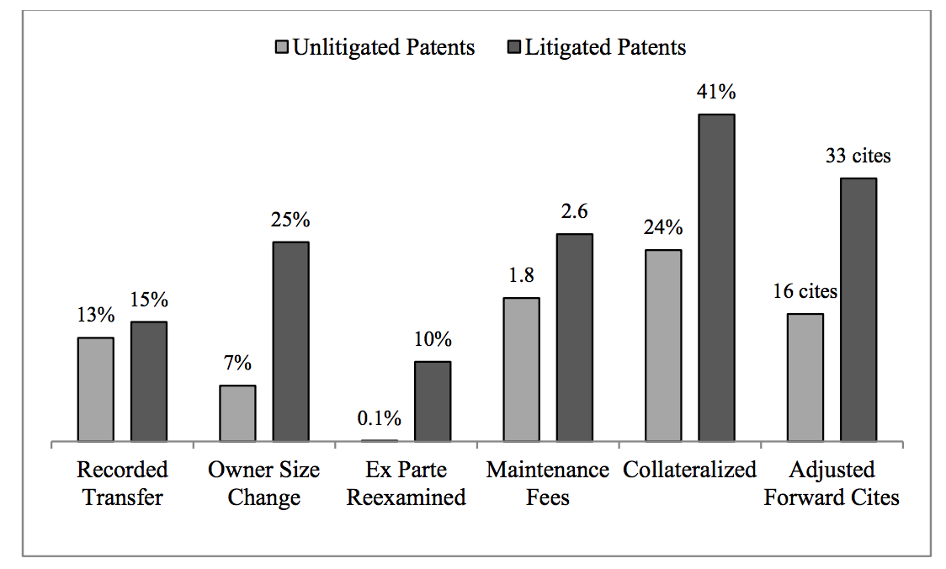
Exploratory Analysis: Acquired Characteristics
Chien, Colleen, Predicting Patent Litigation, Santa Clara Law Digital commons , January, 2011

