Slide 1
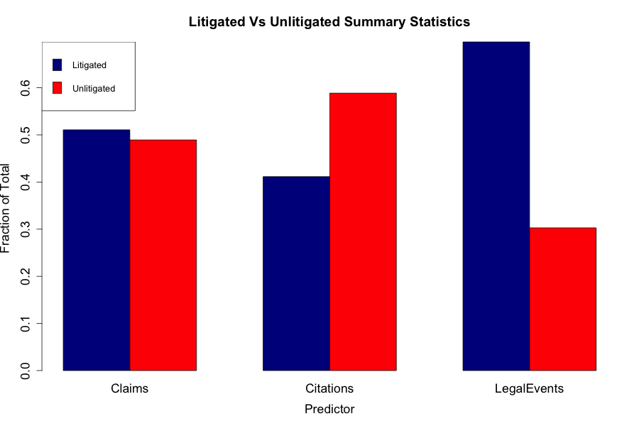
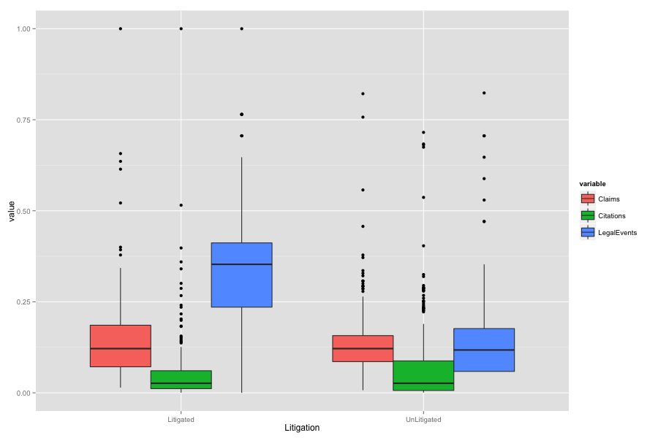
Exploratory Analysis: Inherent Characteristics
Calculations done on 218 litigated & 218 unlitigated patents

