Slide 1
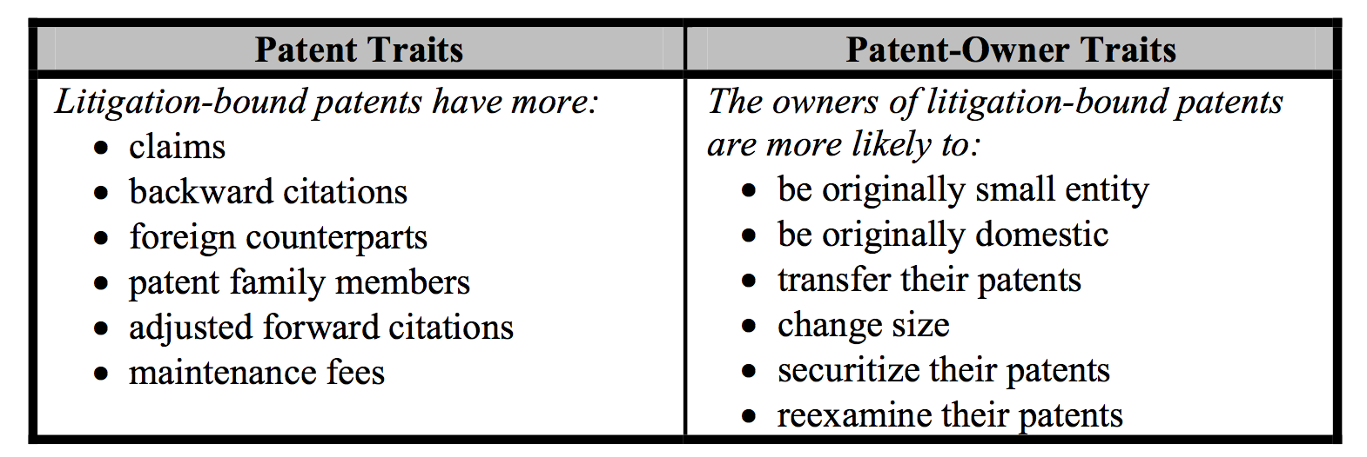
Predictors of Litigation
Chien, Colleen, Predicting Patent Litigation, Santa Clara Law Digital commons , January, 2011

