Slide 1
Artificial Intelligence & GenAI
Overview on GenAI

Slide 2
Structure
Introduction to AL/ML
Machine Learning Techniques
Transformer, what is that?
Generative AI
Future of AL – thoughts
Questions?

Slide 3
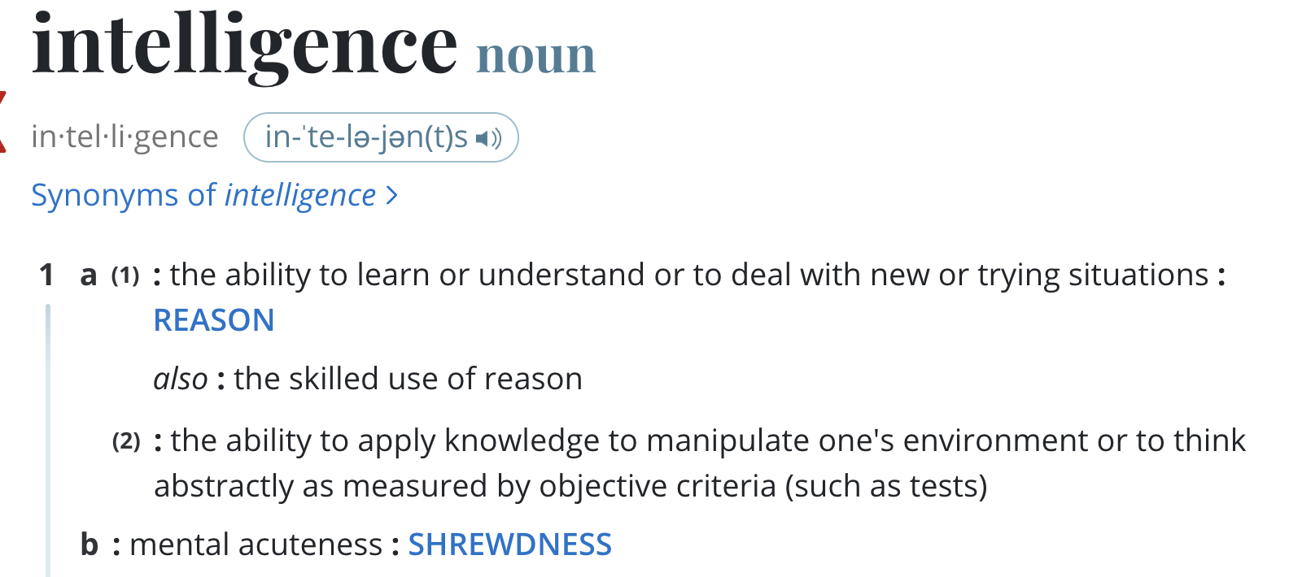
Introduction to AI, ML, & GenAI
What is Artificial Intelligence?
“ability to learn or understand”…..
“to think abstractly” …. “ability to reason”
State the desired objective.
Use multiple points if necessary.
Source: https://www.merriam-webster.com/dictionary/intelligence

Slide 4
Today’s Situation
Summary of the current situation.
Use brief bullets, discuss details verbally.

Slide 5
How Did We Get Here?
Any relevant historical information.
Original assumptions that are no longer valid.

Slide 6
Available Options
State the alternative strategies.
List advantages & disadvantages of each.
State cost of each option.

Slide 7
Recommendation
Recommend one or more of the strategies.
Summarize the results if things go as proposed.
What to do next.
Identify action items.

