Slide 1
Artificial Intelligence & GenAI
Overview on GenAI

Slide 2
General outline
Introduction to AL/ML
Machine Learning Techniques
Deep Learning Techniques
Demo of LLM
Future of AL – thoughts
Questions?

Slide 3
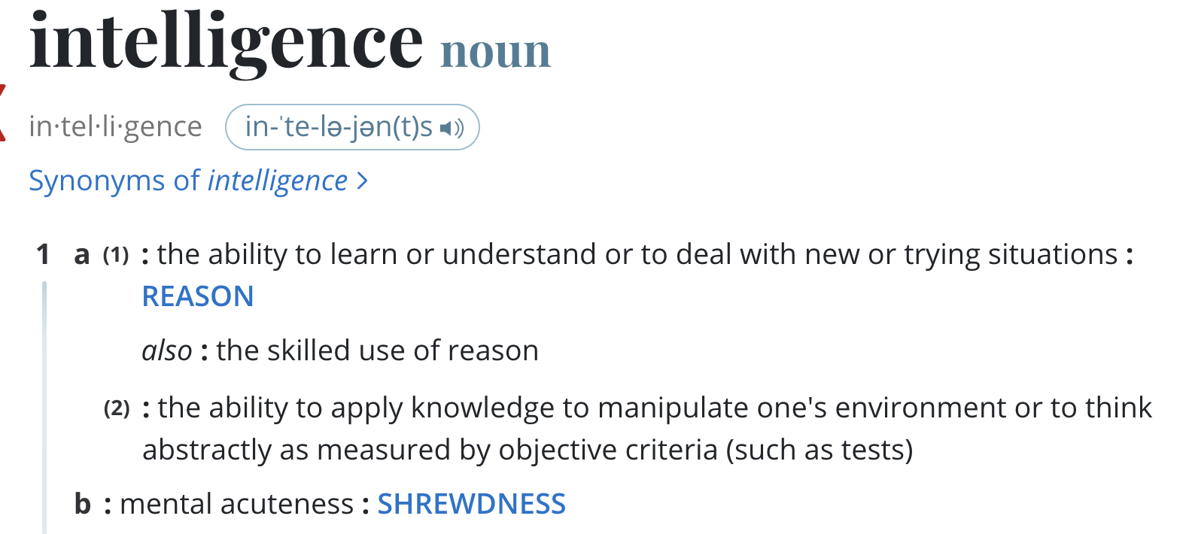
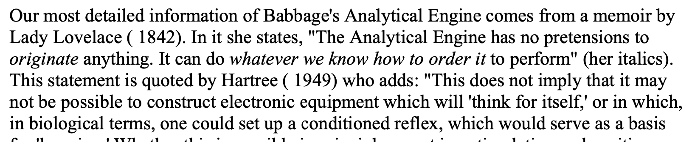
Introduction to AI, ML, & GenAI
What is Artificial Intelligence?
“ability to learn or understand”…..
“to think abstractly” …. “ability to reason”
How old is the concept of AI/ML?
10 to 15 years? 30 years? ..
Source: https://www.merriam-webster.com/dictionary/intelligence

Slide 4
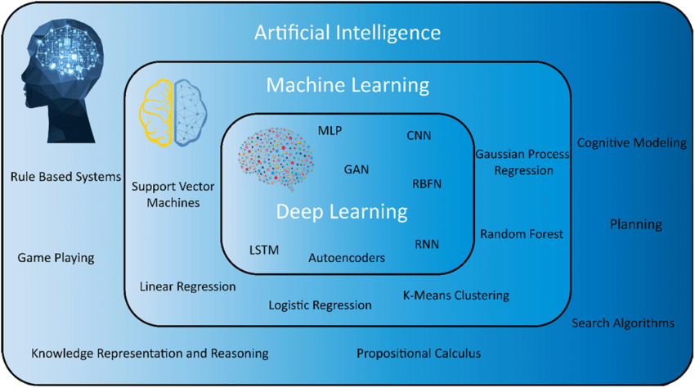
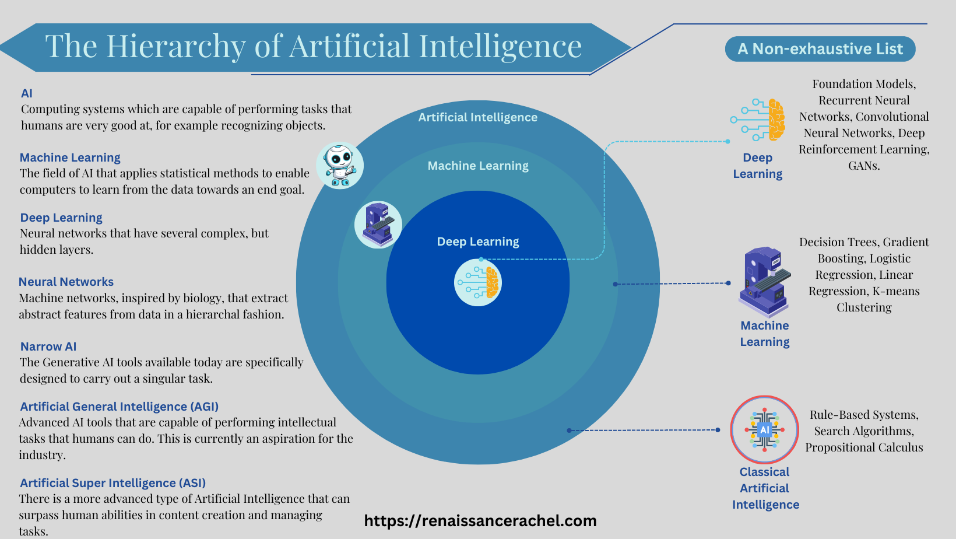
AI, ML, Deep learning, Neural networks… how are they related?
Many ways to organize the dynamic field of AI/ML

Slide 5
Key terminology
Vocabulary
Attention, Reasoning, Comprehension, Perception, Learning, -- Cognitive computing
Cognition - The mental action or process of acquiring knowledge and understanding through thought, experience, and the senses. [Oxford Dictionary]
Machine learning:
Parametric learning vs. Non-parametric learning
Gradient descent: iterative optimization algorithm used to minimize the loss function
Loss function: quantifies the difference between predictions and ground truth
Backpropagation: algorithm for computing gradients of the loss function with respect to network parameters
Learning rate: hyperparameter controlling the step size of gradient descent updates

Slide 6
ML: Parametric learning
Consider the equation for a straight line (Ax + By + C = 0).
There are two parameters that define the boundary for a given scenario (Yes/No).
When we use a Llama 2 trained on 7B, 13B, or 70B… it gives us the idea why it is expensive to train and build a good model.
Machine learning is an optimization exercise.
Gradient descent (and its variants) is the most common optimization algorithm used in ML.
.. cost function, loss function, etc. Then we have regularization, etc. Minima/Maxima, etc.
The best examples are linear regression, logistic regression, etc.
Fundamentally, the model tries to guess (predict) the output based on the input.

Slide 7
ML: Non-Parametric learning
In a non-parametric model, there is no equation with parameters is supplied.
The model is learned as part of the machine learning process. The algorithm needs to determine the model based on the training data.

Slide 8
Classification of Data
Structured data: Table, list of stock prices, monitoring data from IOT device, etc.
Unstructured data: text, audio, video, images, etc.
Semi-structured data: With a structure, but the structure contains Unstructured data. example: XML, JSON, etc.
Or as…
Labeled data .. data with output.
Unlabeled data .. data without output.
Can someone guess what these are?

Slide 9
Machine Learning Algorithms (reference material)
Supervised – Regression
- Simple & multiple linear regression
Supervised - Classification
- Naïve Bayes
- Support Vector Machines (SVM)
- Logistic Regression
Supervised - Both
- Decision trees
- Random forest
- Neural Networks
- K Nearest Neighbors (KNN)
- ExtraTrees
- Generalized Linear/Additive Models (GLM/GAM)
Unsupervised
- K-Mean
- Principle Component Analysis (PCA)
- Hidden Markov Models
- Gaussian Mixture Model

Slide 10
Deep Learning Algorithms (reference material)
Convolutional Neural Networks (CNNs)
Long Short Term Memory Networks (LSTMs)
Recurrent Neural Networks (RNNs)
Generative Adversarial Networks (GANs)
Radial Basis Function Networks (RBFNs)
Multilayer Perceptrons (MLPs)
Self Organizing Maps (SOMs)

Slide 11
Deep learning – RNN & CNN
RNN
Neural networks designed for processing sequences of data
Maintain internal hidden states to capture temporal dependencies
Variants of RNNs:
a. Long Short-Term Memory (LSTM)
b. Gated Recurrent Unit (GRU)
Applications: text classification, language modeling, sequence-to-sequence learning
CNN
Specialized neural networks for processing grid-like data (e.g., images)
Convolutional layers: learn local features in input data (context)
Pooling layers: reduce spatial dimensions and enhance feature representations
Fully connected layers: perform classification based on learned features

Slide 12
Demo time…
Let us look at a simple LLM to understand some of the internals
Thoughts on future….

Slide 13
Questions

