Slide 1
Artificial Intelligence & GenAI
Overview on GenAI

Slide 2
General outline
Introduction to AL/ML
Machine Learning Techniques
Transformer, what is that?
Generative AI
Future of AL – thoughts
Questions?

Slide 3
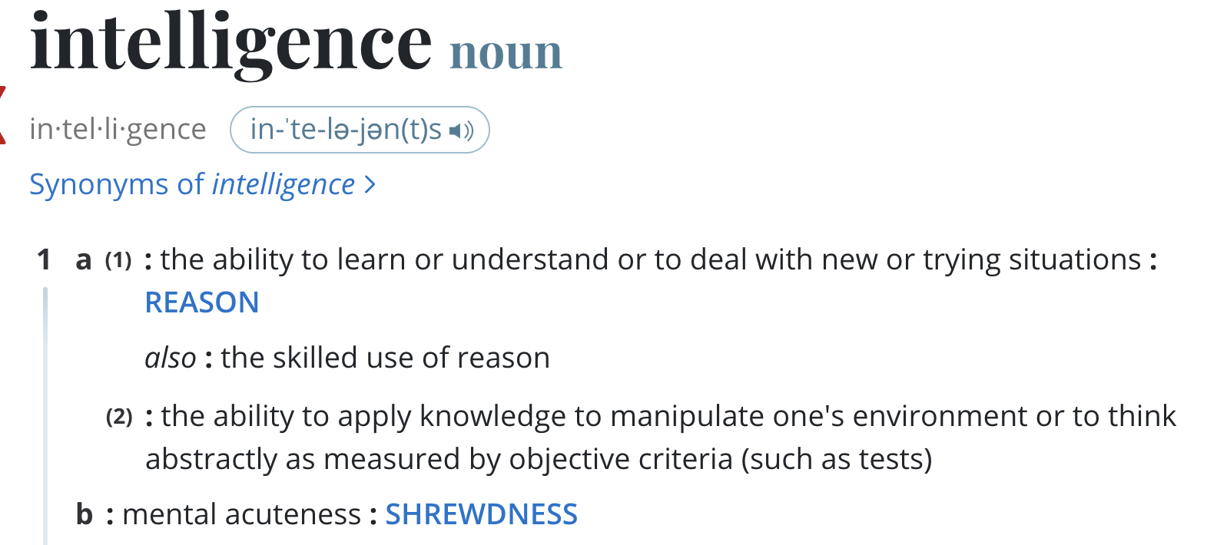
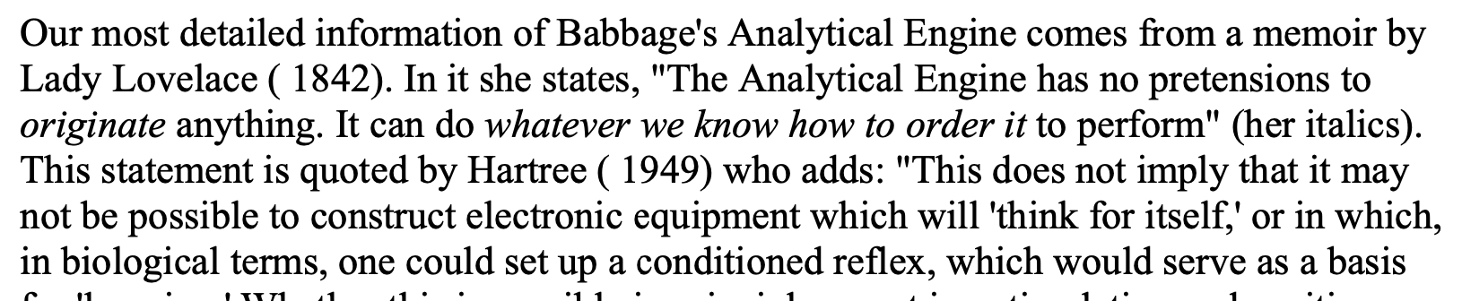
Introduction to AI, ML, & GenAI
What is Artificial Intelligence?
“ability to learn or understand”…..
“to think abstractly” …. “ability to reason”
How old is the concept of AI/ML?
10 to 15 years? 30 years? ..
Source: https://www.merriam-webster.com/dictionary/intelligence

Slide 4
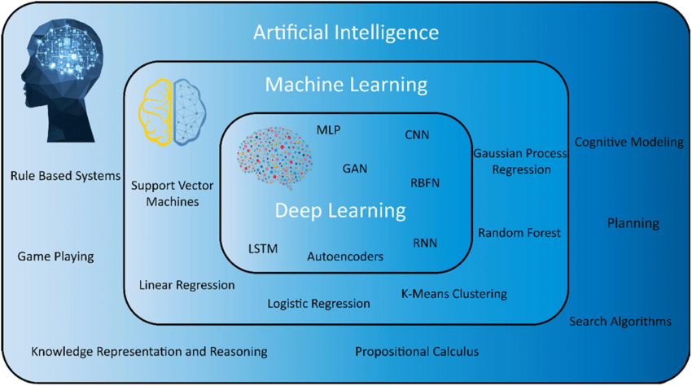
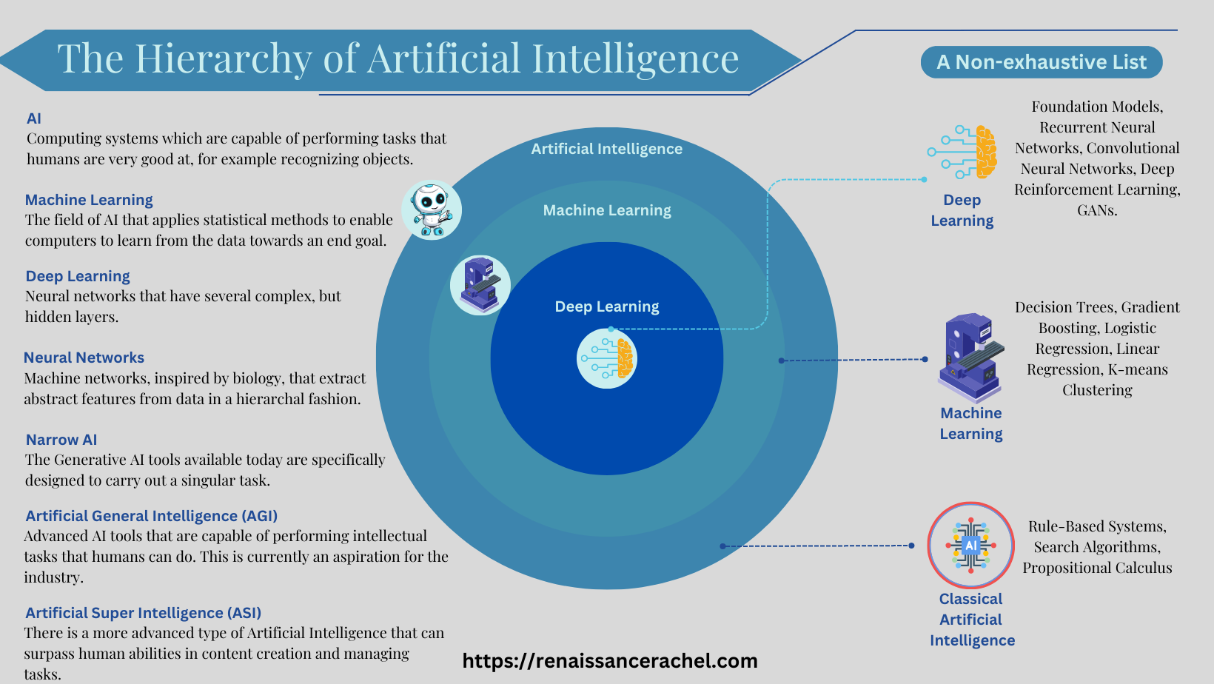
Today’s lay of the land
Many ways to structure the dynamic field of AI/ML

Slide 5
Key terminology
Vocabulary
Attention, Reasoning, Comprehension, Perception, Learning, -- Cognitive computing
Cognition - The mental action or process of acquiring knowledge and understanding through thought, experience, and the senses. [Oxford Dictionary]
Machine learning:
Parametric learning vs. Non-parametric learning
Gradient descent: iterative optimization algorithm used to minimize the loss function
Loss function: quantifies the difference between predictions and ground truth
Backpropagation: algorithm for computing gradients of the loss function with respect to network parameters
Learning rate: hyperparameter controlling the step size of gradient descent updates

Slide 6
ML: Parametric learning
Consider the equation for a straight line (Ax + By + C = 0).
There are two parameters that define the boundary for a given scenario (Yes/No).
When we use a Llama 2 trained on 7B, 13B, or 70B… it gives us the idea why it is expensive to train and build a good model.
Machine learning is an optimization exercise.
Gradient descent (and its variants) is the most common optimization algorithm used in ML.
.. cost function, loss function, etc. Then we have regularization, etc. Minima/Maxima, etc.
The best examples are linear regression, logistic regression, etc.
Fundamentally, the model tries to guess (predict) the output based on the input.

Slide 7
ML: Non-Parametric learning
In a non-parametric model, there is no equation with parameters is supplied.
The model is learned as part of the machine learning process. The algorithm needs to determine the model based on the training data.

Slide 8
Classification of Data
Structured data: Table, list of stock prices, monitoring data from IOT device, etc.
Unstructured data: text, audio, video, images, etc.
Semi-structured data: With a structure, but the structure contains Unstructured data. example: XML, JSON, etc.
Or as…
Labeled data .. data with output.
Unlabeled data .. data without output.
Can someone guess what these are?

Slide 9
Recommendation
Recommend one or more of the strategies.
Summarize the results if things go as proposed.
What to do next.
Identify action items.

Slide 10
Recommendation
Recommend one or more of the strategies.
Summarize the results if things go as proposed.
What to do next.
Identify action items.

Slide 11
Recommendation
Recommend one or more of the strategies.
Summarize the results if things go as proposed.
What to do next.
Identify action items.

Slide 12
Recommendation
Recommend one or more of the strategies.
Summarize the results if things go as proposed.
What to do next.
Identify action items.

