Slide 1
Real Time Facial Emotion Detection in Live Videos Feed By- Mahima Agarwal Sudipta Swarnakar

Slide 2
Content:
Introduction
Overview
Solution Approach
Conclusion
Demo
Questions

Slide 3







Facial Emotions:
Seven Universal Emotions

Slide 4
Problem ?
How a machine can recognize these emotions without any human supervision with accurate results?

Slide 5
About this Project-
Identifies the person’s face from a video frame through a video source.
Recognizes seven facial emotion expression from the face – Happy, Sad, Anger, Fear, Disgust, Neutral and Surprise.
Includes main two main tasks-
Feature Extraction
Classification
Used FER2013 dataset to train the model.
Trained the model using deep learning with two CNN architectures – VGGNet and Googlenet.
Feature extraction from live feed using Haar-Cascade Classifier

Slide 6

Approach Overview
Training Stage
Testing Stage
Experiment with real Data
Conclusion

Slide 7
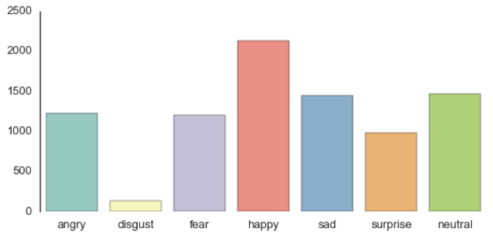
Overview of FER2013 Dataset
From Kaggle Facial Expression Recognition Challenge
Comprises total of 35887 pre-cropped, 48-by-48-pixel grayscale images of faces each labeled with one of the 7 emotions.
Training - 28,709 images , Testing - 3,589 images.

Slide 8

Deep Learning and AWS
Given the pattern complexity of facial expressions, it is necessary to build with a deeper architecture in order to identify subtle signals. That is the reason we used deep learning
It is Computationally Heavy.
Configuration and Setup-
Setup Used- g2.2xlarge Deep Learning AMI
(Amazon Linux) cluster on AWS EC2 which offers
NVIDIA GRID K520 GPUs having 3072 CUDA Cores
with 4.7 TFLOPS performance
On AWS, used Keras with Tensorflow backend in
Python.

Slide 9
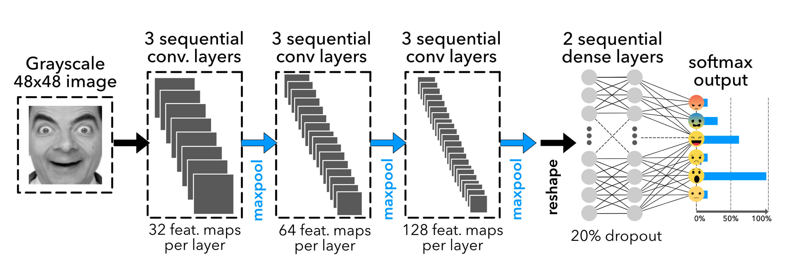
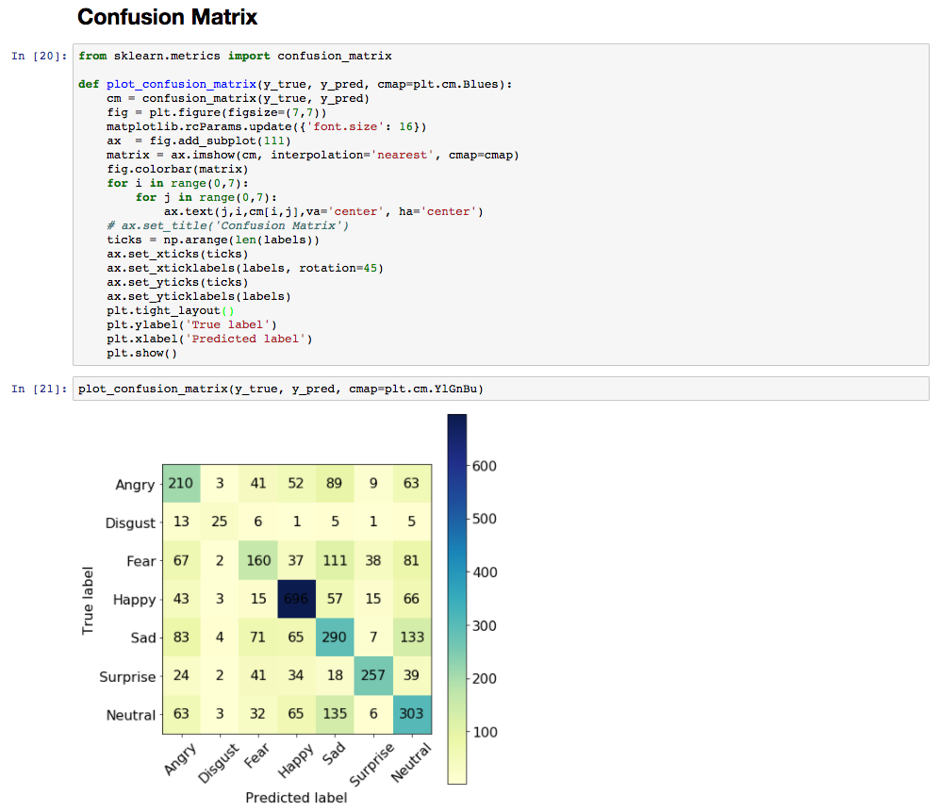
About CNN architecture
VGGNet
(Validation Accuracy - 54.2 %)
(Training Accuracy – 97% (approx.))

Slide 10
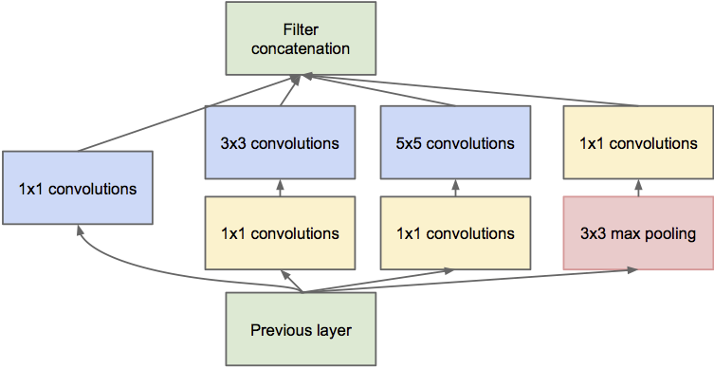
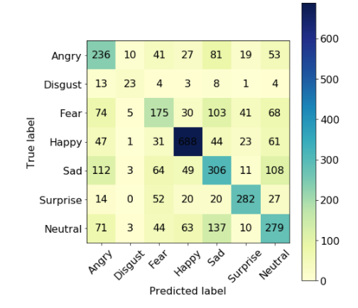
GoogleNet
Training Accuracy – 94%
Validation Accuracy - 65.55

Slide 11
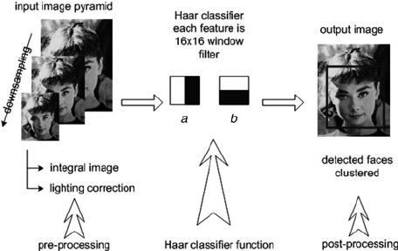
Face Detection Classifier-
Used OpenCV Haar-Cascade Classifier
Decides whether an image is a positive image (face image) or not.
This classifier is trained on thousand of human faces.
Training data is stored in an XML file(haarcascade_frontalface_alt.xml)) and used by classifier during testing of our trained model with live video feed.

Slide 12
Conclusion
Facial Expression Recognition with 65.55 % validation accuracy on live video feed.
Applications-
Patient Emotional State in Healthcare
Audience Reaction in entertainment industry
Student Feedback in Lecture Room.
Future Recommendations-
Test with more subjects and expressions.
Data for Disgust was very less in comparison to other expressions, it can be merged with sad or angry to get more accurate results.

Slide 13
References
https://link.springer.com/chapter/10.1007/978-3-319-44781-0_5#enumeration
https://arxiv.org/pdf/1509.05371.pdf
https://link.springer.com/content/pdf/10.1007%2F978-3-319-44781-0_5.pdf
http://ieeexplore.ieee.org/document/7745199/
http://ieeexplore.ieee.org/document/7489424/
https://keras.io/
https://www.pyimagesearch.com/2017/03/20/imagenet-vggnet-resnet-inception-xception-keras/
http://cs231n.stanford.edu/

Slide 14
Demo

Slide 15


Slide 16

Thank You

