Slide 1
AURA Mood‑Based Music Discovery Krupenikova Polina Innopolis University Summer 2026

Slide 2
Why AURA?
Problem:
• Music discovery is limited to metadata
• Users want to find music that "feels" a certain way
Solution:
• Search by vibe – emotional and acoustic character
• Query by text description or audio clip
Who Needs It?
• DJs & Producers • Music Therapists
• Game/Film Designers • Casual Listeners

Slide 3
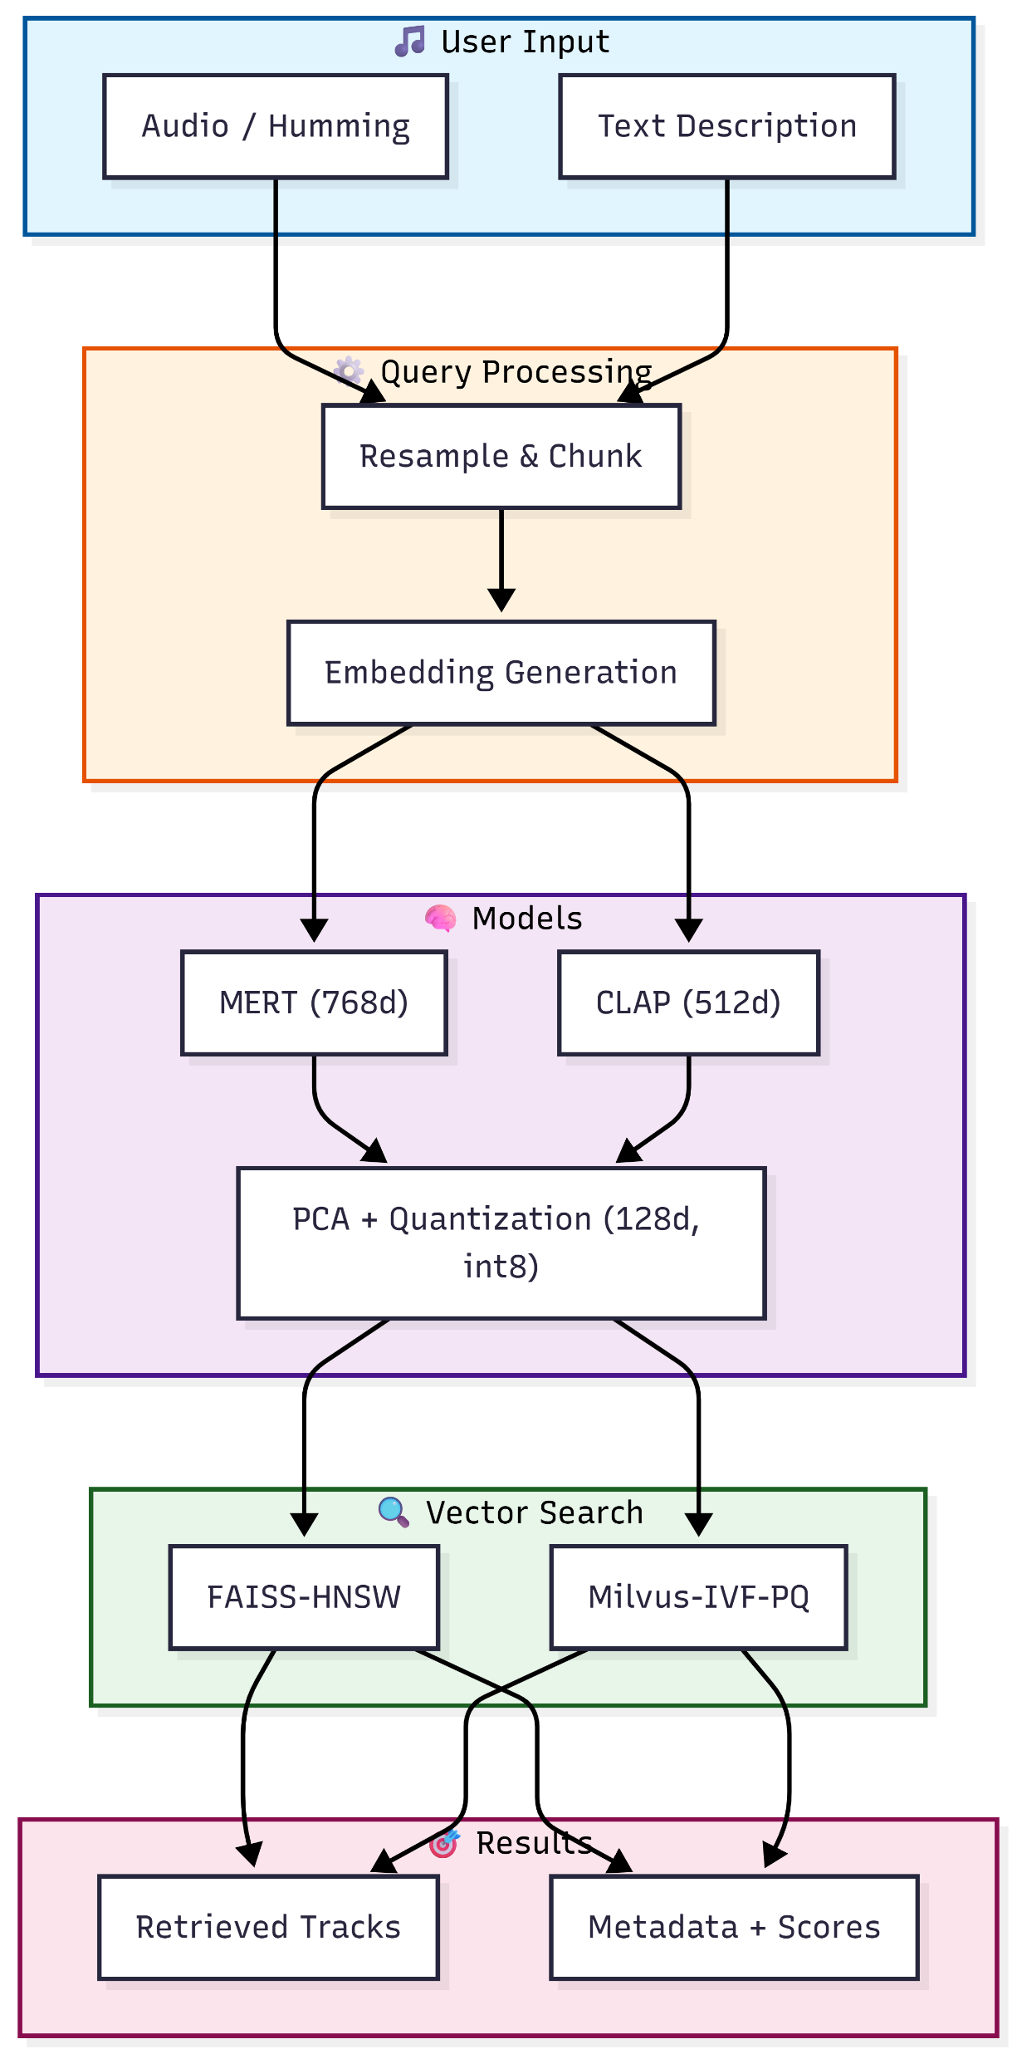
Architecture
Key Technologies:
• MERT: State-of-the-art music audio
model
• CLAP: Multimodal text-audio
embeddings
• FAISS/Milvus: Efficient vector search
• PCA + Quantization: Memory/speed
optimization

Slide 4
Dataset
FMA (Free Music Archive)
• 25,000 tracks
• 150,000 chunks (10‑second segments)
GTZAN (Validation)
• 1,000 tracks
• 10 genres
Why These Datasets?
• Large-scale, diverse, freely available
• Natural ground truth (genre labels)
• Challenging acoustic diversity

Slide 5
Experimental Iterations
Iteration 1: Baseline using full MERT embeddings with FAISS-HNSW
Iteration 2: Optimized with PCA, quantization, and Milvus-IVF-PQ
Iteration 3: Multimodal text‑to‑audio search using CLAP
Iteration | Model | Index | Dim | Recall@10 | QPS | Memory
1 (Baseline) | MERT | FAISS-HNSW | 768 | 0.92 | 35 | 450 MB
2 (Optimized) | MERT+PCA+Quant | Milvus-IVF-PQ | 128 | 0.87 | 210 | 85 MB
3 (Multimodal) | CLAP | Milvus-IVF-PQ | 512 | 0.68 | 190 | 110 MB

Slide 6
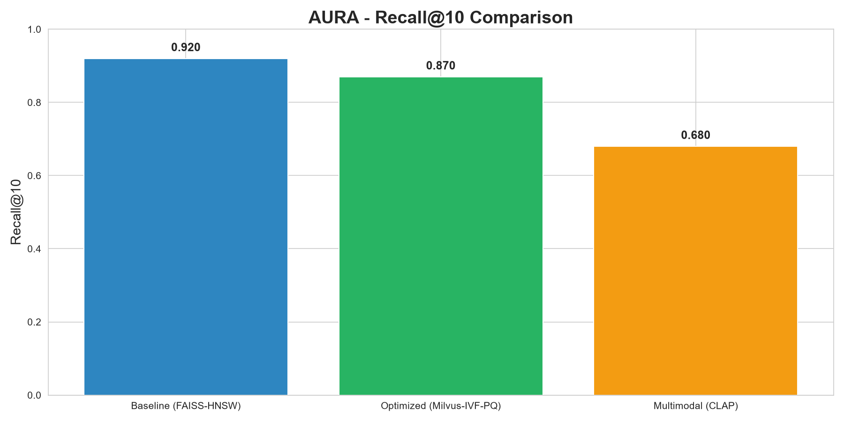
Results - Accuracy
Key Finding:
Optimized system preserves 94% of baseline accuracy (0.92 → 0.87)

Slide 7
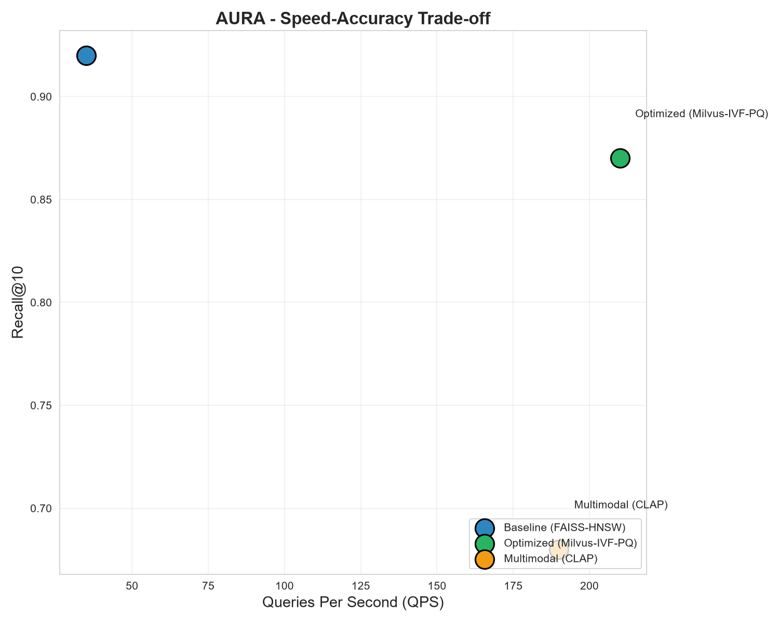
Results – Speed and Memory

Slide 8
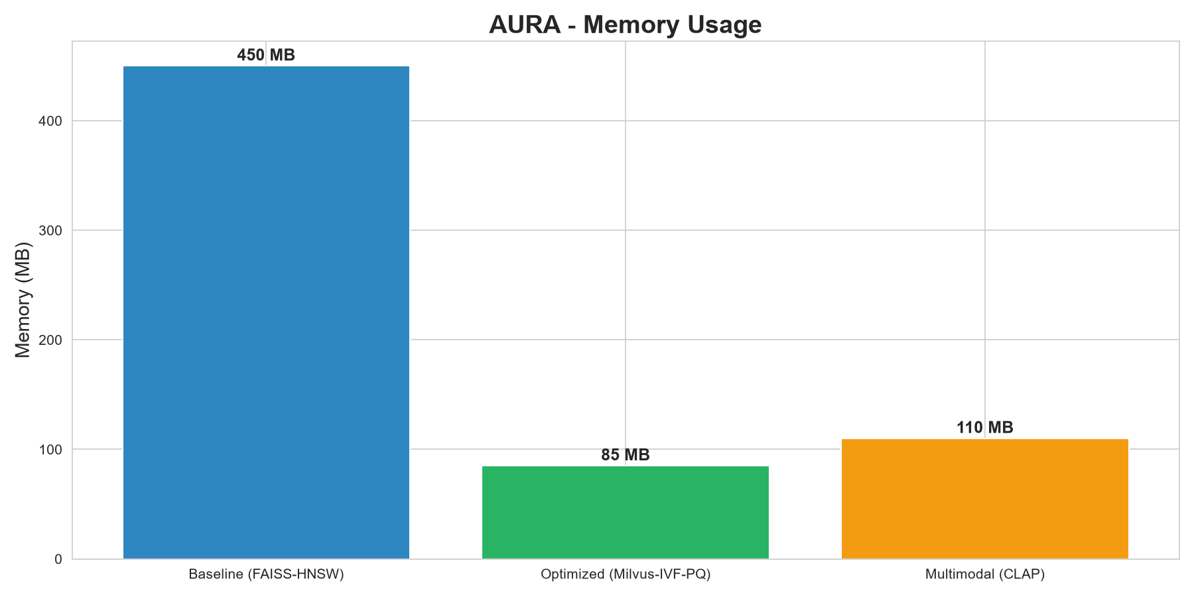
Results – Speed and Memory
Key Results:
• 6× Speedup (35 → 210 QPS)
• 81% Memory Reduction (450 → 85 MB)
• Only 5% Accuracy Loss

Slide 9
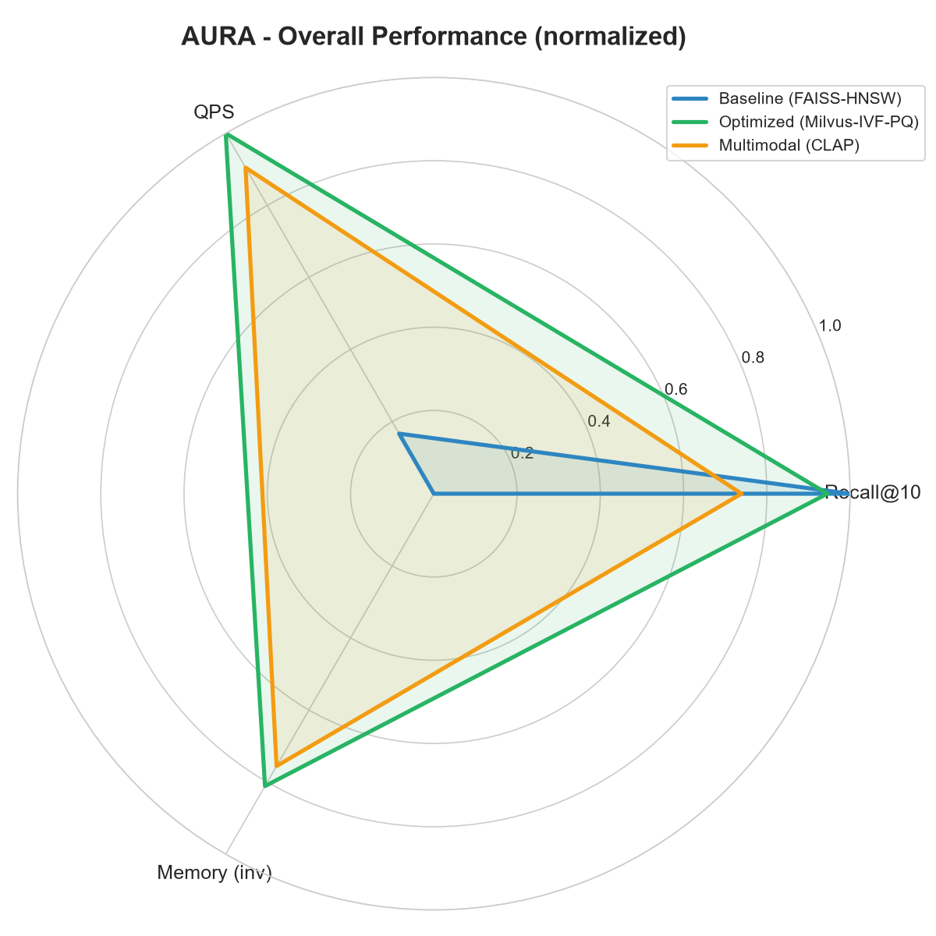
Overall Performance
Summary:
• Iteration 2 offers the best balance
• Production-ready: runs on CPU with < 100 MB RAM
• Scalable to milions of tracks via Milvus

Slide 10
Live demo
• Text descriptions
• Sample queries
• Audio upload
• Results with metadata, genre badges, similarity scores

Slide 11
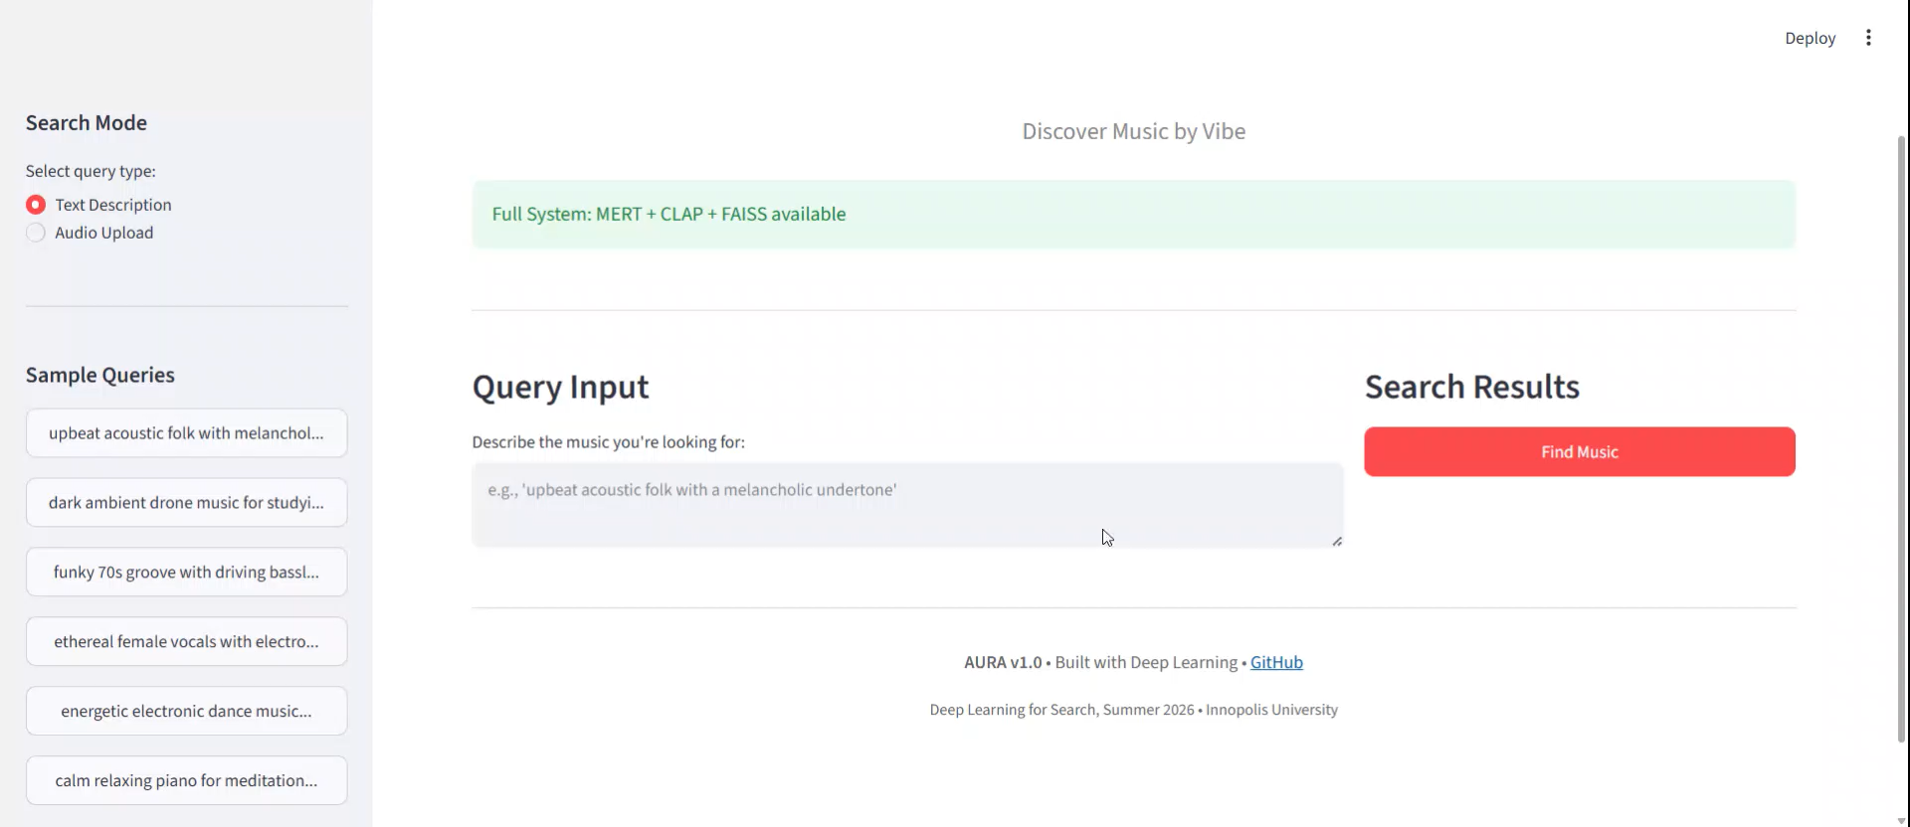

Slide 12
Key Takeaways
1. PCA + Quantization is highly effective
• 94% accuracy preserved
• 6× speedup
• 81% memory reduction
2. IVF-PQ indexing provides excellent memory-speed trade-off
• Ideal for large-scale deployments

