Slide 1
A
Center Point (x,y)
B
Circle Area exp(a)
Tilt Point (r,s)
V_{0L}
V₁
W₁
Tilt Point Height z
f_{L}(W,V)
Tilt Vector
V₀
W₀
Ellipse Projection
data augmented
(assigned to nodes)
f_{R}(W,V)
Projection Plane
Resulting Ellipse
V_{0R}
V₂
W₂
Real Geography
C
h₂
D
Sympatry
E
Allopatry
h₃
h₁
d₂
d₂
R₂
h₄
c₀
c₁
c₂
c₃
h₀
d₁
R₁
d₁
h₅
h₇
h₆
R₂ = (1+c) 𝗑 R₁

Slide 2
Center Point x,y
h2
Circle Area exp(a)
h3
h1
Tilt Point r,s
Tilt Point Height z
Tilt Vector
h4
h0
Ellipse Projection
c0
c1
c2
c3
Projection Plane
Resulting Ellipse
h5
h7
Real Geography
h6
Sympatry
Allopatry
d2
d2
R2
d1
R1
d1
R2 = (1+c) 𝗑 R1
Sympatry
Allopatry
d2
d2
R2
d1
R1
d1
R2 = (1+c) 𝗑 R1

Slide 3

V_{0L}
V₁
W₁
f_{L}(W,V)
V₀
W₀
data augmented
(assigned to nodes)
f_{R}(W,V)
V_{0R}
V₂
W₂
Constraint:
$$0 ≤ θ ≤ π$$
V_{0L}
V₁
W₁
f_{L}(W,V)
V₀
W₀
data augmented
(assigned to nodes)
f_{R}(W,V)
V_{0R}
V₂
W₂

Slide 4
change in x relative to ancestral circle
total change relative to ancestral circle
change in x relative to ancestral circle
change in y relative to ancestral circle
extracting x component
$$\sqrt{\frac{exp⁡(a)}{π} } × \sqrt{\frac{{(1+c)}^{2}}{1+{(1+c)}^{2}}} ×\cos\left(h\right)+\frac{r ×\left[r × \sqrt{\frac{exp⁡(a)}{π} } × \sqrt{\frac{{(1+c)}^{2}}{1+{(1+c)}^{2}}} ×\cos\left(h\right)+s × \sqrt{\frac{exp⁡(a)}{π} } × \sqrt{\frac{{(1+c)}^{2}}{1+{(1+c)}^{2}}} × sin⁡(h)\right]}{z^{2}}$$
radius of ancestral circle
proportion of radius inherited by daughter circle
projection onto ellipse space

Slide 5
Center Point x,y
Center Point x,y
Circle Area exp(a)
Circle Area exp(a)
Tilt Point r,s
Tilt Point r,s
Tilt Point Height z
Tilt Point Height z
Tilt Vector
Tilt Vector
Ellipse Projection
Ellipse Projection
Projection Plane
Projection Plane
Resulting Ellipse
Resulting Ellipse
Real Geography
Real Geography
h2
h3
h1
Sympatry
Allopatry
d2
d2
R2
h4
c0
c1
c2
c3
h0
d1
R1
d1
h5
h7
R2 = (1+c) 𝗑 R1
h6

Slide 6
?
?
?
V_{0L}
V₁
W₁
f_{L}(W,V)
V₀
W₀
data augmented
(assigned to nodes)
f_{R}(W,V)
V_{0R}
V₂
W₂

Slide 7
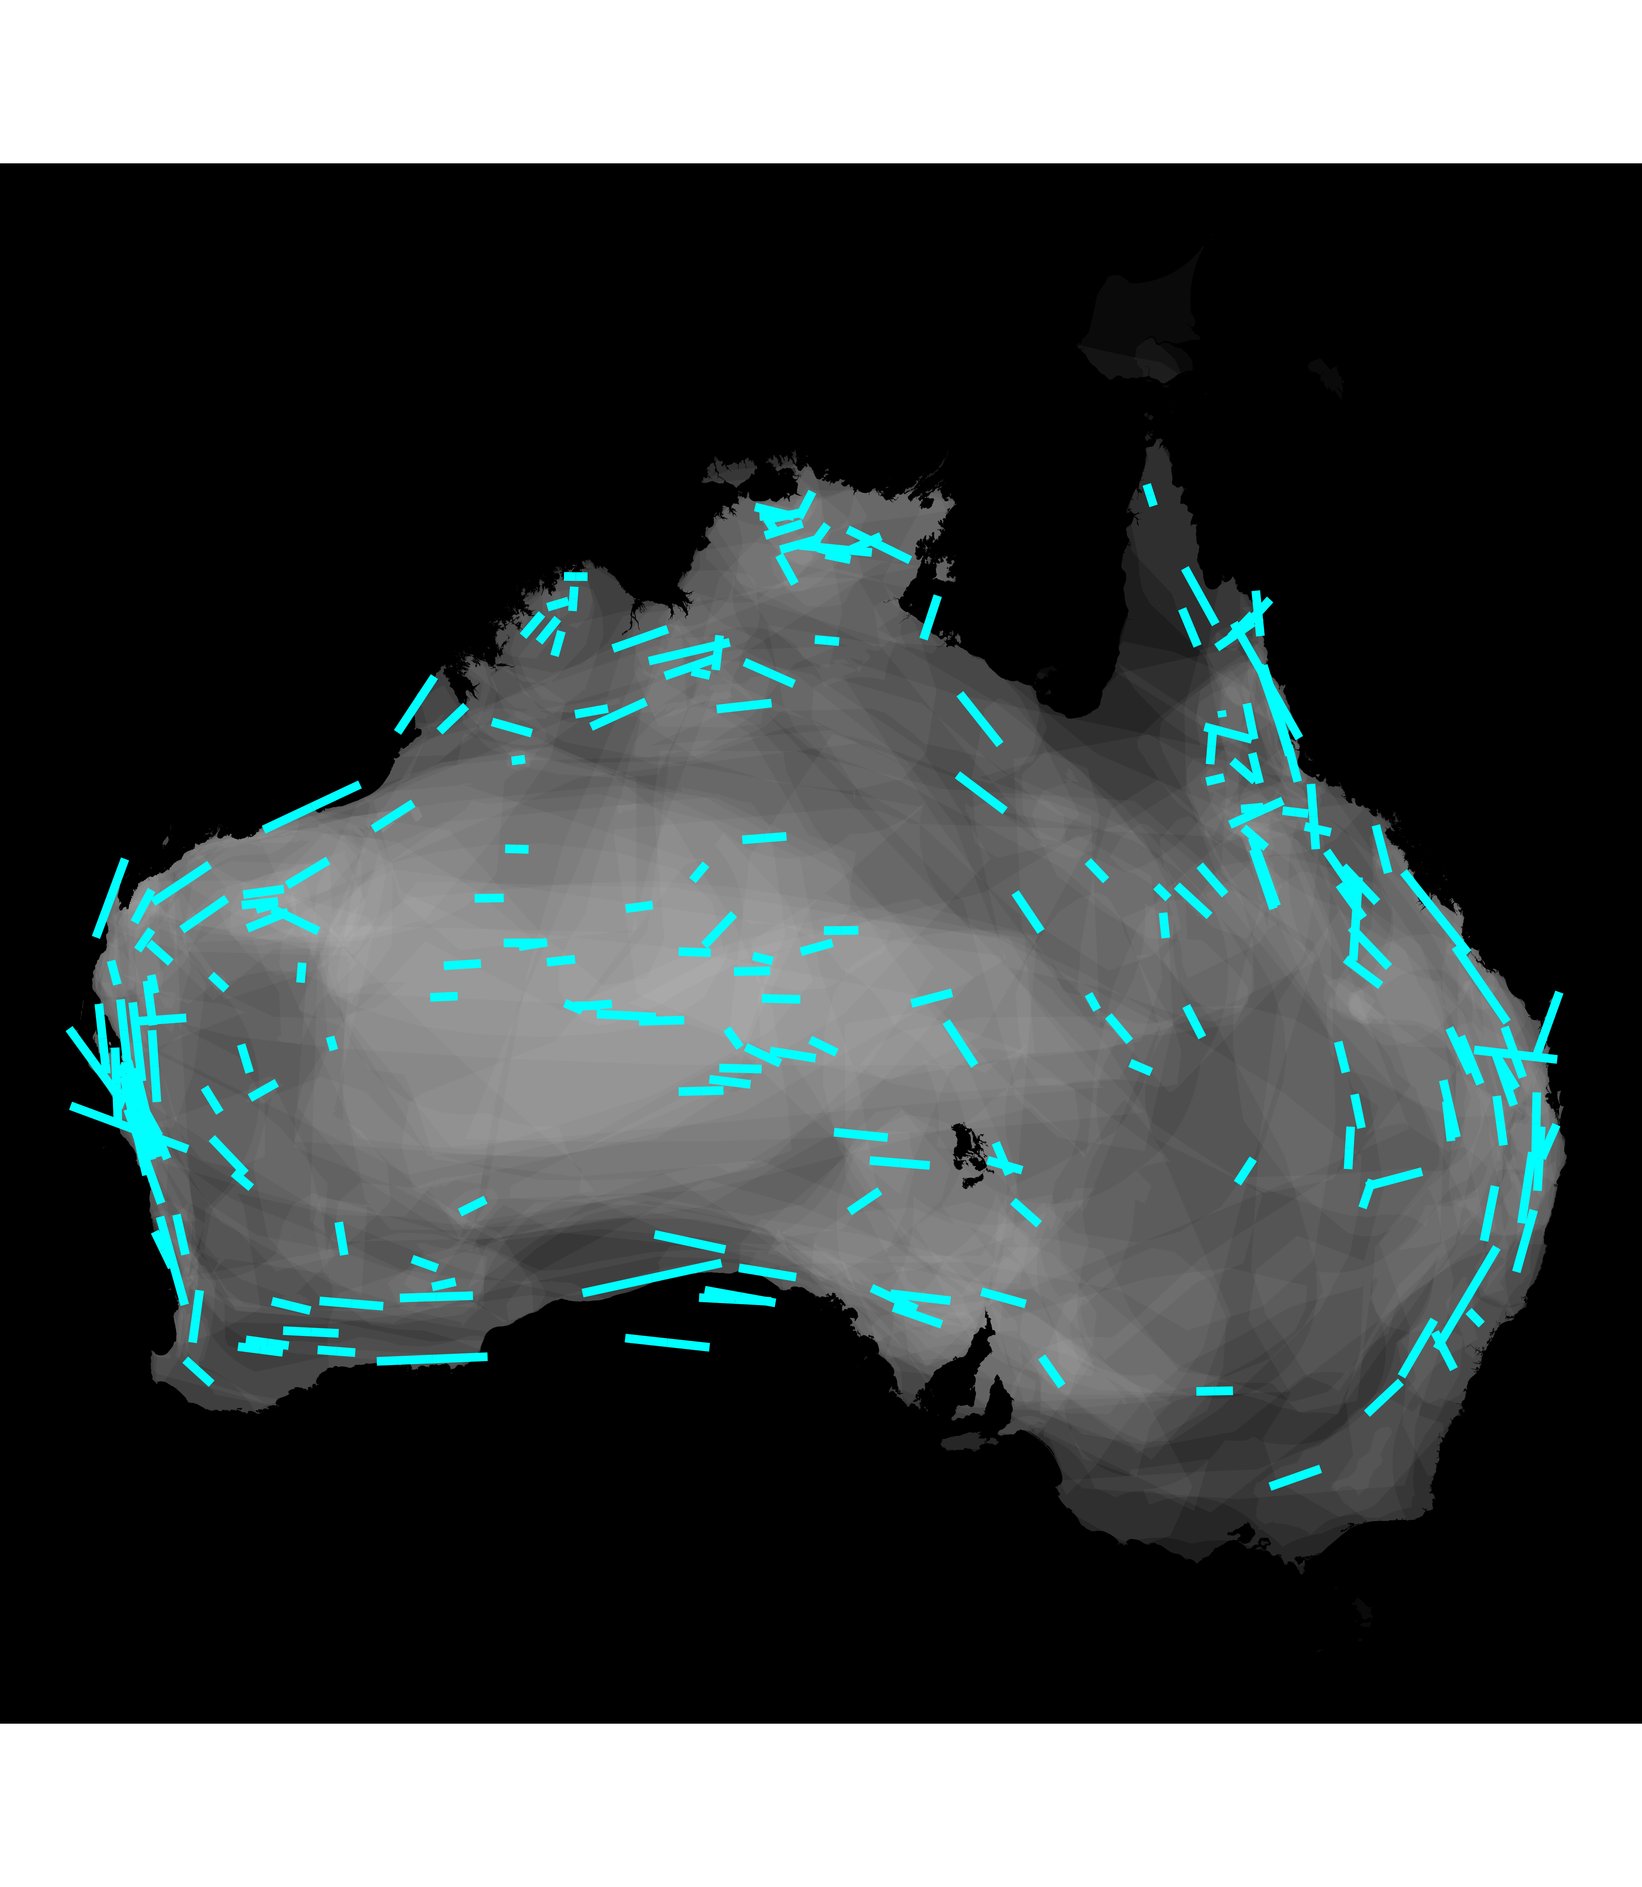
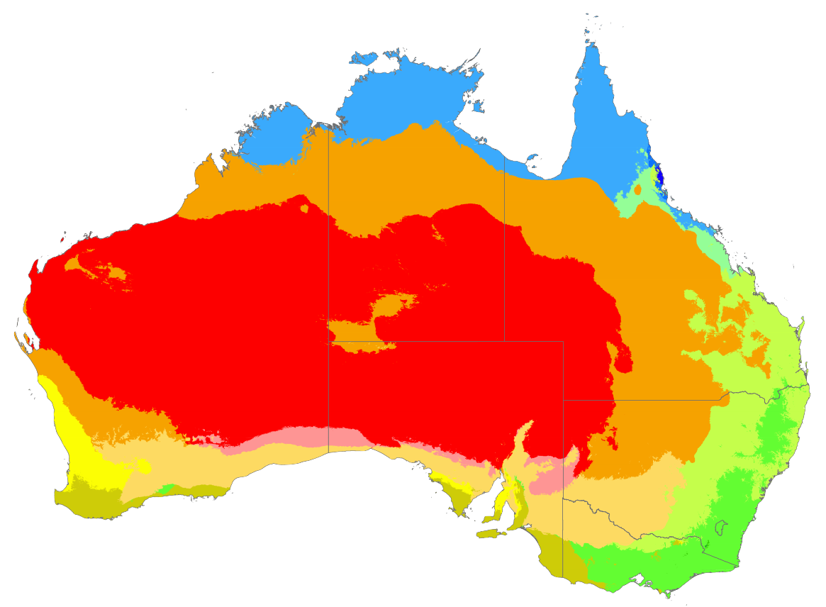
change in x relative to ancestral circle
total change relative to ancestral circle
change in x relative to ancestral circle
change in y relative to ancestral circle
extracting x component
$$\sqrt{\frac{exp⁡(a)}{π} } × \sqrt{\frac{{(1+c)}^{2}}{1+{(1+c)}^{2}}} ×\cos\left(h\right)+\frac{r ×\left[r × \sqrt{\frac{exp⁡(a)}{π} } × \sqrt{\frac{{(1+c)}^{2}}{1+{(1+c)}^{2}}} ×\cos\left(h\right)+s × \sqrt{\frac{exp⁡(a)}{π} } × \sqrt{\frac{{(1+c)}^{2}}{1+{(1+c)}^{2}}} × sin⁡(h)\right]}{z^{2}}$$
radius of ancestral circle
proportion of radius inherited by daughter circle
projection onto ellipse space

