Slide 1

ptimus
OPTIMIZING YOUR DAY, ONE PLANNER AT A TIME
Notes:
Through Optimus, we strive to declutter the chaos that comes with a busy workload and commitments on top of commitments. Our uniquely designed program enables everyday users to tackle their to-do lists and take back control of their schedules. Maintaining a healthy schedule that still leaves you with time to do the things you love is key to effectively managing our mental healths. For the first time, Optimus introduces daily affirmations and suggested tasks to help you focus on the right things in life. Our easy to use interface enables users to quickly setup their schedules, set priorities, monitor recorruing events and plan ahead. Our application is your one stop shop to optimizing the perfect schedule for your everyday needs!

Slide 2
Meet the Team
MALEK MEKAWI: PROJECT MANAGER
SULAYMAN SYED: FRONTEND DEVELOPER
AKIB SHAMSUDDIN: BACKEND DEVELOPER
JATHUSHAN KRISHNAMOHAN: FULL-STACK DEVELOPER

Slide 3


TO THE POINT PLANNING:
ORGANIZE YOUR DAILY LIFE
MOTIVATE AND REAFFIRM
KEEP YOURSELF BUSY AND HEALTHY
TAKE ADVANTAGE OF THE LITTLE THINGS
FOCUS ON WHAT MATTERS
PRIORITIZE WHAT MATTERS, TO YOU
STAY ON TOP OF EVERYTHING
PLAN AHEAD
Notes:
intuition and rationale behind the project and intention

Slide 4
THE DESIGN PROCESS:
ASK: DEVELOP AN APPLICATION CAPABLE OF TAKING IN EVENTS FROM THE USER AND DISPLAYING THE SCHEDULE IN AN EASY-TO-READ AND AESTHETIC FASHION
RESEARCH: PLANNING AHEAD AND ORGANIZING YOUR DAY TO DAY TASKS CAN BE STRESSFUL, OPTIMUS WORKS TO STREAMLINE THE DREADED PROCESS WHILE PROMOTING HEALTHY HABITS
IMAGINE: EVERYDAY PLANNING MADE EASY WITH DAILY AFFIRMATIONS AND SUGGESTED ACTIVITIES. OPTIMUS IS DEDICATED TO BEING YOUR ONE-STOP SHOP TO ALL THINGS PLANNING. WITH OPTIMUS, TRUST THAT YOUR LIFE IS ACCESSIBLE AT THE TOUCH OF YOUR FINGERTIPS.
Notes:
justify

Slide 5
THE DESIGN PROCESS - PLANNING:
PHASE ONE - THE USER: USING PYTHON, AN EVENTS CLASS WAS CREATED THAT UTILIZES A CONSTRUCTOR TO TAKE IN KEY INFORMATION. EACH INDIVIDUAL ATTRIBUTE OF AN EVENT IS PROCESSED BY THE CLASS TO AVOID CONFLICTS AND ERRORS IN SCHEDULING
THE CLASS PRIORITIZES EFFICIENCY WHERE IT MATTERS WHILE PROMOTING UTILITY, UNIVERSALITY, AND APPLICABILITY
INTERMEDIATE PHASE: THE CLASS MEMBERS ARE CONVERTED INTO A LIST AND CONVERTED VIA A UNIQUE ALGORITHM THAT GRAPHICALLY OUTPUTS THE SCHEDULE
THE PLOTLOI LIBRARY IS RESPONSIBLE FOR PROCESSING DATA FRAMES TO CREATE GRAPHS
PHASE TWO - THE OUTPUT: USING THE STREAMLIT LIBRARY, A UI IS CREATED TAKING ADVANTAGE OF THE LOTTIE ANIMATIONS. THE USER INPUT IS PASSED TO A SORTED LIST THAT OUTPUTS THE DATA IN AN ORGANIZED AND ACCESSIBLE MANNER. THE PANDAS LIBRARY IS KEY TO OPTIMIZING THE PROGRAM
Notes:
justify
phase 1: akib
intermediate: jt
phase 2: sulayman

Slide 6
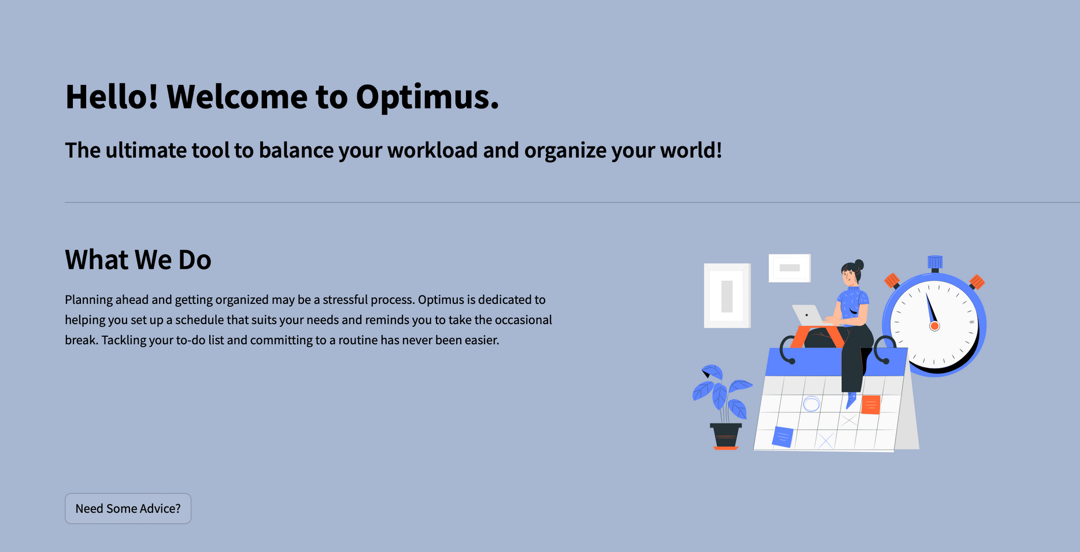
THE DESIGN PROCESS - PROTOTYPE:
Notes:
*landing screen
*walk through the program
*need some advice button (bonus q): if you click it, it'll give you suggested activities based on a predetermined uploaded list

Slide 7
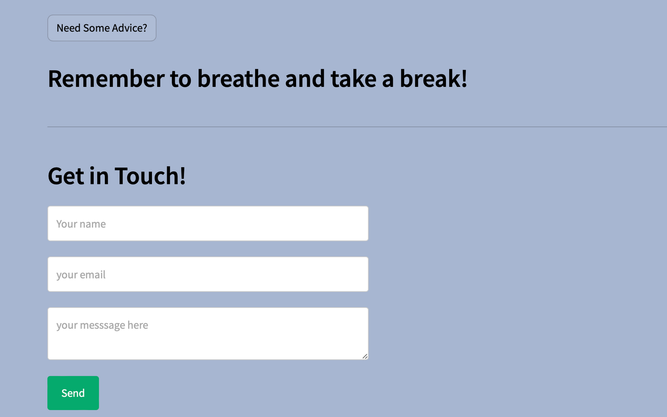
THE DESIGN PROCESS - PROTOTYPE:
Notes:
*The remember to breathe and take a break is part of the automated messaging system that automates a new motivational quote each time the program runs
*get in touch section shows how much we prioritize mental health and wellness as we constantly want to better our program and hear directly from our consumers

Slide 8
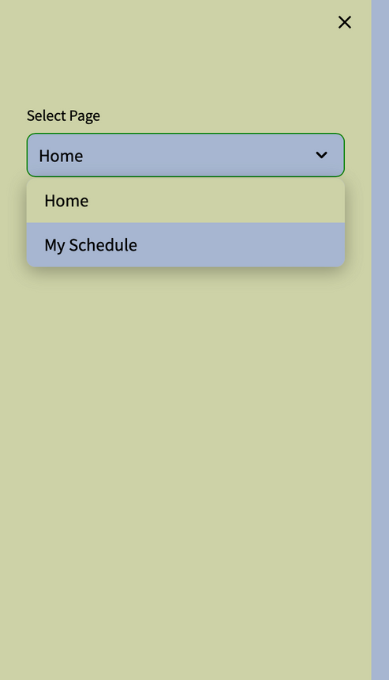
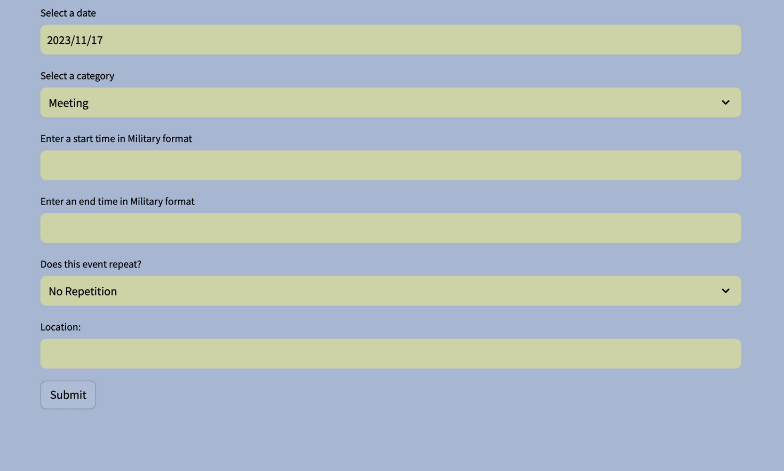
THE DESIGN PROCESS - PROTOTYPE:
Notes:
*side panel showing multiple displays exist in the code

Slide 9
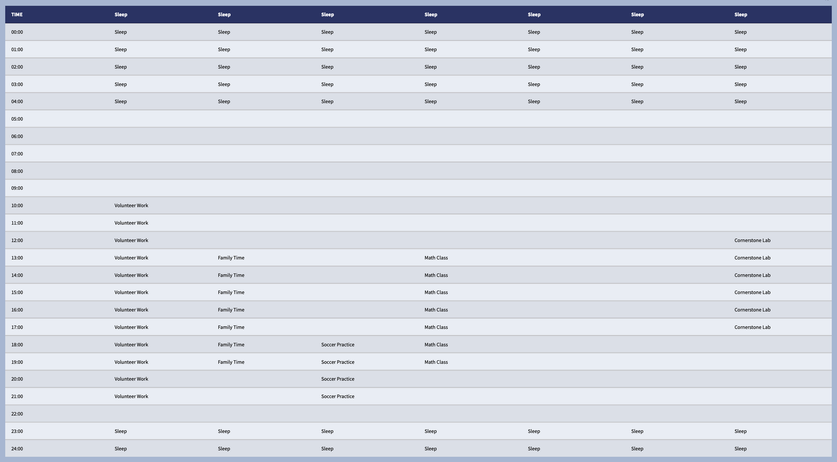
THE DESIGN PROCESS - PROTOTYPE:

Slide 10
AREAS OF IMPROVEMENT:
INITIALLY PLANNED ON USING OPEN AI TO HELP GENERATE NEW ELEMENTS BASED ON CURRENT AND ACTIVE DATA ON THE WEB
CREATES A DYNAMICALLY VARIABLE EXPERIENCE FOR THE USER
PYTHON WAS THE BEST LANGUAGE AVAILABLE FOR THE CONTEXT OF THE PROJECT, HOWEVER ITS LIBRARIES REQUIRE STRICT AND SPECIFIC PARAMETERS MAKING IT DIFFICULT TO NAVIGATE
THE INTERMEDIATE PHASE WAS CRUCIAL TO BRIDGING THE GAP BETWEEN THE INPUT AND EXPECTED OUTPUT

Slide 11
ptimus
PROGRAM IN REVIEW

