Slide 1
displayIMU Intellectual Property (IP)
Frequently Asked Questions (FAQ)

Slide 2
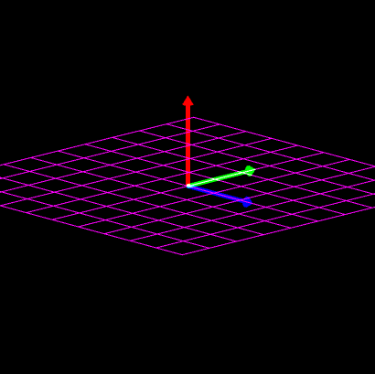
General Information
displayIMU is Open Source Software (OSS) licensed under the GNU General Public License, Version 2
under Section 1 of the GPL, the integrator must do the following:
  place a copyright notice and disclaimer of warranty on the software
  maintain record of such notices; and
  provide users a copy of the license
the current repository is compliant (see displayIMU/LICENSE)
if modifying the software before distributing, under Section 2 of the GPL, the integrator must also
  mark modified files to state files changed along with date changed
  if the software normally prints on-screen notices, the host program much display the copyright notice, disclaimer of warranty, and a license link
if the software is copied and distributed, that source code has to be made available for a charge no more that the cost of physically performing source distribution

Slide 3
Nominal Use Case
displayIMU “core” is designed to be a library managed separately from the application – including that library will not contaminate the host software
if no changes are to displayIMU, GPL license requirements can be met by simply citing the project, its warranty, and providing a link to the repository
if changes are made to source code within the repository, those changes must be made available to the greater public
the recommendation is also to push those changes back to original git repo as a branch to facilitate code review and future adoption

Slide 4
Application Programming Interface (API)
to facilitate integration and to minimize IP exposure from the host software, the ability to expand via function handles was added
upon certain events, the host software has the option to provide a function and variable pointer, which automatically be called by the library as needed
if the library is configured for multi-threaded support, this operation will be done in a non-blocking fashion to minimize impact to response time
it is recommended to use this interface to add “significant” new capability that the host organization wish to keep proprietary
this API can also be used to integrate complex interfaces such as a multi-point calibration integrated with a display/GUI
last, if the current function handles do not support whatever new feature or interface, the code can simply be modified to add a new API call
only this API code change would have to be available for redistribution and nothing else

Slide 5
Module Replacement
IMU core consists of modular units, each consisting their own configuration, independent state, and operate as independent of each other as possible
primary reason is to facilitate enabling/disabling features, allowing for high level features and processing performance trades
another benefit is to allow competing algorithms to be easily swapped out without significantly changes to the code base
if the host organization wants to replace functionality while maintaining the IP ownership, this can be done provided that code is not being modified or reused from the displayIMU project
in this case, it is recommended to preserve the interface and maintain the module codebase in a separate repository (minimize code contamination)

