Slide 1
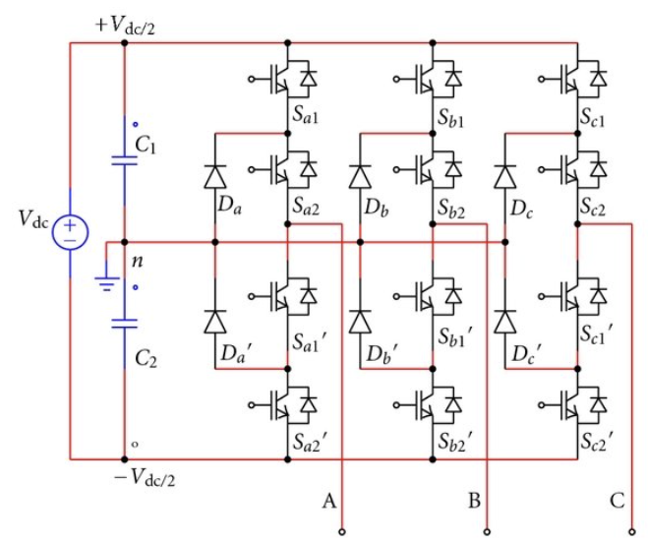

Slide 2




















Inverse Clarke + SPWM
or
SVPWM
Voltage error between two DC-link capacitors
$$V_{q}^{∗}$$
$$V_{α}^{∗}$$
PI
+
Inverse Park Transform
+
$$V_{d}^{∗}$$
$$V_{β}^{∗}$$
$$PWMs$$
$$ω_{m}^{∗}$$
$$I_{q}^{∗}$$
Diode Clamped Inverter
+
PI
+
PI
-
-
$$θ_{e}$$
$$ω_{m}$$
$$I_{q}$$
$$θ_{e}$$
$$I_{d}^{∗}$$
+
PI
-
$$I_{A}$$
$$A$$
$$B$$
$$C$$
$$I_{d}$$
Park Transform
Clarke Transform
$$I_{B}$$
PMSM
Gain = Pole Pairs
$$ω_{m} , θ_{m}$$
Speed / Mechanical Position Decoding
$$ω_{e} , θ_{e}$$

Slide 3


















$$I_{q}^{∗}$$
$$V_{α}^{∗}$$
Inverse Clarke + SPWM
or
SVPWM
$$V_{q}^{∗}$$
Inverse Park Transform
+
PI
-
$$V_{β}^{∗}$$
$$PWMs$$
$$I_{q}$$
$$I_{d}^{∗}$$
$$V_{d}^{∗}$$
+
PI
Diode Clamped Inverter
-
$$I_{d}$$
$$θ_{e}$$
$$θ_{e}$$
$$I_{A}$$
$$A$$
$$B$$
$$C$$
Park Transform
Clarke Transform
$$I_{B}$$
PMSM
Gain = Pole Pairs
$$ω_{m} , θ_{m}$$
Speed / Mechanical Position Decoding
$$ω_{e} , θ_{e}$$

Slide 4






$$ω_{e}∙(I_{d}∙L_{s}+φ_{m}^{′})$$
Inverse Clarke + SPWM
or
SVPWM
Voltage error between two DC-link capacitors
+
$$V_{q}^{∗}$$
$$V_{α}^{∗}$$
PI
+
Inverse Park Transform
+
$$V_{d}^{∗}$$
$$V_{β}^{∗}$$
$$PWMs$$
$$ω_{m}^{∗}$$
$$I_{q}^{∗}$$
+
PI
+
PI
Diode Clamped Inverter
-
-
$$ω_{m}$$
$$I_{q}$$
$$θ_{e}$$
$$ω_{e}∙I_{q}∙L_{s}$$
-
+
$$θ_{e}$$
$$I_{d}^{∗}$$
+
PI
-
$$I_{A}$$
$$A$$
$$B$$
$$C$$
$$I_{d}$$
Park Transform
Clarke Transform
$$I_{B}$$
PMSM
Gain = Pole Pairs
$$ω_{m} , θ_{m}$$
Speed / Mechanical Position Decoding
$$ω_{e} , θ_{e}$$

Slide 5












$$β$$
$$q$$
$$β$$
$$B$$
$$q$$
$$d$$
$$A$$
N
$$d$$
rotor
$$α$$
S
$$θ_{e}$$
$$α$$
stator
$$C$$

Slide 6













$$β$$
$$B$$
II
$$U_{6} (110)$$
$$U_{2} (010)$$
III
I
$$A$$
$$U_{4} (100)$$
$$U_{3} (011)$$
$$U_{0} (000)$$
$$U_{7} (111)$$
$$α$$
IV
VI
$$C$$
$$U_{1} (001)$$
V
$$U_{5} (101)$$

Slide 7
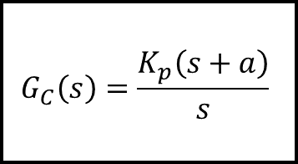


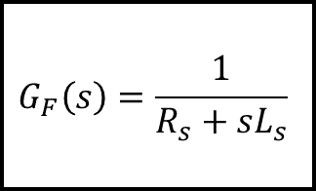


$$G_{C}\left(s\right)=\frac{K_{p}\left(s+a\right)}{s}$$
$$G_{F}\left(s\right)=\frac{1}{{R_{s}+sL}_{s}}$$
$$e_{I}(s)$$
$$I_{ref}(s)$$
+
-
$$V_{INV}(s)$$
$$I_{AC}(s)$$

Slide 8
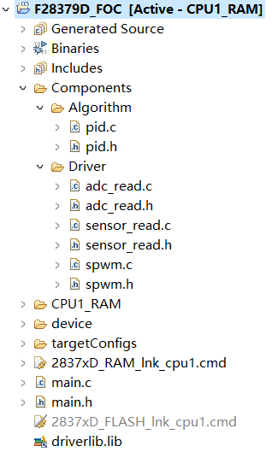


User Created Lib
$$⇒$$
Library, Makefiles, etc.
$$⇒$$
Main (program runs here)

