Slide 1
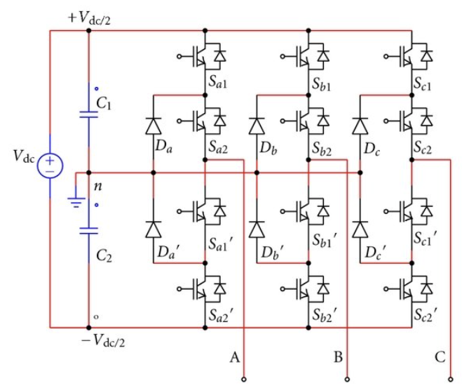

Slide 2




















Voltage error between two DC-link capacitors
$$V_{q}^{∗}$$
$$V_{α}^{∗}$$
Inverse Clarke + SPWM
PI
+
Inverse Park Transform
+
$$V_{d}^{∗}$$
$$V_{β}^{∗}$$
$$PWMs$$
$$ω_{m}^{∗}$$
$$I_{q}^{∗}$$
Diode Clamped Inverter
+
PI
+
PI
-
-
$$θ_{e}$$
$$ω_{m}$$
$$I_{q}$$
$$θ_{e}$$
$$I_{d}^{∗}$$
+
PI
-
$$I_{A}$$
$$A$$
$$B$$
$$C$$
$$I_{d}$$
Park Transform
Clarke Transform
$$I_{B}$$
PMSM
Gain = Pole Pairs
$$ω_{m} , θ_{m}$$
Speed / Mechanical Position Decoding
$$ω_{e} , θ_{e}$$

Slide 3


















$$I_{q}^{∗}$$
$$V_{q}^{∗}$$
$$V_{α}^{∗}$$
Inverse Clarke + SPWM
+
PI
Inverse Park Transform
-
$$V_{β}^{∗}$$
$$PWMs$$
$$I_{q}$$
$$I_{d}^{∗}$$
$$V_{d}^{∗}$$
+
PI
Diode Clamped Inverter
-
$$I_{d}$$
$$θ_{e}$$
$$θ_{e}$$
$$I_{A}$$
$$A$$
$$B$$
$$C$$
Park Transform
Clarke Transform
$$I_{B}$$
PMSM
Gain = Pole Pairs
$$ω_{m} , θ_{m}$$
Speed / Mechanical Position Decoding
$$ω_{e} , θ_{e}$$

Slide 4






$$ω_{e}∙(I_{d}∙L_{s}+φ_{m}^{′})$$
Voltage error between two DC-link capacitors
+
$$V_{q}^{∗}$$
$$V_{α}^{∗}$$
Inverse Clarke + SPWM
PI
+
Inverse Park Transform
+
$$V_{d}^{∗}$$
$$V_{β}^{∗}$$
$$PWMs$$
$$ω_{m}^{∗}$$
$$I_{q}^{∗}$$
+
PI
+
PI
Diode Clamped Inverter
-
-
$$ω_{m}$$
$$I_{q}$$
$$θ_{e}$$
$$ω_{e}∙I_{q}∙L_{s}$$
-
+
$$θ_{e}$$
$$I_{d}^{∗}$$
+
PI
-
$$I_{A}$$
$$A$$
$$B$$
$$C$$
$$I_{d}$$
Park Transform
Clarke Transform
$$I_{B}$$
PMSM
Gain = Pole Pairs
$$ω_{m} , θ_{m}$$
Speed / Mechanical Position Decoding
$$ω_{e} , θ_{e}$$

Slide 5
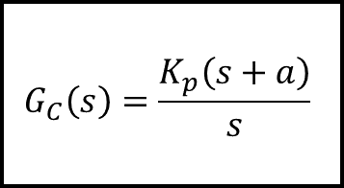


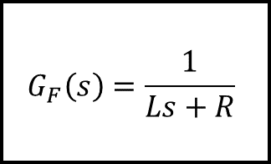


$$G_{C}\left(s\right)=\frac{K_{p}\left(s+a\right)}{s}$$
$$G_{F}\left(s\right)=\frac{1}{Ls+R}$$
$$e_{I}(s)$$
$$I_{ref}(s)$$
+
-
$$V_{INV}(s)$$
$$I_{AC}(s)$$

