Slide 1
Understanding Driver Behavior
Studies on NYC Taxi Data
Daniel Abramson
Yoon Kim
Sylvia Zhao

Slide 2
Q1: Driver Productivity
Are there productivity differences among drivers?
Do some drivers consistently make more revenue per unit time worked than others?

Slide 3

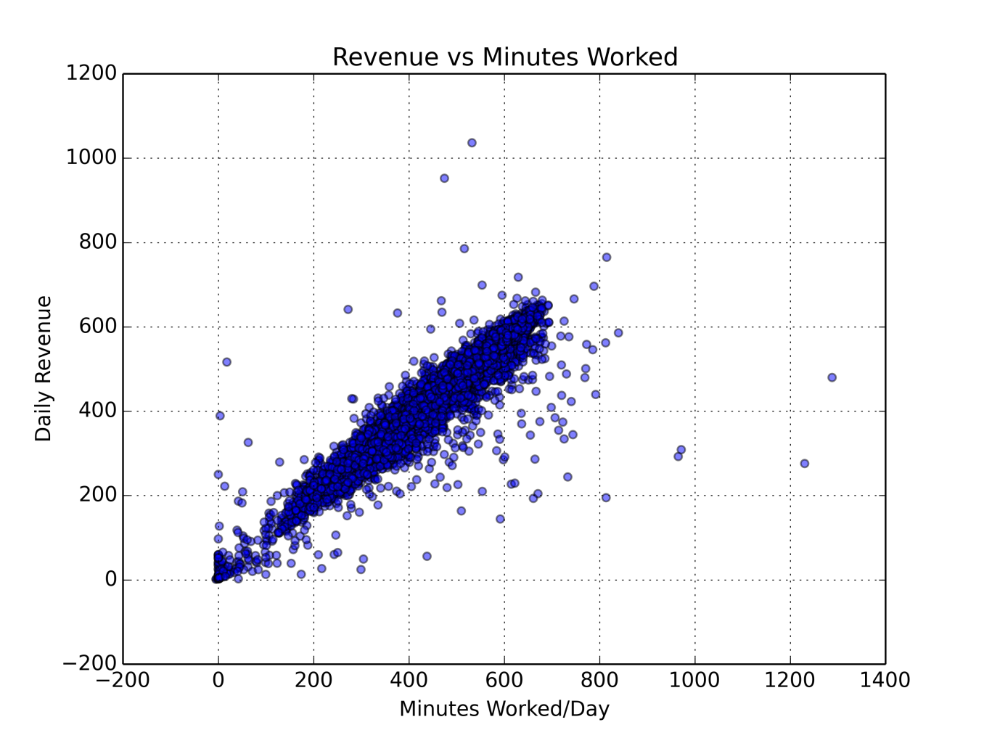
Q1: Driver Productivity
There are some outliers, but trend is largely linear

Slide 4
Q2: Fare Sensitivities
What factors like day of the week, month, hour affect revenues?
How do these factors affect them?

Slide 5
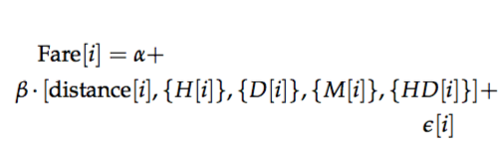


Q2: Fare Sensitivities
Are these sensitivities the same for 2010 and 2013?

Slide 6
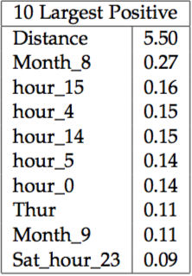
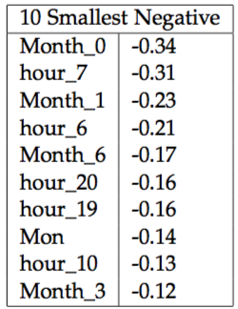
Q2: Fare Sensitivities

Slide 7
Q3: Overcharging Drivers
Do some drivers consistently overcharge?
Do customers notice this, and thus give less tip on trips on which they feel like they were overcharged?

Slide 8
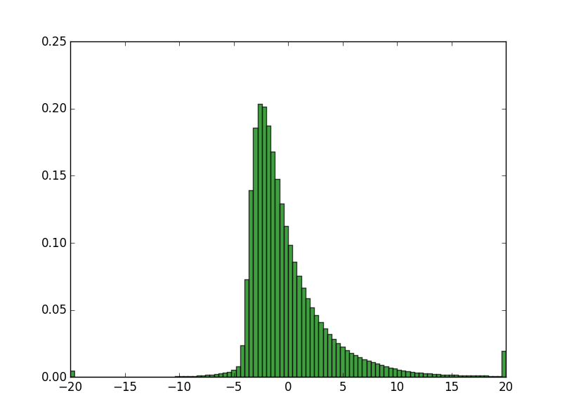

Q3: Overcharging Drivers
Fare (excluding tip) = f(Distance , Time, Day of the week, Month, …)
Plot of Actual - Predicted
%
$

Slide 9
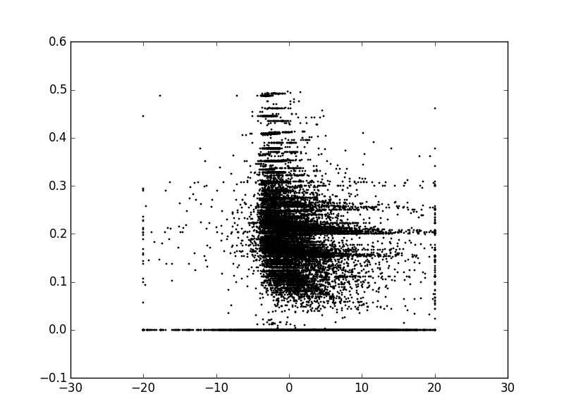
Q3: Overcharging Drivers
Tip %
Actual – Predicted ($)
Weak relationship between residual (actual – predicted) and tip %

Slide 10
Q4: Driver Tip Hot-Hand
Do previous earnings affect driver behavior?
Is there some sort of ’hot-hand’ with respect to tips—i.e., if a driver receives an above-median tip, is he/she more likely to receive and above-median tip the next ride?

Slide 11

Q4: Driver Tip Hot-Hand
We form the tip statistic and aggregate

Slide 12
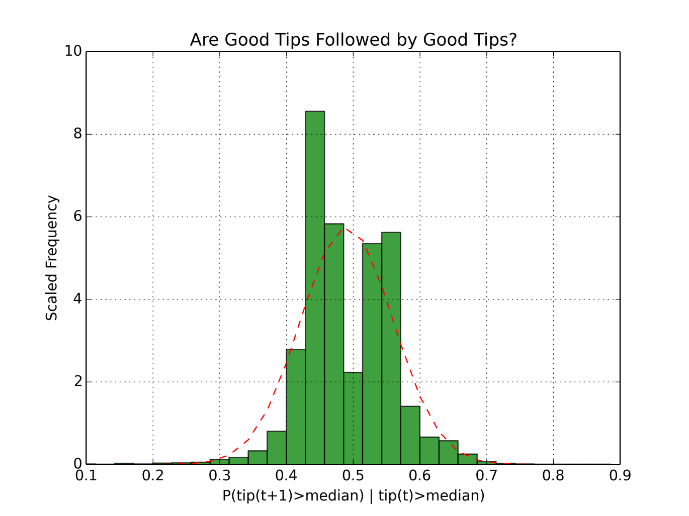
Q4: Driver Tip Hot-Hand
Distribution seems weakly bimodal: some drivers are more motivated, some drivers are less motivated

Slide 13
Q5: Income Effect on Tip
How does income affect the tip %?

Slide 14
Q5: Income Effect on Tip
1. Construct grid of zip codes from Lat-Long via geocoding
2. Get dropoff zip code for each trip (assume going home)
3. Match zip code data to census data to get median income

Slide 15
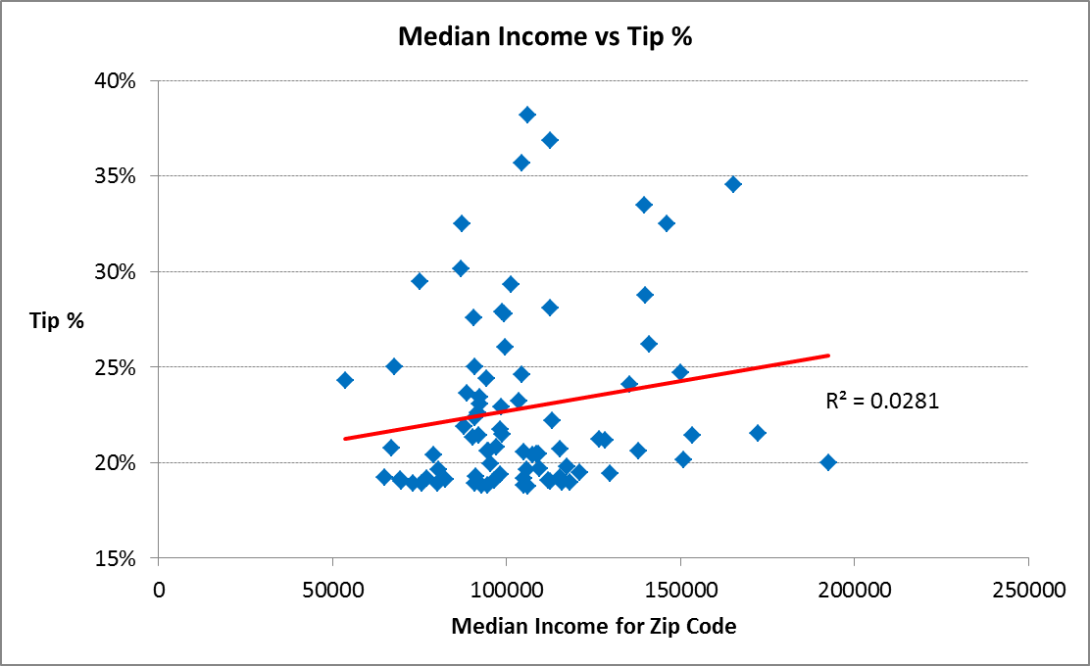
Q5: Income Effect on Tip
Weak relationship

