Slide 1
Understanding Driver Behavior
Studies on NYC Taxi Data
Daniel Abramson
Yoon Kim
Sylvia Zhao

Slide 2
Q1: Driver Productivity
Are there productivity differences among drivers?
Do some drivers consistently make more revenue per unit time worked than others?

Slide 3

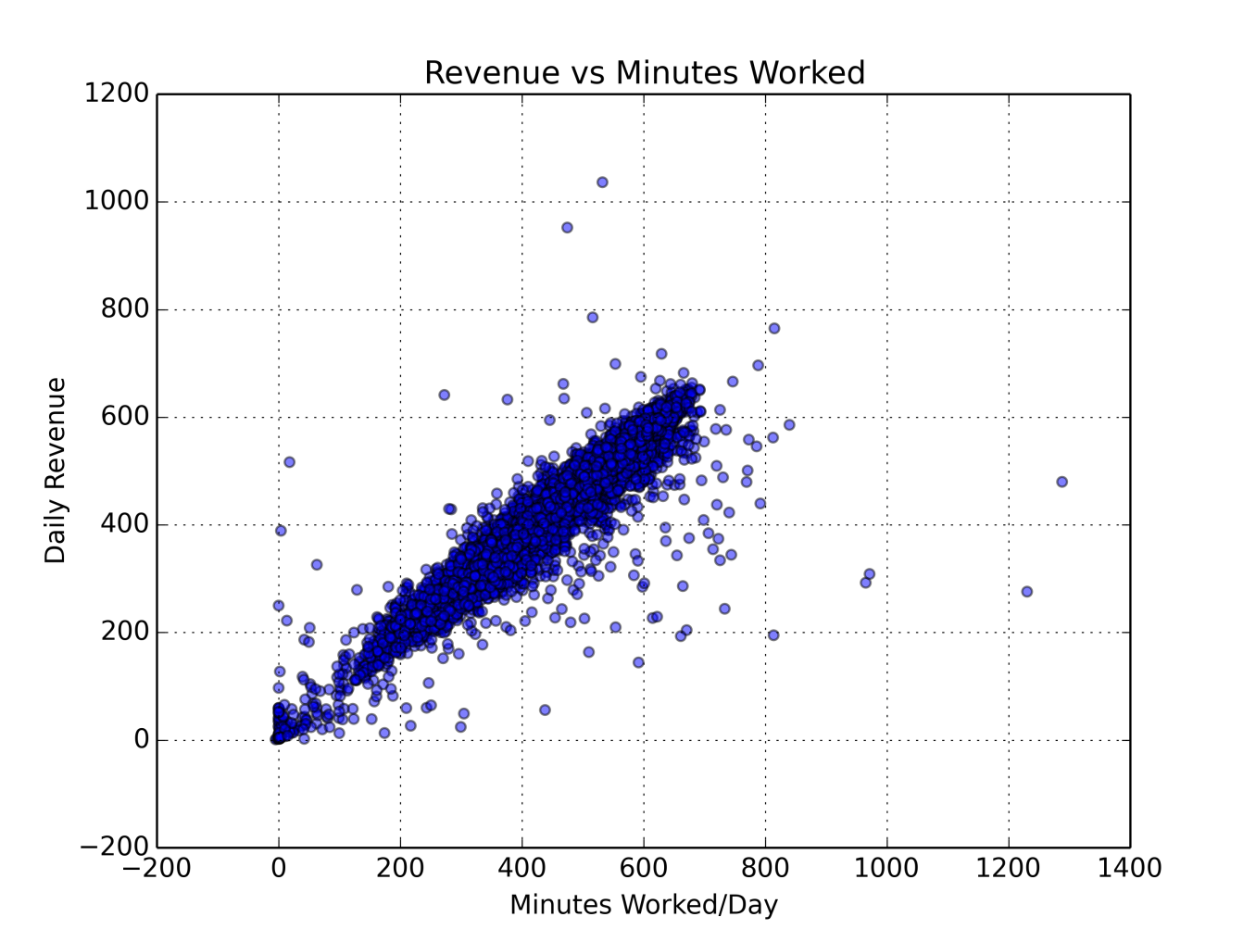
Q1: Driver Productivity
There are some outliers, but trend is largely linear

Slide 4
Q2: Fare Sensitivities
What factors like day of the week, month, hour affect revenues?
How do these factors affect them?

Slide 5
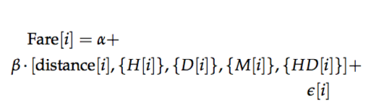


Q2: Fare Sensitivities
Are these sensitivities the same for 2010 and 2013?

Slide 6
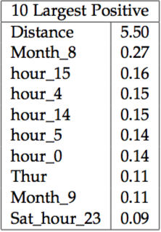
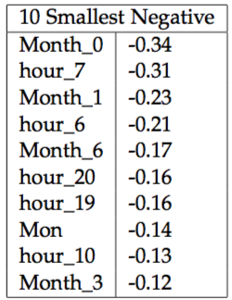
Q2: Fare Sensitivities

Slide 7
Q3: Overcharging Drivers
Do some drivers consistently overcharge?
Do customers notice this, and thus give less tip on trips on which they feel like they were overcharged?

Slide 8
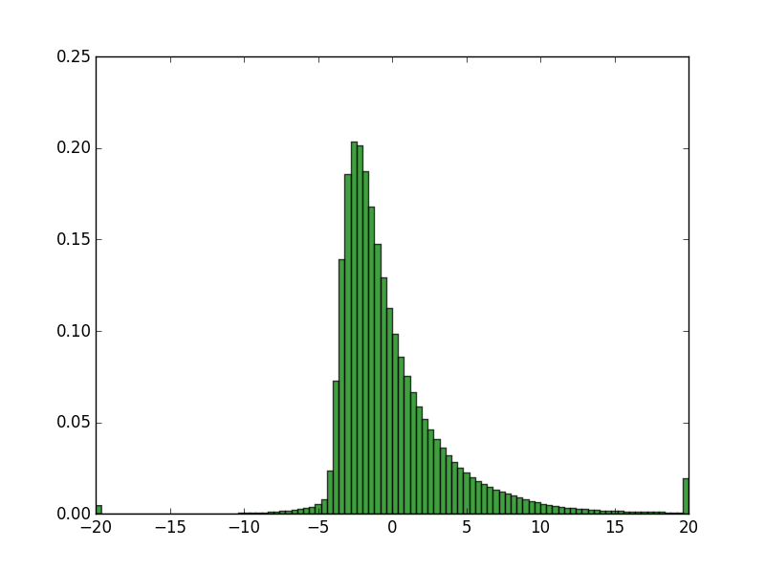

Q3: Overcharging Drivers
Fare (excluding tip) = f(Distance , Time, Day of the week, Month, …)
Plot of Actual - Predicted
%
$

Slide 9
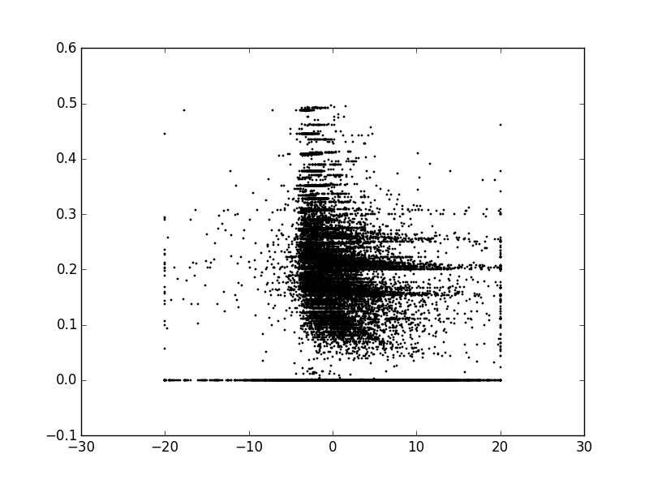
Q3: Overcharging Drivers
Tip %
Actual – Predicted ($)
Weak relationship between residual (actual – predicted) and tip %

Slide 10
Q4: Driver Tip Hot-Hand
Do previous earnings affect driver behavior?
Is there some sort of ’hot-hand’ with respect to tips—i.e., if a driver receives an above-median tip, is he/she more likely to receive and above-median tip the next ride?

Slide 11

Q4: Driver Tip Hot-Hand
We form the tip statistic and aggregate

Slide 12
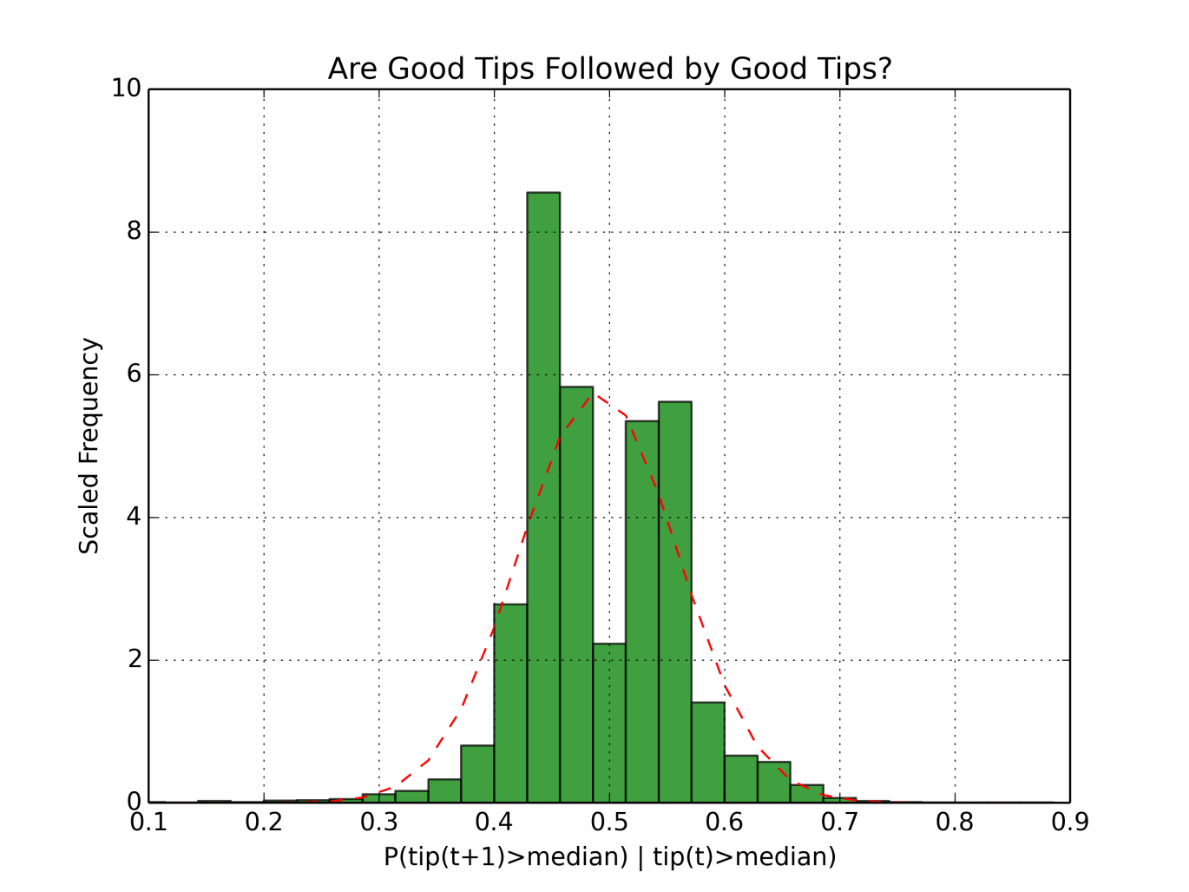
Q4: Driver Tip Hot-Hand
Distribution seems weakly bimodal: some drivers are more motivated, some drivers are less motivated

Slide 13
Q5: Income Effect on Tip
How does income affect the tip %?

Slide 14
Q5: Income Effect on Tip
1. Construct grid of zip codes from Lat-Long via geocoding
2. Get dropoff zip code for each trip (assume going home)
3. Match zip code data to census data to get median income

Slide 15
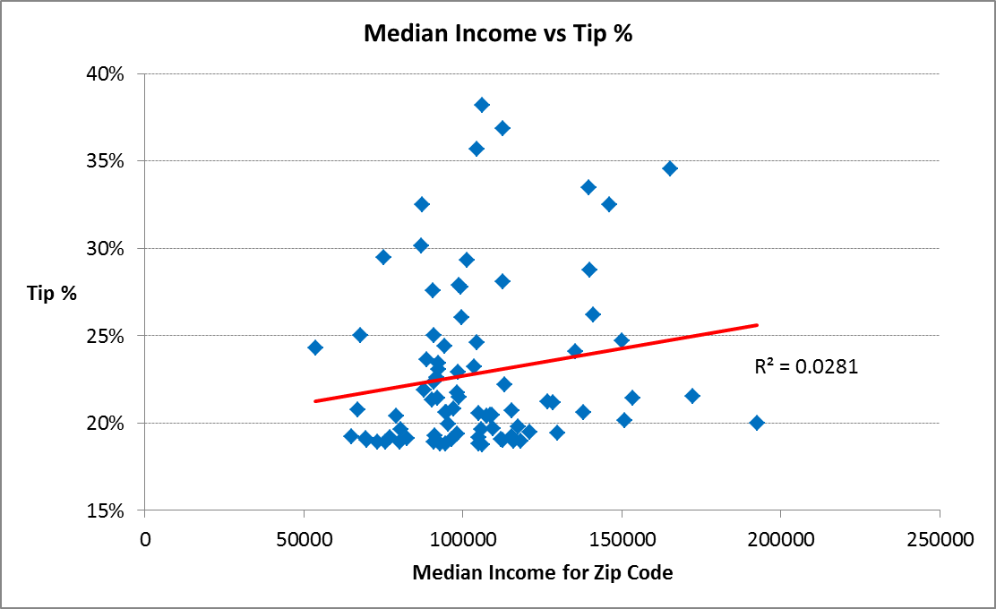
Q5: Income Effect on Tip
Weak relationship

Slide 16
Q6: Aggregate Trends
Do passengers tip more with respect to payment type and number of riders?
Is driver behavior affected by tipping trends?
How do number of passengers, tips, payment type, and day of week interact?

Slide 17
Q6: Aggregate Trends

Slide 18
Q6: Aggregate Trends

Slide 19
Q6: Aggregate Trends

Slide 20
Q6: Aggregate Trends

Slide 21
Q&A

