Slide 1
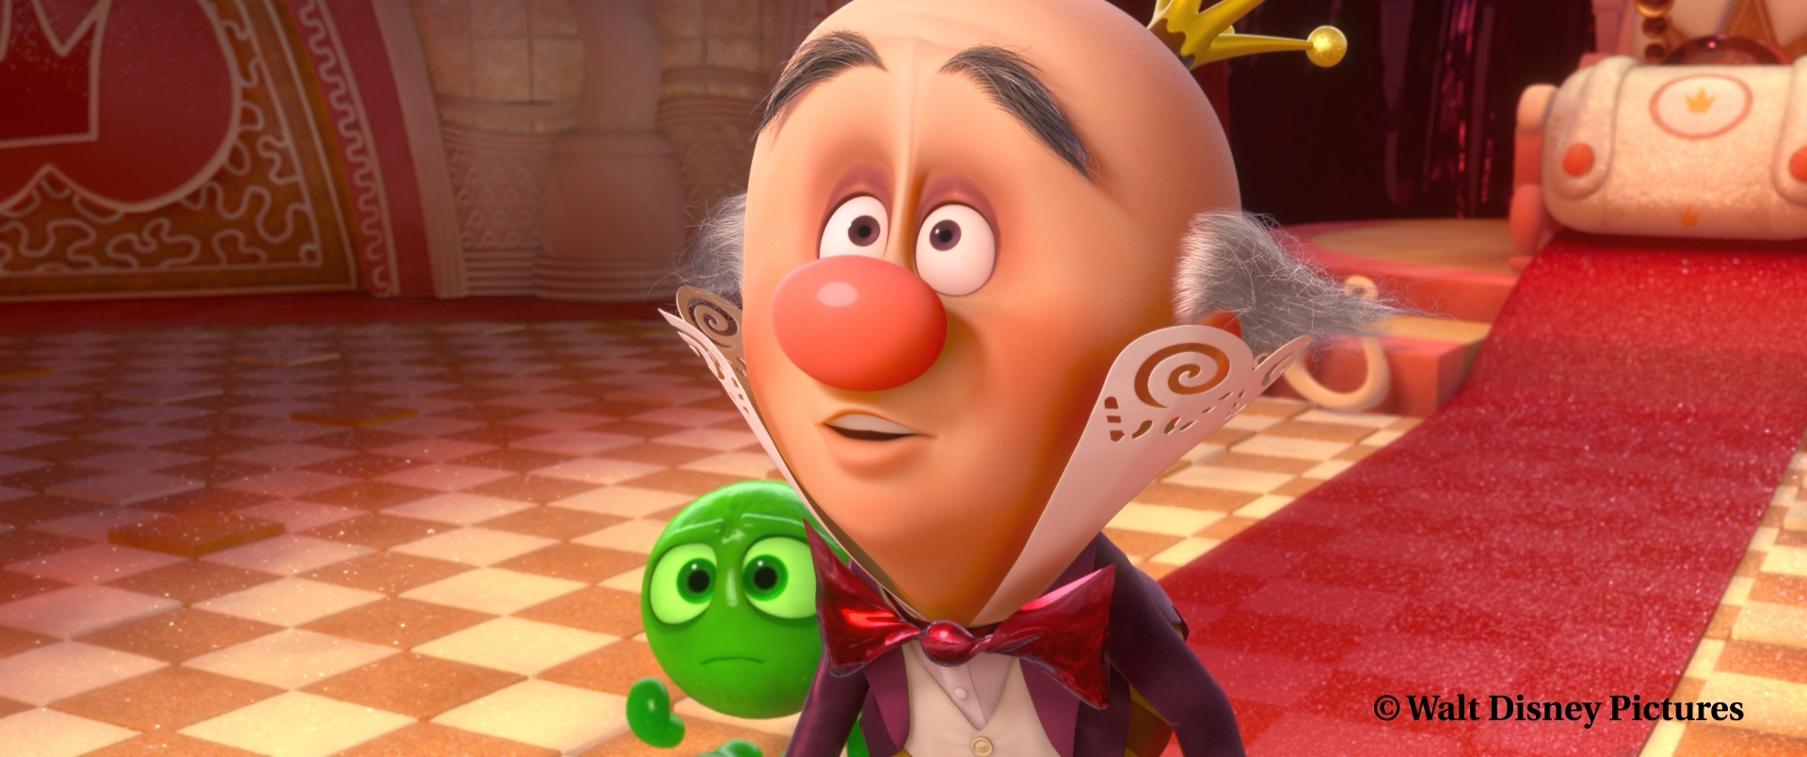
Physically-Based Shading at Disney
Figure 21: Production still from Wreck-It Ralph.
Burley, Brent, and Walt Disney Animation Studios. "Physically-based shading at disney." Acm siggraph. Vol. 2012. No. 2012. vol. 2012, 2012.

Slide 2
There are many new concepts here
This picture just doesn't look like it belongs in the same era as the other papers.
Physically-Based Shading at Disney
I selected an image from Disney's 2012 SIGGRAPH paper, Physically-Based Shading at Disney. The specific image is a production still from the movie Wreck-It Ralph.
Technically, shading acts as a solver for the BRDF. BRDF stands for Bidirectional Reflectance Distribution Function. It describes the rules about the interaction between light and material surfaces. The term 'bidirectional' indicates that light propagation is determined by both the light direction and the viewing direction.
In this work Disney introduced 11 famous intuitive parameters, effectively translating complex physical parameters into artist-friendly terms such as ‘Metallic’ and ‘Roughness.’ This approach unified the representation of complex materials—like car paint (via the Clearcoat parameter) and cloth (via the Sheen parameter)—and established a foundational industrial standard for modern real-time game engines.
Burley, Brent, and Walt Disney Animation Studios. "Physically-based shading at disney." Acm siggraph. Vol. 2012. No. 2012. vol. 2012, 2012.

Slide 3
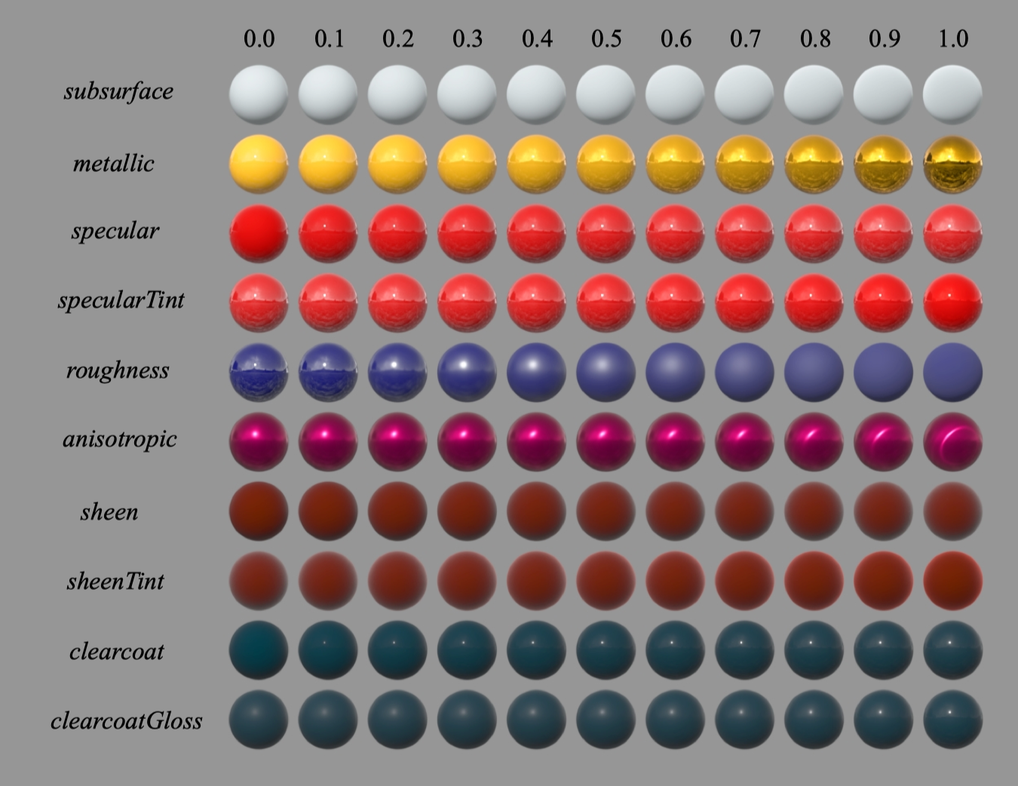
Figure 16: Examples of the eﬀect of our BRDF parameters. Each parameter is varied across the row from zero to one with the other parameters held constant.

Slide 4
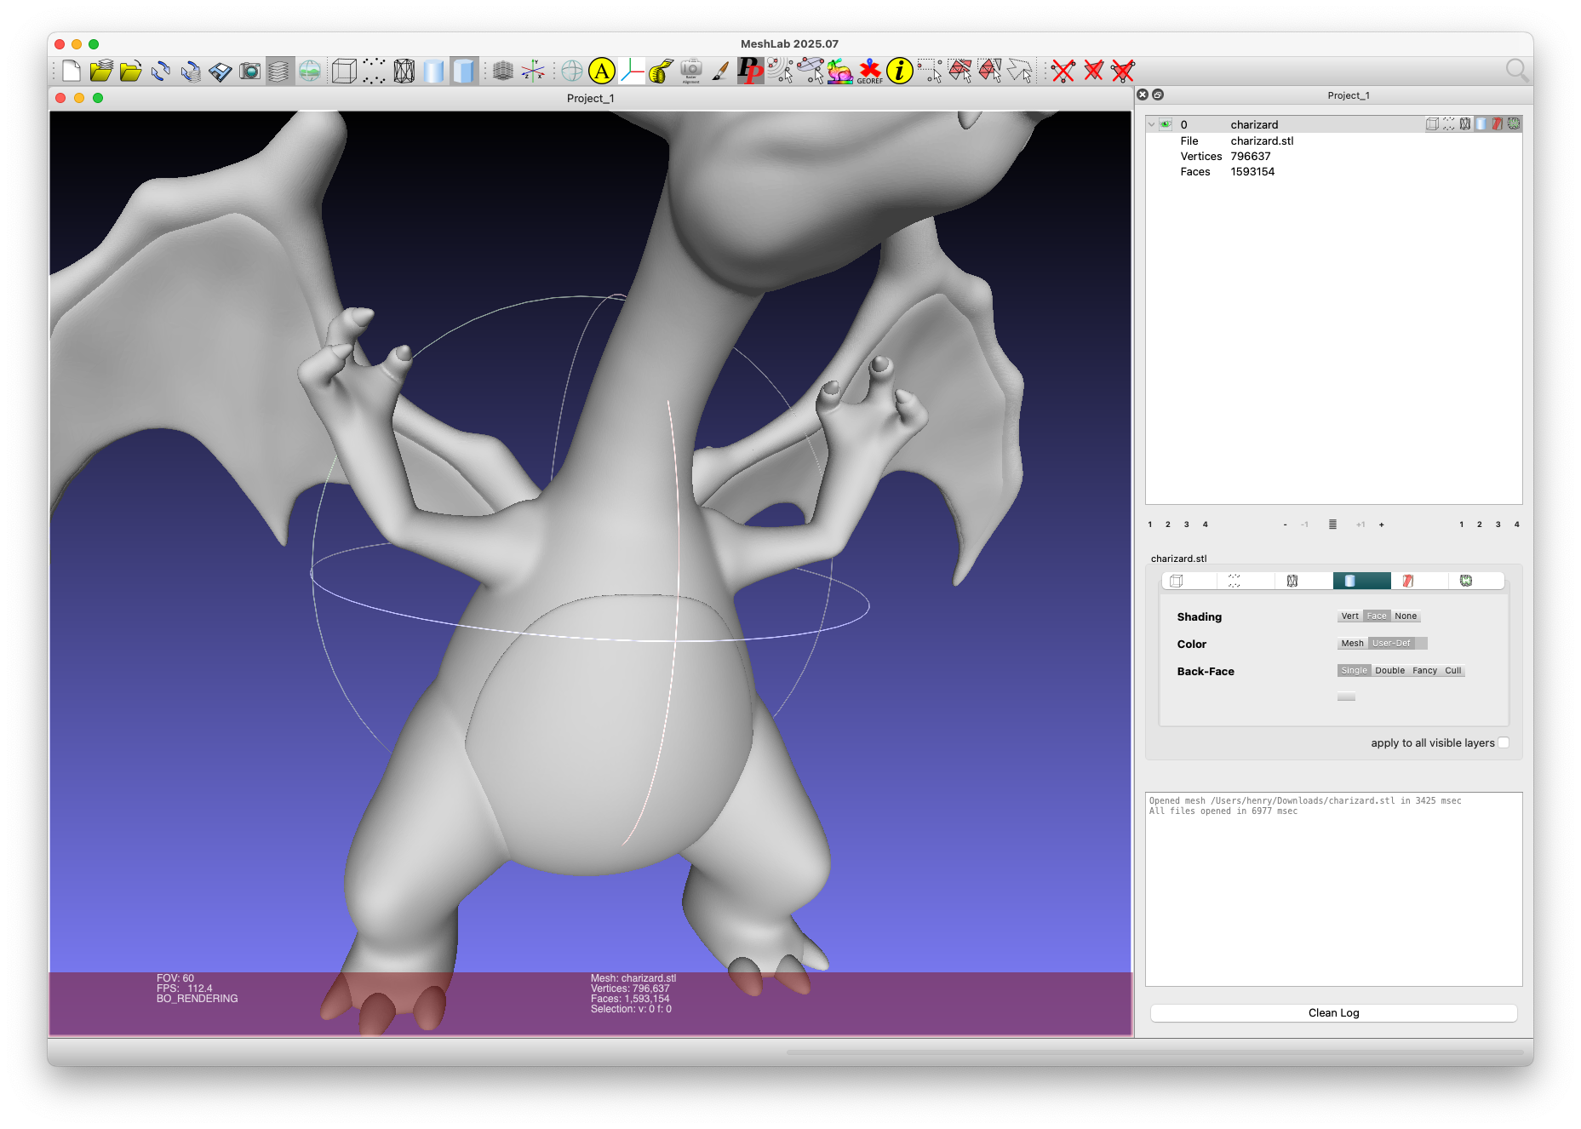
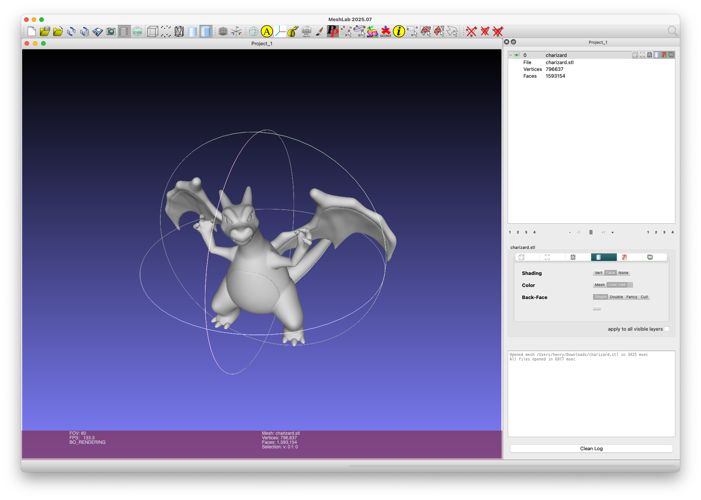
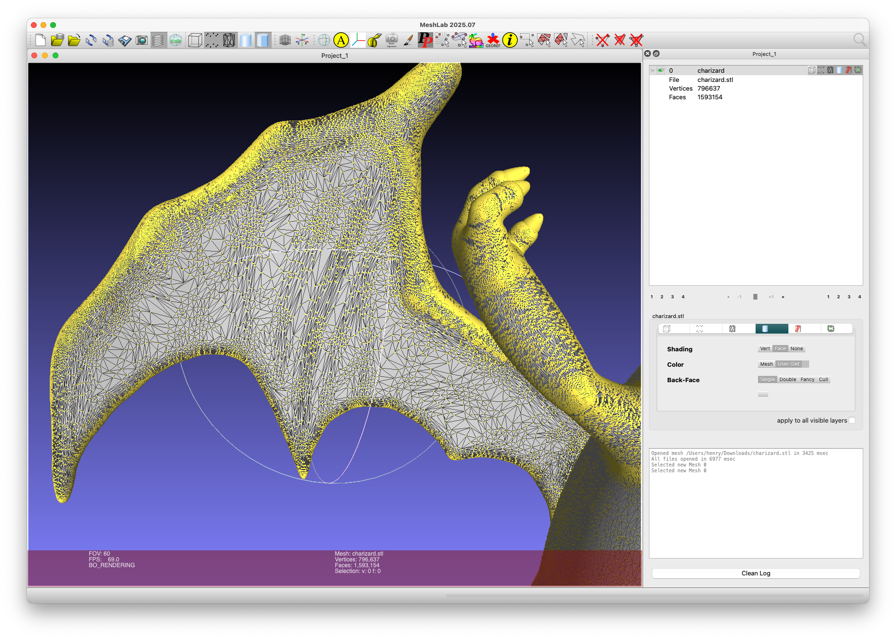
Charizard (Pokémon)

