Slide 1
Relationships Between Health Indicators and Number of Breweries
Steven Decker
Nashville Software School
LinkedIn
https://www.linkedin.com/in/stevendecker3
GitHub
https://github.com/st-decker

Slide 2
Why
Beer and specifically the brewery industry is large, profitable, and growing
“Retail dollar sales of craft increased 6%, up to $29.3 billion, and now account for more than 25% of the $116.0 billion U.S. beer market” – Brewers Association
Love of beer and breweries
I have always been interested in beer and exploring breweries

Slide 3
Mission
Do any correlations exist between the number of breweries and different health indictors
Relations between regions, states, counties, cities
Where are most breweries?
What health measures specific to a certain regions are most affected by the number of breweries?
Observations

Slide 4
Tools Used
Python
(Geo)Pandas
Seaborn
Folium

Slide 5
The Data
BreweryDB API
Location and Brewery Data
County Health Rankings
Health Indicator Data
Census
Regional/Division Mapping
Simple Maps
FIPS Crosswalk

Slide 6
Preface
Relationships only point towards associations and not causations
According to County Health Rankings, all indicators used were already adjusted to a per capita of 100,000
There was some data loss

Slide 7
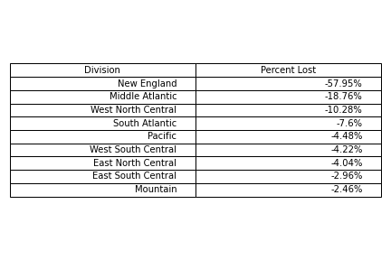
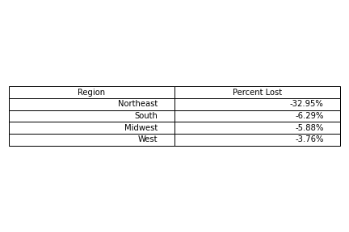
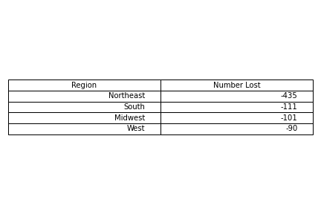
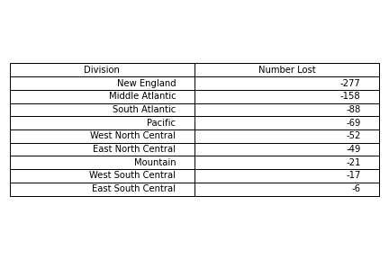
Data Loss
Through merges (inner join)
Not all counties/fips codes matched
FIPS codes were used to match to counties
Zip codes avoided

Slide 8
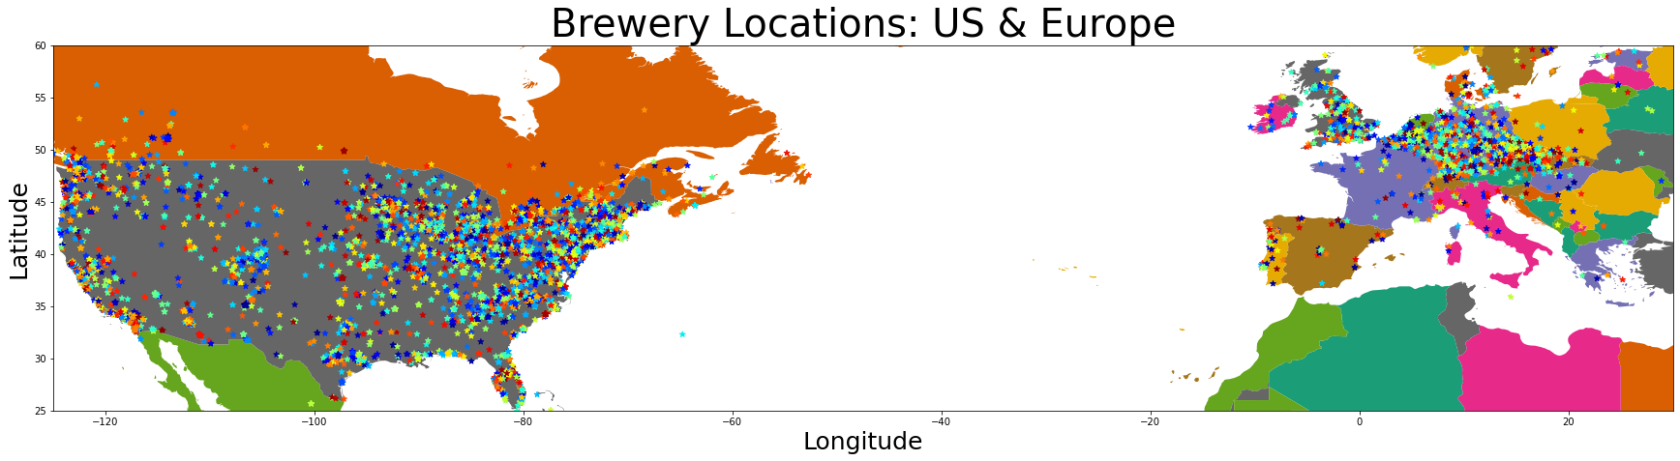
Most of the data is located between Europe and the United States

Slide 9
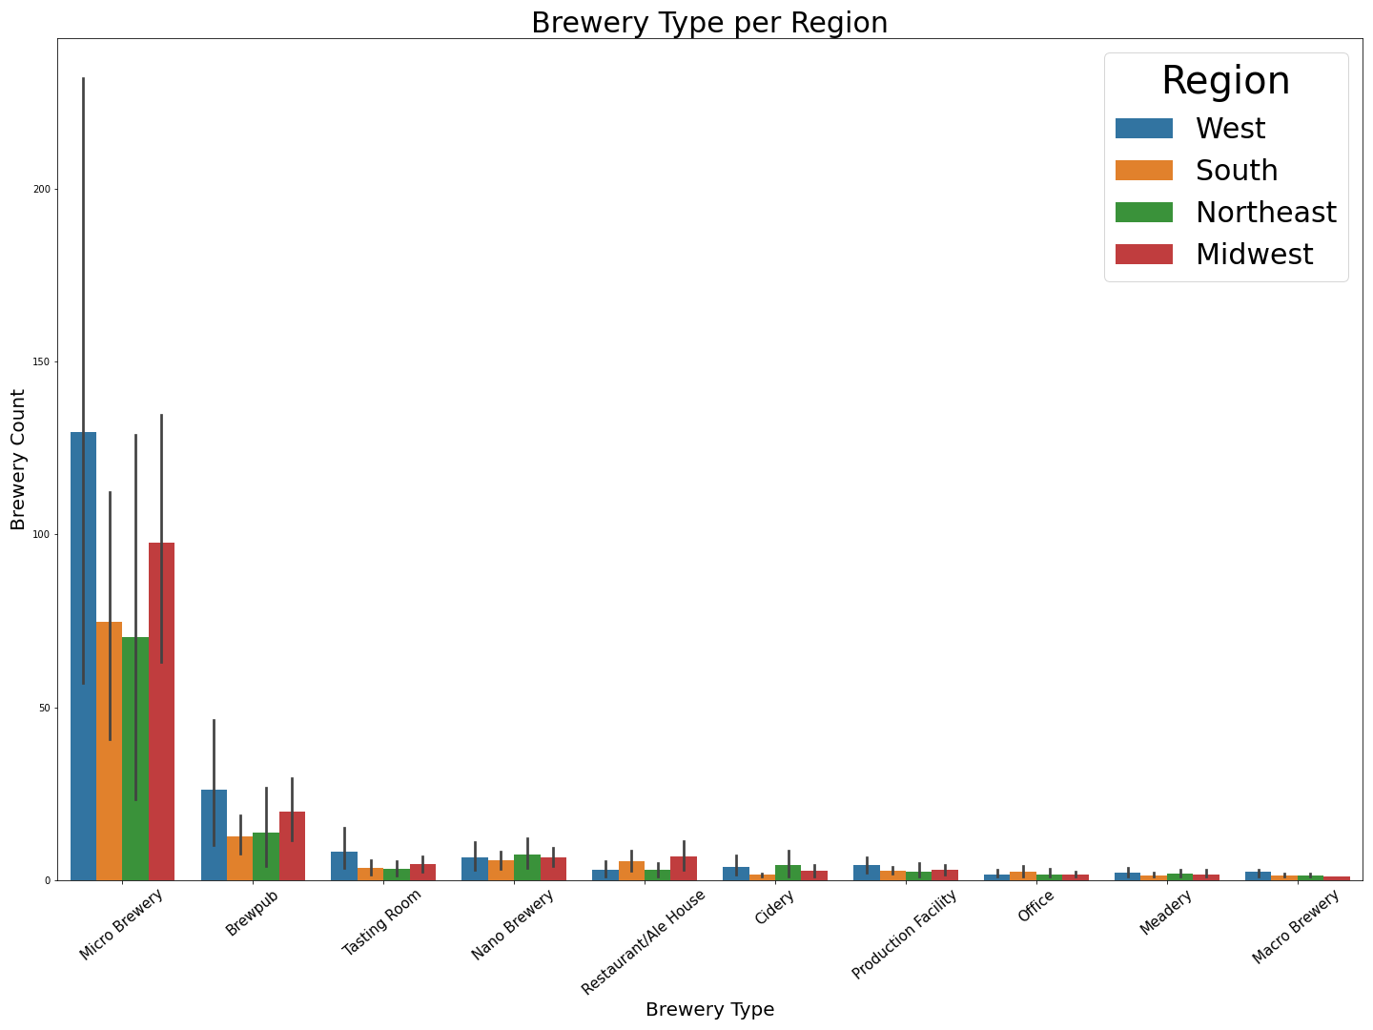
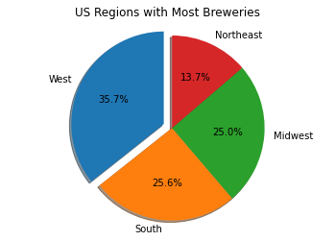
Where and What Type
States with the most breweries
West
4 of the top 10 states
South
3 of the top 10 states
Northeast
2 of the top 10 states
Midwest
1 of the top 10 states
US Breweries - Folium Map

Slide 10
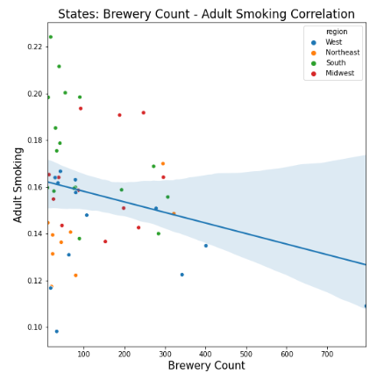
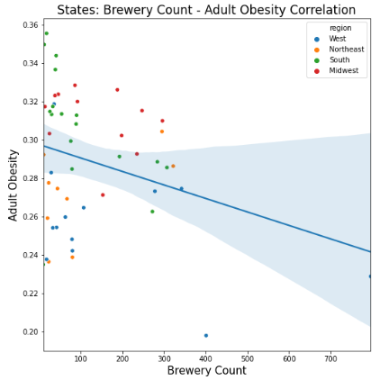
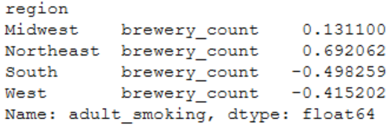
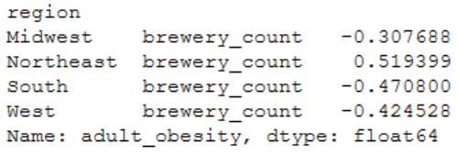
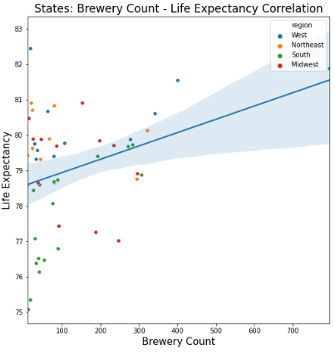
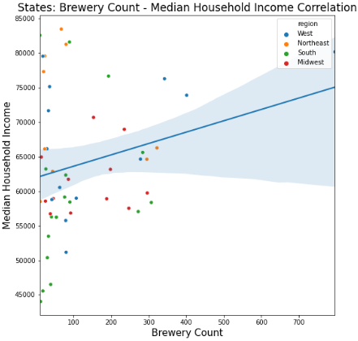
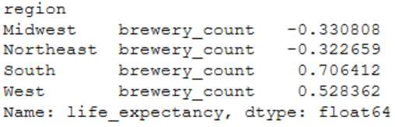
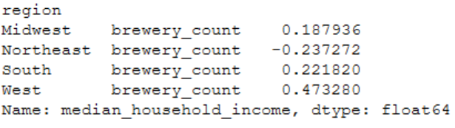
States
Overall negative correlations between smoking and obesity
South and West show weak negative correlations
Life expectancy
Strong positive correlation in the South
Moderate correlation in the West
Median income
Almost moderate correlation in the West
Across all regions, the correlations are fairly weak

Slide 11
Cities/Counties
The West, South, and Northeast correlations are fairly even on a county level.
Adult obesity and smoking, albeit weak, have the strongest (negative) correlation in counties
Granularity: Counties show stronger relationships. City correlations almost nonexistent

Slide 12

Observations Southern Libations – West is Best
Number of breweries show some associations/correlations
Locality eagerness to break into the brewery industry
The economic incentive might not always be there but there is some evidence to invest
Your locality might attract smarter, healthier, potentially slightly richer citizens but not a guarantee
Bias towards metropolitan areas
The beauty of breweries is they can grow anywhere.
With that they bring hops and unfiltered memories, and that’s something to which we can all drink

Slide 13
Future Studies
Predictive model
Beer Analysis
Happiness
Religion

Slide 14
Questions?
Thank you for your time

Slide 15
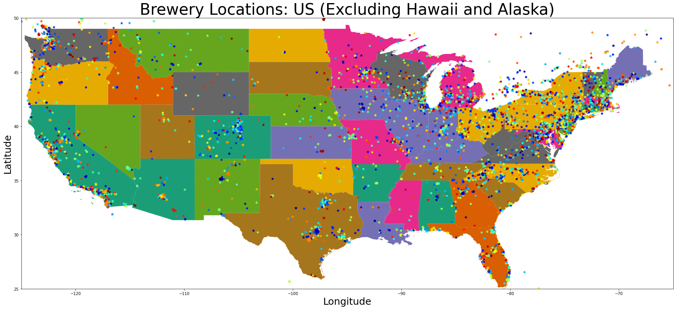
U.S. Breweries

Slide 16
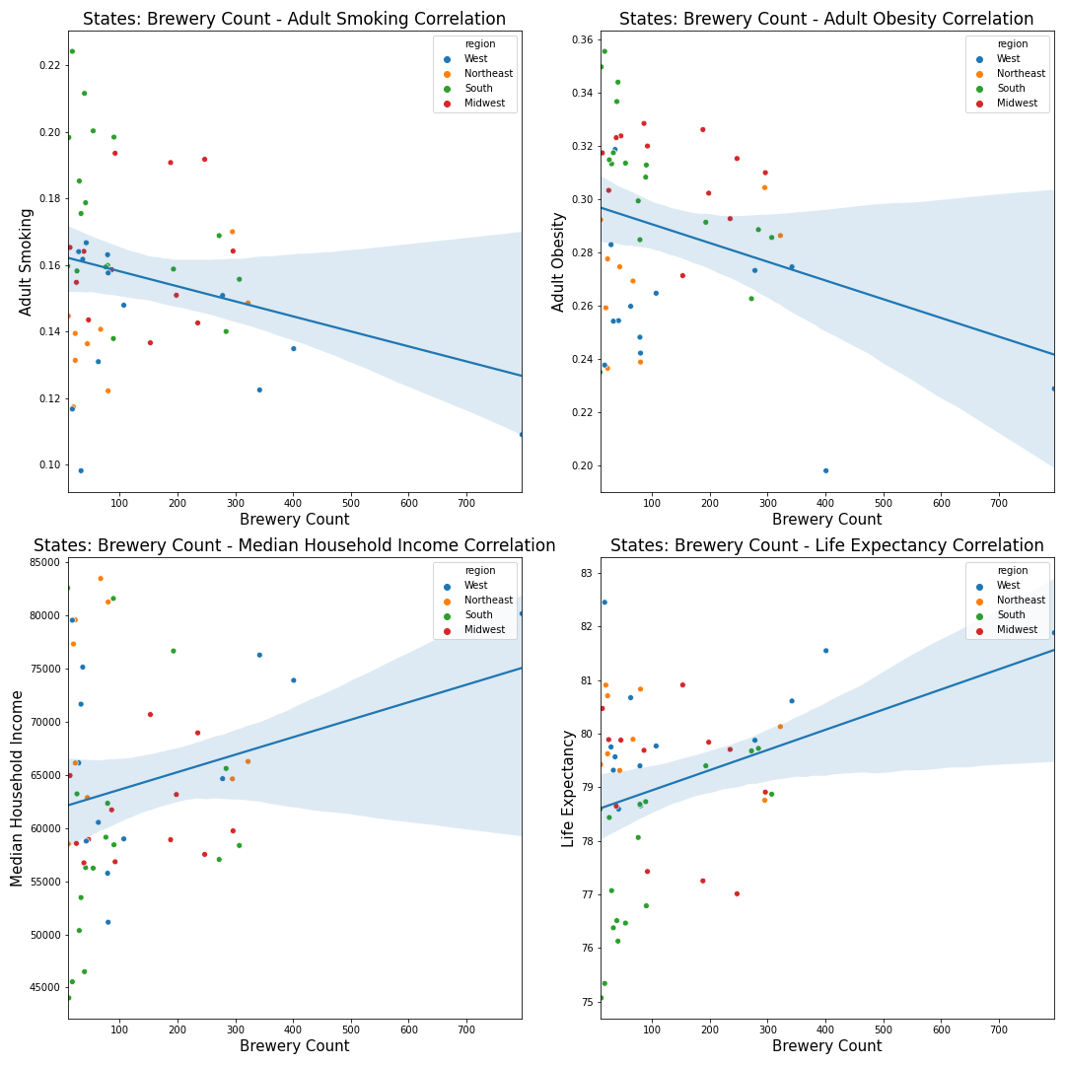
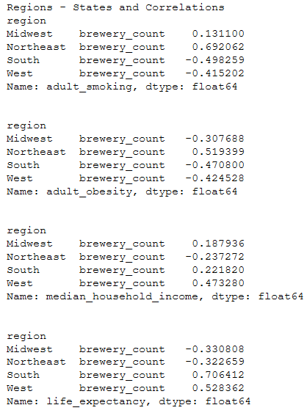
States
Overall negative correlations between smoking and obesity
South and West show weak negative correlations
Life expectancy
Strong positive correlation in the South
Moderate correlation in the West
Median income
Almost moderate correlation in the West
Across all regions, the correlations are all weak

