Slide 1


Real Estate | Urban Analytics
Stavros Kalimeris
Dipl. Civil Engineer NTUA | Technical Designer GNO
Data Engineering Bootcamp

Slide 2
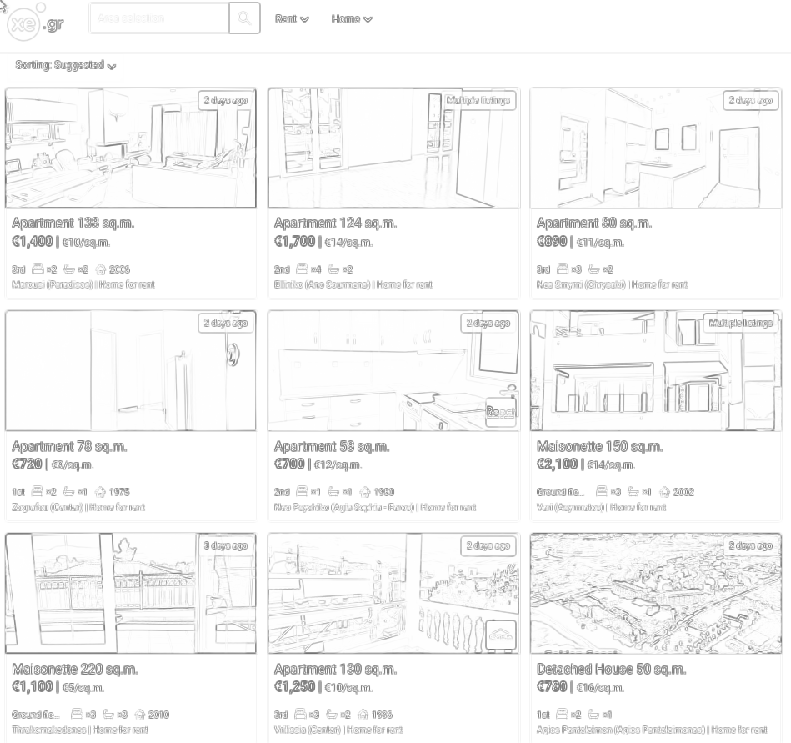
Webscraping xe.gr athens
Target Groups:
Journalists | Urbanists | Researchers (housing crisis reports, Urban Analysis )
Government/Municipality (Insights for data informed urban policies)
Real Estate Investors( Business Insights)

Slide 3
Workflow
Webscraper_Python (used proxyserver to avoid getting blocked from xe.gr)
Pandas to create dataframes | SQL Alchemy and Psycopg2 for database creation
Docker compose yaml with services: metabase | postgre | webscraper
airflow or pipelines in Gitlab

Slide 4







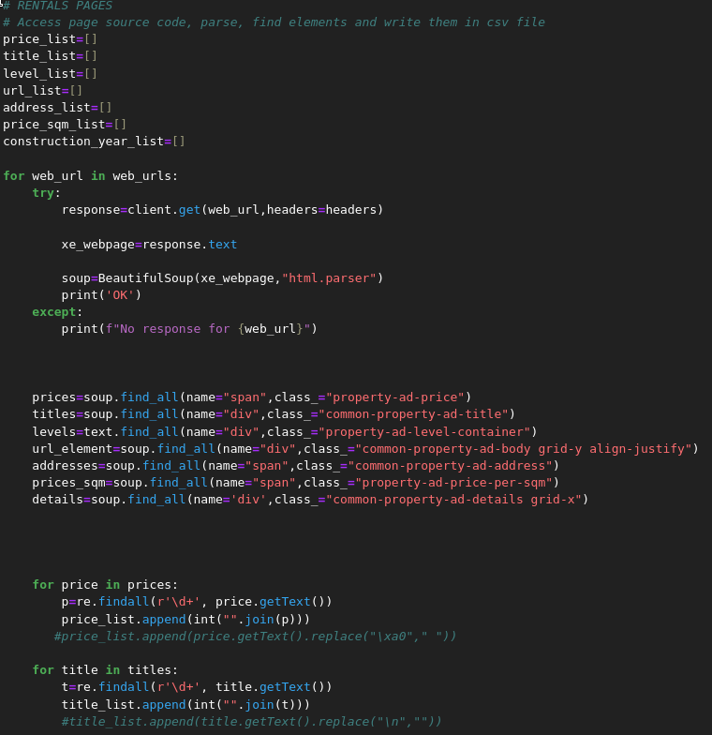
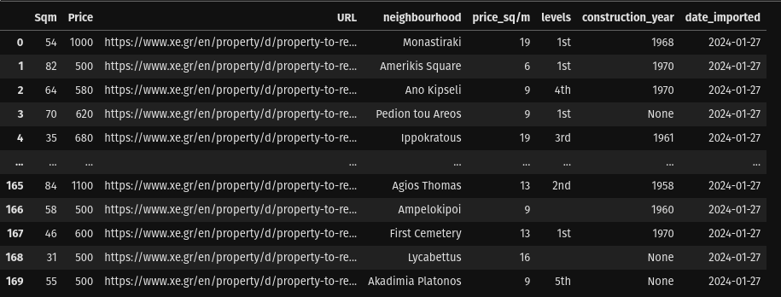
Workflow ELT
CSV files
PostgreSQL
Python &
libraries
Data Lake
Data Warehouse
Data Analytics | Visualisation
Webscraper_Python (used proxyserver to avoid getting blocked from xe.gr)
Pandas to create dataframes | SQL Alchemy and Psycopg2 for database creation
Docker-Compose
Docker compose yaml with services: metabase | postgre | webscraper
airflow or pipelines in Gitlab

Slide 5
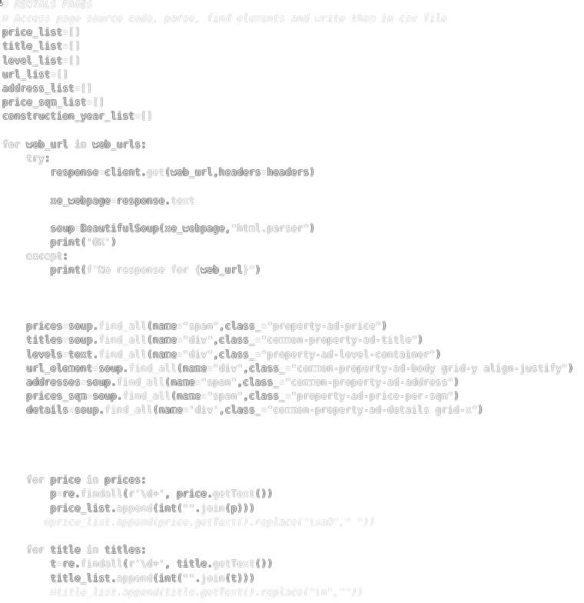
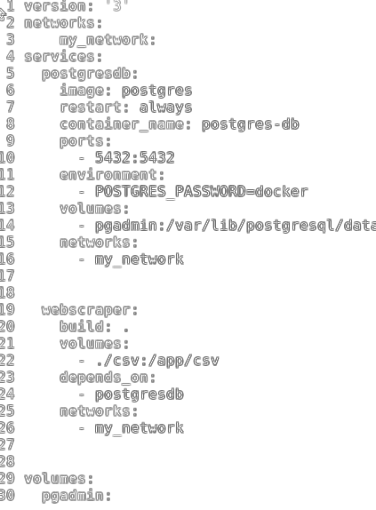
Docker compose yaml with services: metabase | postgre | webscraper
Pandas to create dataframes | SQL Alchemy and Psycopg2 for database creation

Slide 6
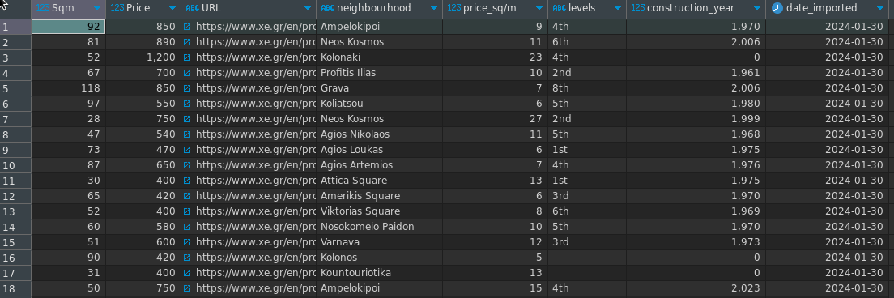
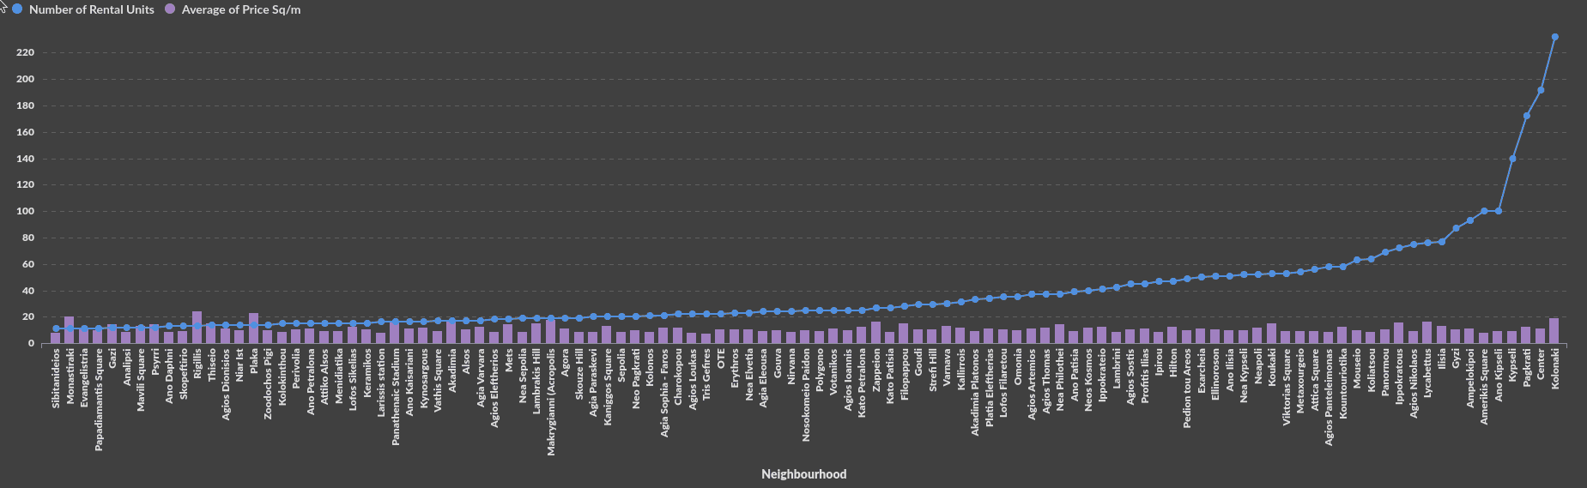
Database
Chart

Slide 7
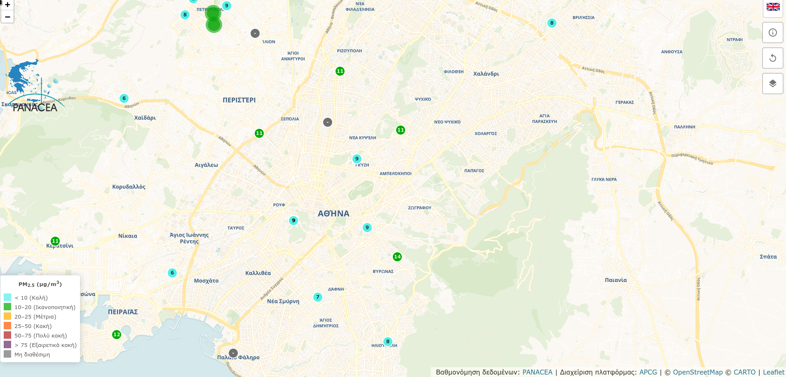
air-pollution.gr
Panacea network

Slide 8
Target Groups:
Journalists | Urbanists | Researchers (housing crisis reports, Urban Analysis )
Government/Municipality (Insights for data informed urban policies)
Real Estate Investors( Business Insights)

