Slide 1
Coroutines
Stephen W. Carson
Refinitiv

Slide 2
 | Execution State | Thread of Execution
Thread | 1 | 1
Coroutine | 1 | 0
Notes:
A coroutine is a little program that can be suspended and then resumed on whatever thread you like.
So it doesn’t “own” a thread of execution.
“traditional threads have a flaw: they are costly to maintain. Thus it is not practical to have more than a few available and they are mostly controlled by the system. A coroutine offers a lightweight alternative that is cheap in terms of resources and it is easier to control by the developer.”
“blocking a thread means the thread cannot do anything else… coroutines are blocks of code that can be suspended, without blocking a thread.”
“Threads are pre-emptively scheduled by the operating system. This means task switches have a high overhead, and may occur at inconvenient times. This overhead has two components: the cost of suspending the state of the thread, and the cost of switching between user mode (for the thread) and kernel mode (for the scheduler).
“If a process schedules its own threads directly and cooperatively, the context switch to kernel mode is unnecessary, and switching tasks is comparably expensive to an indirect function call, as in: quite cheap. These light weight threads may be called green threads, fibers, or coroutines depending on various details. Notable users of green threads/fibers were early Java implementations, and more recently Goroutines in Golang. A conceptual advantage of coroutines is that their execution can be understood in terms of control flow explicitly passing back and forth between coroutines. However, these coroutines do not achieve true parallelism unless they are scheduled across multiple OS threads.”

Slide 3
Think Cooperative Multitasking!
Coroutine:
Gets the thread of execution
Does some work
Yields the thread of execution
(Remembers execution location + all “stack” variables)

Slide 4
“Coroutines, like if, loops and function calls, are another kind of “structured goto” that lets you express certain useful patterns (like state machines) in a more natural way.”

Slide 5
Coroutines in C++

Slide 6
 | Subroutine | Coroutine
Invoke | Function call, e.g. f() | Function call, e.g. f()
Return | return statement | co_return statement
Suspend |  | co_await expression co_yield expression (suspend and return value)
Resume |  | coroutine_handle<>::resume()
Destroy |  | coroutine_handle<>::destroy()
Notes:
New keywords:
co_return: Finish execution. Return a value.
co_await: Get results from awaitable (like a Coroutine). Suspend if results not ready yet.
co_yield: Give up thread of execution. Optionally return a value.
A function becomes a coroutine by having one of these keywords in its body. So from their declaration they are indistinguishable from functions.
A class member function can be a Coroutine.

Slide 7
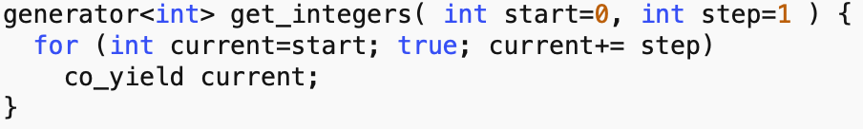
Notes:
This is an example of a generator. Each time it suspends it yields the next integer in the sequence.
co_yield suspends the functions execution, stores that state in the generator<int>, then returns the value of current through the generator<int>.
There is more to coroutines than a simple generator. You can await a coroutine in a coroutine, which lets you compose coroutines in a useful manner.

Slide 8
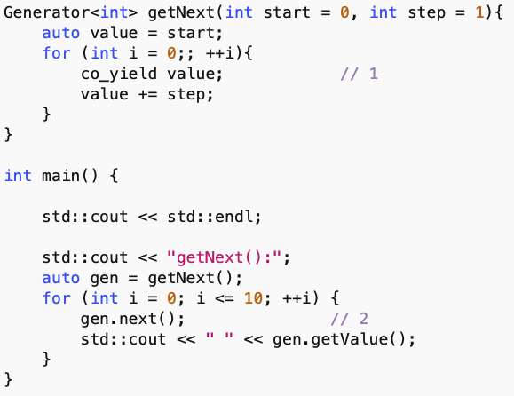
Notes:
Example of a generator being used.

Slide 9
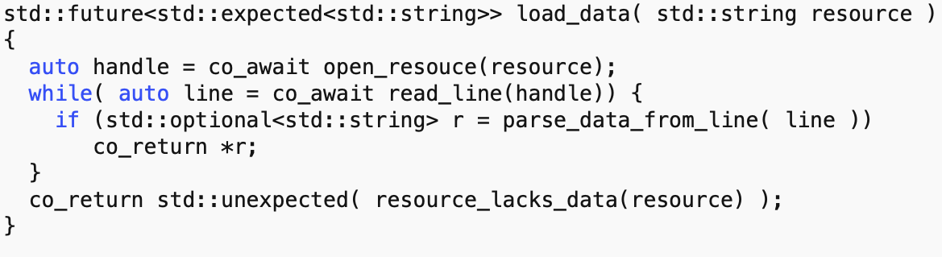
Notes:
load_data is a coroutine that generates a std::future when the named resource is opened and we manage to parse to the point where we found the data requested.
open_resource and read_lines are probably async coroutines that open a file and read lines from it. The co_await connects the suspending and ready state of load_data to their progress.

Slide 10
Coroutine Mechanics

Slide 11
C++ Coroutines Can’t Use
variadic arguments
plain return statements
placeholder return types (`auto` or Concept)

Slide 12
C++ Coroutines Can’t Be
Constexpr functions
constructors
destructors
main function

Slide 13
promise
A promise object is manipulated inside the coroutine.
The coroutine submits its result or exception through this object.
You needn’t deal with this promise directly! It is mostly under the hood.

Slide 14
Coroutine handle
Refers to the coroutine’s dynamically allocated state
This is used outside of the coroutine to:
resume execution of the coroutine
or destroy the coroutine frame

Slide 15
Coroutine State
Heap-allocated (unless the allocation is optimized out)
Contains:
the promise object
the parameters (all copied by value)
some representation of the current suspension point, so that resume knows where to continue and destroy knows what local variables were in scope
local variables and temporaries whose lifetime spans the current suspension point
Notes:
Interesting side note: I saw someone asking why coroutines weren’t done in libraries. In fact there are coroutine implementations in boost.
One answer: Library code can’t keep track of which local variables need to be cleaned up. The language can.

Slide 16
Co_awaiting Coroutines

Slide 17
co_await operator
Forces compiler to generate some coroutine boilerplate code
Creates the Awaiter object

Slide 18
Simplest Awaitables
suspend_always
co_await suspend_always will always suspend the coroutine and return back to the caller
suspend_never
co_await suspend_never will never suspend the coroutine

Slide 19
Library Awaitables
Notes:
Before creating an awaitable, you should see if one is out there already.

Slide 20
cppcoro awaitables
single_consumer_event
single_consumer_async_auto_reset_event
async_mutex
async_manual_reset_event
async_auto_reset_event
async_latch
sequence_barrier
multi_producer_sequencer
single_producer_sequencer

Slide 21
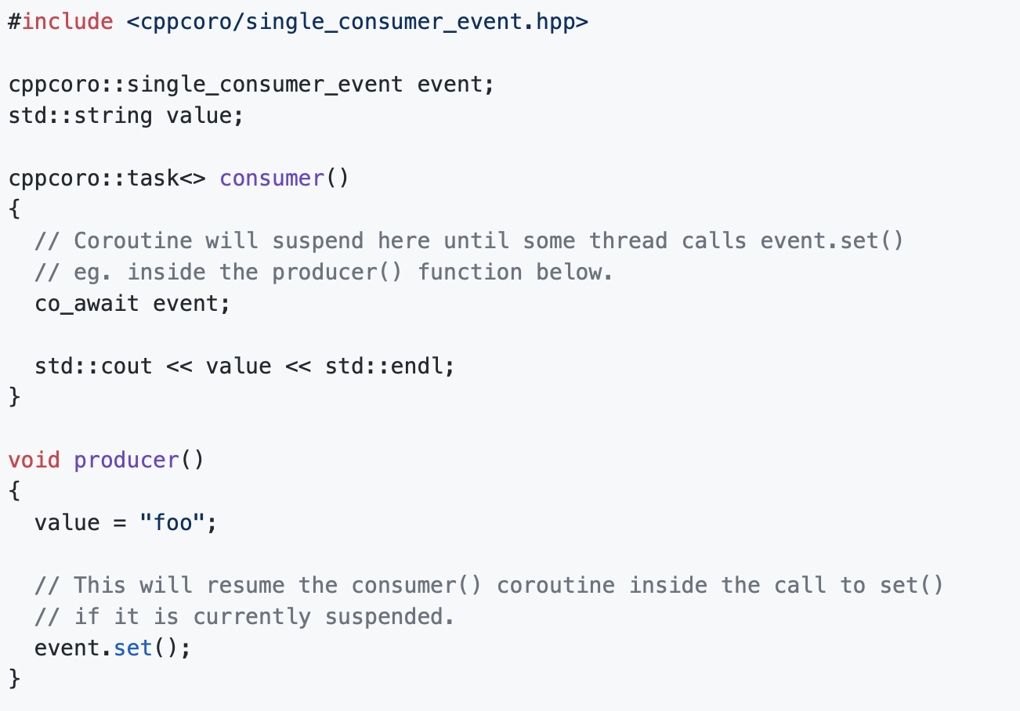
single_consumer_event

Slide 22
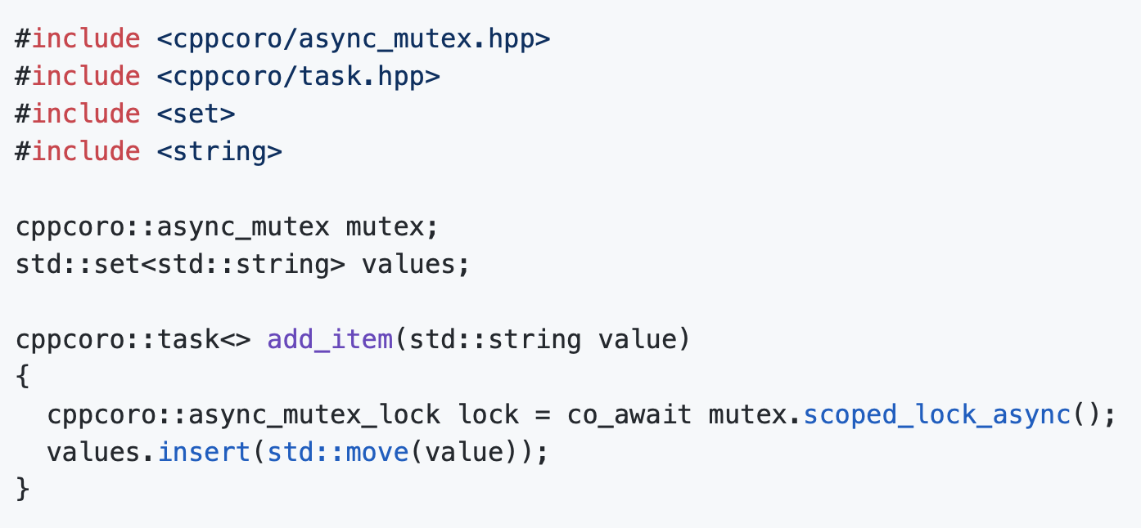
async_mutex

Slide 23
Learn More

Slide 24
GitHub - lewissbaker/cppcoro: A library of C++ coroutine abstractions for the coroutines TS
What are use-cases for a coroutine? - Stack Overflow
Iterator - Generators - Wikipedia
Coroutines (C++20) - cppreference.com
c++ - What are coroutines in C++20? - Stack Overflow
When should I use coroutines? : Unity3D

Slide 25
CppCon 2015: Gor Nishanov “C++ Coroutines - a negative overhead abstraction" - YouTube
CppCon 2016: James McNellis “Introduction to C++ Coroutines" - YouTube
GitHub - lewissbaker/cppcoro: A library of C++ coroutine abstractions for the coroutines TS
C++ links: Coroutines (WIP draft) · GitHub

Slide 26
Coroutines in Python
David Beazley - Python Concurrency From the Ground Up: LIVE! - PyCon 2015 - YouTube
Curious Course on Coroutines and Concurrency - YouTube
A Curious Course on Coroutines and Concurrency
Also see Ch. 16 in Fluent Python: Clear, Concise, and Effective Programming: Luciano Ramalho: 4708364244547: Amazon.com: Books
Available on O’Reilly Books Online

