Slide 1
Marketing Lead
Assessment
Strategic Growth Plan for BIST & BGA
Artyom Ananov | April 2026

Slide 2
ARTYOM
ANANOV
Marketer | 8+ Years | Data-Driven | AI Native
$750K+
45+
25K
Ad spend
managed
Partner
companies
MAU product
(uCraft)
2017-18
2018-22
2020-23
2022-23
2023-25
2025+
Marketing Specialist
CMO & Founder
Digital Marketing Lead
Sr. SEO Specialist
Co-Founder
Sr. Marketing Manager
Maxim (14+ countries)
MSG Agency
ARC Digits (US clients)
Gladus (300→175K)
uCraft (SaaS, 25K MAU)
Growth Hunters
AI Trainer (Alte + BTU)
Google/Meta/LinkedIn Ads
SEO + GEO
CRM
N8N Automation
Georgian + English + Russian

Slide 3






Agenda
01 Situation Audit
Strengths, pain points, competition
02 BIST: 12-Month Strategy
Audience, funnel, channels, KPIs
03 BGA: 12-Month Strategy
Positioning, Georgian market, IB
04 Digital & Lead Gen
CRM, SEO+GEO, social, paid
05 Retention & Loyalty
NPS, ambassadors, alumni
06 First 90 Days
Quick wins, stakeholders
07 Team Structure
Roles & responsibilities

Slide 4
01
Situation Audit &
Research Findings
Understanding where we are before deciding where to go

Slide 5
Competitive Landscape
16+ international schools in Tbilisi
School | Curriculum | Students | Key Strength
BIST | Cambridge/A-Level | 520+ | Only COBIS-accredited British school
BGA | Cambridge/IB/Georgian | 500+ | Leading Georgian-national school
QSI Tbilisi | American/AP/SAT | ~250 | US Embassy community, 30+ yrs
European School | IB (all 3 prog.) | ~900 | Only CIS member in Georgia
Newton Free | IB | ~1,500 | Largest, fast-growing IB school
Maarif Schools | Turkish/Intl | N/A | Modern campus near Lisi Lake
GZAAT | American/AP | ~250 | Selective, trilingual

Slide 6
Pain Points & Growth Blockers
BIST
BGA
Low social engagement
IB track still new
12.5K FB vs BGA's 37K. Only 125 talking. Low digital loyalty
Authorized 2022. No results yet compared to European School
Sixth Form retention
Brand confusion
54/520 post-16. Drop-off after IGCSE.
Similar names, shared campus.
Fee opacity
Georgian-market ceiling
No public fees anywhere. Which can be a benefit at some point as well. Should be A/B tested
Limited international enrollment.
WordPress stack
No CRM, chat, or tracking.

Slide 7
Common Pain Points For Both Schools
Poor funnel setup
setup does not rely on data-driven solutions
Lack of digital activities and ads
No active digital ads (on the moment of research)
Poor virtual tour
Poor virtual tour both for BIST and BGA
Communication mismatch with the target audience
Content and communication does not match target audience and ICP. It requires more luxurious/well-branded communication

Slide 8
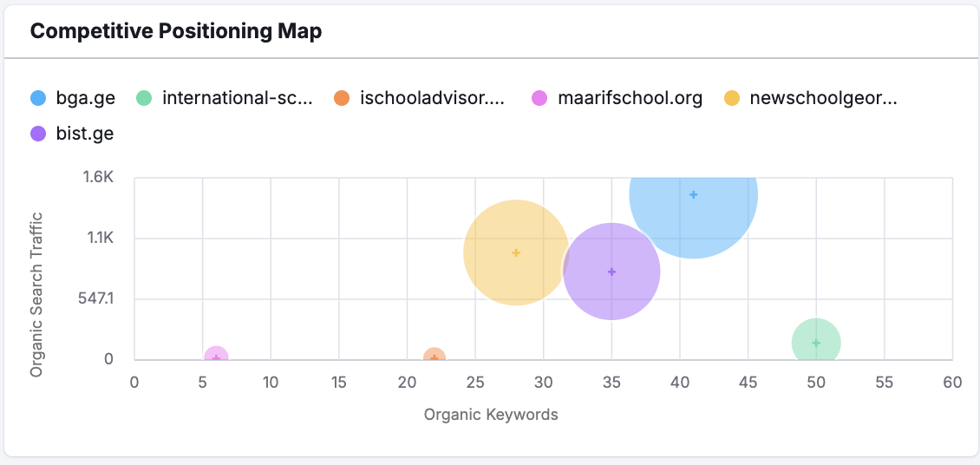
SEO overlap

Slide 9





Growth Opportunities
University destination marketing
Early Years entry funnel
Expat relocation pipeline
BIST alumni at top unis - barely marketed.
Ages 2-5: highest potential lifetime value.
No school targets relocation agents.
SEO + GEO (AI Search)
Referral program at scale
Changing trend - FROM US to British education
Optimize for Google AND AI engines.
WOM #1 driver
As a longrun strategy it’s important to change trend from US to British education.

Slide 10
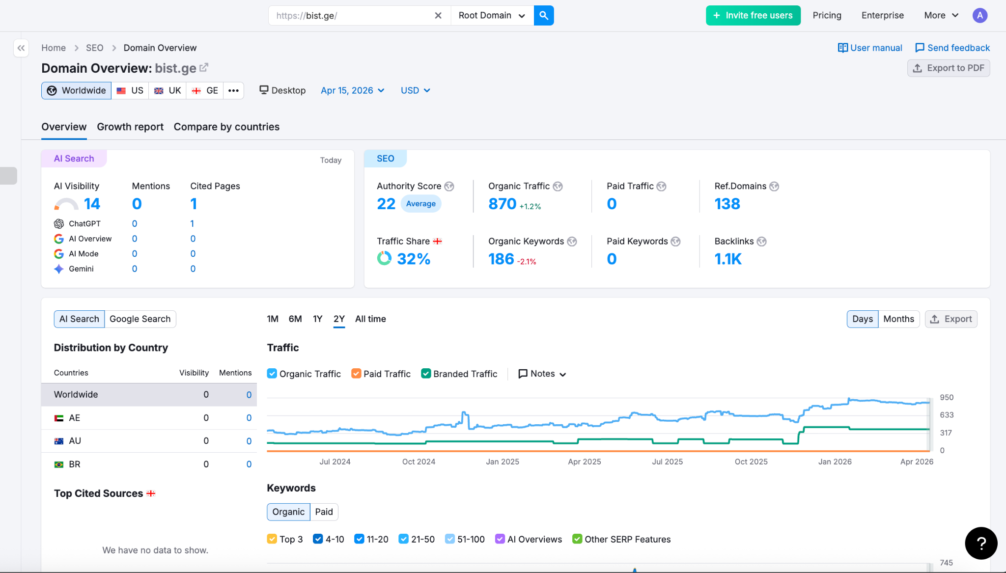

Slide 11
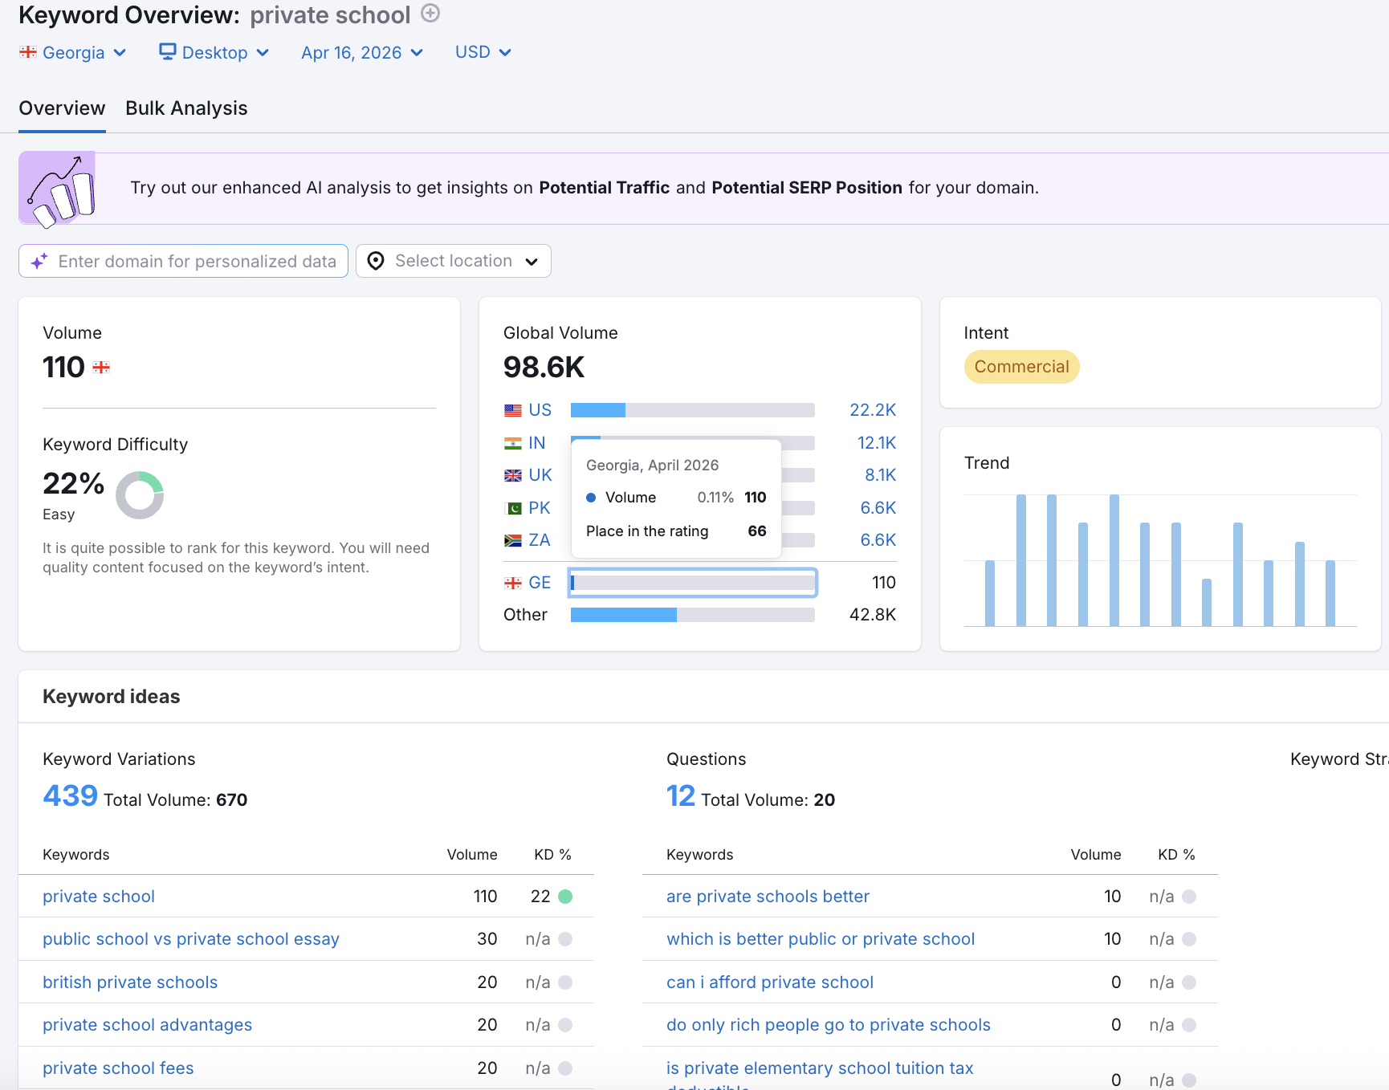

Slide 12
02
BIST: 12-Month
Growth Strategy

Slide 13

BIST: Ideal customer profile
Goals
British curriculum | Global university | Safe multicultural | Pastoral care
Pain Points
Limited time (relocating) | Unclear fees | Mid-year entry needed | Cultural exposure
Sarah & James
Expat Family, Tbilisi
Decision/Awareness Triggers
Age 35-45 | UK/US Origin
NGO / Embassy / Corporate
2 children (ages 4 & 8)
Income: $150-200K+/y
Google 'international school Tbilisi' | Relocation agent | Embassy list | Expat FB group/ WOM
Top Channels
Google Search (70%) | Facebook expat groups | Relocation agent | bist.ge + virtual tour/ Community

Slide 14
BIST: Ideal customer profile custdev
Would love to hear your version and insights of ICP. Customer development will also help us to understand customers more precisely

Slide 15
BIST: Marketing Funnel
Awareness (10,000)
Meta | Google Display | YouTube | SEO+GEO | PR
20-25%
Interest (2,000)
Search Ads | Retargeting | Blog | Email | Tour
3-5%
Enquiry (60)
CRM auto-response | WhatsApp | Phone | Scoring
55-65%
Visit (33)
Open Days | Private tours | Tasters | Ambassadors
70-76%
Application (23)
Online app | Assessment | $325K Scholarship
70-75%
Enrolled (16)
Welcome pack | Onboarding | Buddy | Portal
Target LTV:CAC = 5 - 5.5 : 1

Slide 16

BIST: 12-Month Timeline
M1-3
M4-6
M7-9
M10-12
Foundation
Growth
Optimize
Scale
Marketing audit + analytics + Custdev
Open Day campaign (peak)
A/B test pages + creative
Intl directory listings
CRM setup + lead scoring
Meta lookalike/custom audiences
Retargeting visited-not-applied
PR: university destinations
Website conversion optimization
Relocation agent partnerships
YouTube pre-roll stories
Budget reallocation
SEO+GEO: target keywords
Little Learners tasters
Parent ambassador program launch
Pre-enrollment campaign
Google Search campaigns
Video: campus + testimonials
Embassy partnerships
Alumni video series
Content + marketing strategy and first campaigns
Email nurture sequences
Quarterly NPS survey
Next-year strategy

Slide 17
BIST: Channel Strategy
High-intent: 'international school Tbilisi'. Expat vs Georgian campaigns.
Google Ads (Search)
30%
CPL<$35
Lookalike audiences. Interest: expat, education, relocation.
Meta Ads (FB/IG)
25%
CPL<$25
20+ articles + AI-optimized for ChatGPT/Perplexity/Google AI.
SEO + GEO Content
15%
Traffic +200%
4 Open Days. Little Learners tasters. Embassy sessions.
Events & Open Days
15%
50+ families
Relocation agents. Embassy network. Georgia Today. LinkedIn.
Partnerships & PR
10%
5+ mentions/qtr
Fee credit. 15-20 ambassadors. CRM-tracked.
Referral Program
5%
15% referrals

Slide 18
BIST: Expected Outcomes
+30%
~ +20%
3x ROI
Qualified Inquiries
Net Enrollment
Marketing Return
Year 1
vs prior year
Revenue/$
~ <$35
~ 620-650+
~ 80+
Cost Per Lead
Total Students
Post-16
Blended
From 520
From 54

Slide 19
03
BGA: 12-Month
Growth Strategy
Growing Georgia's leading bilingual school

Slide 20

BGA: Ideal Customer Profile
Goals
Bilingual ed | Georgian identity + global | IB for EU/US unis | Community
Pain Points
Losing Georgian culture | IB new at BGA | Price sensitivity | Want proven results
Giorgi & Nino
Georgian Family, Vake
Triggers
Age 32-42 | Georgian
Business / Professional
Children ages 3 & 10
Income: 30K+ GEL/month
Friend's recommendation | FB post/ad | Open Day | IB availability
Channels
Facebook (60%) | Word of mouth | Georgian media | Instagram | bga.ge

Slide 21
BGA: 12-Month Timeline
M1-3
M4-6
M7-9
M10-12
Foundation
Growth
Optimize
Scale
Audit social (37K FB)
Open Day: IB showcase
A/B Georgian vs English
Re-enrollment (Jan)
CRM + lead scoring
Georgian media PR
IG: student takeovers
Annual gala + awards
Website: IB + outcomes
Video: alumni success
University showcase event
IB destinations campaign
Georgian content strategy
Meta Live: tours + Q&A
Cross-campus summer camp
2027 strategy + budget
Meta engagement plan
Corporate partnerships
Ambassador recruitment
Alumni network
Parent NPS survey
IB results press
Quarterly NPS review
Brand visual refresh

Slide 22
BGA: Channel Strategy
37K base. Daily Georgian. Lookalike. FB Groups. Lives.
Meta (Fb/Ig) (Organic+Paid)
35%
Engage 5%+
Student reels, day-in-life. Teacher spotlights. GEO-subtitled.
Instagram & TikTok
20%
+30% followers
Georgian + English. 'IB school Tbilisi'. Comparison pages.
Google Ads
15%
CPL<$30
TV segments. Local mags. IB results. Thought leadership.
Georgian Media & PR
15%
10+ mentions
Open Days. BGA Gala. TEDx Lisi Lake. Sports tournaments.
Events & Community
10%
60+ families
Fee credit. Corporate program. BIST cross-referral. Alumni.
Referral & Corp
5%
20% referrals

Slide 23
BGA: Expected Outcomes
+25%
+15%
3x ROI
Qualified Inquiries
Net Enrollment
Marketing Return
Year 1 from all channels
New students vs prior year
Revenue per marketing dollar
<$20
600+
NPS 50+
Cost Per Lead
Total Students
Parent Satisfaction
Blended (Facebook-heavy)
From ~500 baseline
Quarterly measurement

Slide 24
Brand Architecture: BIST vs BGA
Clear differentiation prevents cannibalization
BIST: "World-Class British Education"
BGA: "Georgian Roots, Global Reach"
Audience: International / Expat
Audience: Georgian + mixed families
Language: 100% English
Language: Bilingual EN+GE
Curriculum: Cambridge (IGCSE+A-Level)
Curriculum: Cambridge+IB+Georgian
Identity: Global citizen
Identity: Georgian + global access
Hook: "Where 50 nationalities thrive"
Hook: "No barriers to your future"
SHARED: Lisi Lake Campus | World-class facilities | British values | Joint summer camp | Cross-referral pipeline

Slide 25
Key Value Propositions
Why parents should choose BIST or BGA over every alternative
BIST - Why Us Over QSI or Others?
BGA - Why Us Over European School?
Only COBIS-accredited British school in Georgia - internationally verified quality
Triple pathway: IB Diploma + Cambridge + Georgian Diploma - maximum flexibility
Cambridge IGCSE + A-Levels: the gold standard for UK and global university entry
True bilingual model: Georgian identity preserved while gaining global access
All British or UK-trained teachers - not adapted, authentically British
Founded by Georgians, for Georgians - understands local values and aspirations
50+ nationalities: multicultural immersion
Shared campus with BIST: access to world-class British facilities and community
17,000 sqm purpose-built Lisi Lake campus with Innovation Centre, arts, sports, different clubs
IB Diploma opens doors to US, UK, EU universities with globally recognized credential
$325K Founder's Scholarship
Growing IB track record - early graduates proving the pathway works
Dedicated university counsellor: personalised pathway to top global institutions
TEDx Lisi Lake, Research Conference - signature events building intellectual brand

Slide 26
04
Digital Ecosystem &
Lead Generation
CRM, SEO+GEO, website, social, paid, analytics

Slide 27

SEO + GEO: Search & AI Optimization
Optimizing for Google AND AI-powered answer engines
SEO – Search Engine
GEO – Generative Engine
Keywords: 'international school Tbilisi', 'British school Georgia'
Optimize for ChatGPT, Perplexity, Google AI Overviews
20+ blog articles Year 1: parent guides, comparisons
Structured FAQ pages with citation-worthy answers
Technical: speed, mobile-first, schema markup
Entity optimization: knowledge graphs + AI data
Local: Google Business Profile, reviews
Authoritative content: interviews, data-rich comparisons
Backlinks: ISC, expat blogs, Georgian media
Mention strategy: high-authority education sites
Target: 3,000 organic visits/month
Monitor AI-generated mentions, correct inaccuracies

Slide 28



Website & Conversion Optimization
Turning visitors into inquiries - every click matters
Separate BIST & BGA landing pages
Audience-specific journeys. BIST: English-first, expat-focused. BGA: Georgian-first, bilingual. Each with tailored CTAs, testimonials, and virtual tour.
Conversion-focused design
Clear CTAs above the fold on every page. Inquiry form + WhatsApp chat widget. Virtual tour embedded. Fee transparency (range at minimum). AI chat-bot.
Mobile-first optimization
Parents research schools on phones during commutes, at work, in bed. Current WordPress site needs speed, UX, and mobile conversion audit.
A/B testing programme
Test headlines, CTAs, form length, images, social proof placement. Monthly iteration cycle. Track conversion rate by audience segment.

Slide 29
Social Media Strategy
Platform-specific approach for both brands
BIST Social Strategy
BGA Social Strategy
Instagram (primary): campus life, student spotlights, teacher Q&As. 4-5 posts/week. Reels for reach.
Facebook (primary): 37K base is the asset. Daily Georgian-language engagement. FB Lives for campus tours.
Facebook: expat group engagement, parent testimonials, Open Day events. Targeted to expat communities.
Instagram: student takeovers, IB student day-in-the-life, campus reels. Georgian with English subtitles.
YouTube: virtual tour (high production), student day-in-the-life, alumni 'Where Are They Now' series.
TikTok: younger audience pipeline. Student-created content, behind-the-scenes, trending audio formats.
LinkedIn: Principal thought leadership, university partnership announcements, teacher recruitment brand.
YouTube: IB programme explainer, parent testimonials in Georgian, alumni university acceptance celebrations.
Content mix: 40% student stories, 25% campus/facilities, 20% academic outcomes, 15% community events.
Content mix: 40% student/parent stories, 25% IB academic life, 20% Georgian culture integration, 15% events.
Tone: warm, international, aspirational. English-only. Professional but approachable.
Tone: proud, Georgian, modern, ambitious. Bilingual. Community-driven, word-of-mouth amplifier.

Slide 30
Content Strategy
What to create, for whom, where, and how often
Blog / SEO+GEO Articles
2-3/month
Parent guides ('Moving to Tbilisi with kids'), school comparisons, curriculum explainers. Bilingual. Optimized for Google + AI engines.
Video Content
4-6/month
Campus virtual tour (hero asset), student day-in-the-life, teacher introductions, parent testimonials, alumni stories. Short (60s) + long (3-5min) formats.
Email Nurture Sequences
Automated
6-email sequence triggered by inquiry: welcome → school highlights → virtual tour → testimonial → Open Day invite → application prompt. Separate for BIST (English) and BGA (Georgian).
Social Media Content
4-5/week per brand
BIST: Instagram-first, English, international tone. BGA: Facebook-first, Georgian, community tone. Monthly content calendar with themed weeks.
Print & Event Collateral
Quarterly
Open Day brochures, welcome packs, campus maps, scholarship guides. High-quality design aligned with brand architecture.

Slide 31
Data & Analytics Framework
Metric | Tool | Frequency | Owner
Website traffic + conversion rate | GA4 + Looker Studio + HotJar for UX check | Weekly | Advertiser
Lead quality + pipeline stage | CRM | Weekly | Sr. Account Manager
Ad performance (CPC, CPL, ROAS) | Google/Meta dashboards | Weekly | Advertiser
Social engagement + growth | Native analytics + scheduling tool | Bi-weekly | Copywriter
Enrollment funnel (inquiry to enrolled) | CRM custom reports | Monthly | Sr. Account Manager
Brand sentiment + NPS score | Survey tools + Google Reviews | Quarterly | Sr. Account Manager
SEO+GEO performance | Semrush + AI mention tracking | Monthly | Copywriter
Cost per enrolled student | CRM + finance data | Quarterly | Sr. Account Manager

Slide 32
CRM Lead Lifecycle
1
Lead Capture
5
Visit Scheduling
Auto-create with source attribution.
Personalized tour. Feedback 2h.
2
Auto-Response (5m)
6
Post-Visit Convert
AI or human. Email + prospectus. Score 0-100.
48h follow-up. Hot lead flags.
3
Officer Assign
7
App to Enrolled
By year group. 24h follow-up.
Acceptance triggers welcome.
4
Qualify & Nurture
8
Report & Optimize
AI/human. Fast-track or monthly nurture.
Weekly pipeline. Quarterly CPE (cost per enrollment)

Slide 33
How I Assess Current Performance
Systematic audit framework for Days 1-30
Marketing Channels Audit
Website + Digital Audit
Map all active channels (paid, organic, events, referral). Assess spend vs results per channel. Identify what's working, what's not, what's missing entirely.
Full site crawl (Screaming Frog). GA4 data review: traffic sources, bounce rate, conversion paths. Hotjar heatmaps on key pages. Mobile UX test.
CRM + Funnel Audit
Competitive Benchmarking
Map current inquiry-to-enrollment pipeline. Identify where leads drop off. Measure response times. Assess lead source attribution accuracy.
Audit competitor ad libraries (Meta, Google). Compare social presence, content frequency, engagement. Review competitor websites and conversion flows.
Stakeholder Interviews
Brand + Content Audit
1:1 with admissions (what do parents ask?), teachers (what do parents value?), current parents (why did you choose us?), leadership (what are the real goals?).
Review all marketing materials. Assess messaging consistency. Evaluate visual brand quality. Gap analysis vs brand architecture targets.

Slide 34
05
Retention & Loyalty
Retention is the highest-margin growth lever

Slide 35
Retention & Loyalty Programs
Parent NPS & Satisfaction
Quarterly NPS. CRM trends. Detractors flagged 48h. Promoters become ambassadors.
Ambassador & Referral
15-20 ambassadors/school. Open Day presence. Fee credit. Social content.
Re-enrollment & At-Risk CRM
Flags: missed meetings, fee delays. January early-bird. Exit interviews.
Alumni & Reputation
'Where Are They Now' videos. Google Reviews 24h response. University PR.

Slide 36
06
First 90 Days Plan
Clarity, data, and quick wins

Slide 37
90-Day Priorities
Days 1-30
Days 31-60
Days 61-90
Listen & Audit
Build & Launch
Optimize & Present
Marketing audit (both)
Google Ads + Meta Ads
Review data, reallocate
Interview stakeholders
CRM lead tracking
12-month strategy to Directors
Map funnels
Content calendar
Referral + ambassador
GA4 + CRM baseline
First Open Day
Monthly reporting
Competitive audit
Website optimization
Agent partnerships
3 quick-win campaigns
Parent survey
Year 1 KPIs with leadership

Slide 38






3 Quick-Win Campaigns
Connected funnel: each campaign feeds the next launched in Days 1-30
01
Awareness &
Engagement
02
Warm Up &
Build Audience
03
Retarget &
Convert
Meta video ads: 60-sec campus highlight reel targeting parents in Tbilisi (age 28-50)
Carousel / lead-gen ads served to Campaign 1 viewers (warm audience only)
Retargeting ads to: prospectus downloaders who didn't inquire, site visitors, Open Day no-shows
Objective: Video Views + Engagement to build warm audience pool
Content: parent testimonials, 'Why we chose BIST/BGA', key differentiators, virtual tour preview
Content: urgency-driven — 'Limited spots for September', scholarship deadline, student success story
Budget: $500-800 for first 2 weeks
CTA: Download prospectus / Book Open Day / Take virtual tour
Google Search ads running parallel: capture high-intent 'international school Tbilisi' searches
Content: drone campus footage, student smiles, facilities, Lisi Lake setting
Builds email list + identifies high-intent leads via CRM tagging
Direct CTA: Submit inquiry / Schedule private tour / Call admissions now
Target: 50,000+ impressions, 15,000+ video views, build custom audience of viewers
Target: 30+ qualified inquiries, 15+ school visits booked, first enrollments from paid
Target: 500+ prospectus downloads, 200+ Open Day sign-ups, lookalike audience created
Output: Custom audience of engaged viewers
Output: Email list + lookalike + high-intent segment
Output: Qualified inquiries + school visits + enrollments
Awareness (video views) → Warm audience (prospectus + email) → Retarget (inquiries + visits) → Enrolled students

Slide 39


Stakeholder Engagement
Directors (BIST + BGA)
Weekly alignment. Strategy by Day 60. Shared KPIs. Monthly board meetings.
Admissions Team
Funnel mapping. CRM dashboards. Lead quality.
Parents & Students
Focus groups + NPS. Ambassador. Newsletter. WhatsApp.
Teaching Staff
Spotlights. Classroom stories. Marketing = real experience.

Slide 40
07
Team Structure &
Responsibilities
The marketing engine powering both brands

Slide 41



In-house Marketing Team
Lean, high-output team with clear ownership for both BIST and BGA
Sr. Account Manager
Advertiser
Designer
Copywriter
Campaign management
School communication
Budget + reporting
Timeline + QA
NPS Control
CRM Control
Parents QA
Google + Meta Ads
Retargeting + lookalike
Budget optimization
A/B testing + analytics
Ad creatives + visuals
Social graphics
Brand identity
Video editing
SEO+GEO blog content
Ad copy + landing pages
Email sequences
Bilingual content (EN+GE)
OWNS
OWNS
OWNS
OWNS
Strategy execution
Stakeholder alignment
Paid performance
CPL & ROAS targets
Visual brand
Creative quality
Content calendar
Brand voice

Slide 42

Potential Outsourced / Additional Team
Scaling capacity as needed
Jun/Mid Account Manager
Developer
Production Team
Social media communication
Messenger/DM + comments
Partnerships (B2B, relocation agents)
Helping Sr. Account Manager
Website development + optimization
CRM integrations + automation
Landing page builds
Technical SEO implementation
Video Production
Photos
Reels/Short-form content
OWNS: Communication
Partnership support
OWNS: Development
Automations
OWNS: Development
Automations

Slide 43
Scaling
This team will be enough not only to successfully
operate on the local market, but for international
expansion initiation in the region.

Slide 44
Thank You
Ready for your questions!
Questions & Discussion

