Slide 1



Contract Monthly Claim System
By Alexandro Ornelas ST10437348

Slide 2
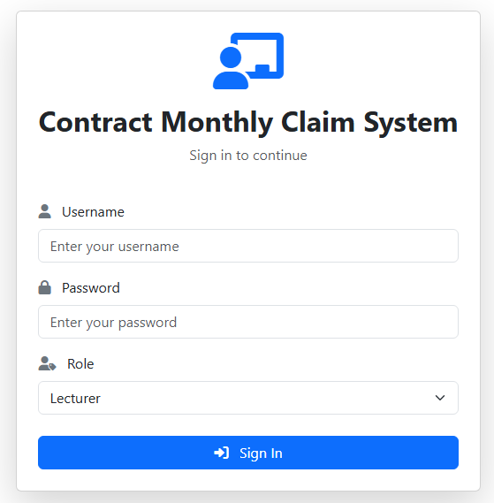

Background
The Contract Monthly Claim System (CMCS) streamlines monthly claim submissions by automating calculations and validation checks, reducing manual paperwork. With dedicated roles for Lecturers, Coordinators, Managers and HR, the system improves accuracy, efficiency and secure document handling across the entire claims workflow.
01

Slide 3
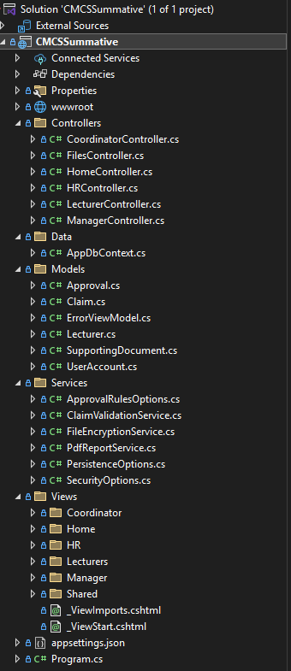
System Architecture
Built with ASP.NET Core MVC
Entity Framework Core + SQL Server (Azure)
Encrypted file storage
Session-based authentication
Automated claim validation
02

Slide 4
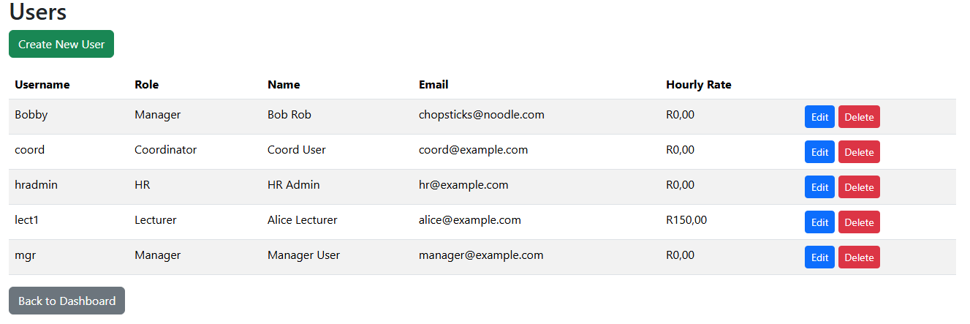
Roles Overview
Lecturer: Submit claims, upload documentation and view claim status
Coordinator: First-level review & approval
Manager: Final approval
HR: User management and report generation
03

Slide 5
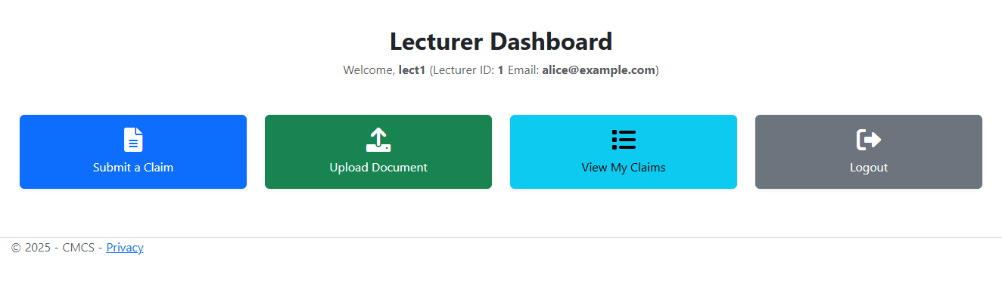
Lecturer Features
Auto-calculated claim totals (Hours × Hourly Rate)
Error handling when hours exceed 180
Submit & upload documents
Track claim progress
04

Slide 6

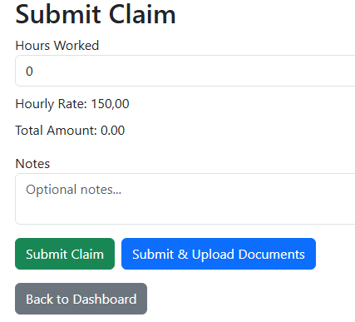
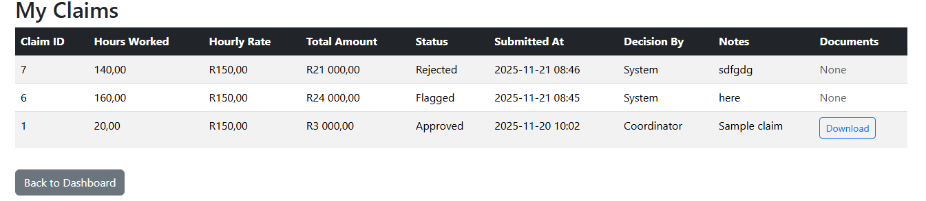
Lecturer Features
05

Slide 7
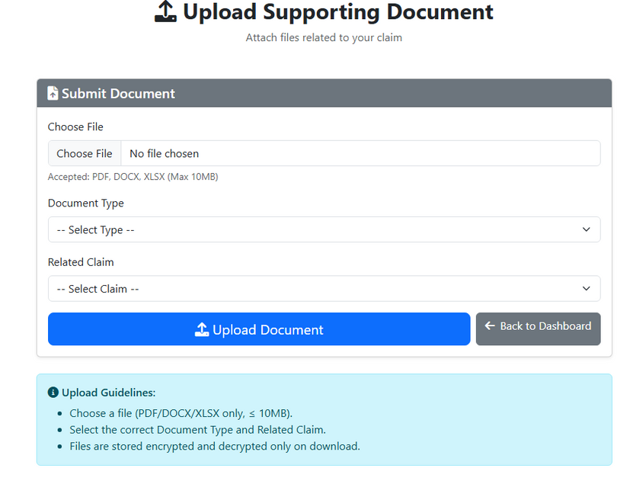
Lecturer: Document Upload
Document upload with AES encryption
Supported file types: .pdf, .docx, .xlsx
Automatically links to clai
06

Slide 8
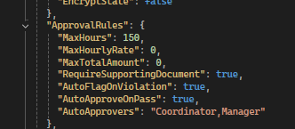
Automatic Validation
Rules:
Hours worked > 150 → Auto-reject
Hourly rate ≤ HR assigned rate
Missing supporting documents → flagged
Auto-approve
07

Slide 9
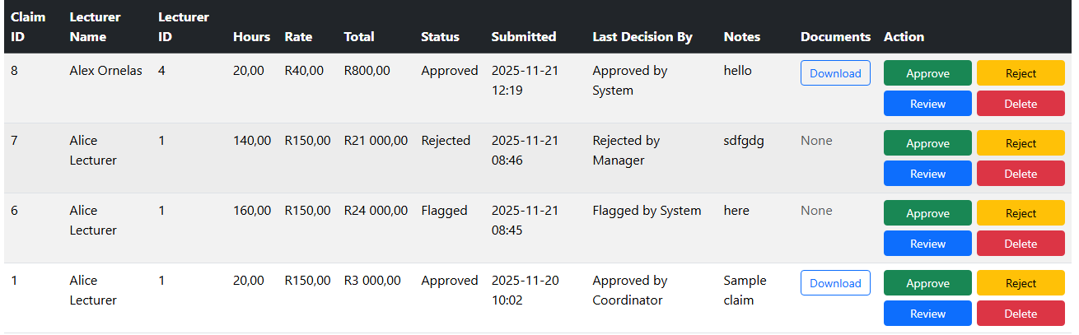
Automatic Validation
Lecturer “Alex Ornelas” decision approved because it met the requirements.
Lecturer “Alice Lecturer” is flagged because there is no supporting document and needs to be manually approved
08

Slide 10
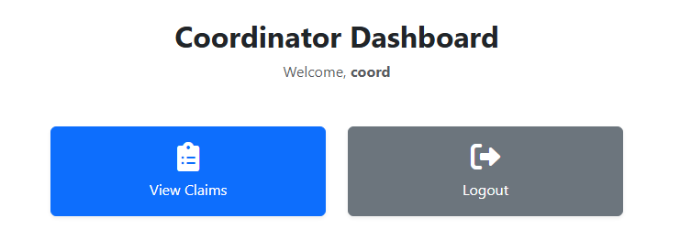
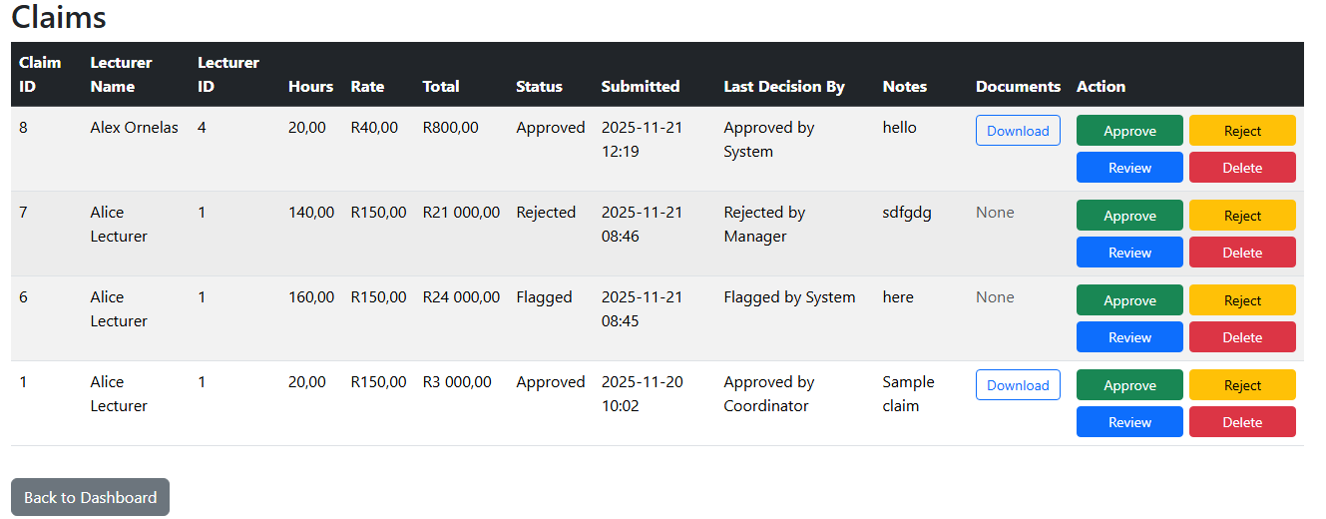
Coordinator/Manager View
Reviews lecturer claims
Approves, rejects, delete or adds comments
Can view supporting documents
Automated validation runs here
09

Slide 11
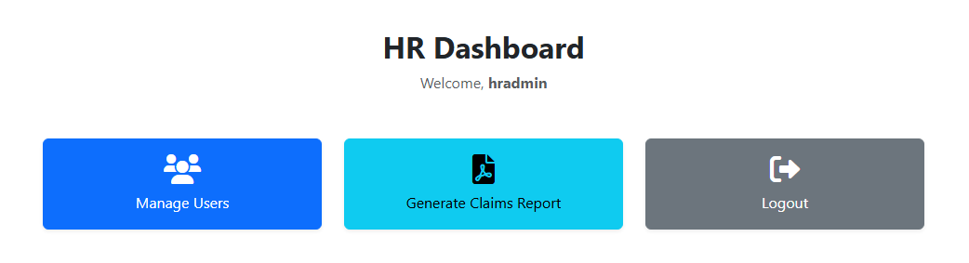
HR Features
Add users (Lecturer, Coordinator, Manager, HR)
Edit/update user profiles
Maintain hourly rate, email and names
Generate PDF reports
10

Slide 12
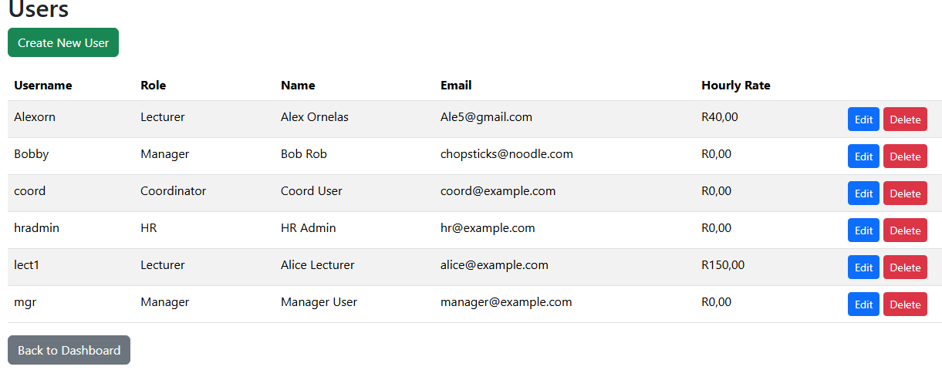
HR Features
11

Slide 13
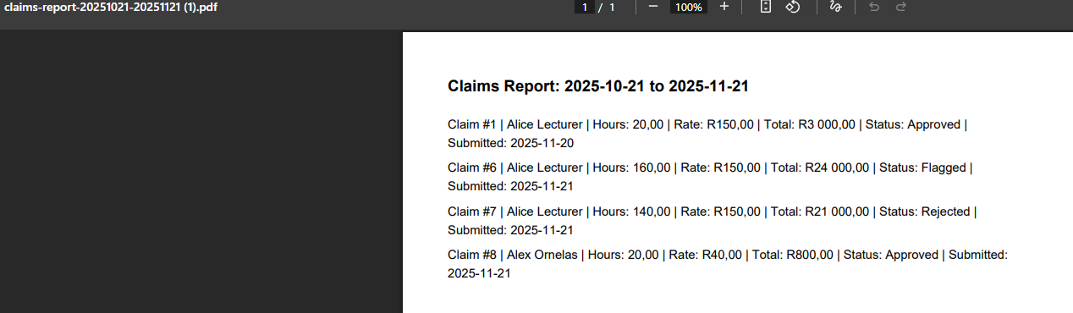
Reporting (HR)
PDF report generation
Shows claims over selected date range
Includes lecturer, amount and status
12

Slide 14
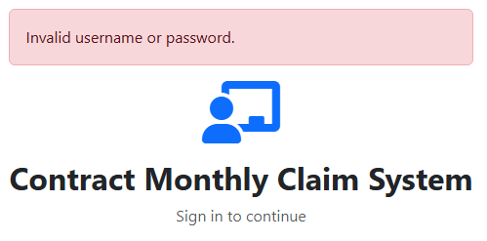
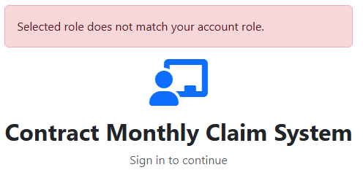
Security Features
Session-based role protection
Only HR can manage users
Encrypted documents (AES)
SQL Server stored securely on Azure
13

Slide 15
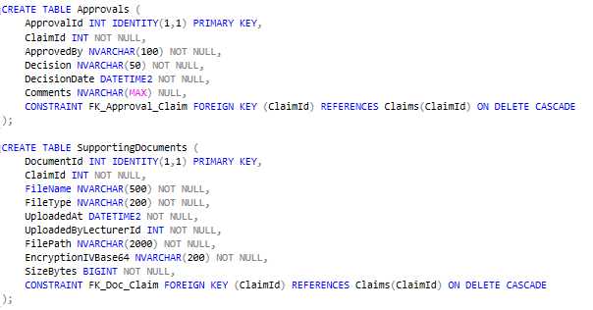
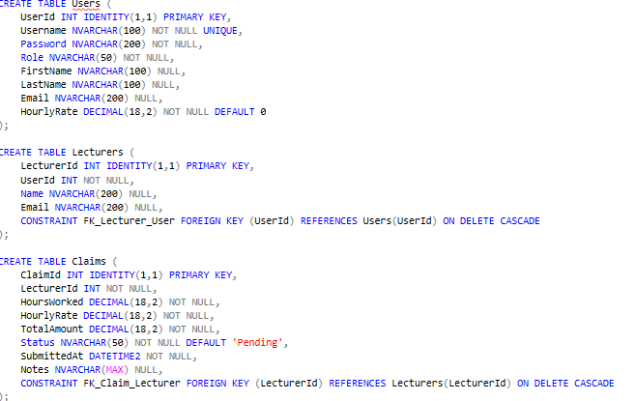
Database Structure
EF Core models mapped to SQL tables
Claims, Users, Lecturers, Documents and Approvals
Relationships implemented with foreign keys
14

Slide 16
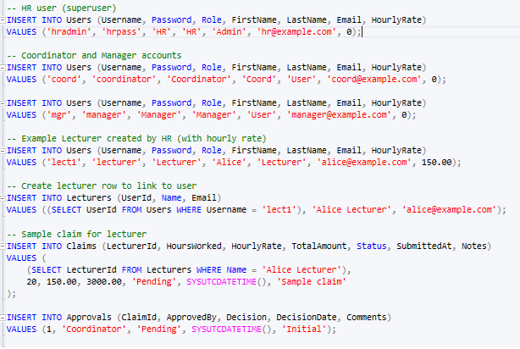
Database Structure
15

Slide 17
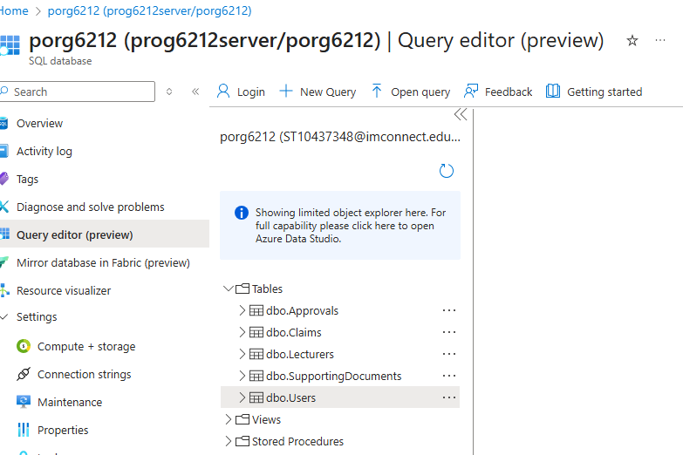
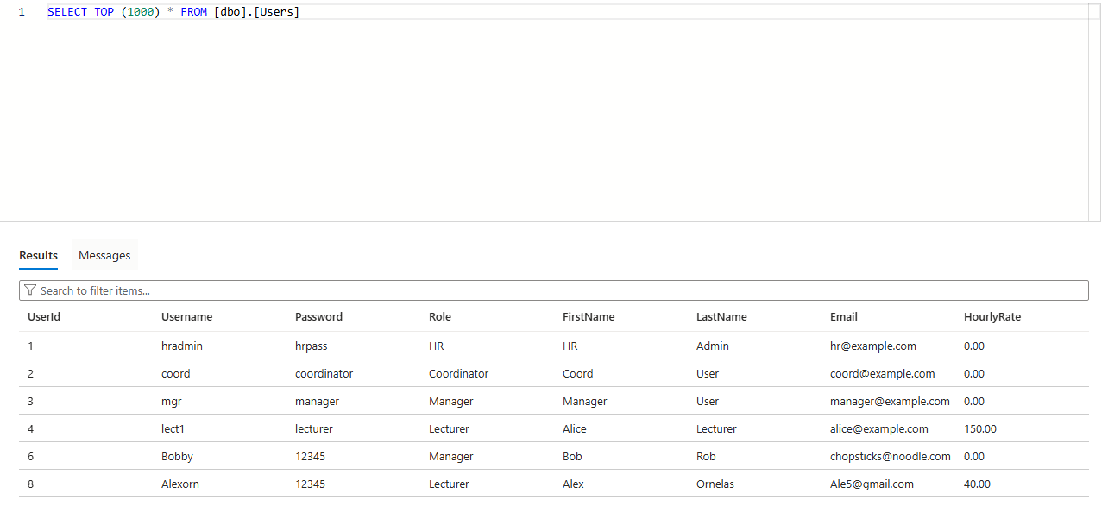
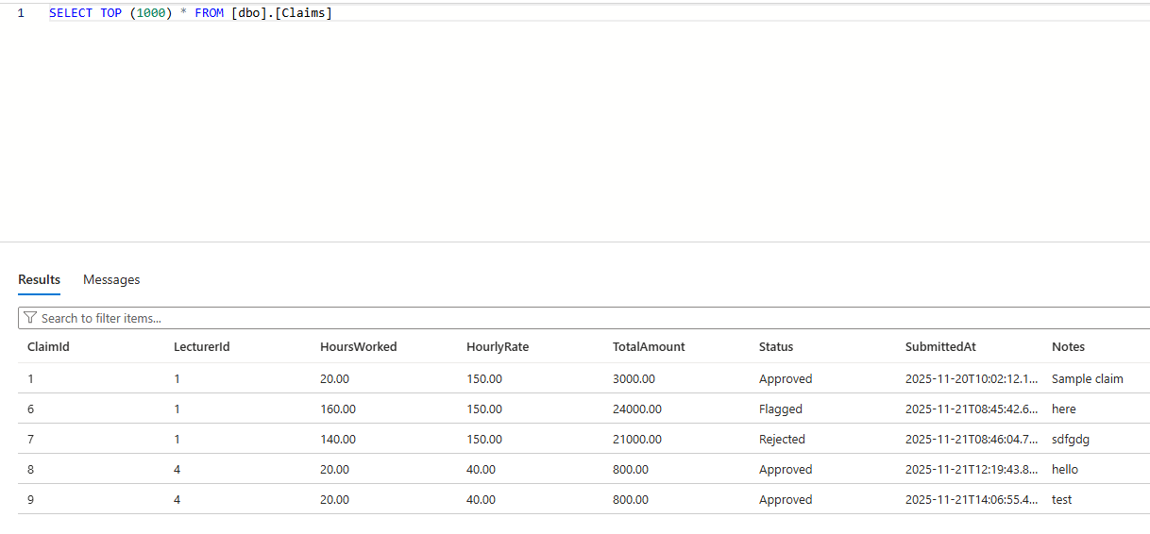
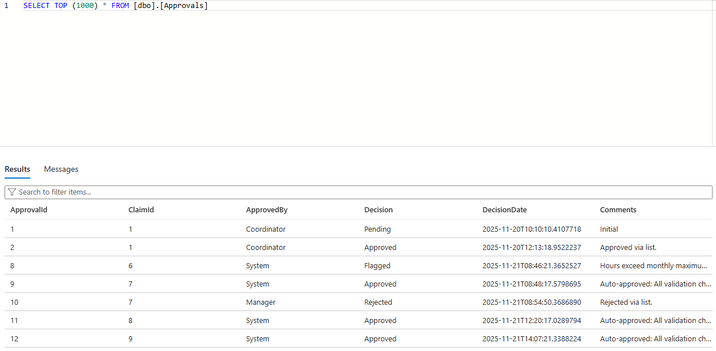
Database Structure
16

Slide 18
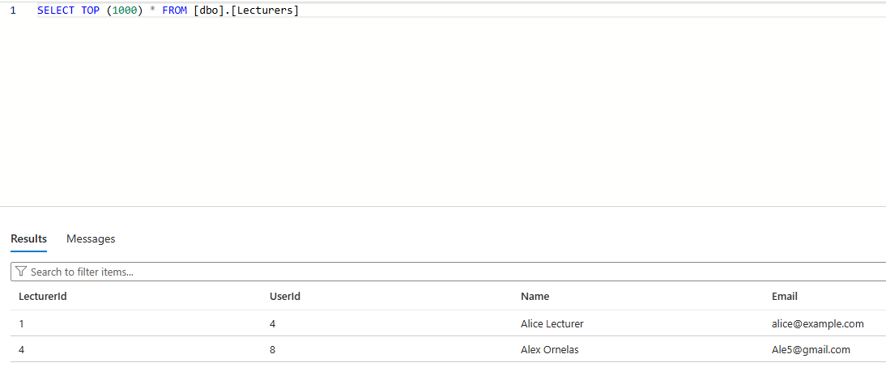
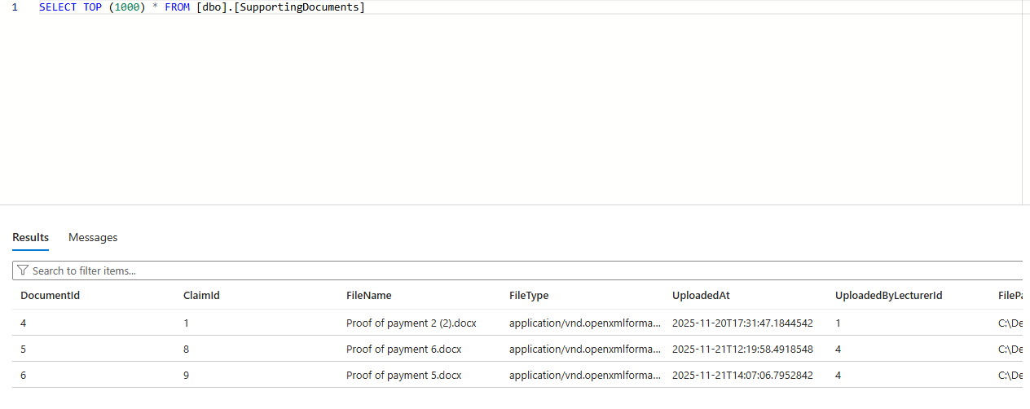
Database Structure
17

Slide 19
Demonstration Summary
Summaries of key workflows:
Lecturer submits claim
Coordinator reviews and approves / rejects
Coordinator reviews and approves / rejects
HR updates user and generates report
18

Slide 20
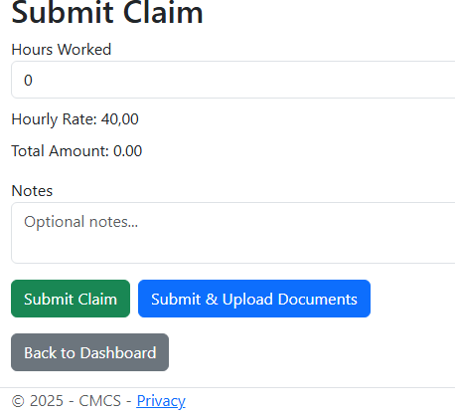
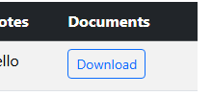
Feedback changes
File name does not show, only “Download”
Lecturer cannot change their hourly rate
Option to upload document in “Submit Claim” page
19

Slide 21
CONCLUSION
CMCS improves accuracy and reduces manual admin
Provides clear workflow between roles
Secure, user-friendly and database-driven system
Meets all automation, validation, and reporting requirements
20

Slide 22
THANK YOU
21

