Slide 1

FINAL INTERNSHIP RECORD
Romagnoli Lorenzo

Slide 2
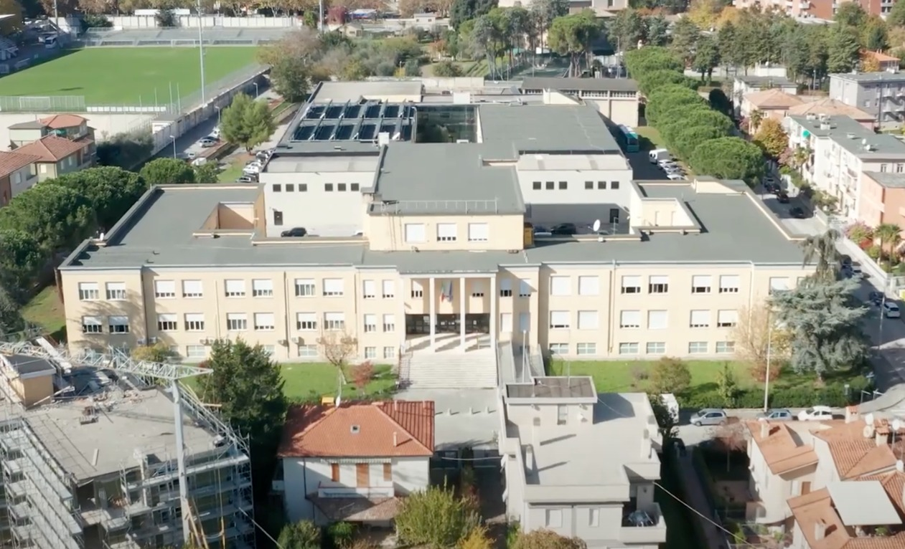
MY PRESENTATION
My name is Lorenzo Romagnoli and I frequent the class 5BM of the institute “IIS MARCONI PIERALISI” located in jesi and I frequented the Informatic course

Slide 3
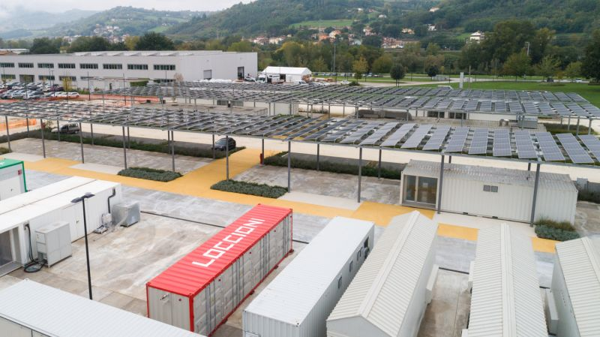
COMPANY INFORMATION
I’m doing my stage in Loccioni, located in Moie, a company specialized in the field of measure. Loccioni has 5 factories and the thing that left the most impression on me is this

Slide 4
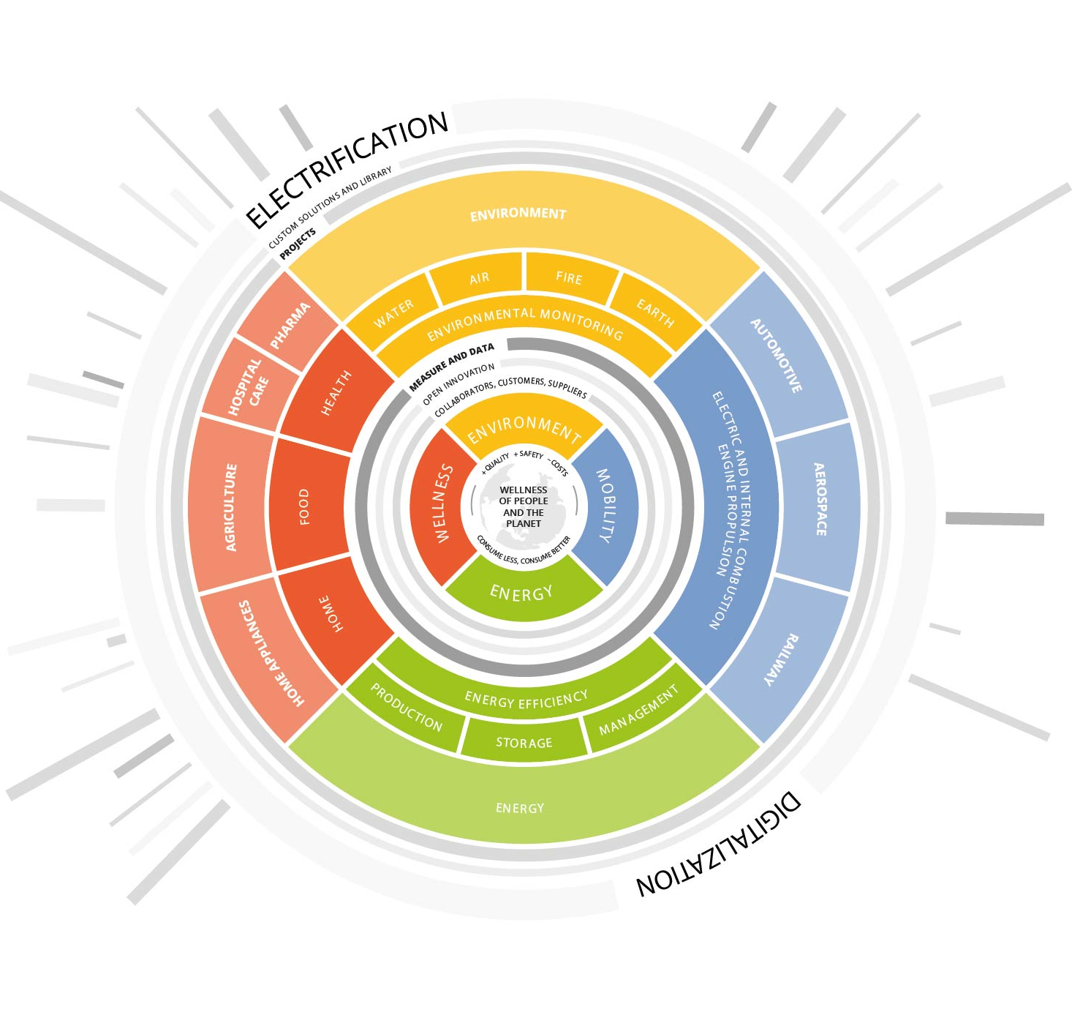

Slide 5
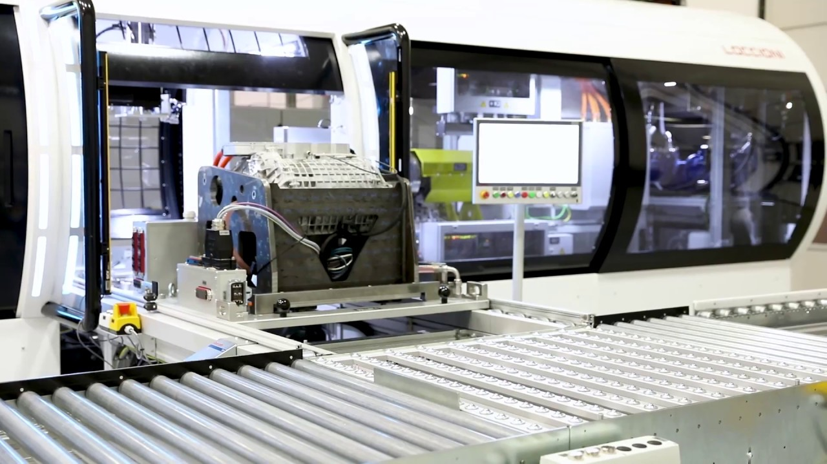
MY EXPERIENCE
my main task was to contribute to the development of the web app for viewing the good and the scrap pieces, and assist staff in making an injector test bench

Slide 6
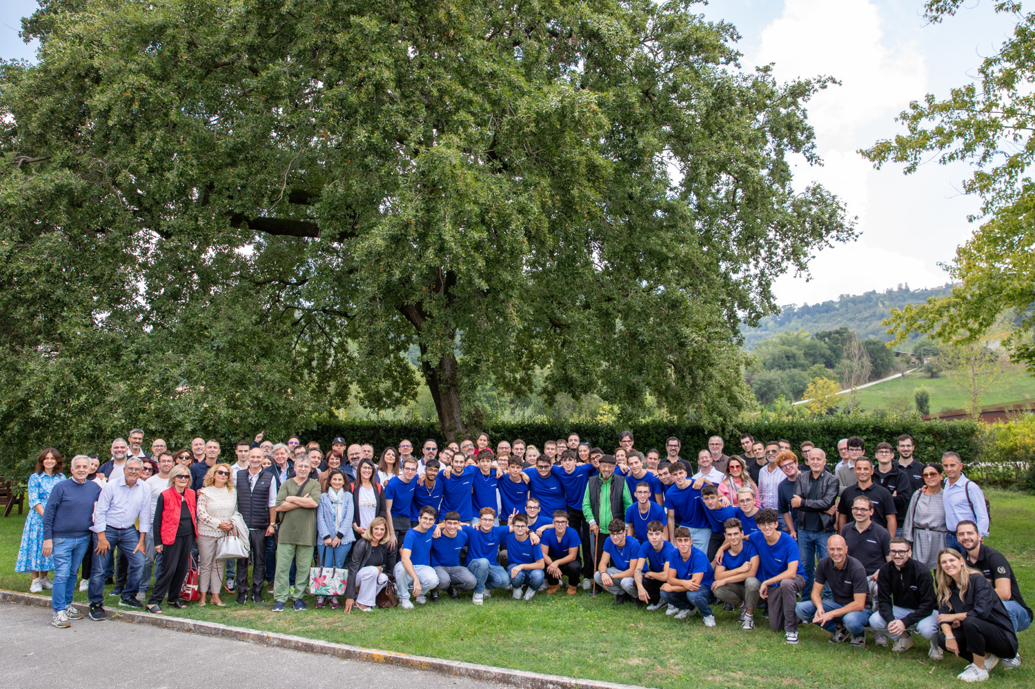
WHAT I LEARN
with this experience I learned to work in a group and precisely in the division of work. I had fun even though it was a very challenging experience

