Slide 1
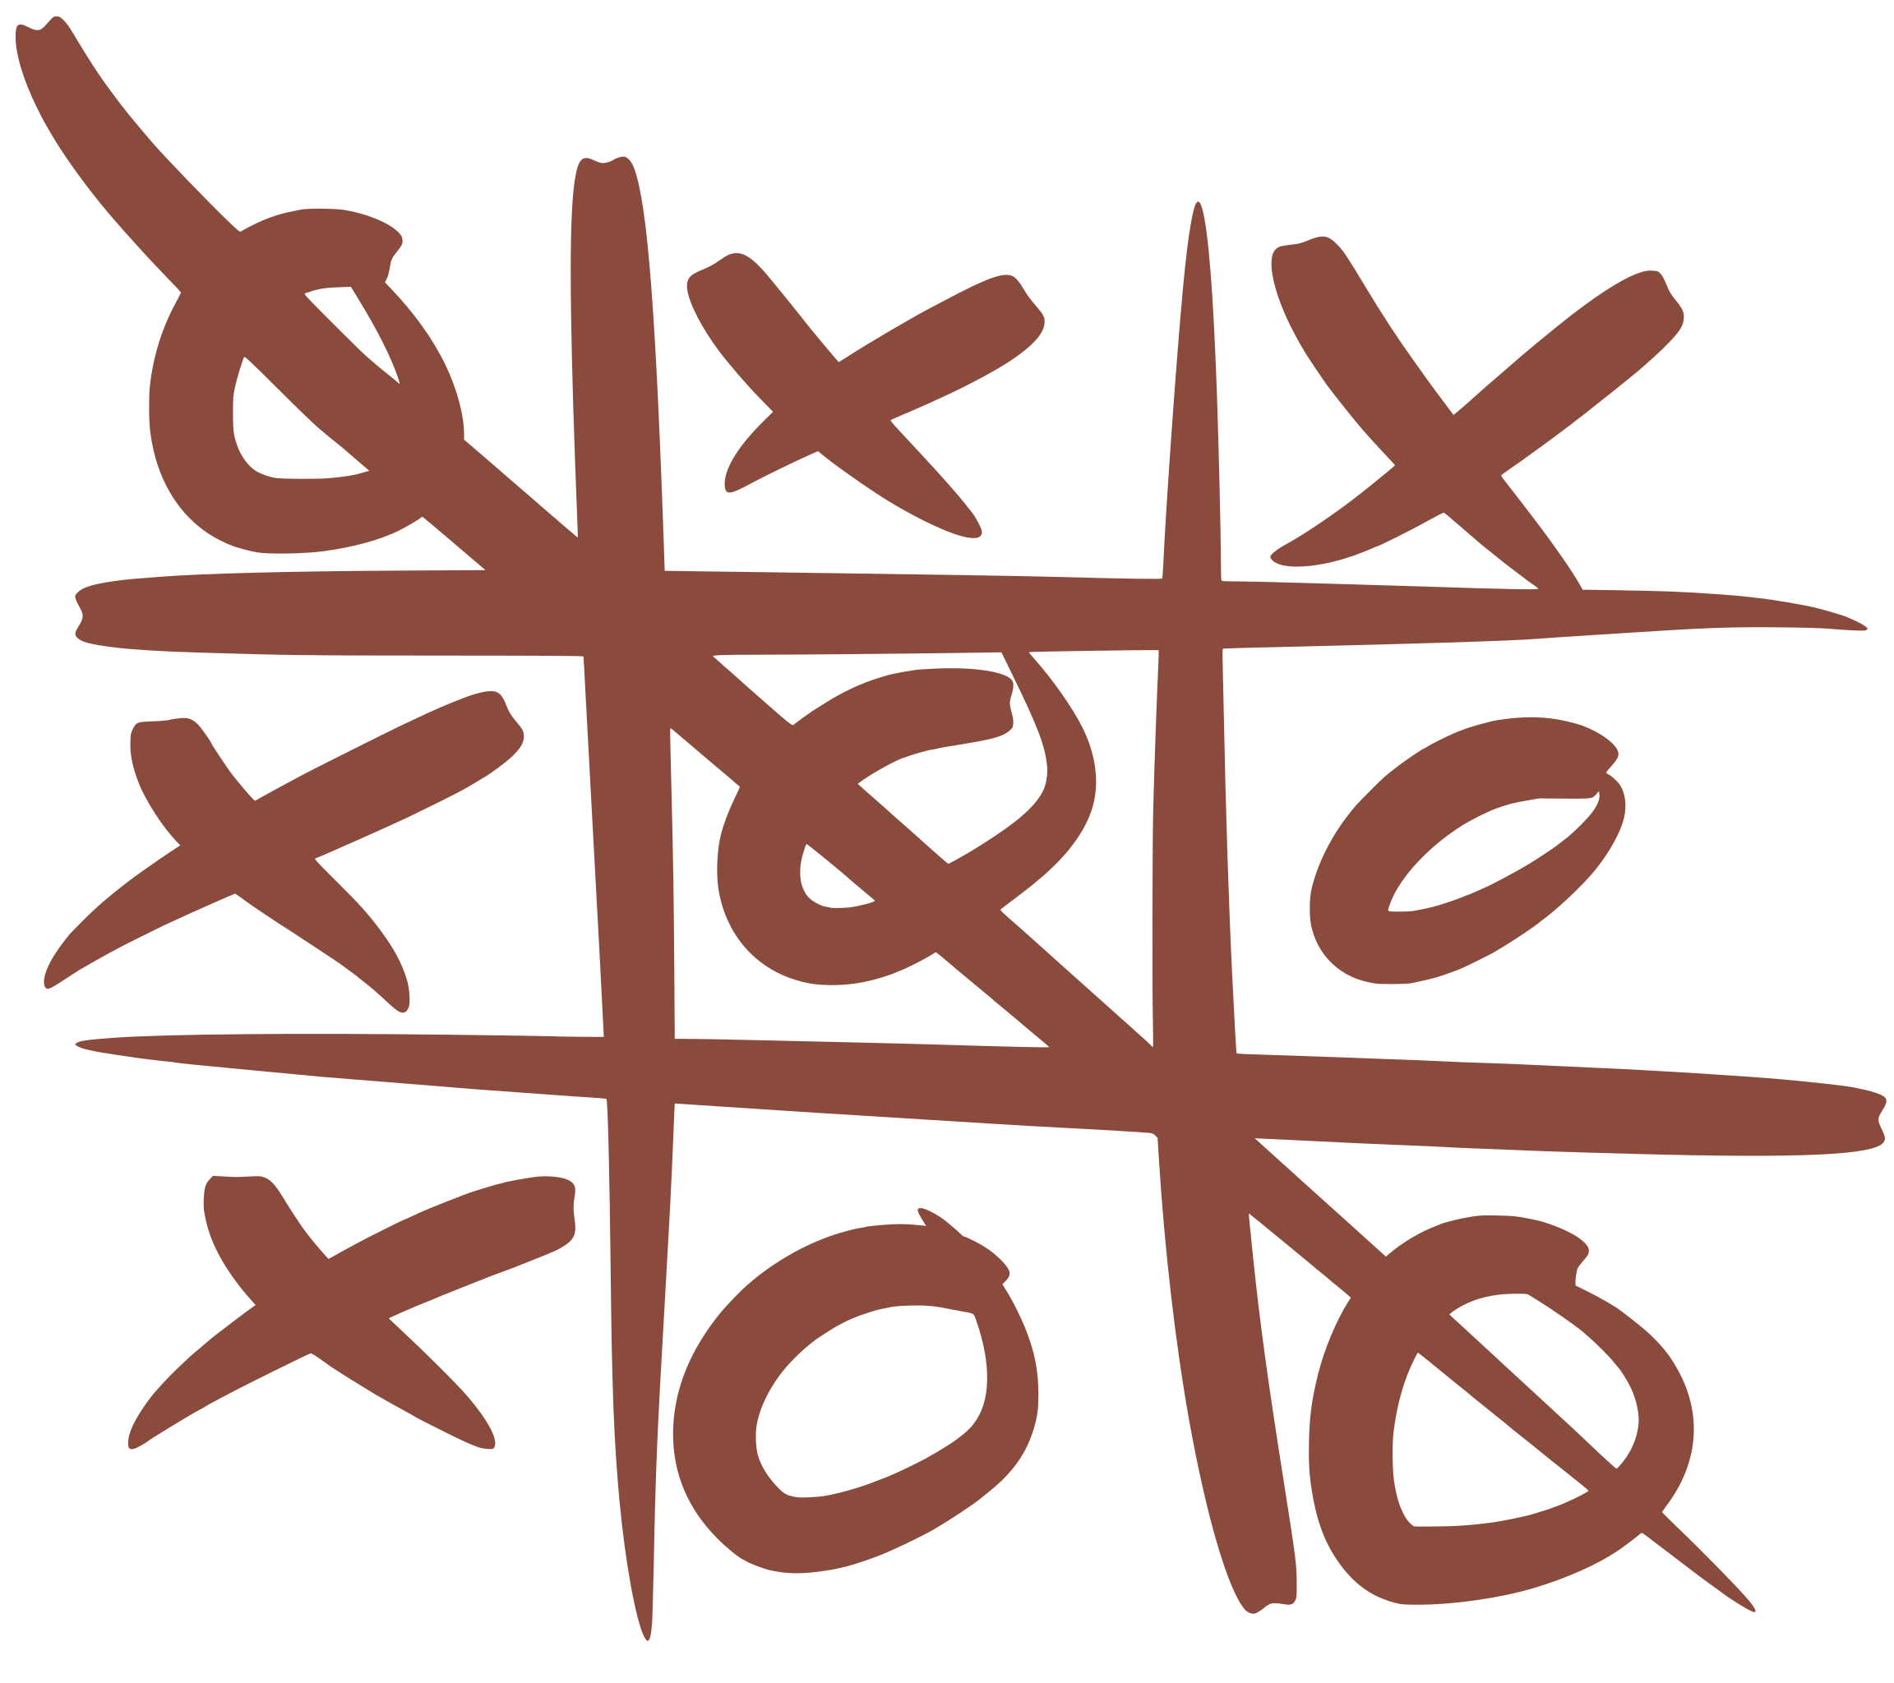
TIC - TAC - TOE
DSA-August 2021

Slide 2
Table of contents
01
Algorithms Used
02
Results
03
Limitations & Future Work
04
References

Slide 3
01
Algorithms Used

Slide 4
Minimax
Minimax is a recursive or backtracking algorithm.
Used for game-playing in AI.
Best move strategy is used in Minimax algorithm.
Typically used in two player games such as chess, checkers, tic-tac-toe etc.,
Minimax algorithm has two players, MIN and MAX.
MAX player tries maximize their utility whereas MIN player tries to minimize their utility.
It performs Depth-first search algorithm to inspect complete game tree.

Slide 5
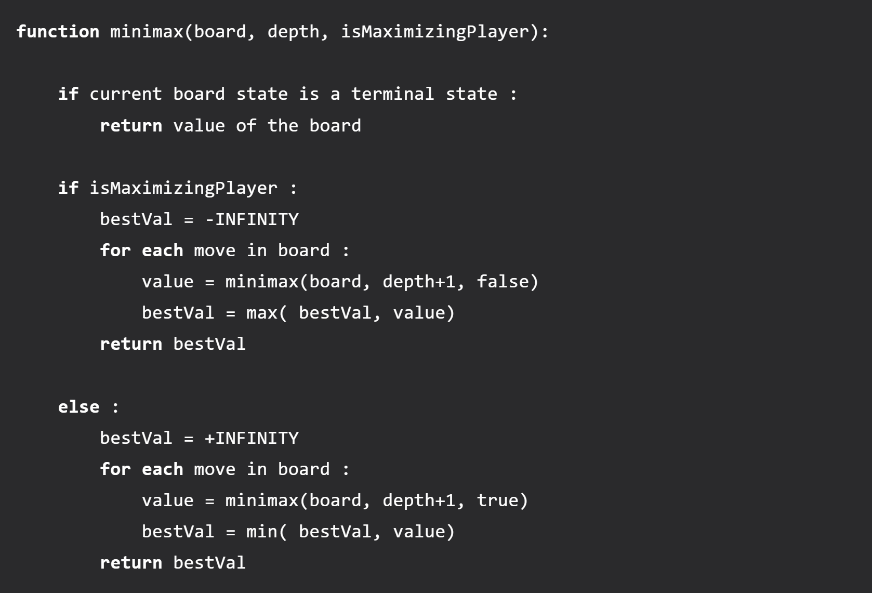
Minimax

Slide 6
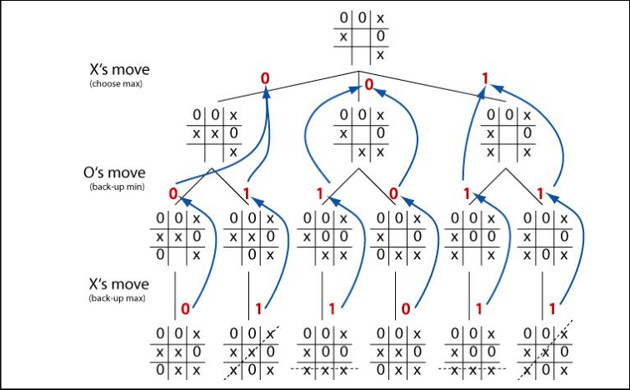
Minimax

Slide 7
Minimax
ADVANTAGES OF MINIMAX
Minimax is complete, as it always finds the solution in the finite search tree(i.e., game tree).
Decision making in AI is easily possible.

Slide 8
Alpha Beta Pruning
Alpha Beta Pruning is a search algorithm, modified version of minimax algorithm.
Used to decrease the number of nodes or branches that are evaluated by the Minimax Algorithm
Passes two additional parameters in the Minimax function, namely Alpha and Beta.
Extremely beneficial, as it reduces the computation time and makes the search go deeper in the game tree, quickly.
Cut-off search by exploring
Less number of nodes.

Slide 9
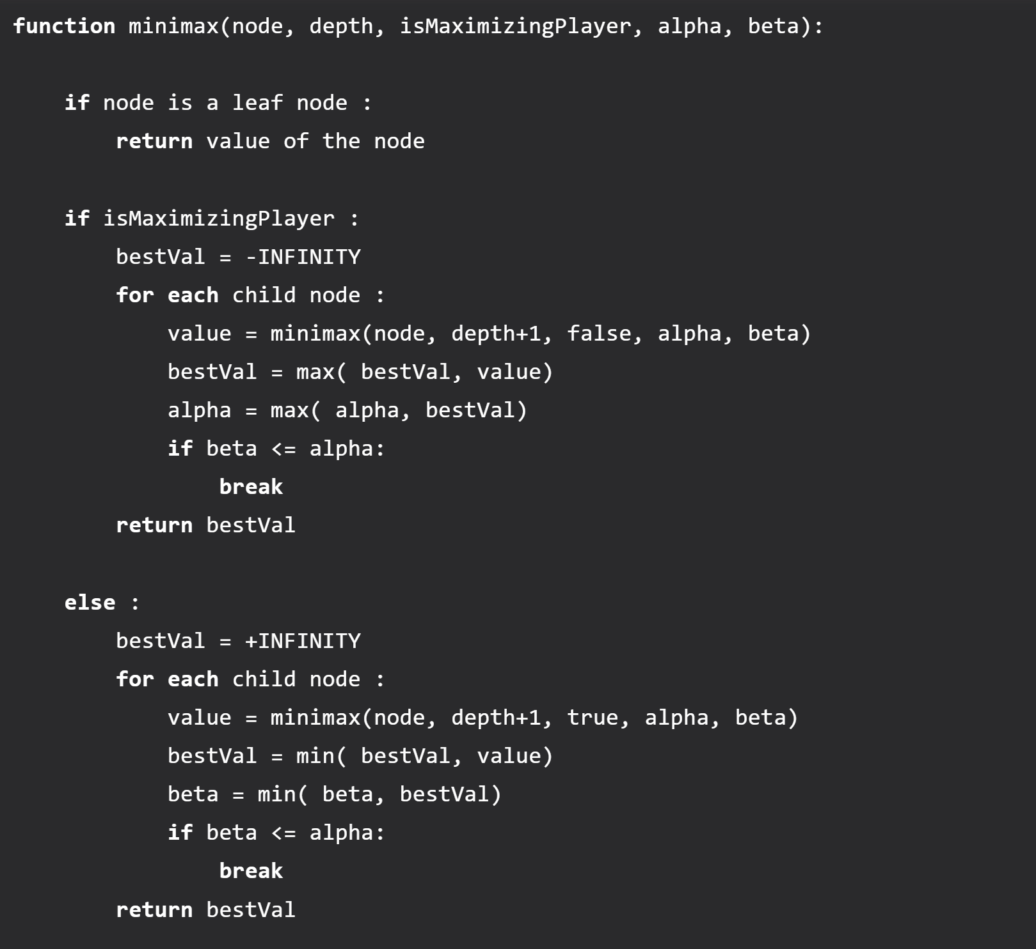
Alpha Beta Pruning

Slide 10
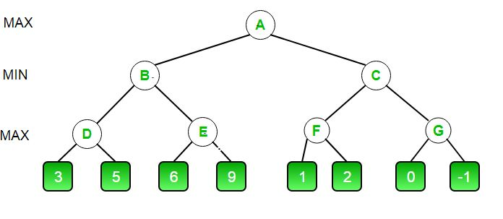
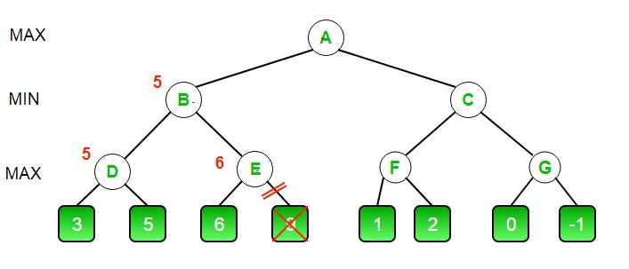
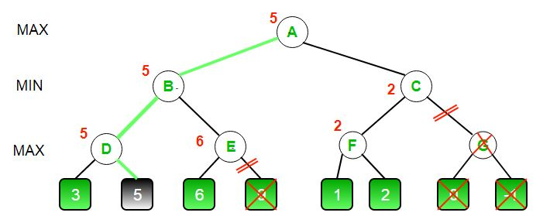
Alpha Beta Pruning

Slide 11
Alpha Beta Pruning
ADVANTAGES OF ALPHA BETA PRUNING
Limits the search time to more promising sub-trees, which enables a deeper search.
Reduces computation and searching during the minimax algorithm.
Prevents the use of additional computational time, making the process more responsive and fast.

Slide 12
02
Results

Slide 13
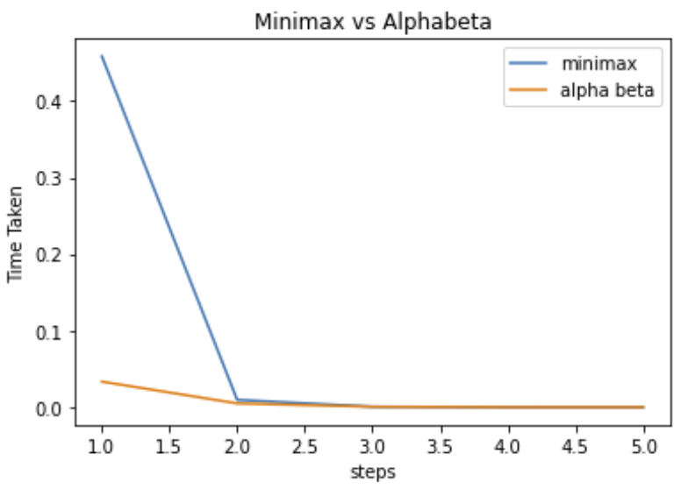
Comparison

Slide 14
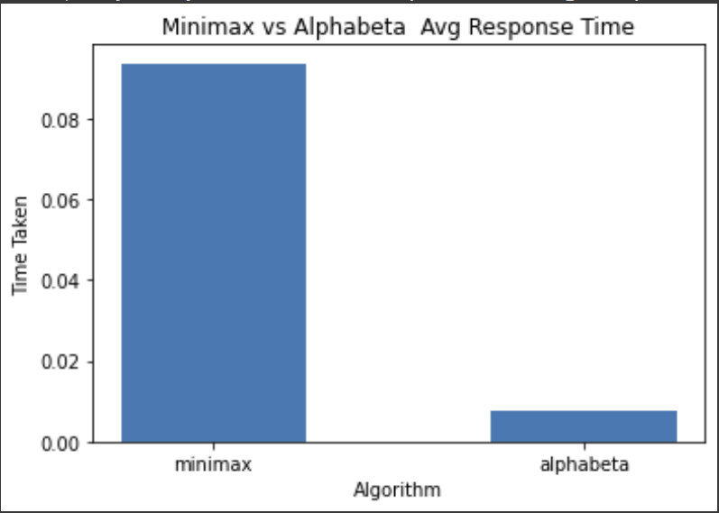
Comparison

Slide 15
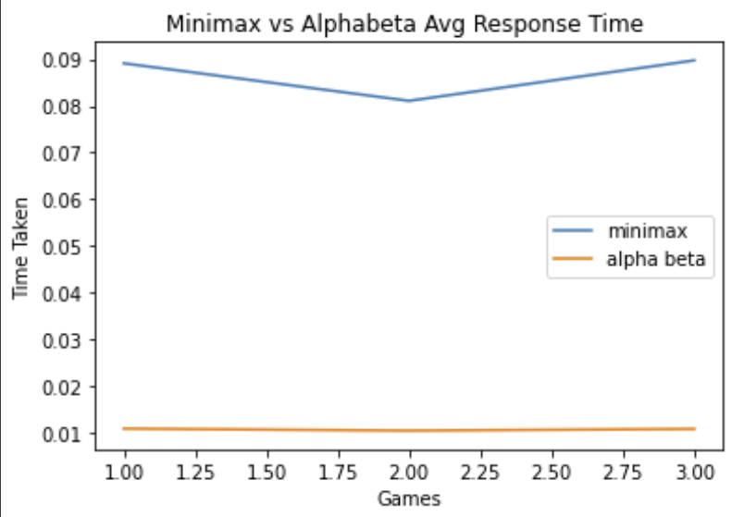
Comparison

Slide 16
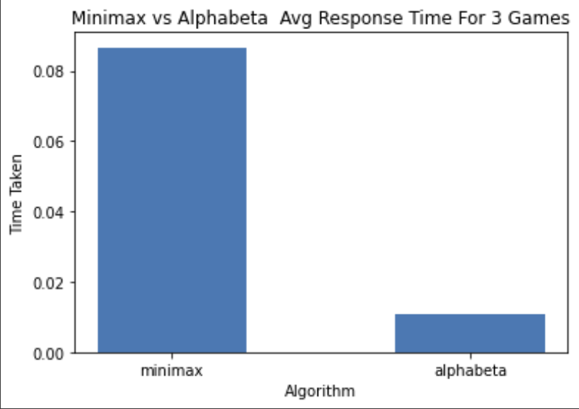
Comparison

Slide 17
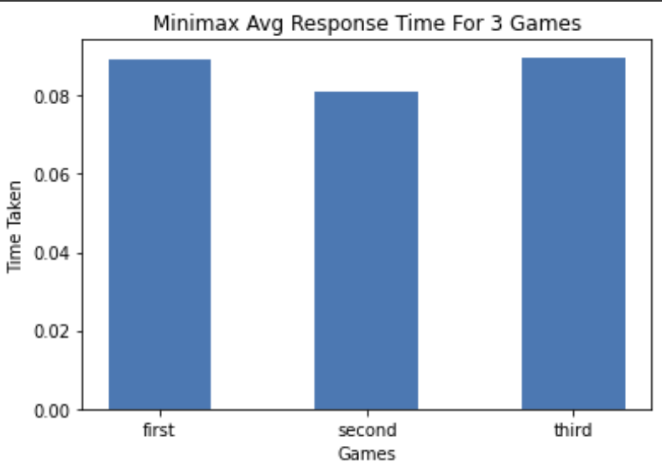
Comparison

Slide 18
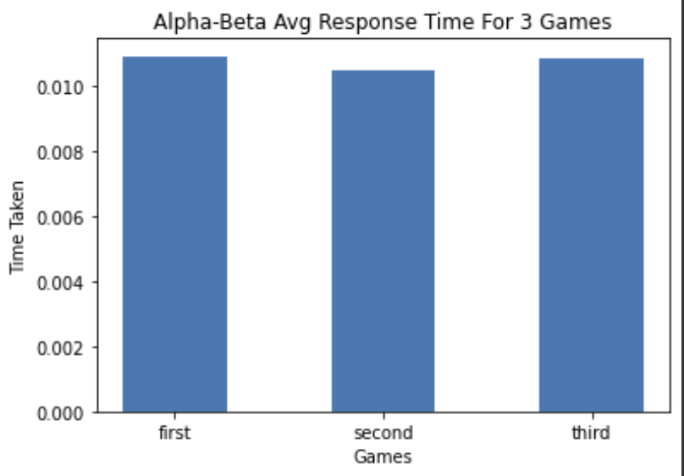
Comparison

Slide 19
03
Limitations & Future Work

Slide 20
Limitations
Future Works
Alpha-beta pruning is not feasible for most of cases to find whole game tree.
It cannot solve all problems that can be solved by minimax algorithm.
Even though alpha-beta is designed to select good move it calculates all the legal moves. It would be better if we use method called utility by node expansion. This could lead to faster decision by searching in smaller space.

Slide 21
04
References

Slide 22
https://www.geeksforgeeks.org/minimax-algorithm-in-game-theory-set-3-tic-tac-toe-ai-finding-optimal-move/
https://www.geeksforgeeks.org/minimax-algorithm-in-game-theory-set-4-alpha-beta-pruning/?ref=lbp

Slide 23
Thank You
Sricharan Yedu Thirnathi (st122037)
Sai Preetham Kamishetty (st122038)

