Slide 1
NeedleBench and the needle in the Haystack

Slide 2
Table of contents
Motivation and Background
What is a context window?
Why we care about long context retrieval
What is a “Needle in a Haystack” ?
Greg kamradt [1]
Initial findings

Slide 3
Table of contents
Building on NIH Testing
Needle bench
Overview
Related Work
Methodology
Experiments
Findings
Summary

Slide 4
Motivation & Background

Slide 5
Background – What is a context window?
Context windows can be thought of as the working memory or RAM of models with the transformer architecture
It contains things like the prompt, system prompt, conversation history and any additional documents relevant for the task at hand
Since this space is limited, we often use RAG to pre-select sections to include in the context window

Slide 6
Motivation – Why long context retrieval?
RAG: More content can be included
Chatbots: Conversations can be longer before the model ‘forgets’ previous exchanges
Eventually: Potentially replace RAG with ultra long context models
Question: How do we evaluate long-Context LLMs?

Slide 7
The needle in the haystack
Developed by Greg Kamradt
Initially tested on GPT4 with Paul Graham essays
Aims to test retrieval ability of an LLM at various context lengths with varied needle placement

Slide 8
The needle in a haystack – The Test
Place a fact or statement (the needle) inside a chunk of a body of unrelated text (the haystack)
Provide the LLM with this text and a prompt asking about the needle
Increase the size of the haystack and change the needle position
Aggregate the results and evaluate accuracy

Slide 9
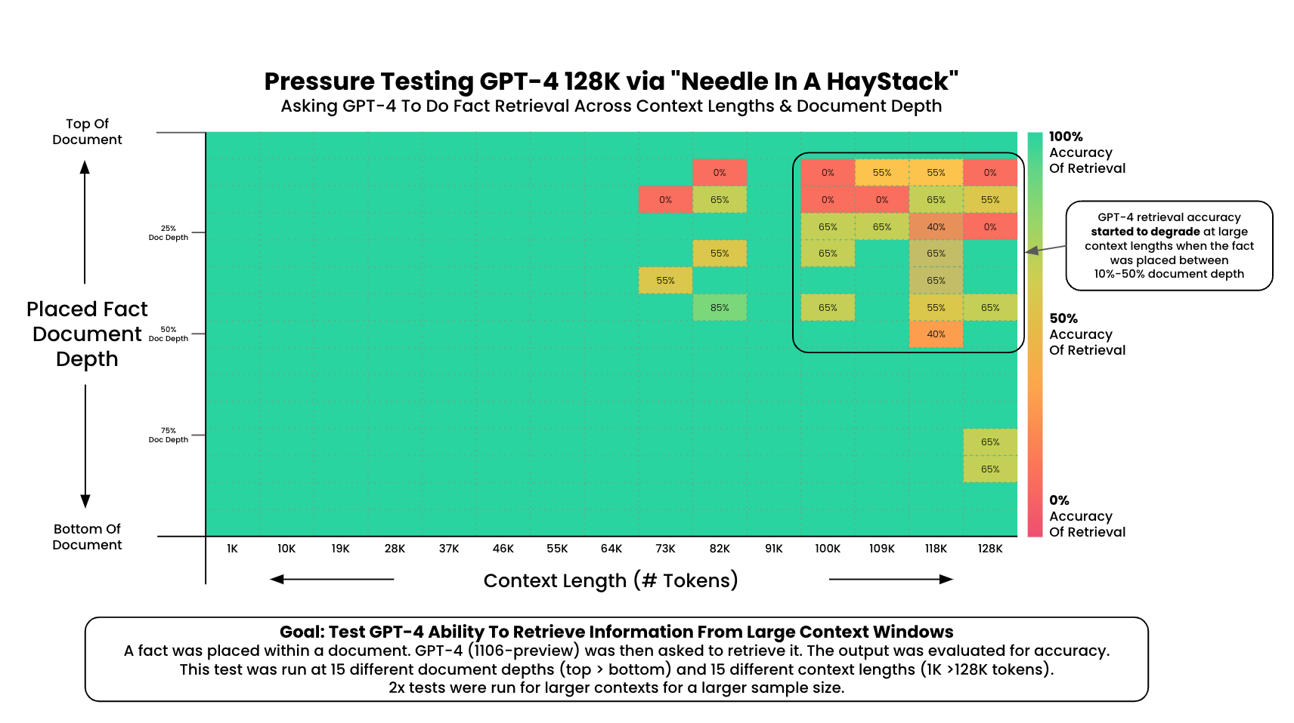
The needle in a haystack – Results (GPT-4)

Slide 10
The needle in a haystack – Limitations
Needles are irrelevant filler content and require no reasoning ability
Modern LLMs crush the basic NIHS test (Ruler)

Slide 11
Related Works

Slide 12
Needle bench – Related Work
RULER (Hsieh et al.): shows that passing retrieval tests does not always mean robust understanding. Models can focus on certain key points to find the needle.
LongBench(Bai et al.): more realistic tests run the risk of allowing the model to rely on its general knowledge to answer the test questions even without finding the needle

Slide 13
Needle bench – Related Work
RULER (Hsieh et al.): shows that passing retrieval tests does not always mean robust understanding. Models can focus on certain key points to find the needle.
LongBench(Bai et al.): more realistic tests run the risk of allowing the model to rely on its general knowledge to answer the test questions even without finding the needle

Slide 14
Needle bench – Related Work
RULER (Hsieh et al.): shows that passing retrieval tests does not always mean robust understanding. Models can focus on certain key points to find the needle.
LongBench(Bai et al.): more realistic tests run the risk of allowing the model to rely on its general knowledge to answer the test questions even without finding the needle

Slide 15
NIHS Benchmark

Slide 16
NeedleBench: Can LLMs Do Retrieval and Reasoning in Information-Dense Context?
Published by Mo Li et al. in https://arxiv.org/abs/2407.11963
Aims to provide a more sophisticated Benchmarking framework

Slide 17
Needle bench – Methodology
assess retrieval and reasoning performance in bilingual long-context tasks
context lengths of (e.g., 32k, 128k, and beyond)
Two types of tests
information-sparse, characterized by minimal relevant details embedded within extensive irrelevant text to simulate simpler real-world retrieval tasks;
information-dense, implemented as the Ancestral Trace Challenge, where relevant information is continuously distributed throughout the context to simulate more complex real-world reasoning tasks.

Slide 18
NeedleBench – Information-Sparse Tasks
Single-Needle Retrieval Task (S-RT)
Multi-Needle Retrieval Task (M-RT)
Multi-Needle Reasoning Task (M-RS)
needles are synthetic, abstract, and fictional statements or relational facts

Slide 19
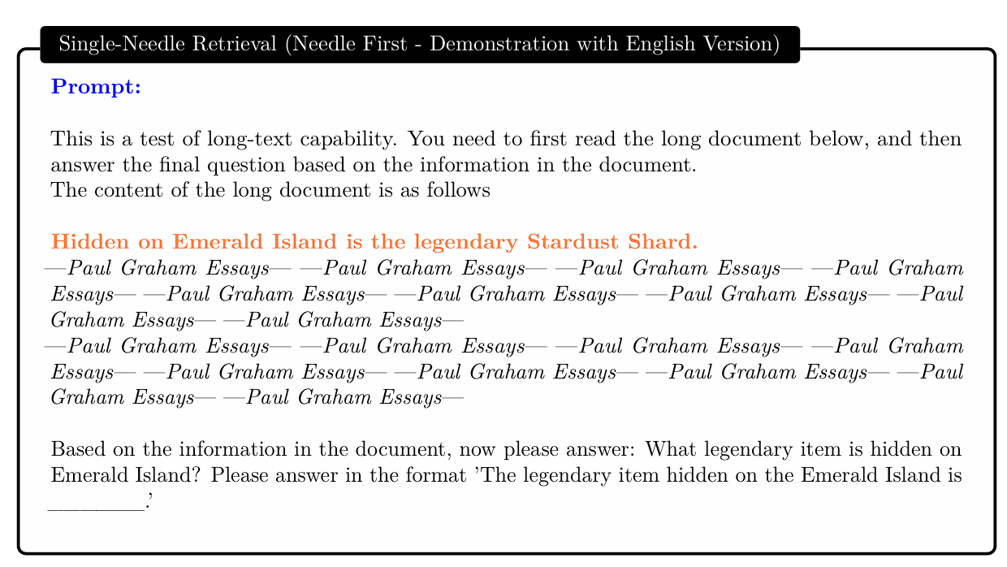
Single-Needle Retrieval Task (S-RT)

Slide 20
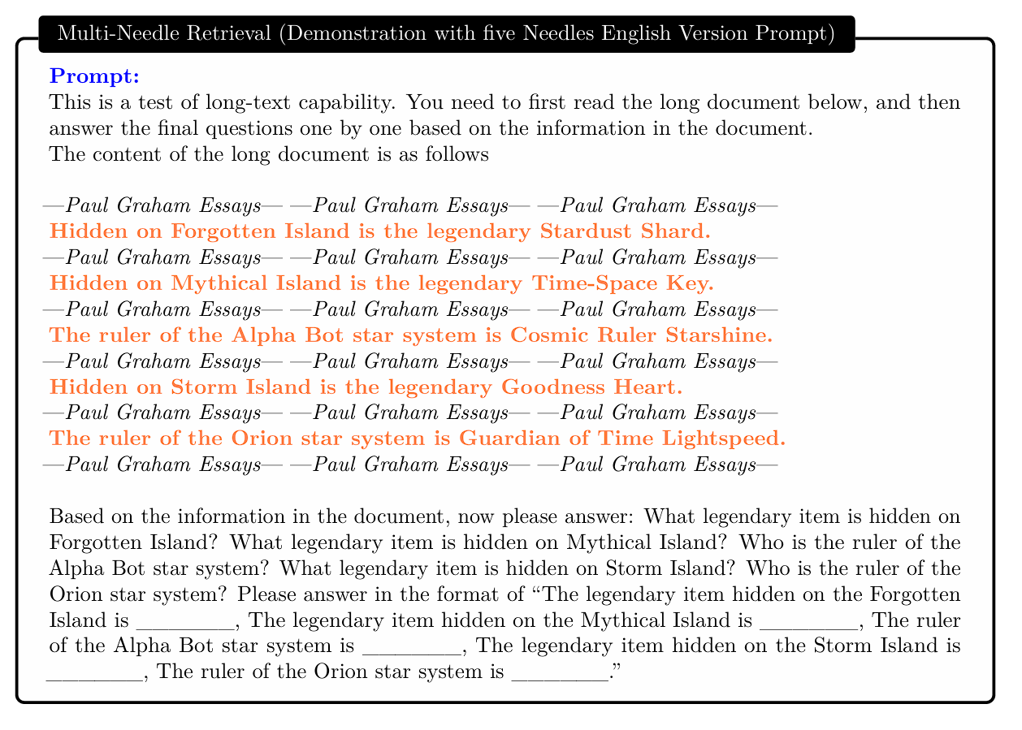
Multi-Needle Retrieval Task (M-RT)

Slide 21
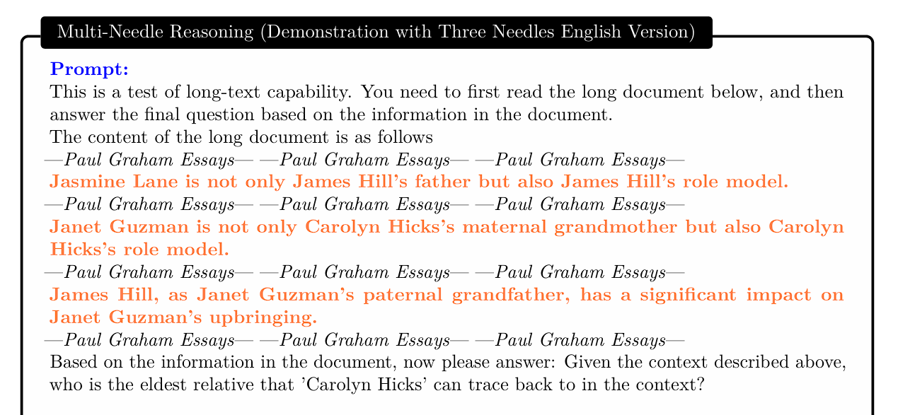
Multi-Needle Reasoning Task (M-RS)

Slide 22
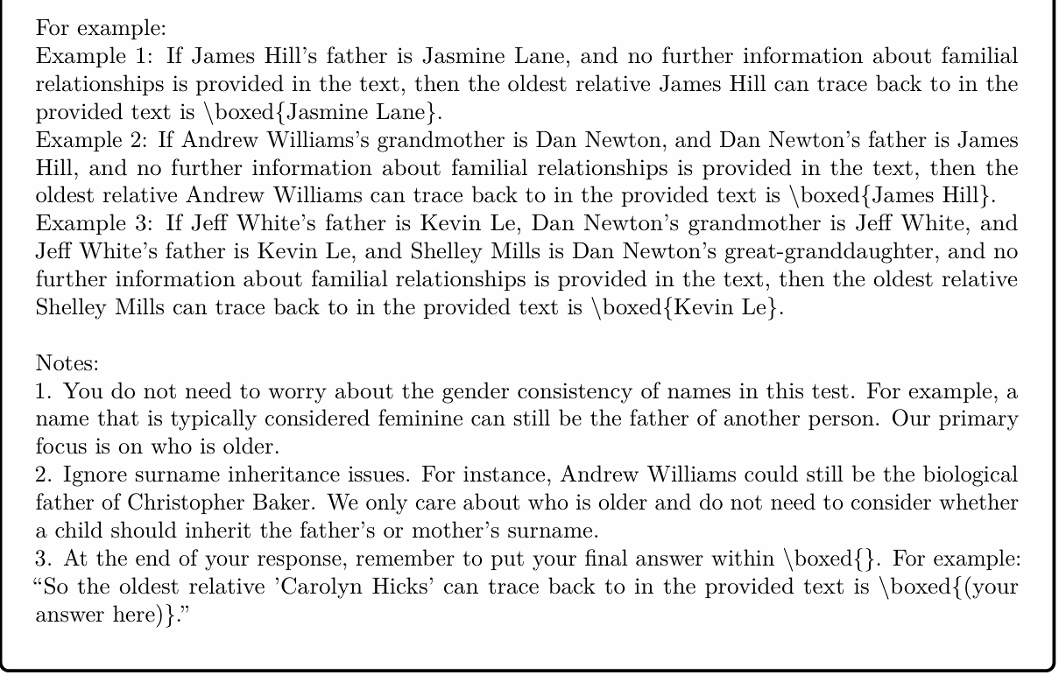
Multi-Needle Reasoning Task (M-RS)

Slide 23
Information-Sparse Tasks: Evaluation

Slide 24
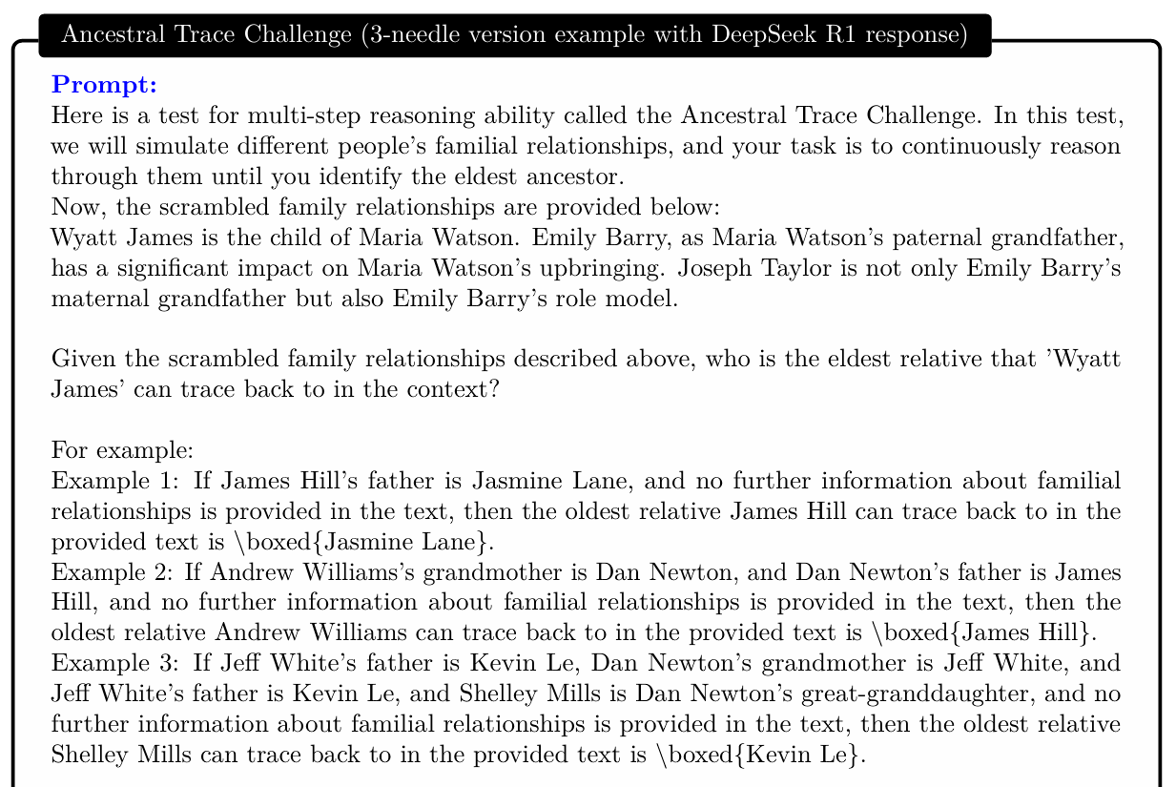
NeedleBench – Information-Dense Tasks
Ancestral Trace Challenge (ATC):

Slide 25
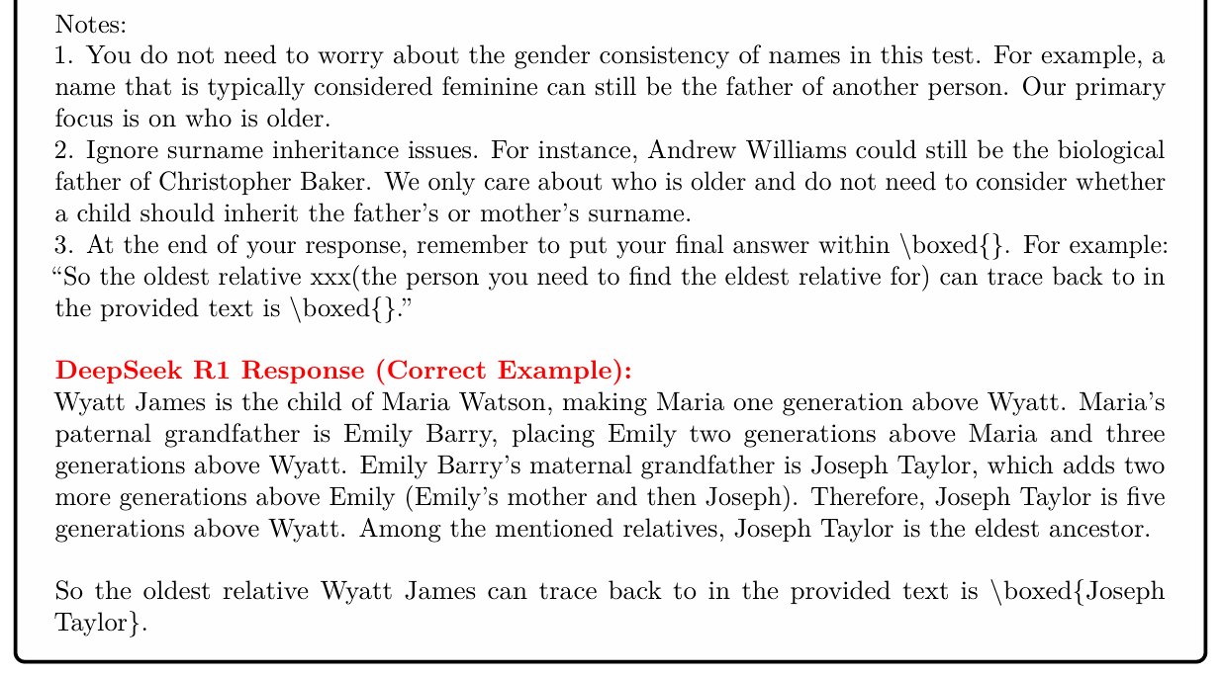
Information-Dense Tasks
Diversity in ATC:

Slide 26
Information-Dense Tasks: Evaluation

Slide 27
Needle bench – Experiments
Evaluation of mainstream open source LLMs
Information-sparse tasks at context lengths of 32K and 128K
ATC task were also performed on close-source models such as GPT-4.1 and DeepSeek R1

Slide 28
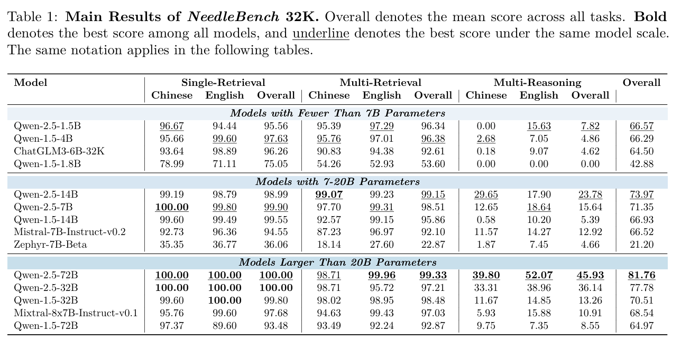
Performance of NeedleBench Information-Sparse Tasks
Impact of Model Architecture and Technical Advances
Effect of Model Scale on Multi-Needle Reasoning Performance
Effect of Needle Count on Multi-Needle Reasoning Performance
Impact of Language

Slide 29
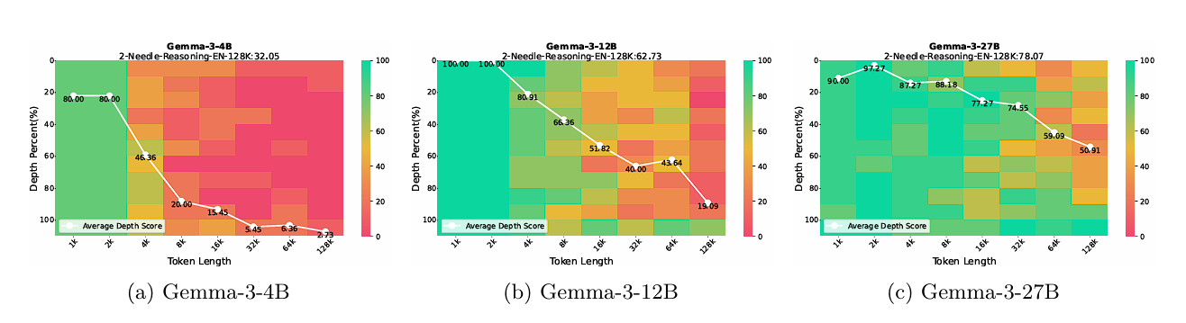
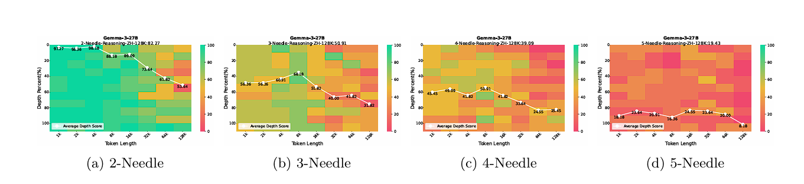
Performance – Generation and Needle Count

Slide 30
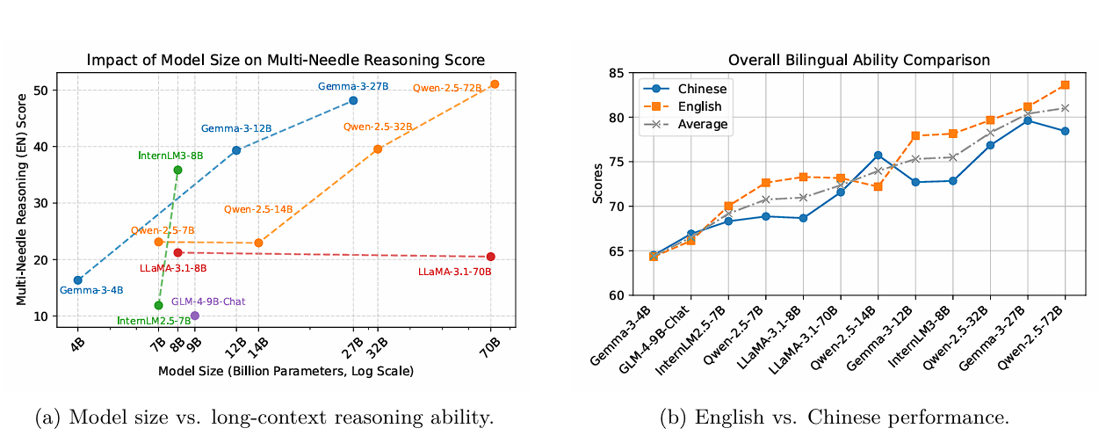
Performance – Size and Language

Slide 31
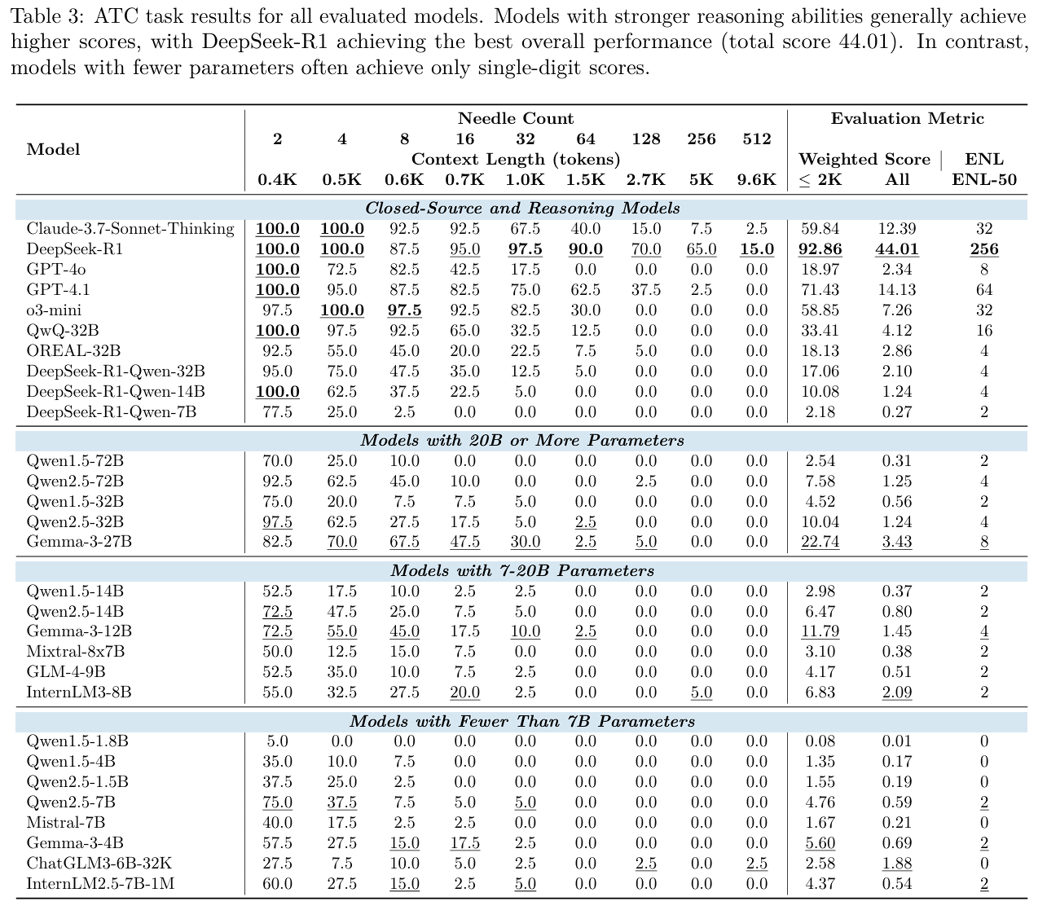
Performance of NeedleBench Information-Dense Tasks

Slide 32
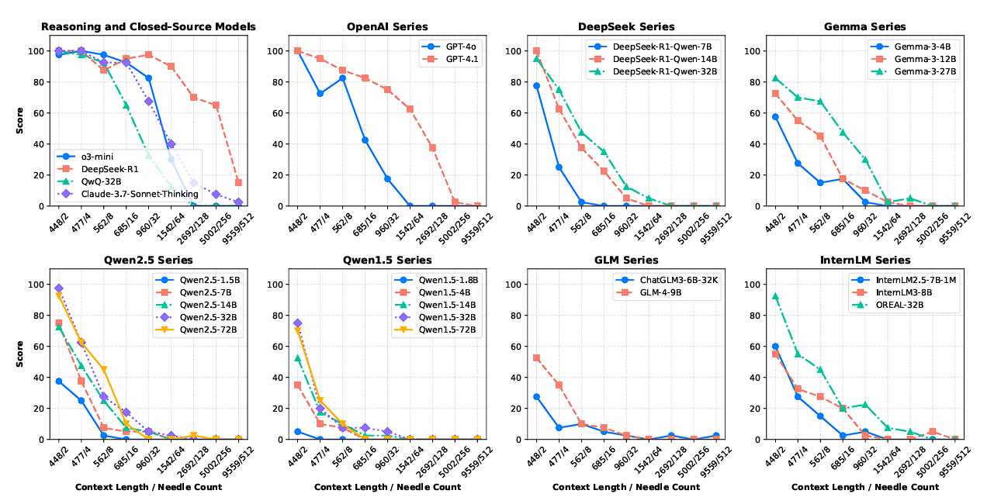

Slide 33
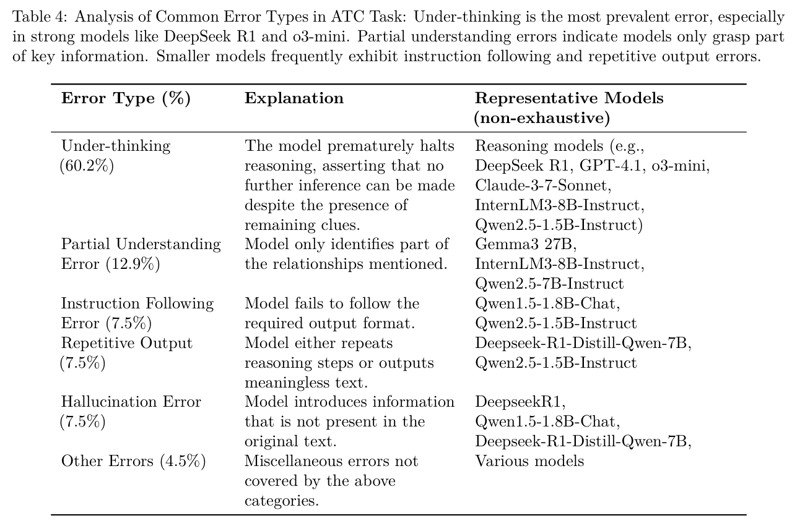

Slide 34
Summary

Slide 35
gkamradt/LLMTest_NeedleInAHaystack: Doing simple retrieval from LLM models at various context lengths to measure accuracy

