Slide 1
Python Mini Project Topic –Web Scrapping
Soham Parate – 706
Gauri Gupta -711
Jenish Panchal -714
Batch –G1

Slide 2
What Is Web Scraping?
Web scraping is a technique for extracting a large amount of data from websites saved to a local file in your computer or to a database in the form of a table. Web Scraping is not only used to extract information from dynamic websites but can also scrape web items. It can be done manually, but automated data scraping tools are mostly preferred because of their efficiency and low cost of web scraping
Our project uses Web scraping for web indexing, data and web mining, online price comparison with an amazon price scraper and price monitoring, product review scraping and more.

Slide 3
Beautiful Soup
Beautiful Soup is a Python library for parsing HTML and XML documents.
It is often used for web scraping and to extract data from websites
Beautiful Soup transforms a complex HTML document into a complex tree of Python objects, such as tag, navigable string, or comment.
Beautiful Soup is a Python library designed for quick turnaround projects like screen-scraping.

Slide 4
Selenium
Selenium is a powerful tool for controlling web browsers through programs and performing browser automation. It is functional for all browsers, works on all major OS and its scripts are written in various languages i.e Python, Java, C#, etc, we will be working with Python.
Why learn Selenium Python ?
Open Source and Portable –
Combination of tool and DSL
Easier to understand and implement
Less burden and stress for testers

Slide 5
Pandas
Pandas is an open-source Python Library providing high-performance data manipulation and analysis tool using its powerful data structures.
Key Features of Pandas
Fast and efficient Data Frame object with default and customized indexing.
Tools for loading data into in-memory data objects from different file formats.
Data alignment and integrated handling of missing data.
Label-based slicing, indexing and sub setting of large data sets.
Group by data for aggregation and transformations.
High performance merging and joining of data.

Slide 6
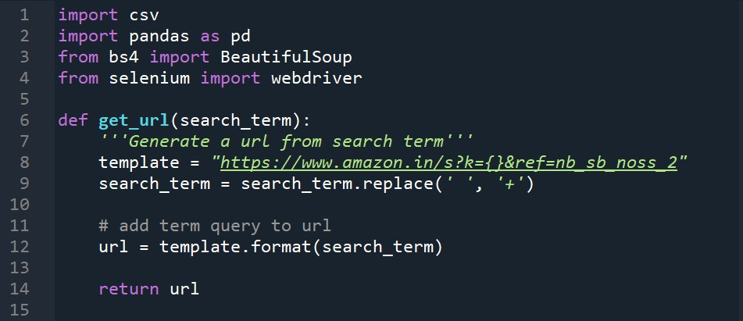
Code:

Slide 7
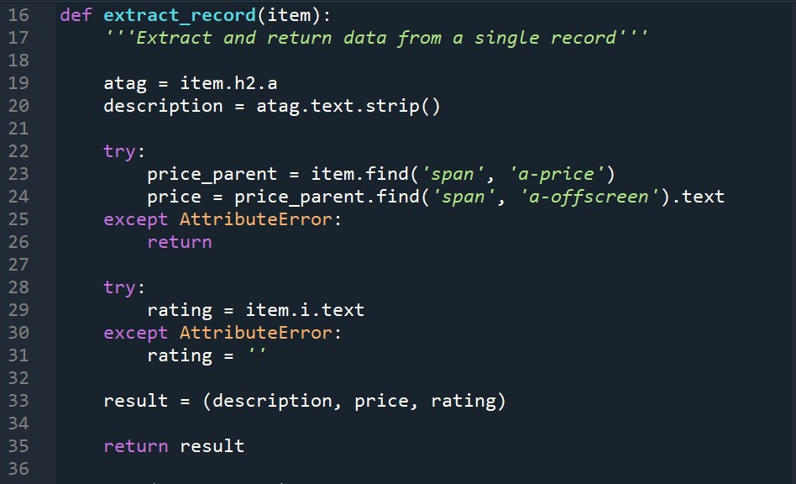

Slide 8
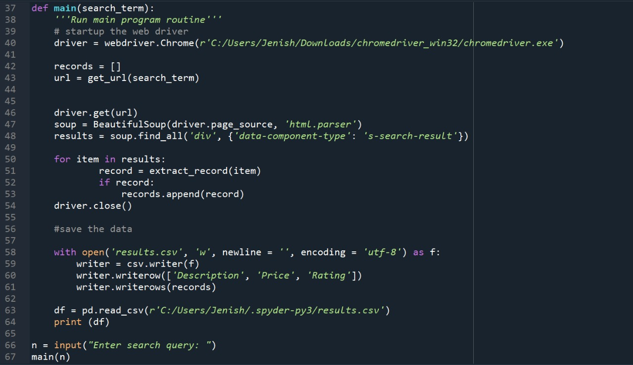

Slide 9
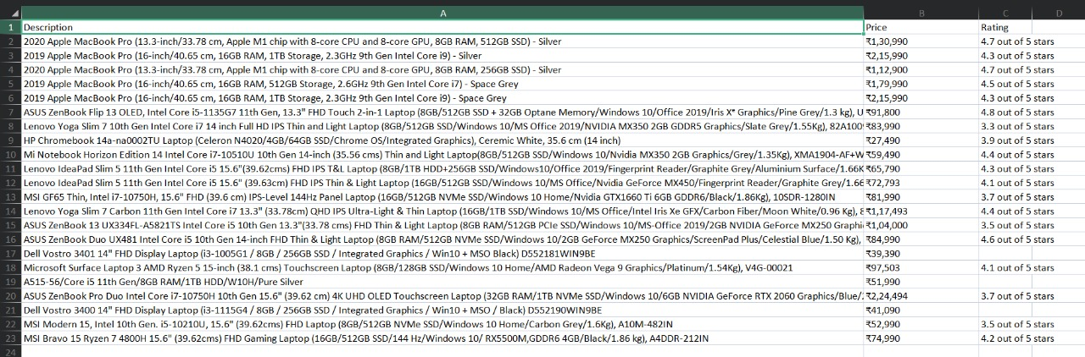
Output: Csv File

Slide 10
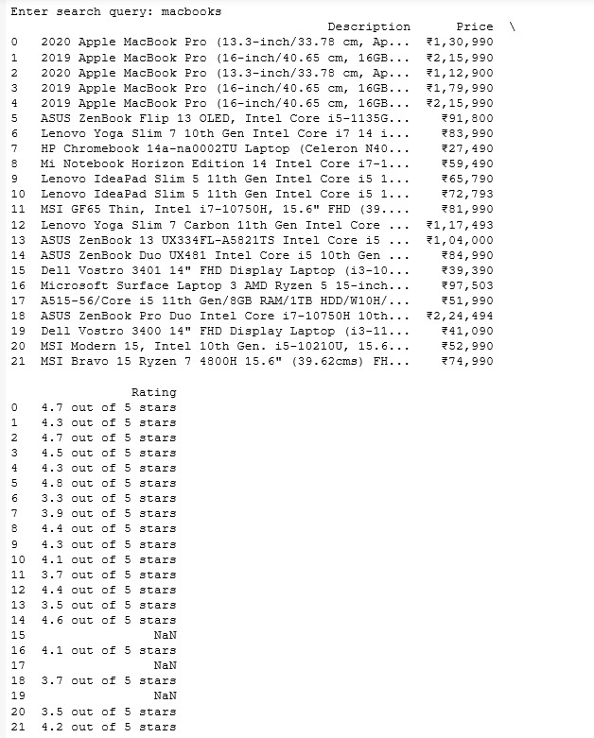
Displaying the output using pandas

Slide 11
Thank You.

