Slide 1

IILM UNIVERSITY
Greater Noida, U.P. | School of Computer Science and Engineering
INTERNSHIP PRESENTATION
CGPA Calculator & Login–Registration System
Built in C++ during a Virtual Internship at CodeAlpha
Student Name
Sunny
Organization
CodeAlpha
Enrollment Number
25SCS1003004966
Internship Duration
1 Aug 2026 – 30 Aug 2026
Program & Semester
B.Tech CSE — 3rd Semester
Domain
C++ Programming

Slide 2




ORGANIZATION PROFILE
About CodeAlpha
CodeAlpha is a technology-focused organization that offers virtual internship programs to students across domains such as C++, Python, web development, Android development, data science, and cybersecurity.
Its mission is to help learners gain hands-on, project-based experience that bridges the gap between academic learning and real industry requirements — through independently completed tasks, reviewed and certified upon completion.
Remote & Self-Paced
Certified Completion
Multiple Tech Domains
Tasks completed independently, at the intern's own pace.
Certificate of Completion + Letter of Recommendation.
C++, Python, Web, Android, Data Science & more.
CodeAlpha Internship — C++ Programming
02

Slide 3
INTERNSHIP OVERVIEW
Objectives of the Internship
1
Design a console-based CGPA Calculator that computes semester GPA and overall CGPA accurately.
2
Build a Login & Registration System with secure-enough credential storage and verification.
3
Apply core C++ concepts — structures, loops, functions, vectors, and file handling — to real problems.
4
Strengthen problem-solving and logical thinking through independent project development.
5
Gain exposure to a real-world, industry-style internship workflow.
CodeAlpha Internship — C++ Programming
03

Slide 4

What It Does
A console-based C++ program that calculates semester-wise GPA and the final overall CGPA, based on course grades and credit hours entered by the user — across any number of semesters and courses.
Handles multiple semesters and multiple courses per semester
Uses a Course struct to store name, grade, and credit hours
PROJECT 01
Computes grade points = grade × credits, per course
CGPA
Calculator
Displays semester GPA and final CGPA with formatted output
CodeAlpha Internship — C++ Programming
04

Slide 5

PROJECT 01 · CGPA CALCULATOR
Program Structure & Logic
Flow
gradePoints = course.grade * course.credits;
semesterTotalCredits += course.credits;
semesterTotalGradePoints += gradePoints;
float semesterGPA =
semesterTotalGradePoints /
semesterTotalCredits;
// after all semesters:
float finalCGPA =
overallTotalGradePoints /
overallTotalCredits;
1
Enter number of semesters
2
For each semester, enter courses (name, grade, credits)
3
Compute semester GPA = Σ(grade×credits) / Σ(credits)
4
Accumulate totals across semesters
5
Compute final CGPA and display formatted results
CodeAlpha Internship — C++ Programming
05

Slide 6

What It Does
A menu-driven C++ console application that lets a new user register a username and password, and lets an existing user log in — with credentials verified against stored records using file handling.
Menu-driven interface: Register, Login, or Exit
Credentials stored persistently in users.txt
Duplicate-username check during registration
PROJECT 02
Login &
Registration
Credential verification against stored records at login
CodeAlpha Internship — C++ Programming
06

Slide 7
PROJECT 02 · LOGIN & REGISTRATION
Program Structure & Logic
Flow
void registerUser() {
// read username, password
// reject if empty
// scan users.txt for duplicate
// append "username password"
}
void loginUser() {
// read username, password
// scan users.txt for a match
// report success / failure
}
1
Show menu: Register / Login / Exit
2
Register → validate input → check duplicate → append to file
3
Login → read file → match username & password
4
Loop back to menu until user chooses Exit
CodeAlpha Internship — C++ Programming
07

Slide 8


TECHNICAL FOUNDATION
Technologies & Tools Used
C++ Language
STL Headers
Code::Blocks / g++
Manual Testing
Core language for both projects
<vector>, <iomanip>, <fstream>, <string>
Compiler & IDE used for development
Multiple test cases incl. edge cases
CodeAlpha Internship — C++ Programming
08

Slide 9

TAKEAWAYS
Key Learnings from the Internship
Hands-on strengthening of core C++: structures, vectors, functions, control flow, and file handling.
Exposure to a real internship workflow — task assignment, independent build, testing, and review.
Better understanding of modular program design — separating input, computation, and output.
Improved debugging and testing discipline through deliberate edge-case checking.
Practical experience with file-based data persistence (reading/writing users.txt).
CodeAlpha Internship — C++ Programming
09

Slide 10
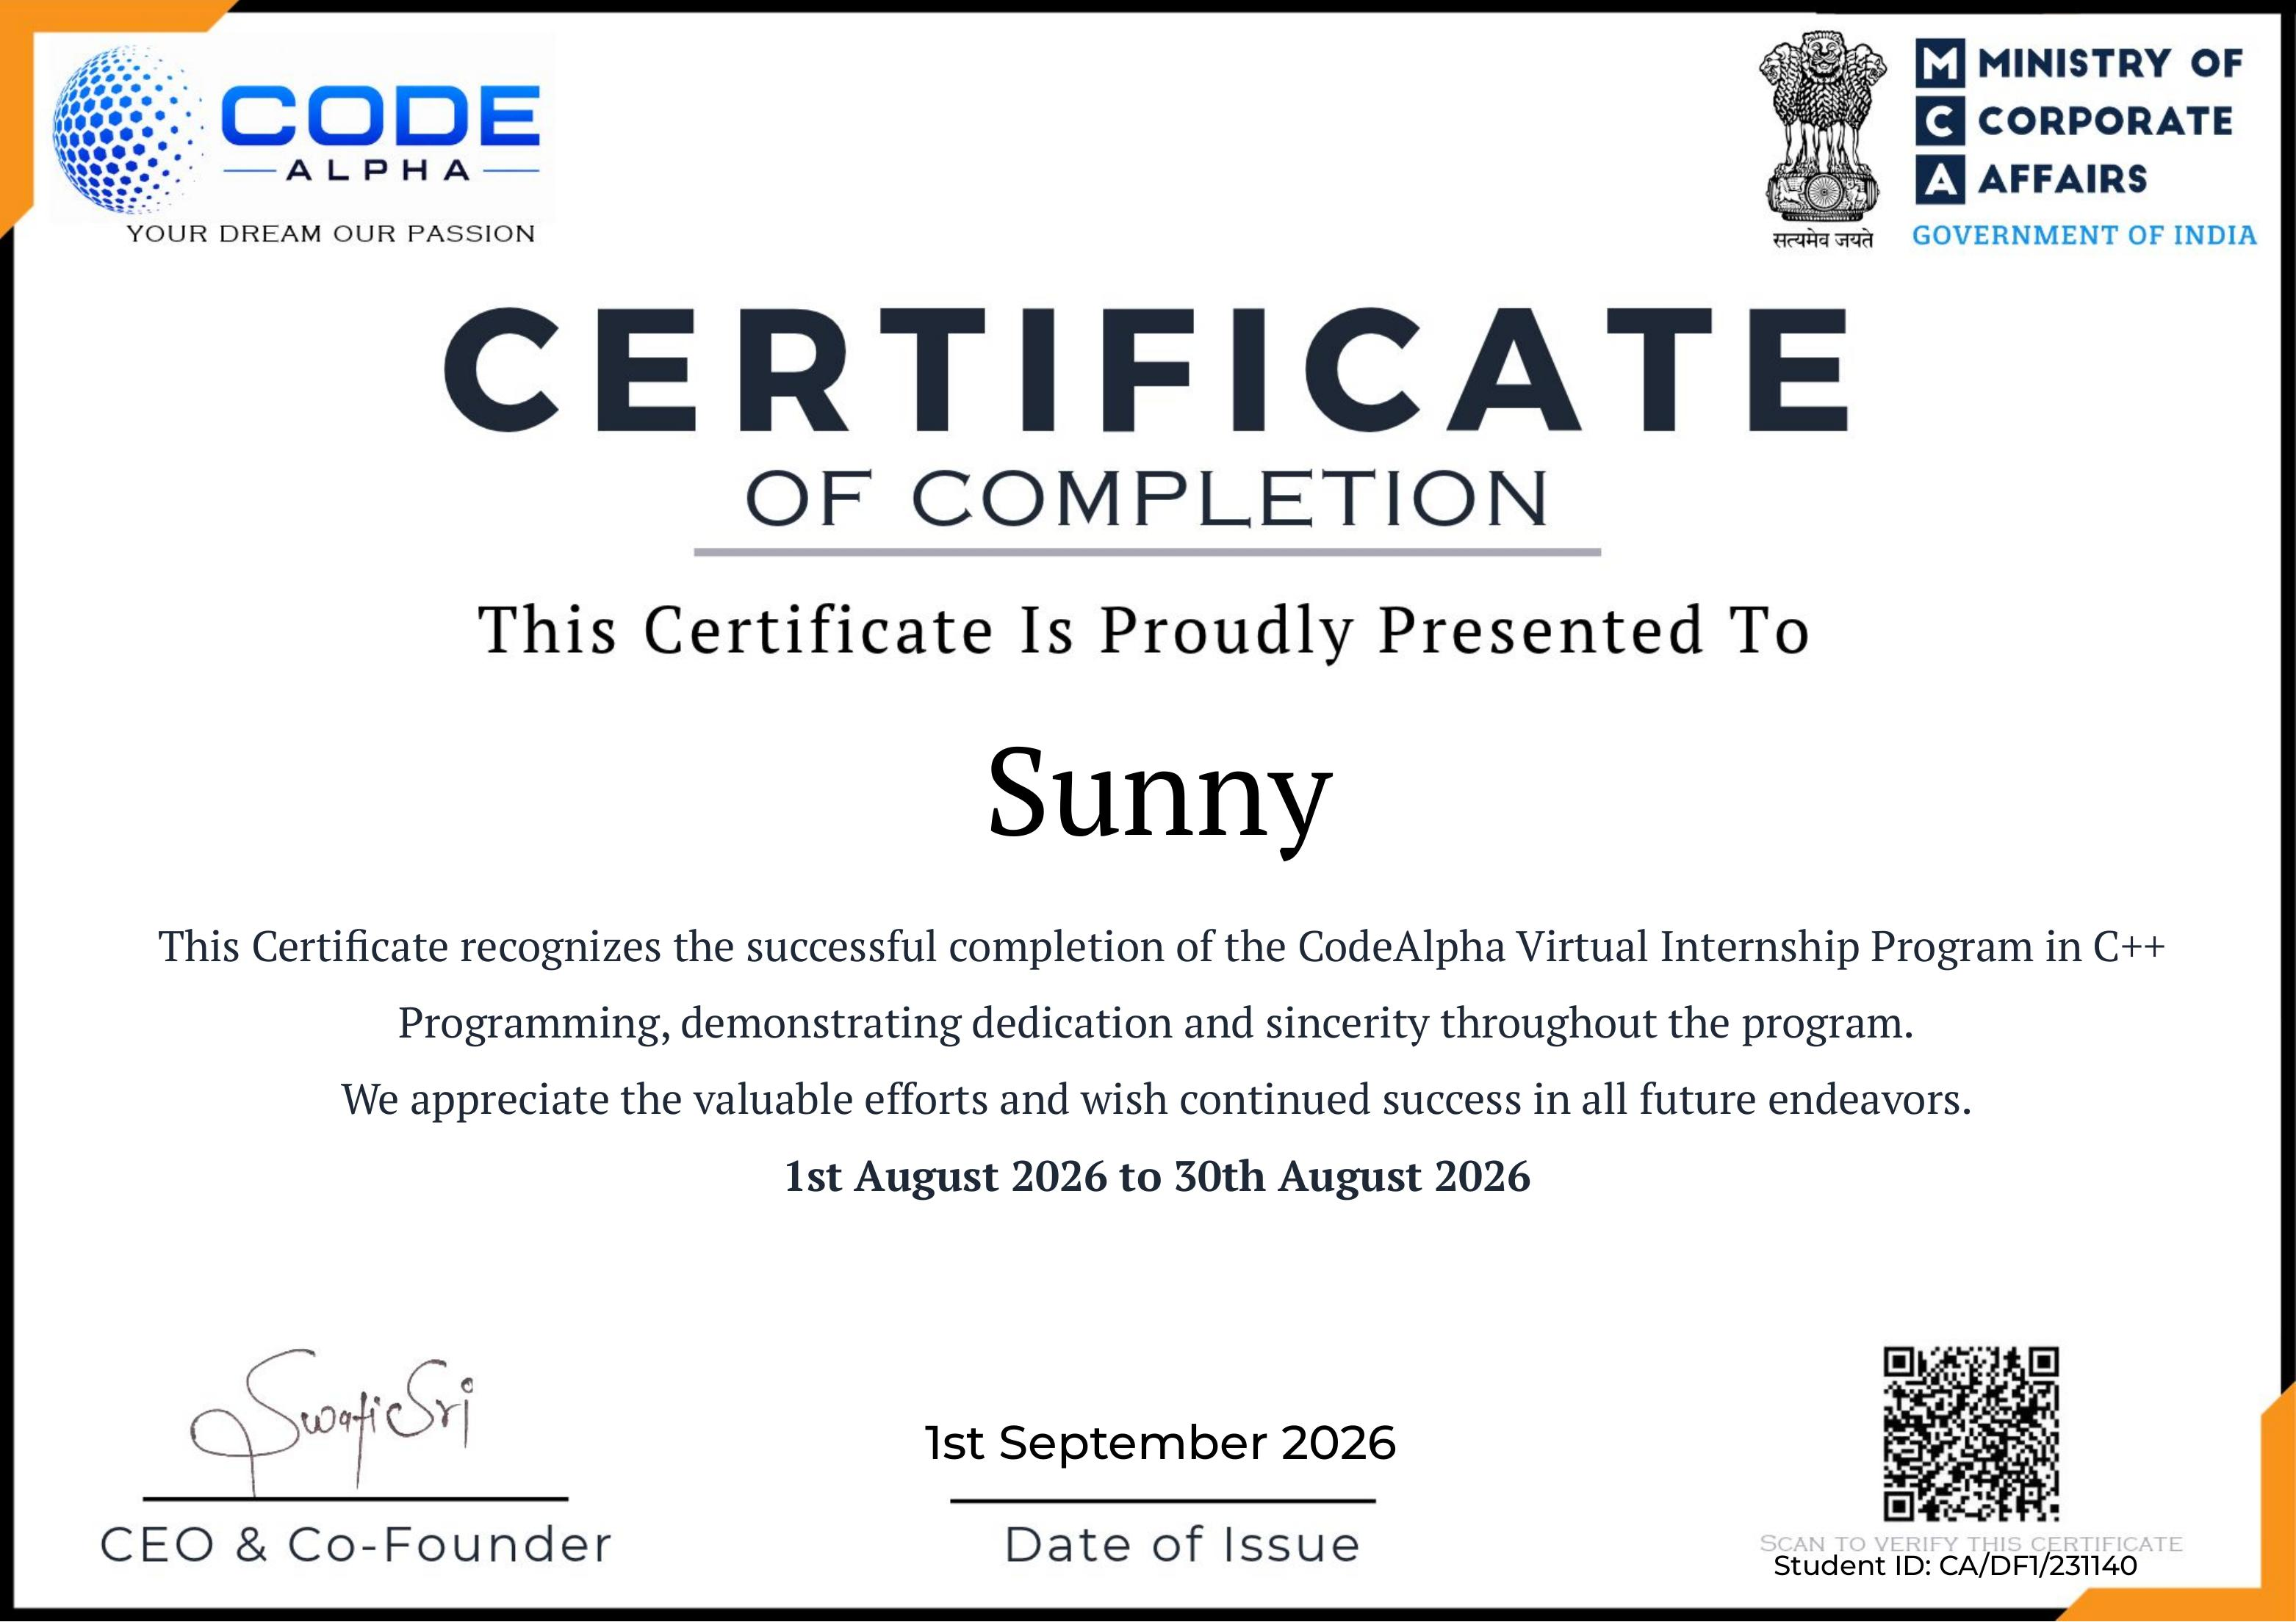
Internship Completion
Certified by CodeAlpha · 1 Aug 2026 – 30 Aug 2026 · Student ID: CA/DF1/231140
CodeAlpha Internship — C++ Programming
10

Slide 11

Conclusion
This one-month C++ internship at CodeAlpha strengthened my core programming fundamentals through two complete, working console applications. It gave me practical experience in structured problem-solving, file handling, and independent, industry-style project delivery.
Thank You
Sunny · 25SCS1003004966 · B.Tech CSE, 3rd Semester · IILM University

