Slide 1
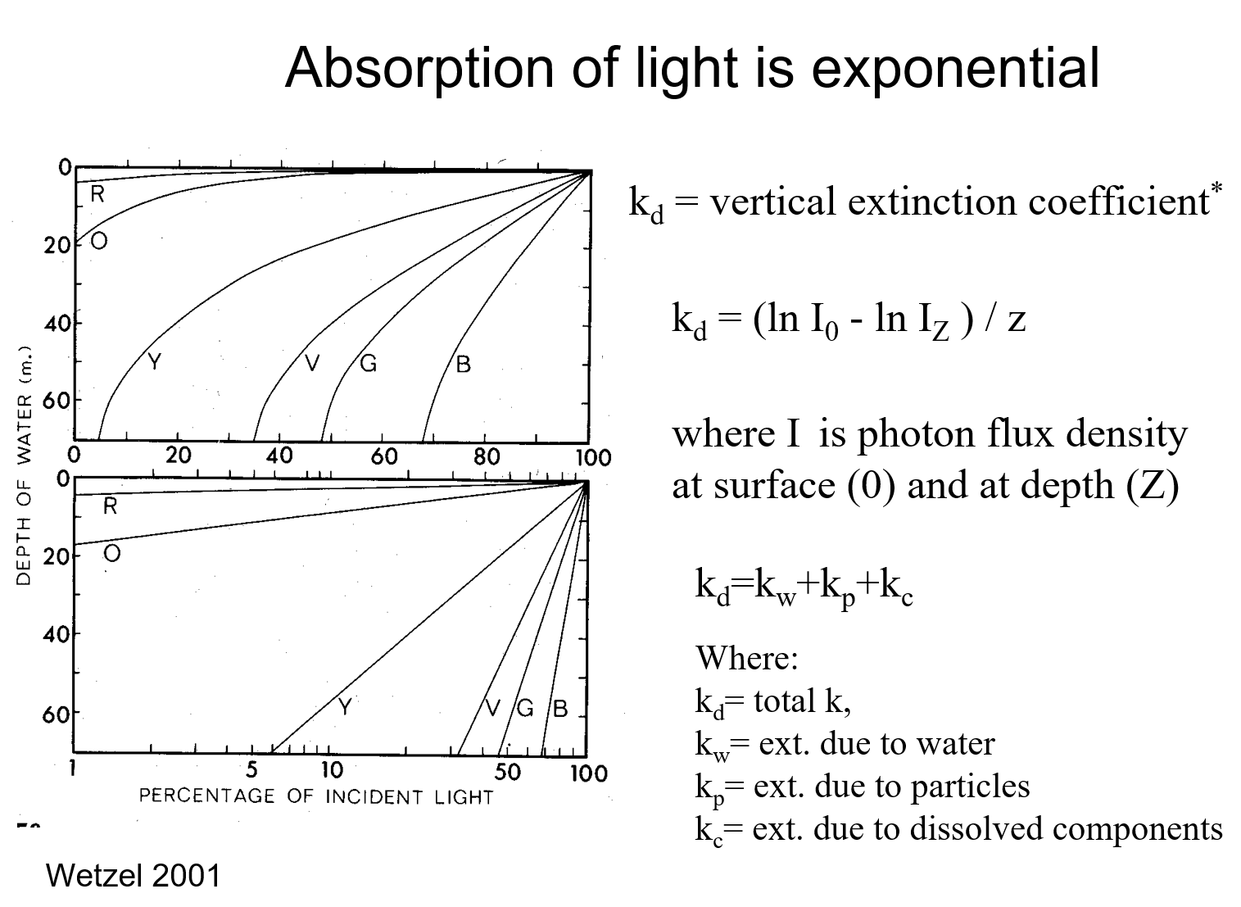

Slide 2
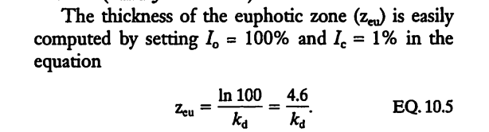

Slide 3
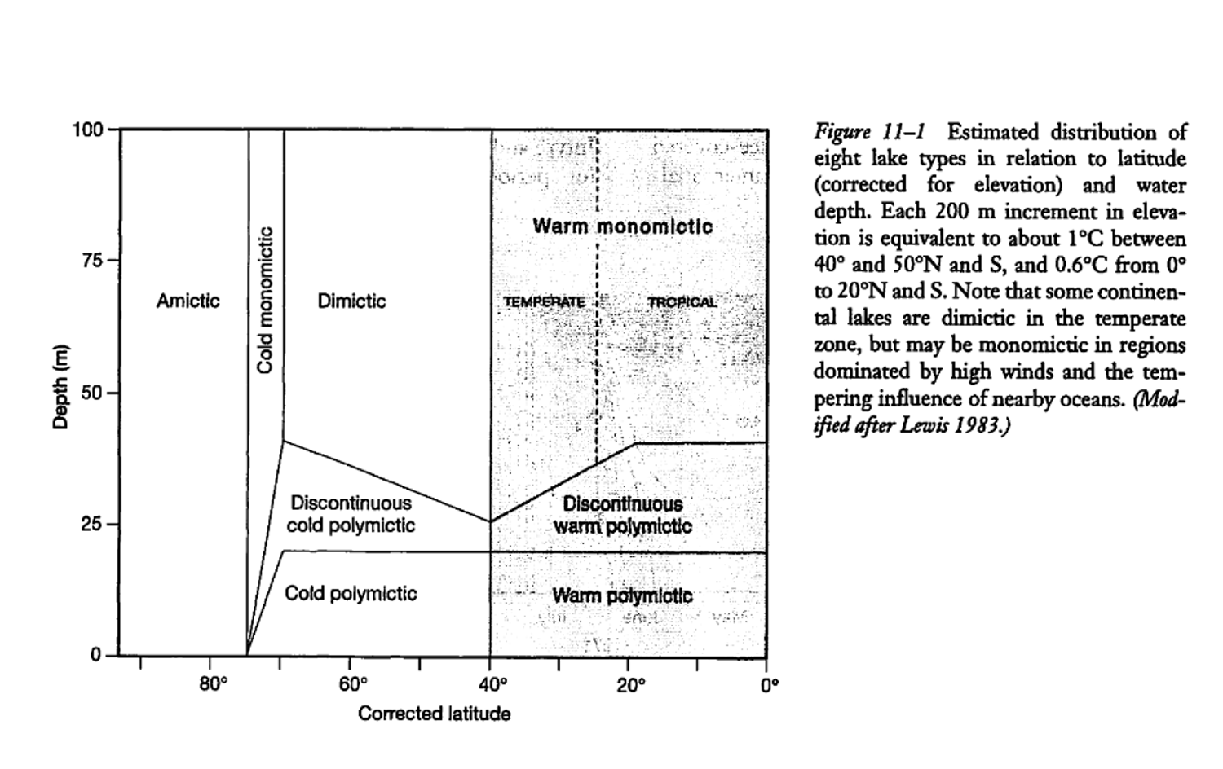

Slide 5
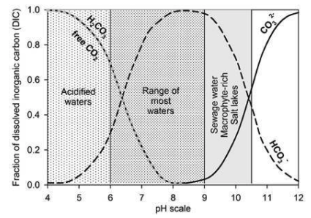
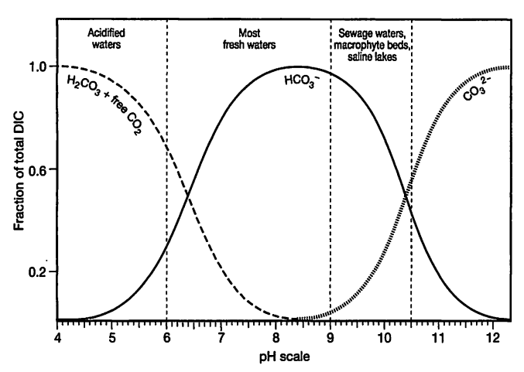
Inorganic carbon and pH

Slide 6
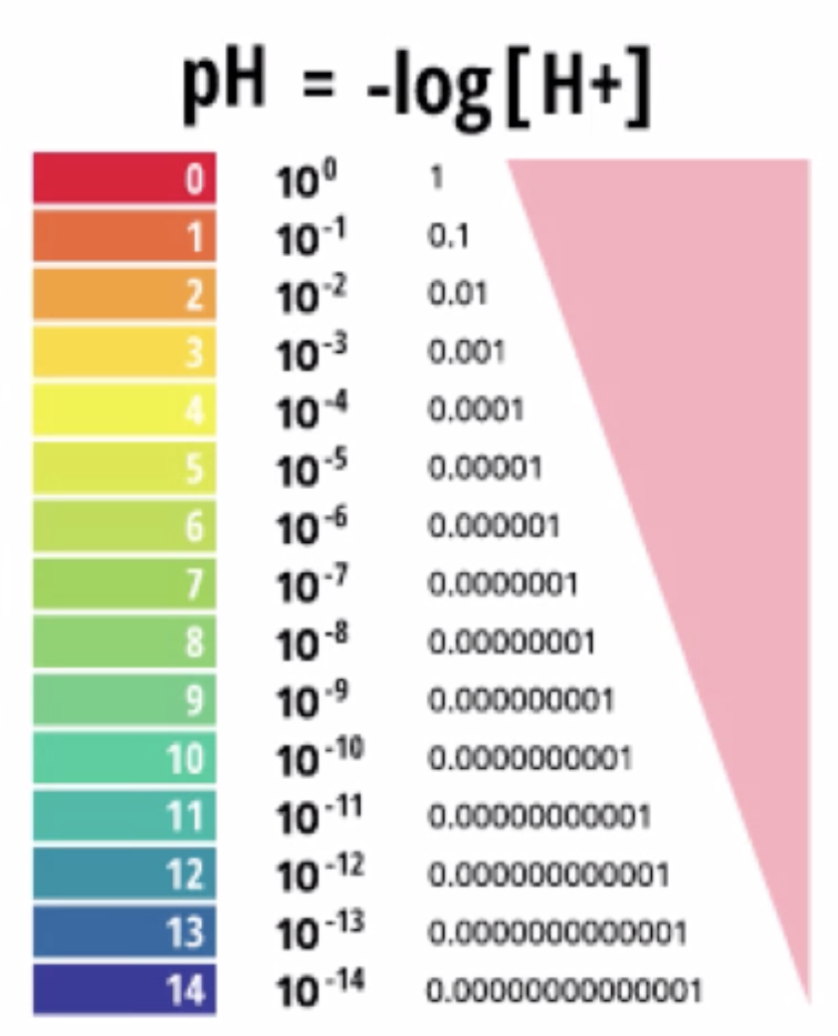
What is pH?
Power of hydrogen
Why a pH scale?

Slide 7
Water is a weak acid and weak base
H₂O H⁺ + OH⁻
*Water dissociates to form acid and base
with equal activities, so does not control pH
*Pure water (no atmosphere) pH is 7

Slide 8
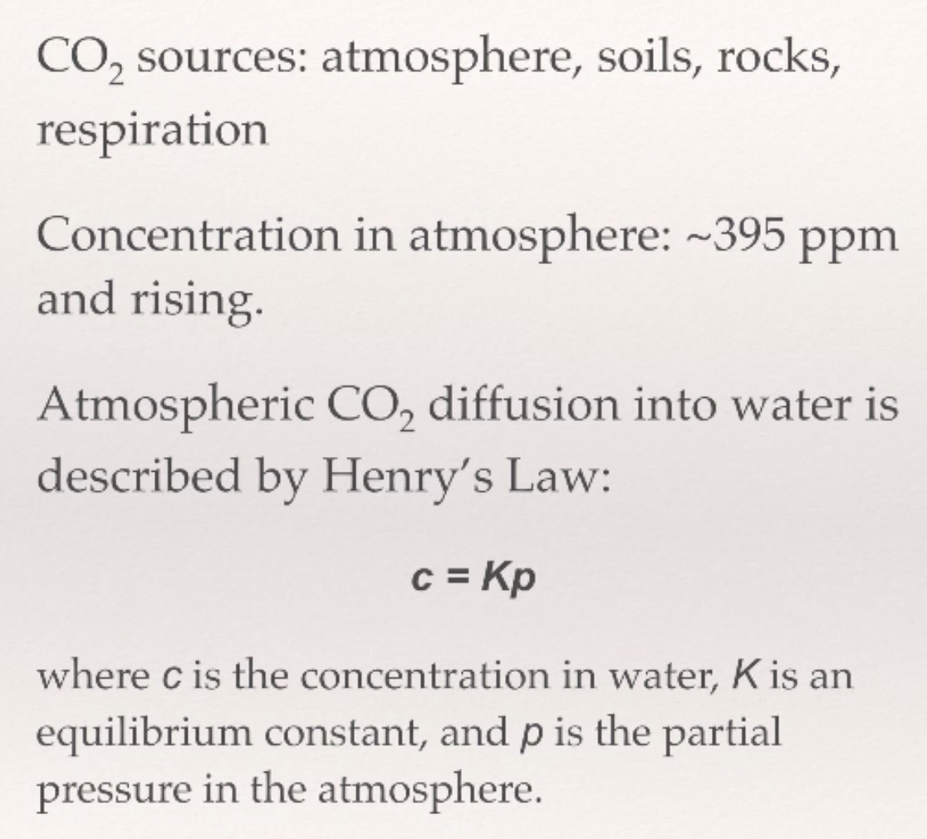
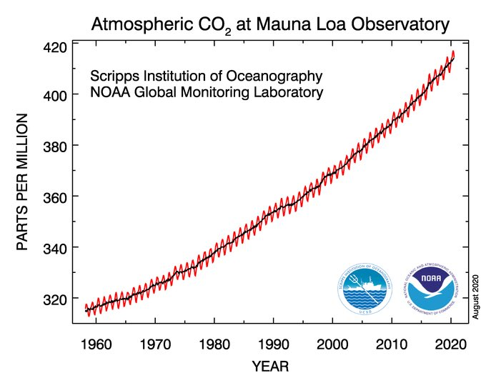
Let's put H2O in contact with atmosphere
Gas | Typical Partial Pressure (atm) | Solubility (K_{H}; atm/M) | mg/L @ STP
N₂ | 0.78 | 1639 | 13.3
O₂ | 0.21 | 769 | 8.73
CO₂ | 0.0004 | 29 | 0.165

Slide 9
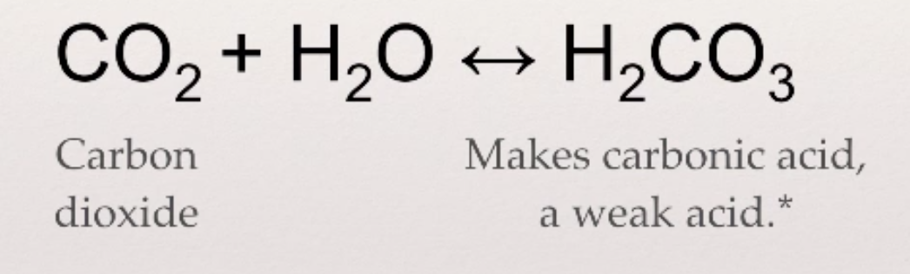
Let's put H2O in contact with atmosphere
Weak acids and bases do not completely dissociate in water
Weak acids and bases are common and control the pH of lakes

Slide 10
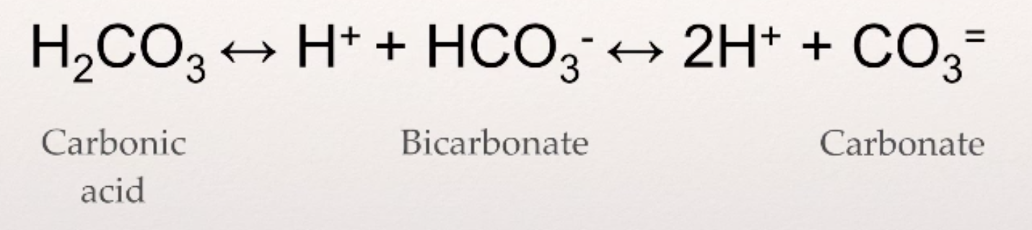
The inorganic carbon equilibrium
*DIC= dissolved inorganic carbon= sum of C in CO2(aq)+H2CO3+HCO3+CO3

Slide 11
The inorganic carbon equilibrium
Why does it matter?
This system neutralizes acid (and base)
Algae and microbes require inorganic carbon in photosynthesis

Slide 12
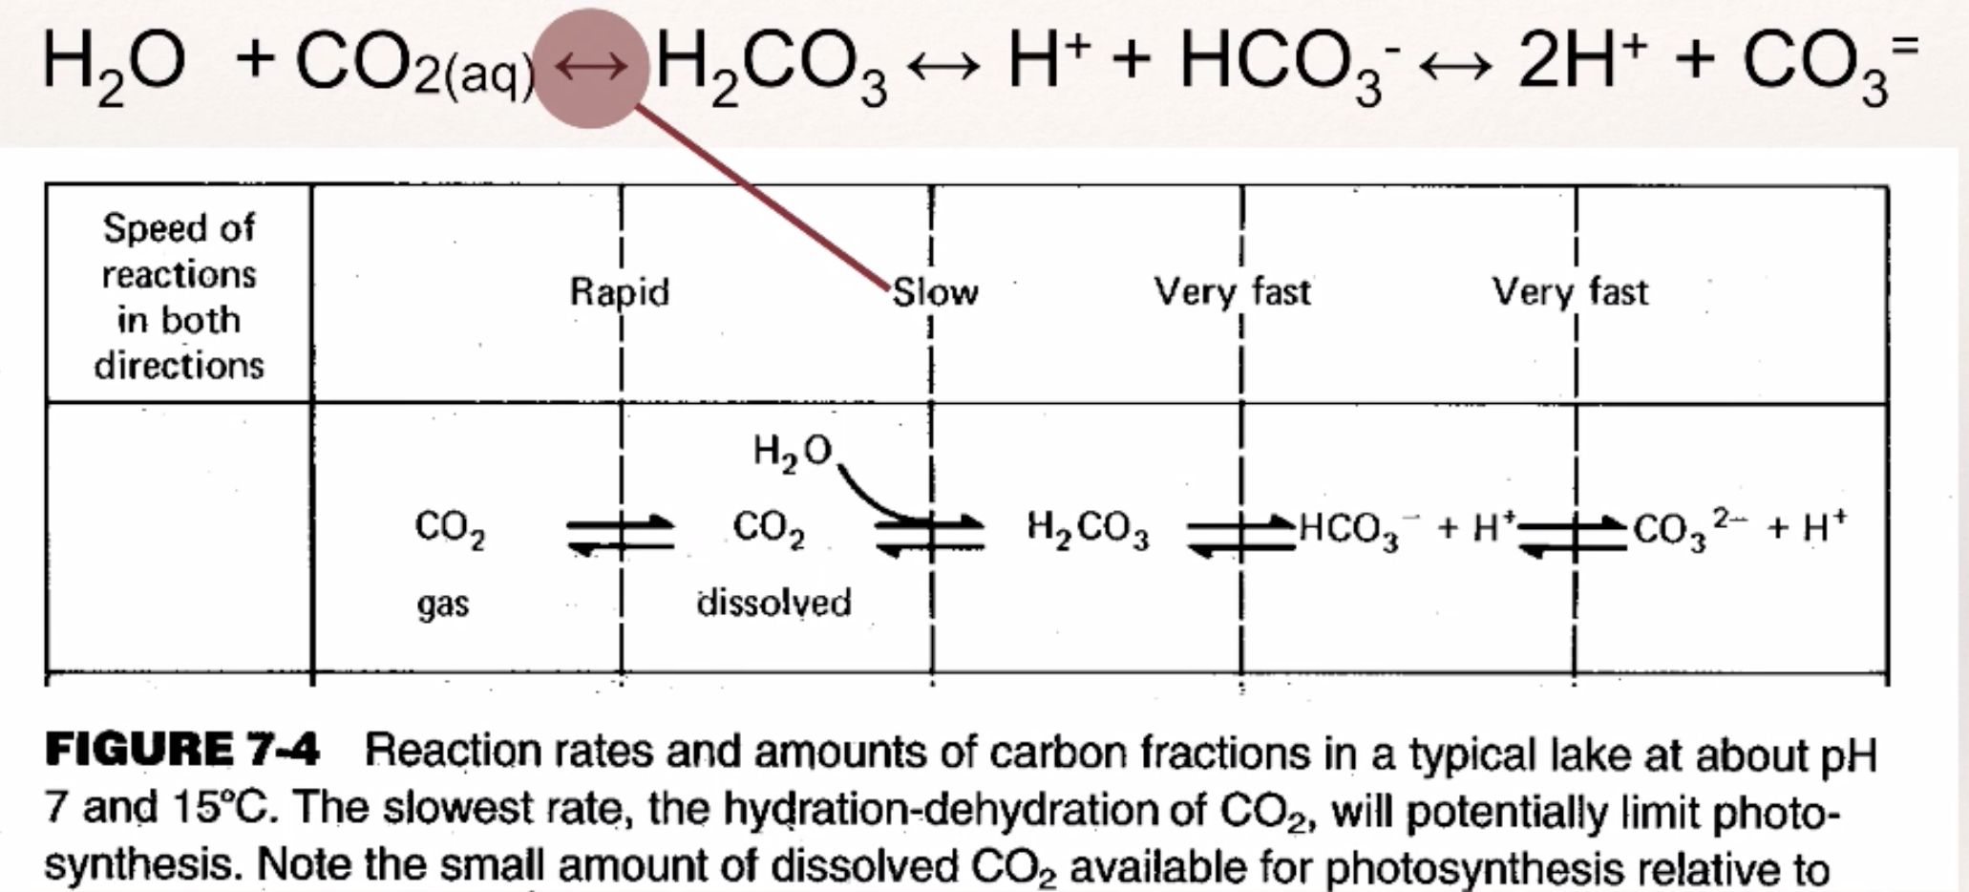
The inorganic carbon equilibrium
*Water in equilibrium with atmosphere does NOT have neutral pH. It has a pH of 5.65. So absent other factors, freshwaters and rain should be mildly acidic.

Slide 13
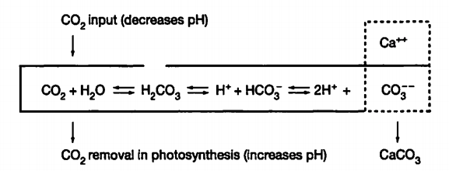
Biological activities are tightly connected to the inorganic carbon cycle
Respiration (R) adds CO₂ and protons to water
Photosynthesis (P) removes CO₂ and protons from water

Slide 14
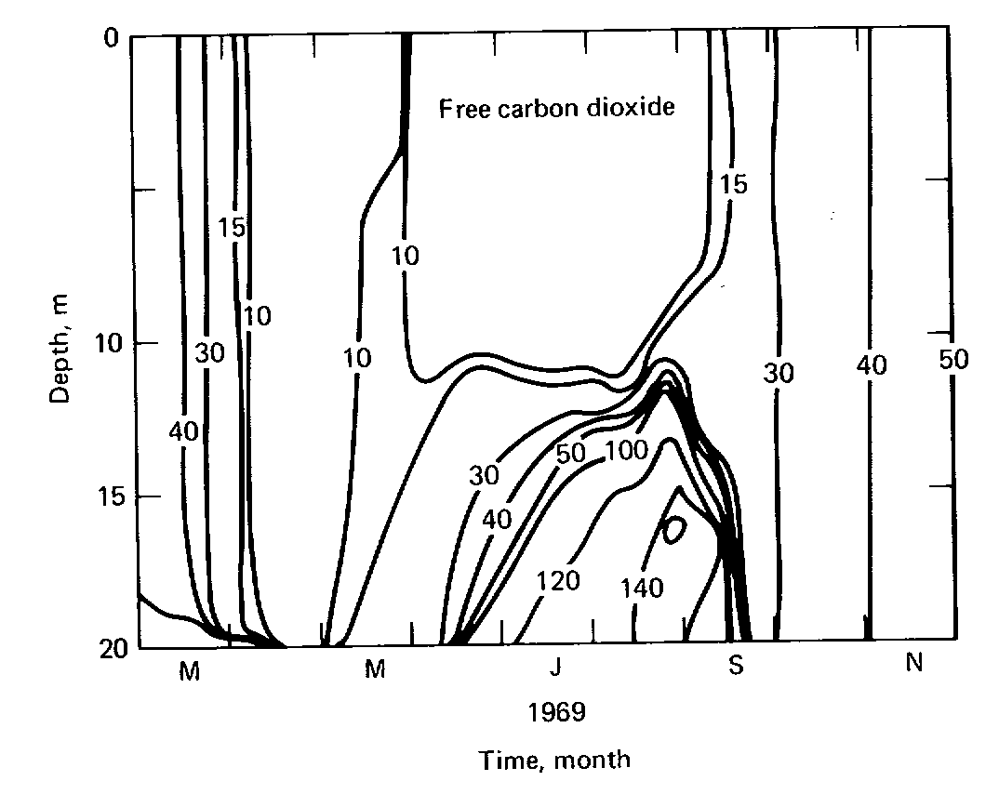
Seasonal dynamics
Drawdown of free
CO₂ in summer and
buildup in the hypo-
limnion

Slide 15
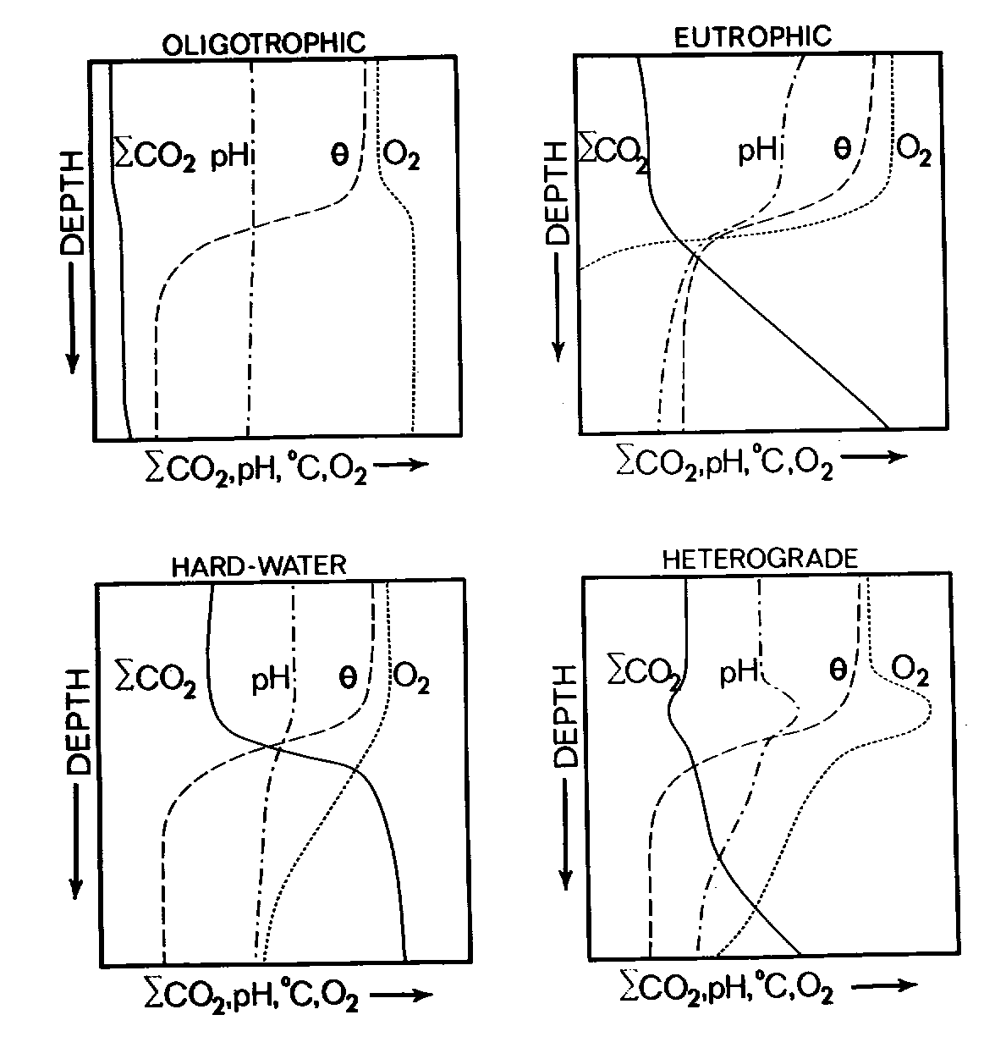
Generalized DIC (dissolved inorganic carbon) profiles in summer
ΣCO2 =H₂CO₃+CO₂+
HCO₃⁻+CO₃²⁻
Wetzel Fig. 11.3

Slide 17

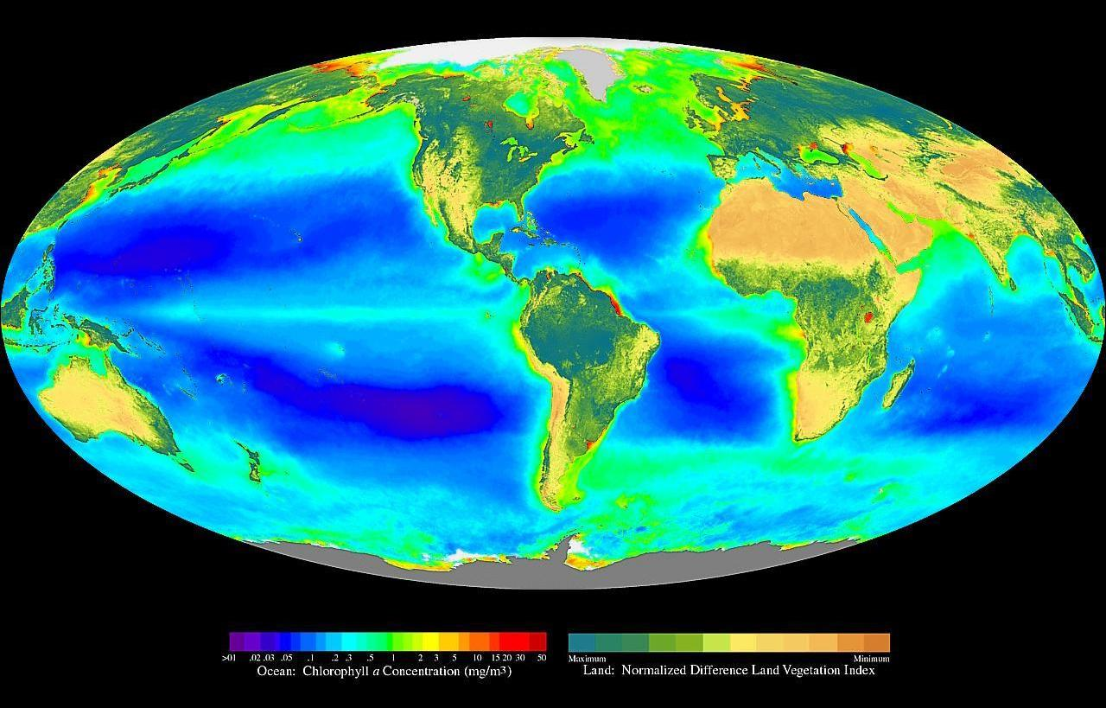
: Oxygen and Metabolism

Slide 18
There's a microbial metabolism for every molecule.

Slide 19
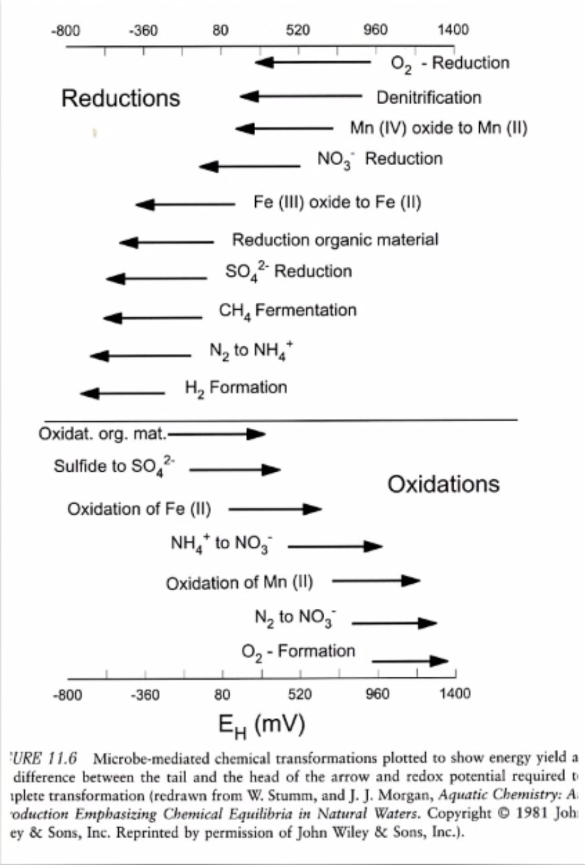
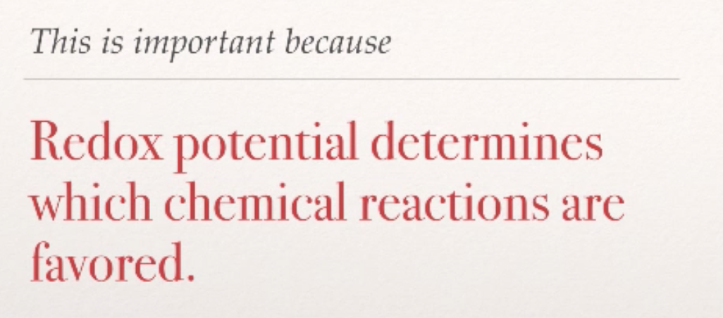
O2- driven reduction

Slide 20
O2- driven reduction
Photosynthesis transfers electrons from water to energy to CO2, forming organic matter
Aerobic respiration transfers electrons from organic matter to oxygen, forming water

Slide 21

Photosynthesis and Respiration and contribute to Ecosystem Metabolism
Photosynthesis (P)
Ecosystem Metabolism
Respiration (R)

Slide 22
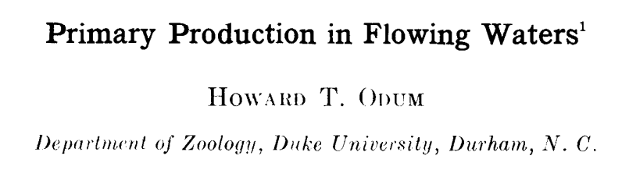
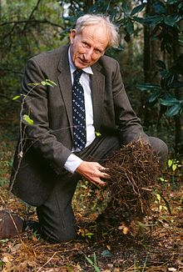
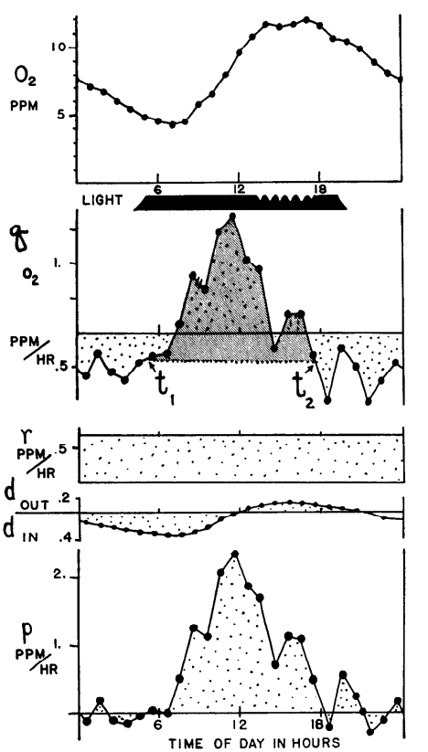
Limnology and Oceanography 1956

Slide 23
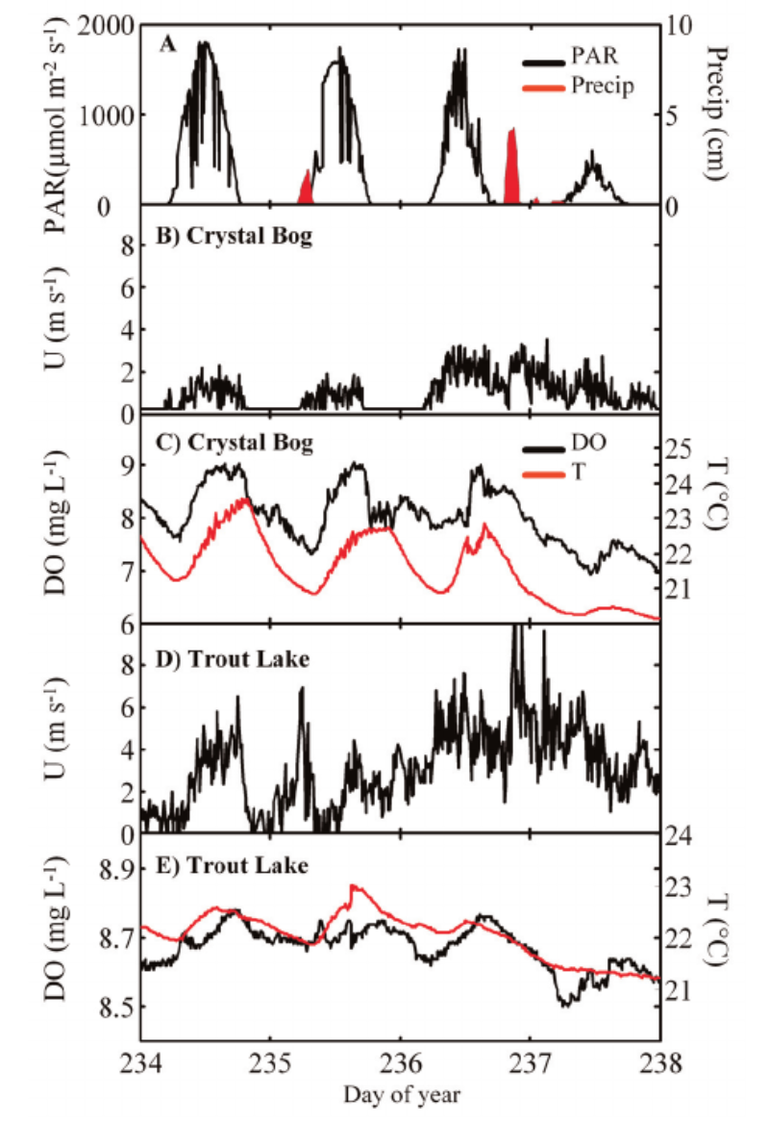
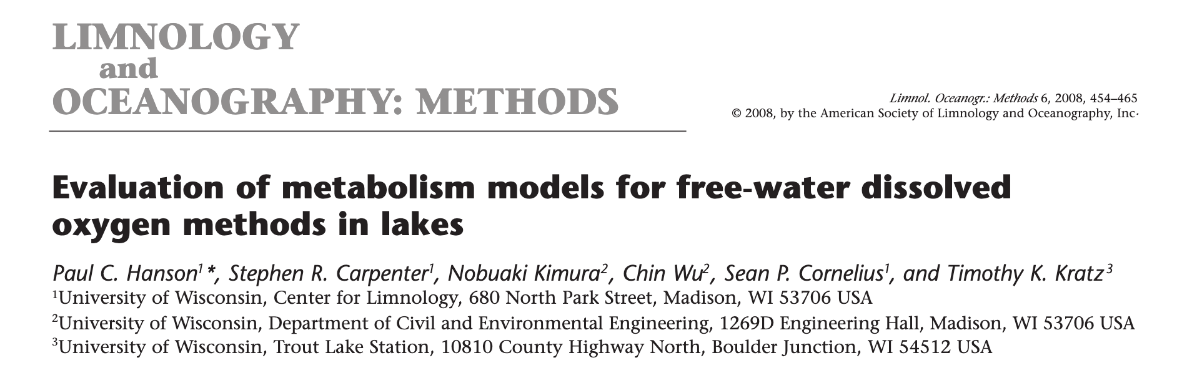

Slide 24
Net Ecosystem Production (NEP) = Gross Primary Production (GPP) and community Respiration (R)
…controls the variation in DO, CO₂, and pH in many waterbodies!

Slide 25
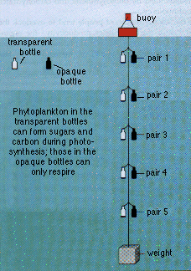
Dissolved Oxygen Method of Gross Primary Production, Respiration, NEP
Measure changes in dissolved oxygen concentrations (DO)
DO_{o}= initial concentration
L= “light” bottle, D= “dark” bottle
Net production = DO_{L}- DO_{o}
Respiration= DO_{D} - Do_{o}
( Is Negative due to oxygen consumption)
GPP= DO_{L}-DO_{D}

Slide 26
D.O. mg/L
CO₂ mg/L
12:00 PM
12:00 AM
12:00 PM
12:00 AM
12:00 PM
12:00 AM
12:00 PM
12:00 AM
12:00 PM
12:00 AM
pH
12:00 PM
12:00 AM
12:00 PM
12:00 AM
12:00 PM
12:00 AM
12:00 PM
12:00 AM
12:00 PM
12:00 AM

Slide 27
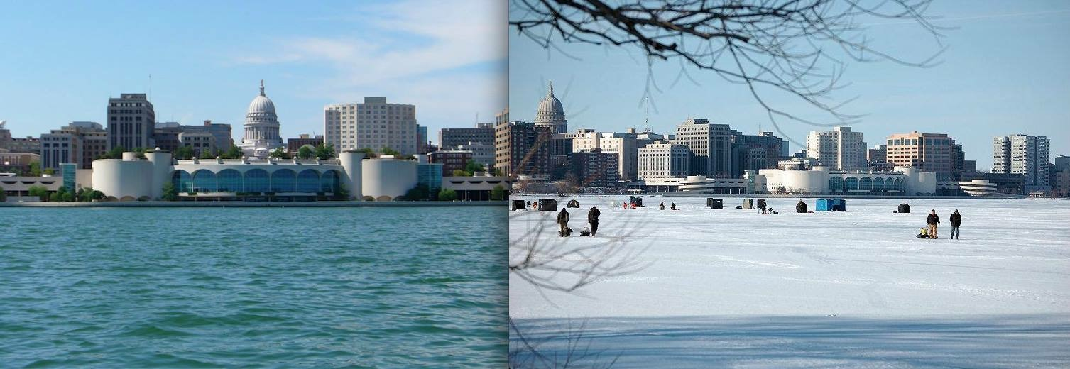
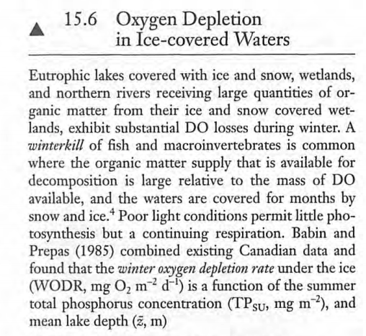
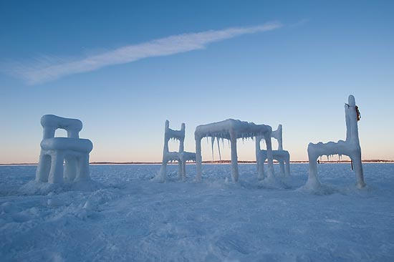

Slide 28
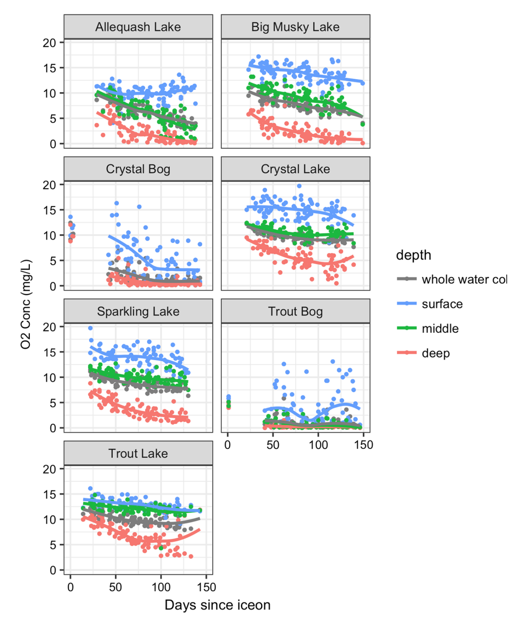
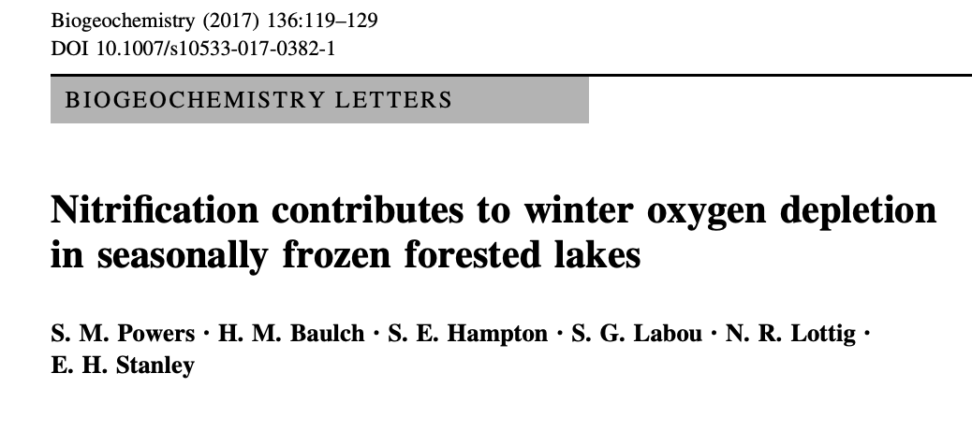

Slide 29
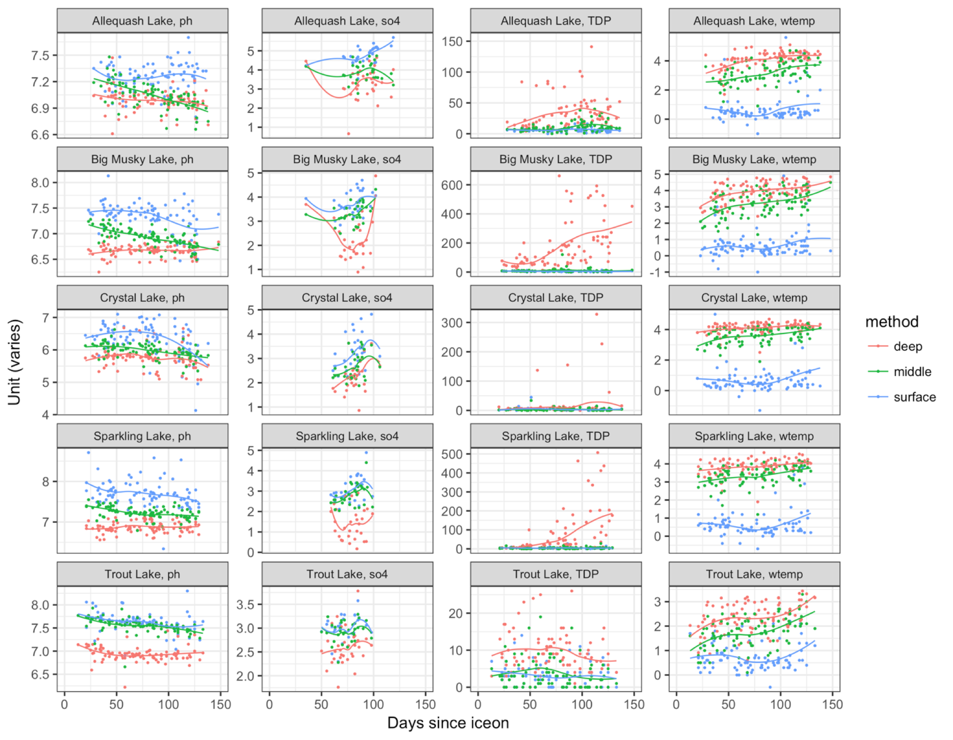
Days since ice-on

Slide 30
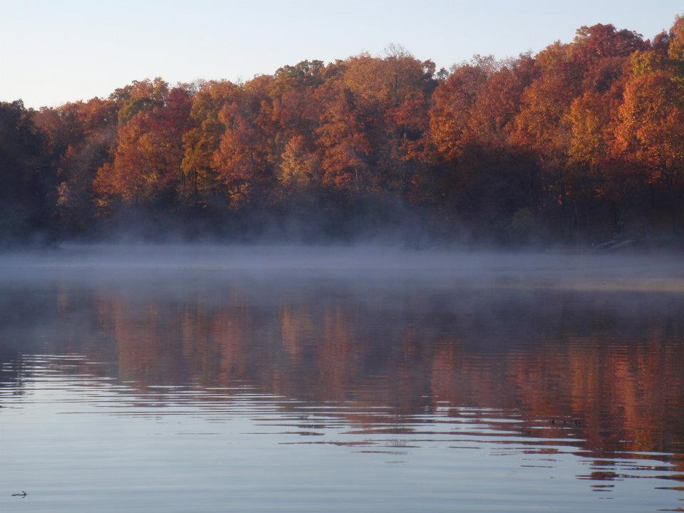
Highlights of this week
Lake dissolved oxygen ~ temperature
Oxygen varies day/night and seasonally through tight coupling with biological processes
Hypoxia/anoxia can happen with important consequences to organisms

Slide 32


Slide 33
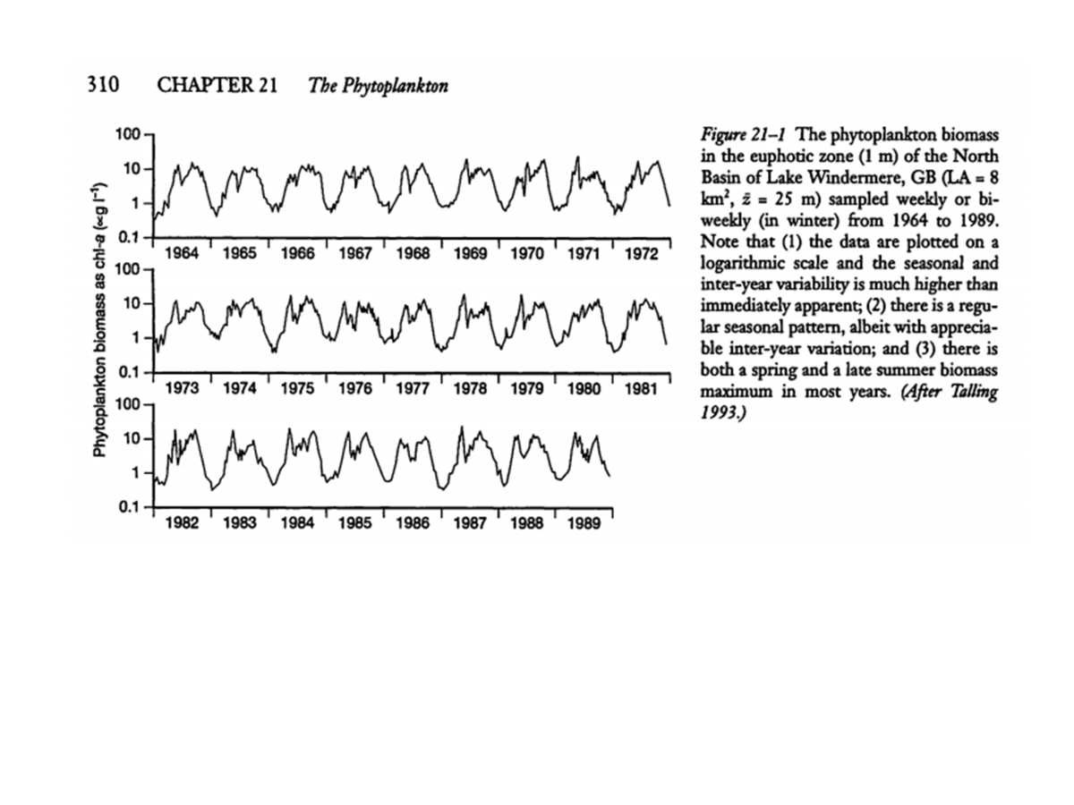

Slide 34
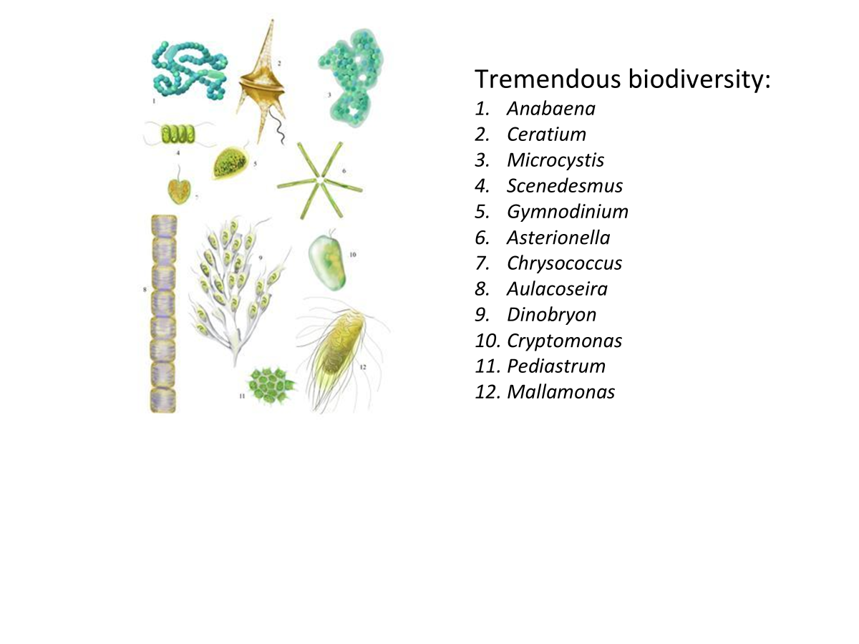

Slide 36
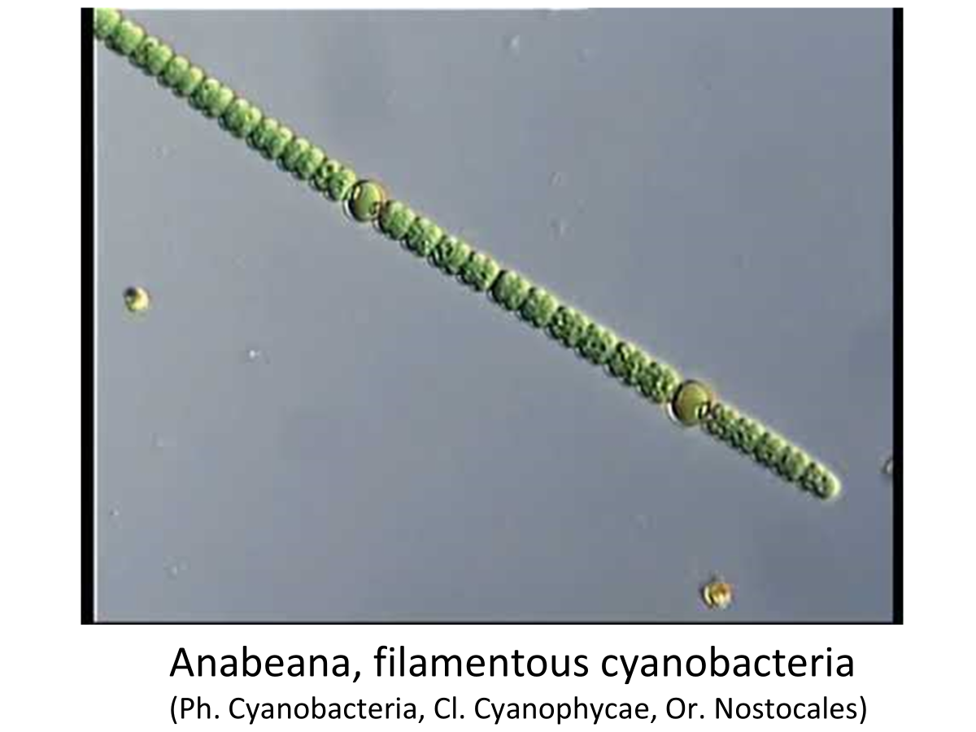

Slide 38
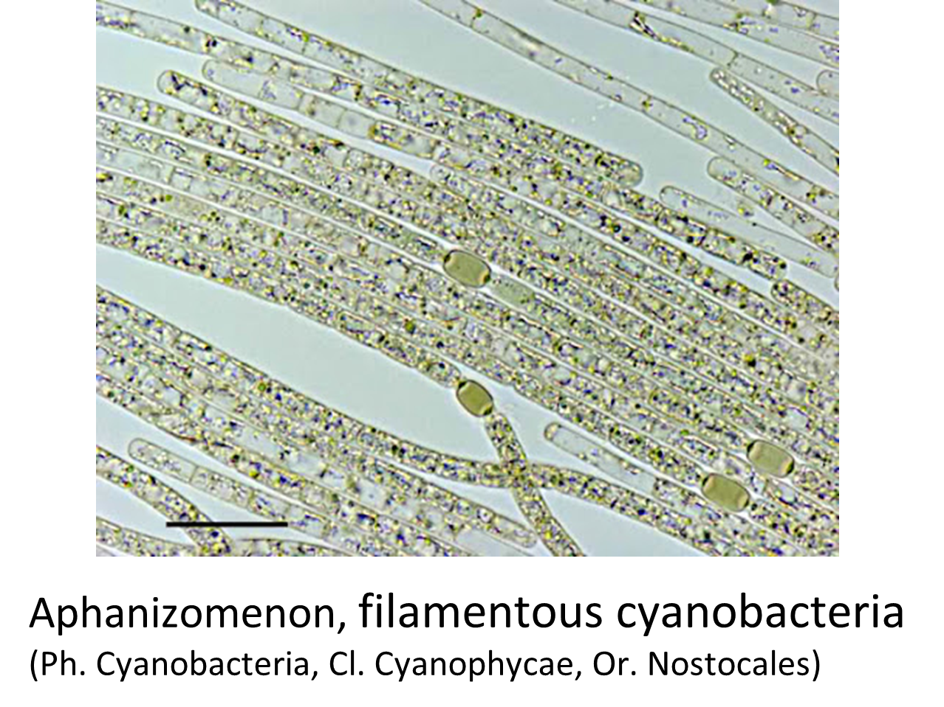

Slide 40
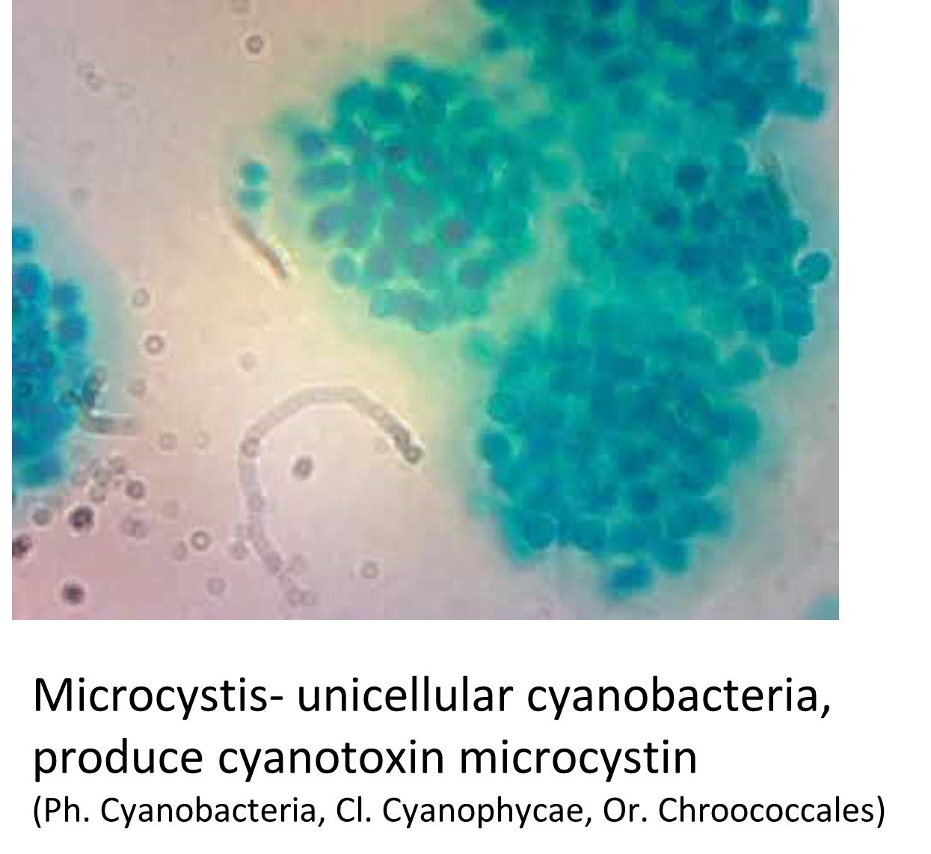

Slide 41
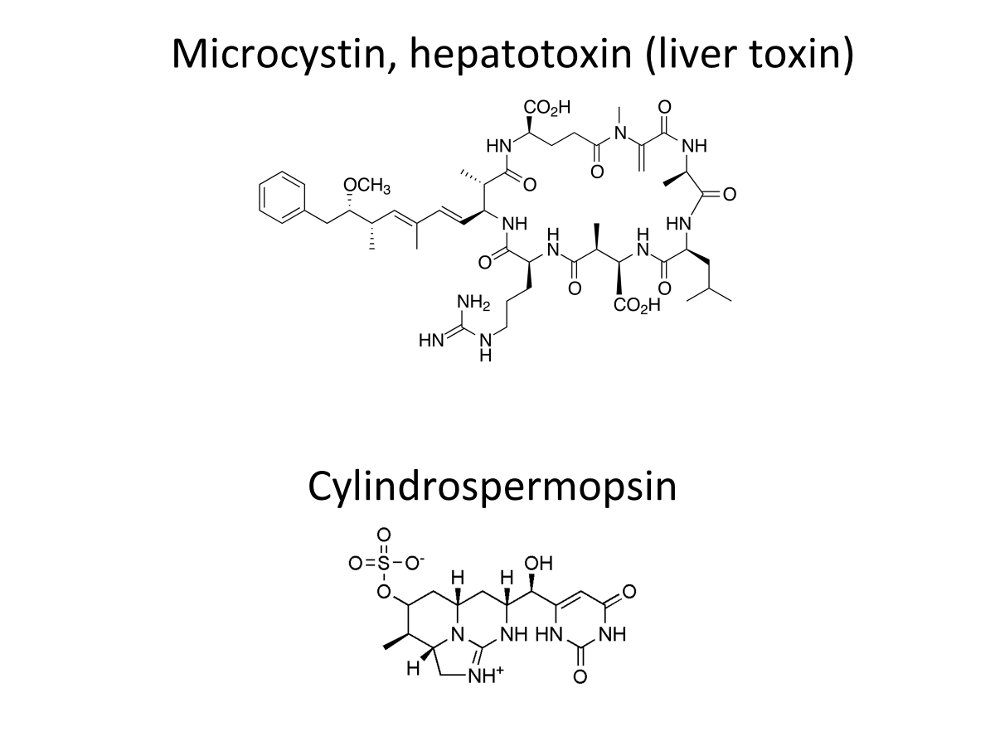

Slide 43
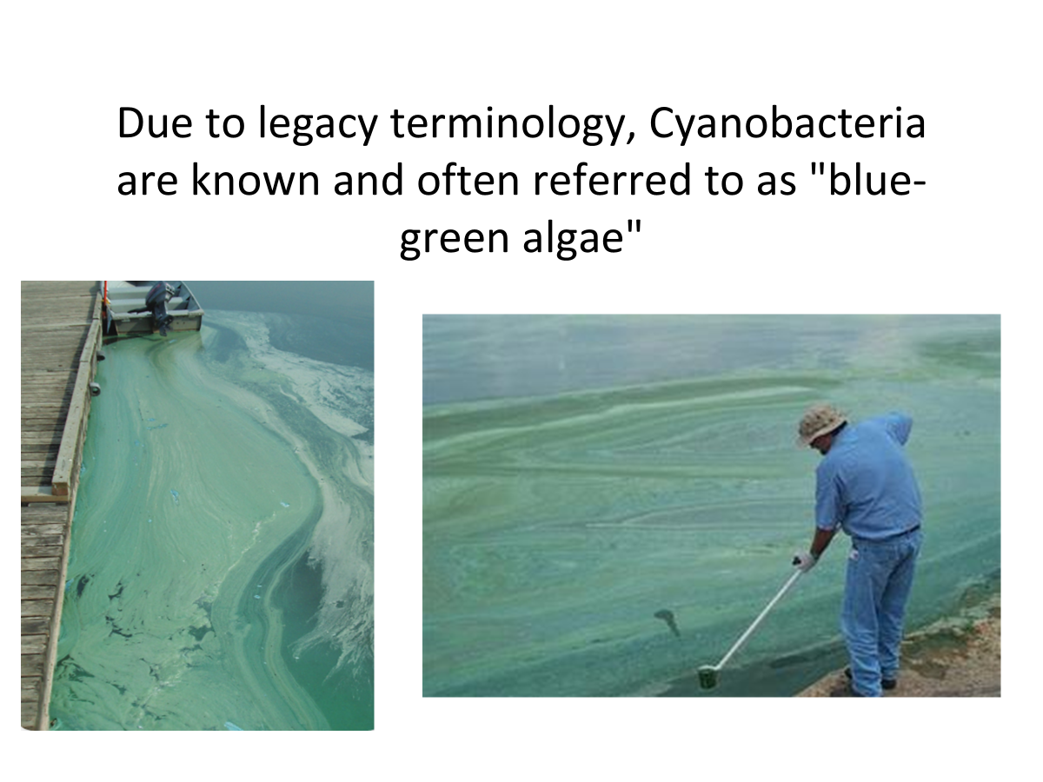

Slide 44
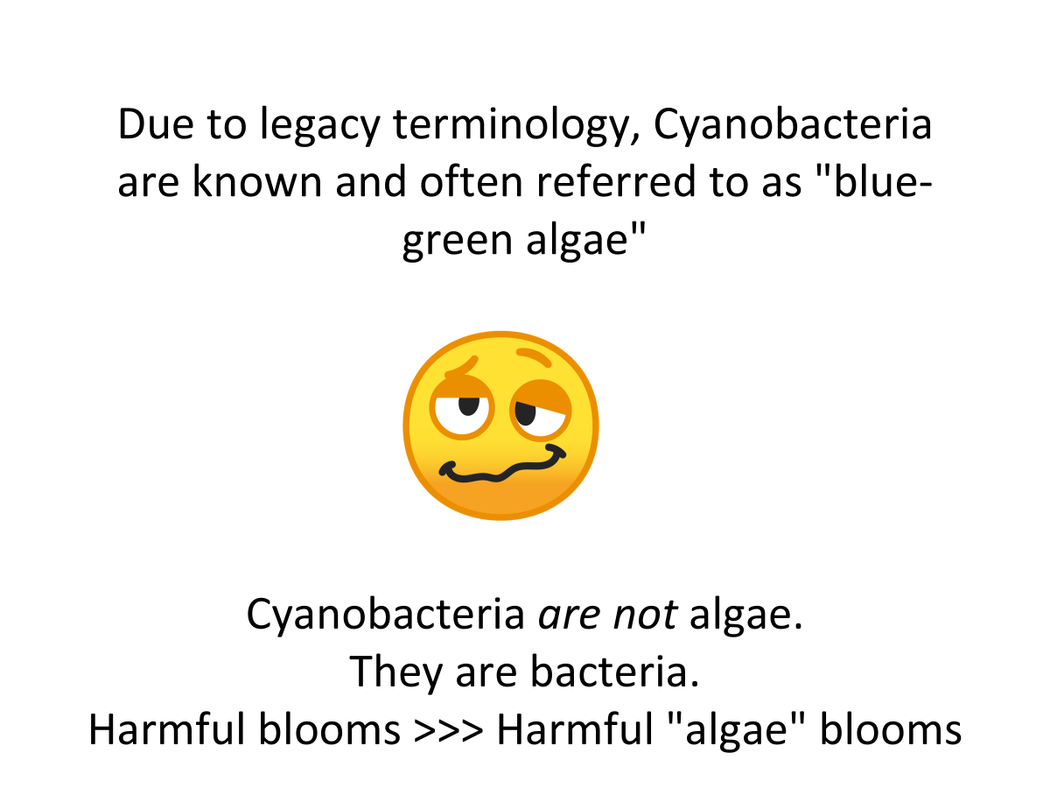

Slide 45
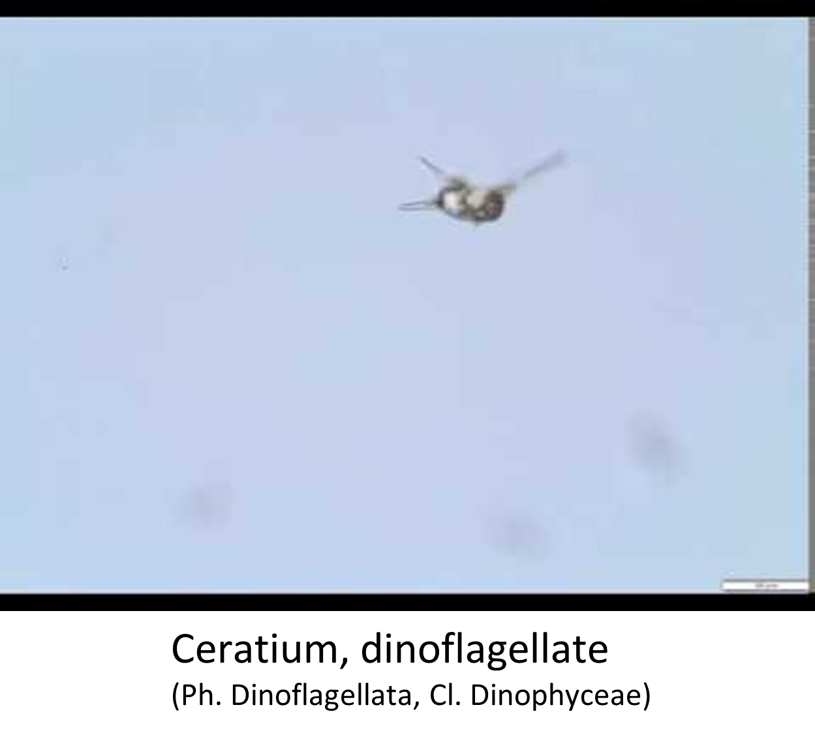

Slide 46
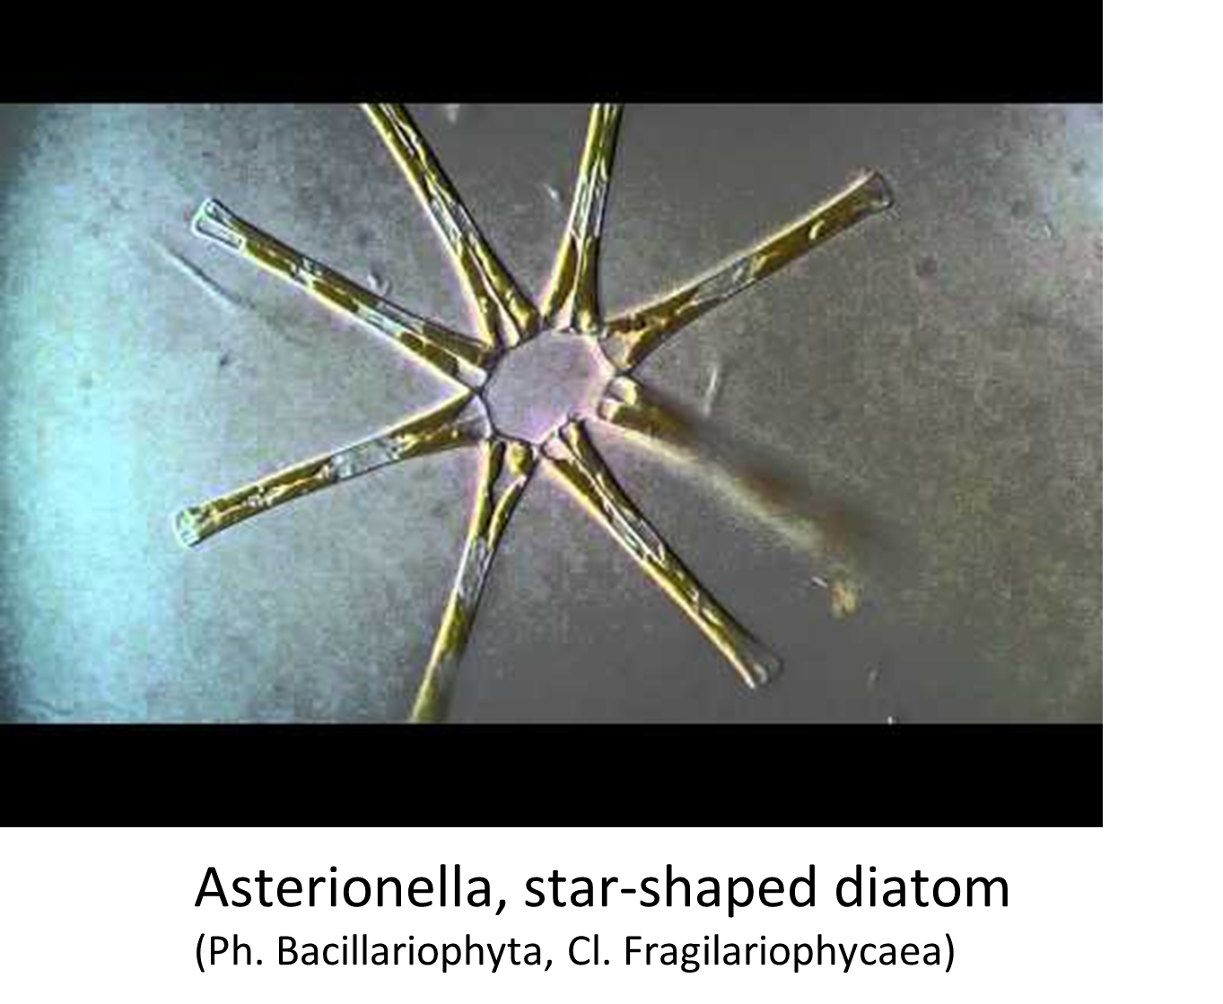

Slide 47
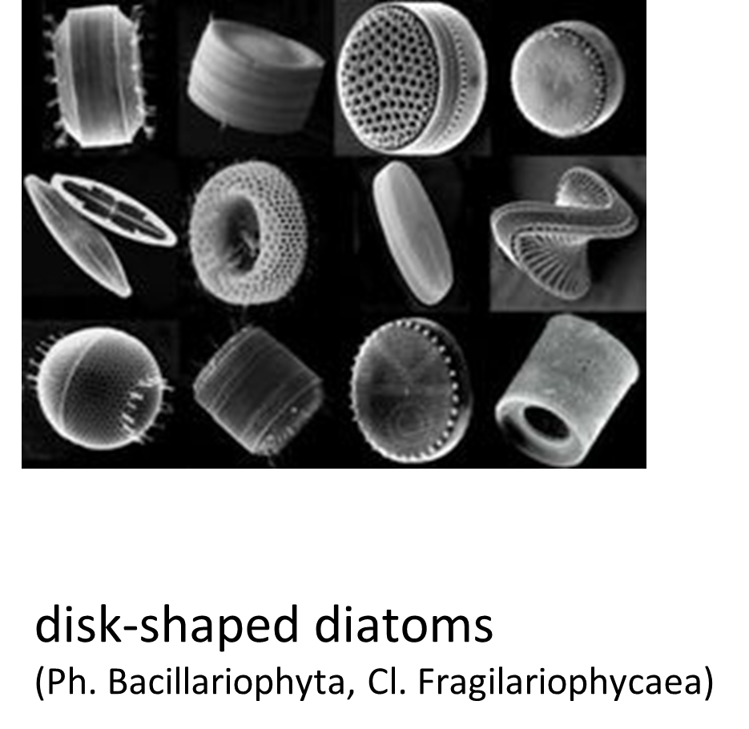

Slide 49
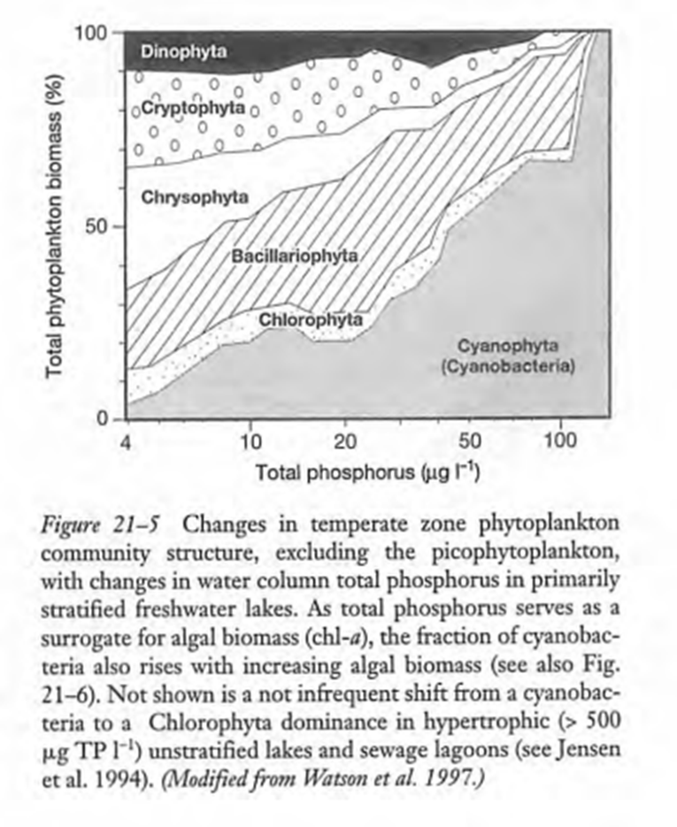

Slide 50
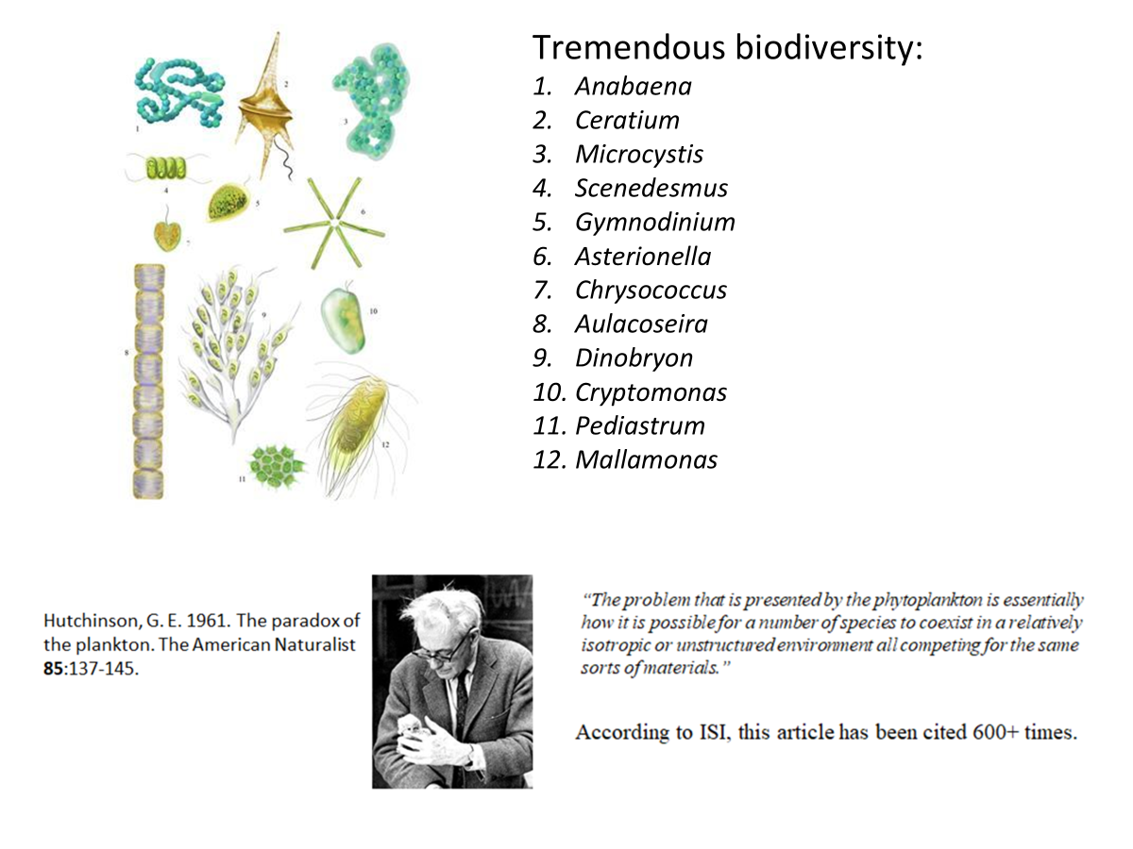

Slide 51
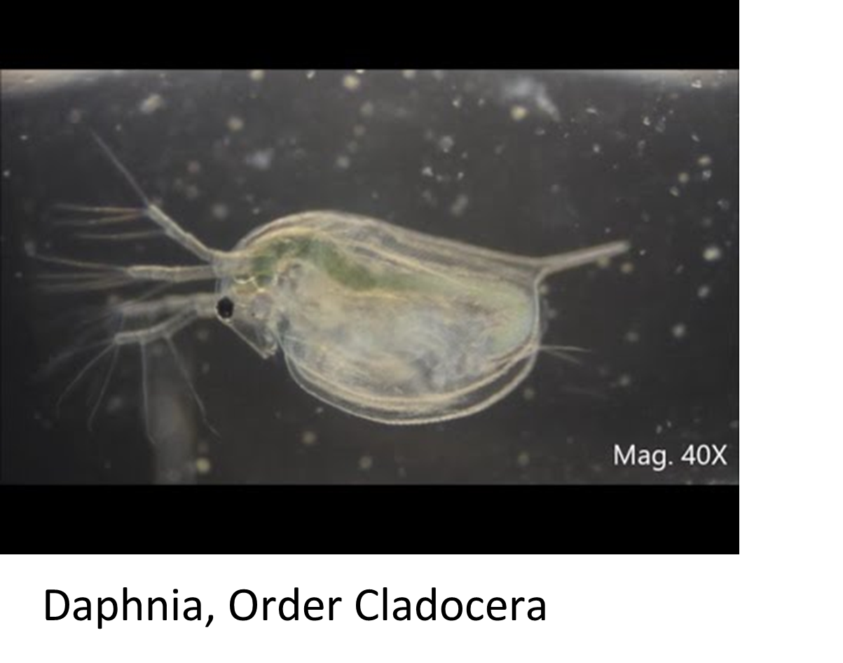

Slide 52
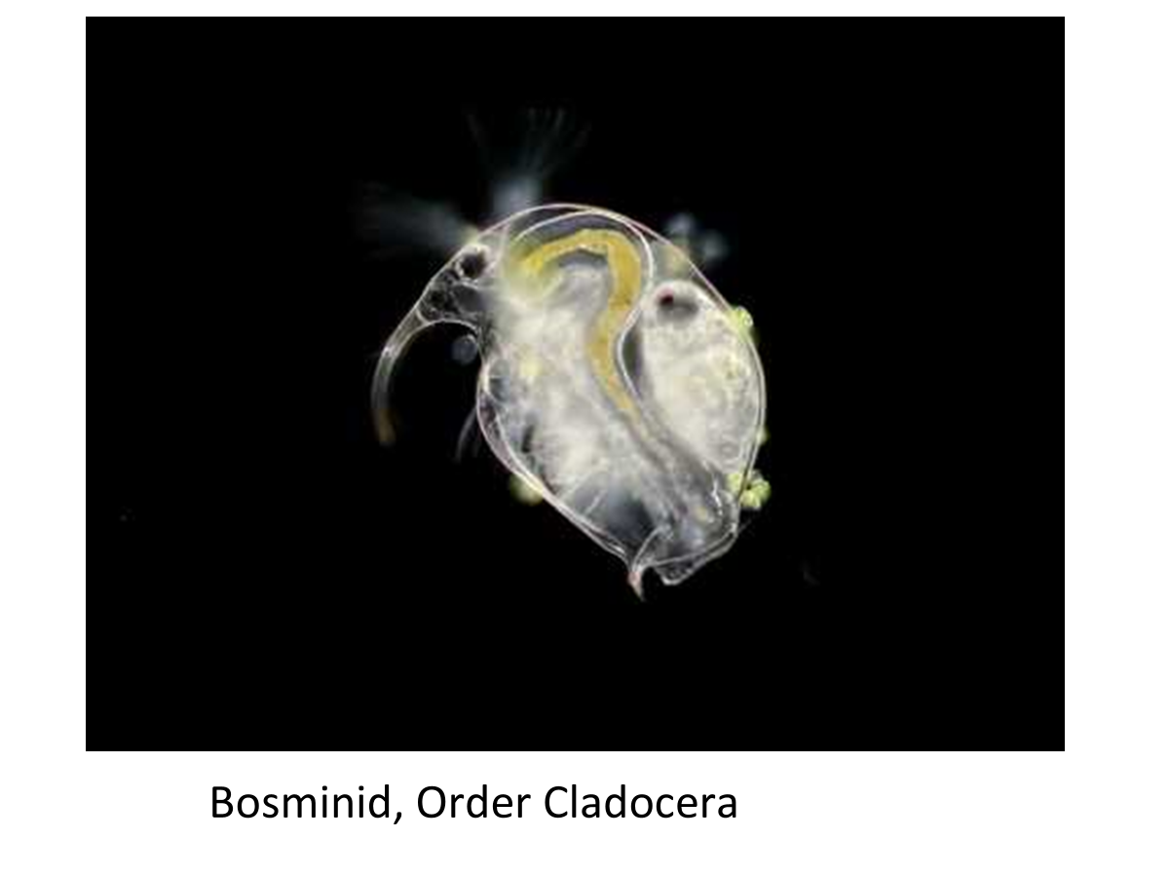

Slide 53
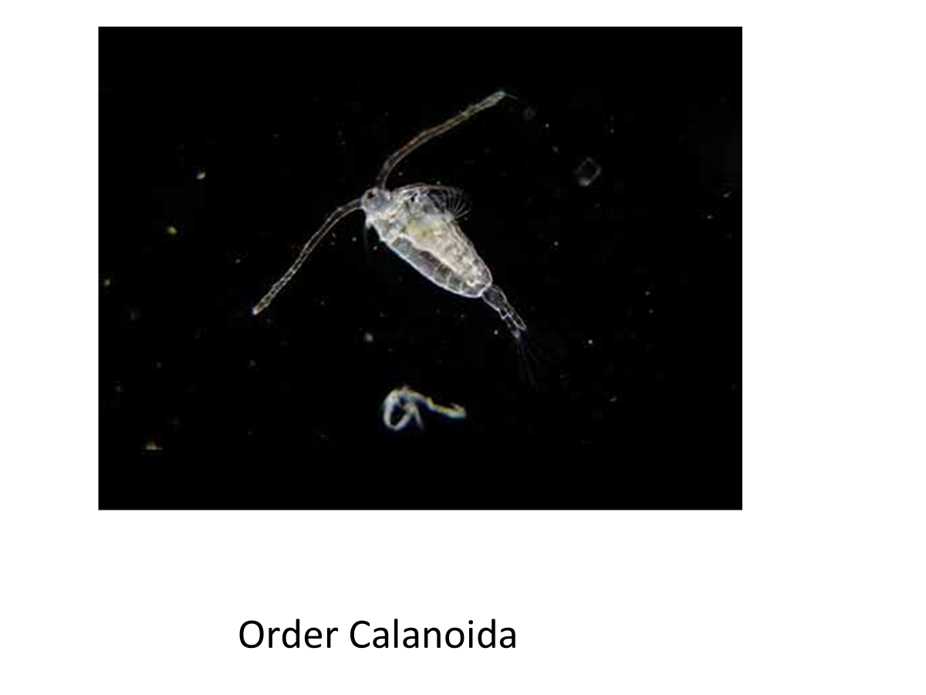

Slide 54
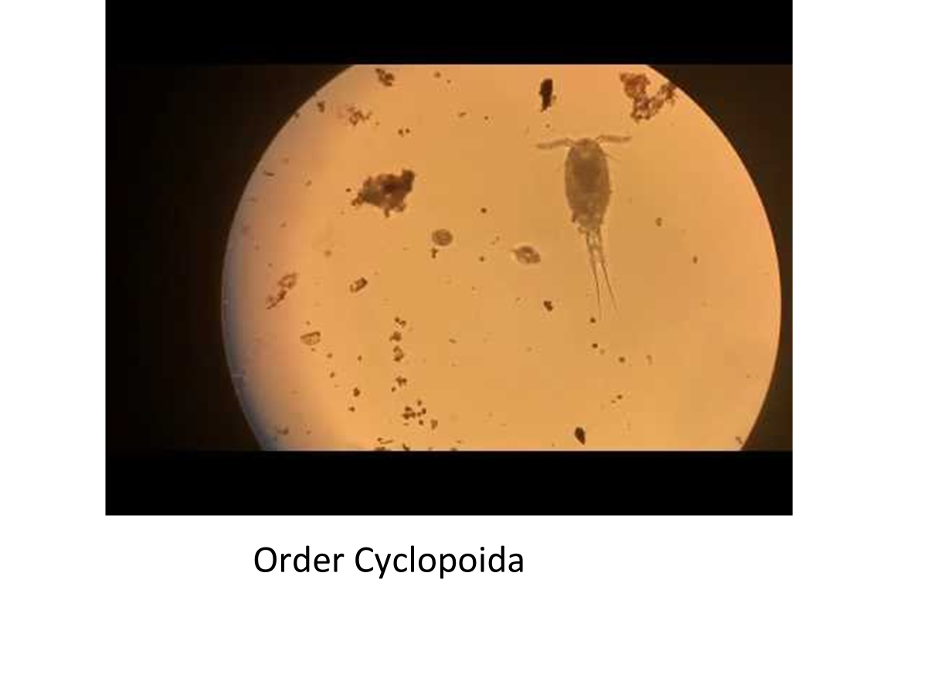

Slide 55
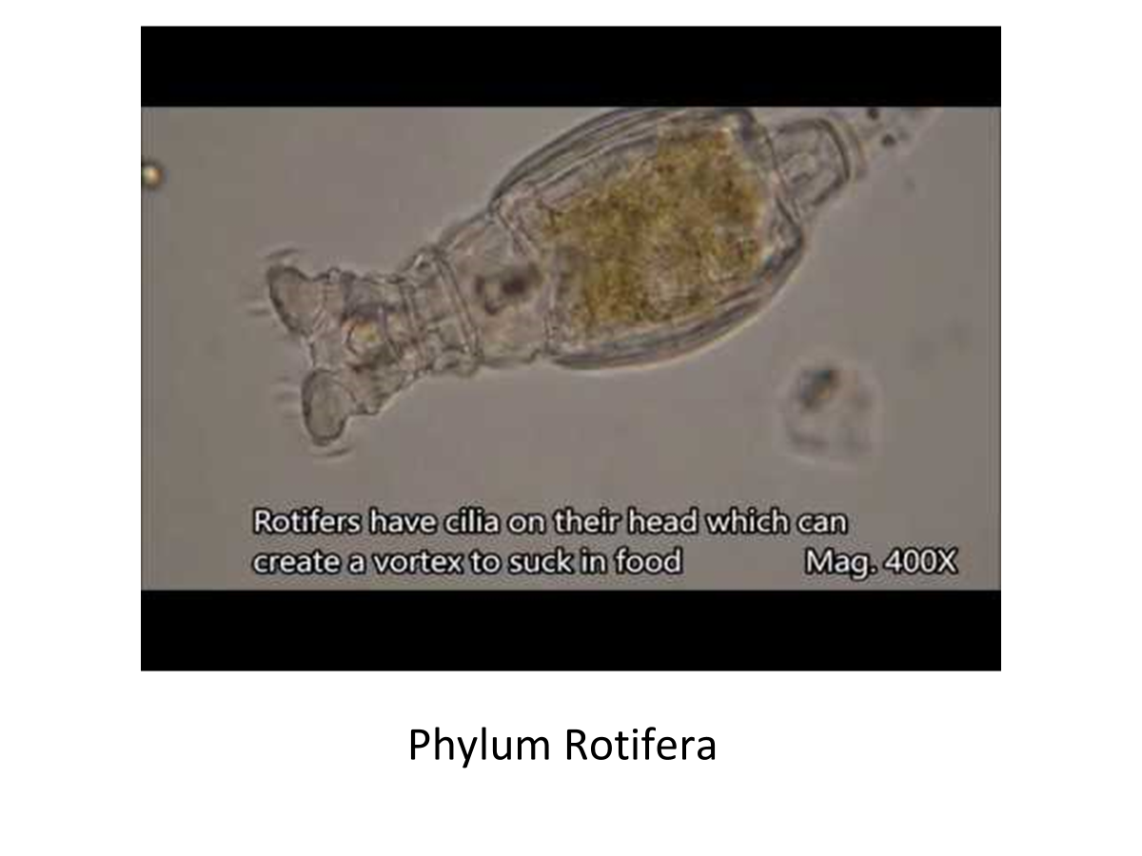

Slide 56
