Slide 1
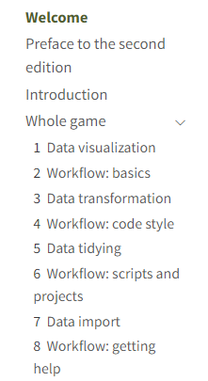
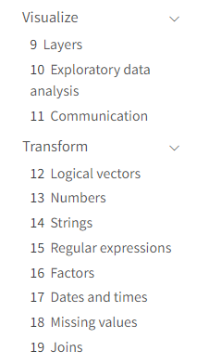
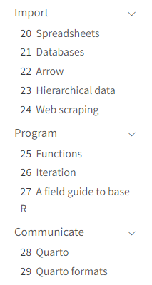

For next week of class
Read
4- Workflow: code style
6- Workflow: scripts and projects
7- Data import

Slide 3
Recall from last week- Accessing literature

Slide 4
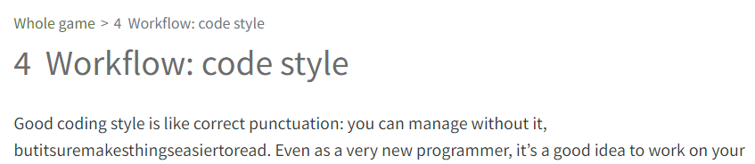
I think this statement is easier to write, interpret, and build upon.
vs.
I think this statement is
easier to write,
interpret, and
build upon.

Slide 5
How are effective R scripts structured?

Slide 6
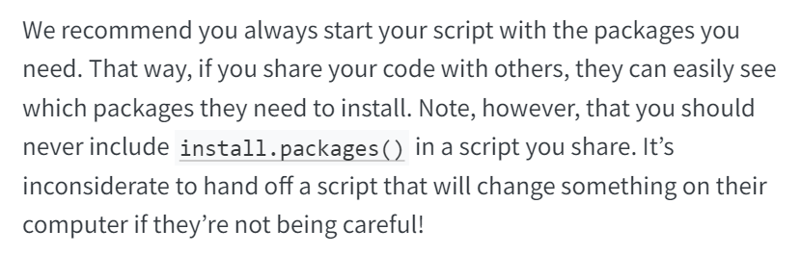

Slide 8
For next week of class
Read
3- Data transformation
5- Data tidying

Slide 9
Agenda for today
Warm up
Questions log
Wrap up Ch 6, 7
Analysis tutorial guidance
commonlyused.R
Logistics / loose ends

Slide 10


Slide 11


Slide 12
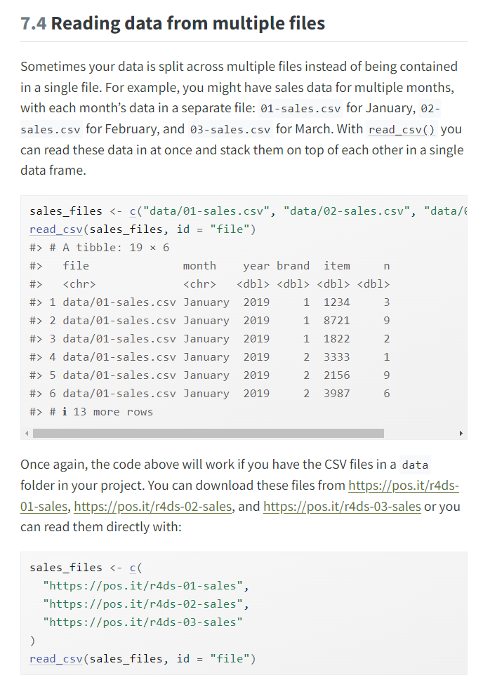

Slide 14
Agenda for today
Analysis tutorial guidance
commonlyused.R
Ch 3, 5
Logistics / loose ends

Slide 15
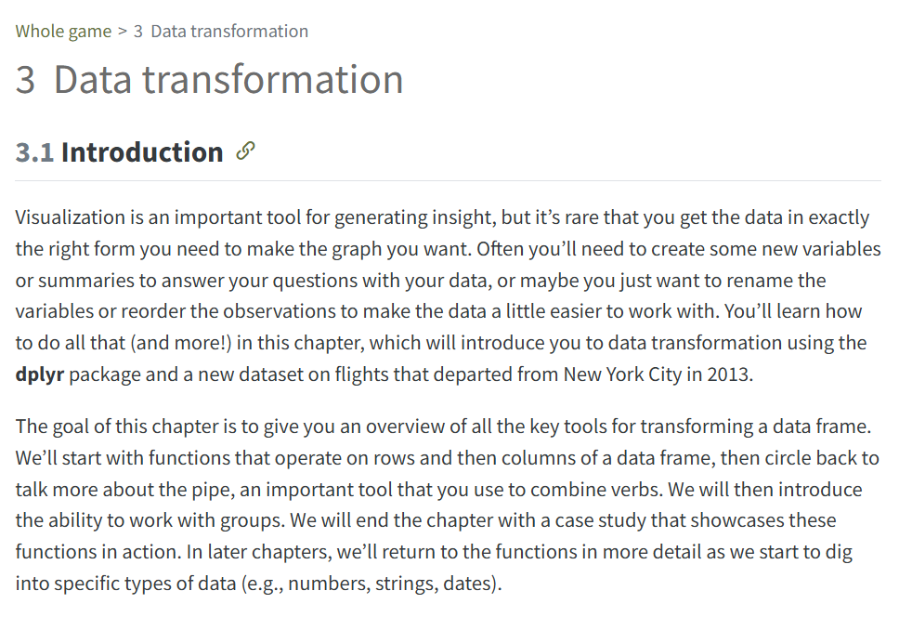

Slide 16
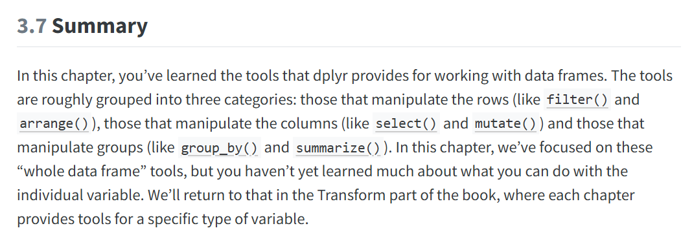

Slide 17
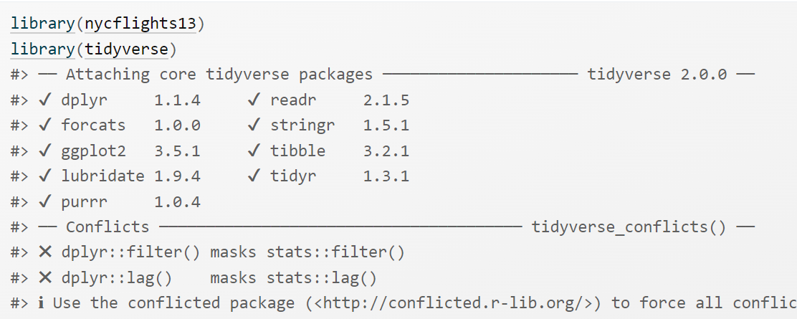

Slide 18
Pipes in R and tidyverse
Original style %>%
New style |>
Both styles should work in the recent versions of tidyverse

Slide 19
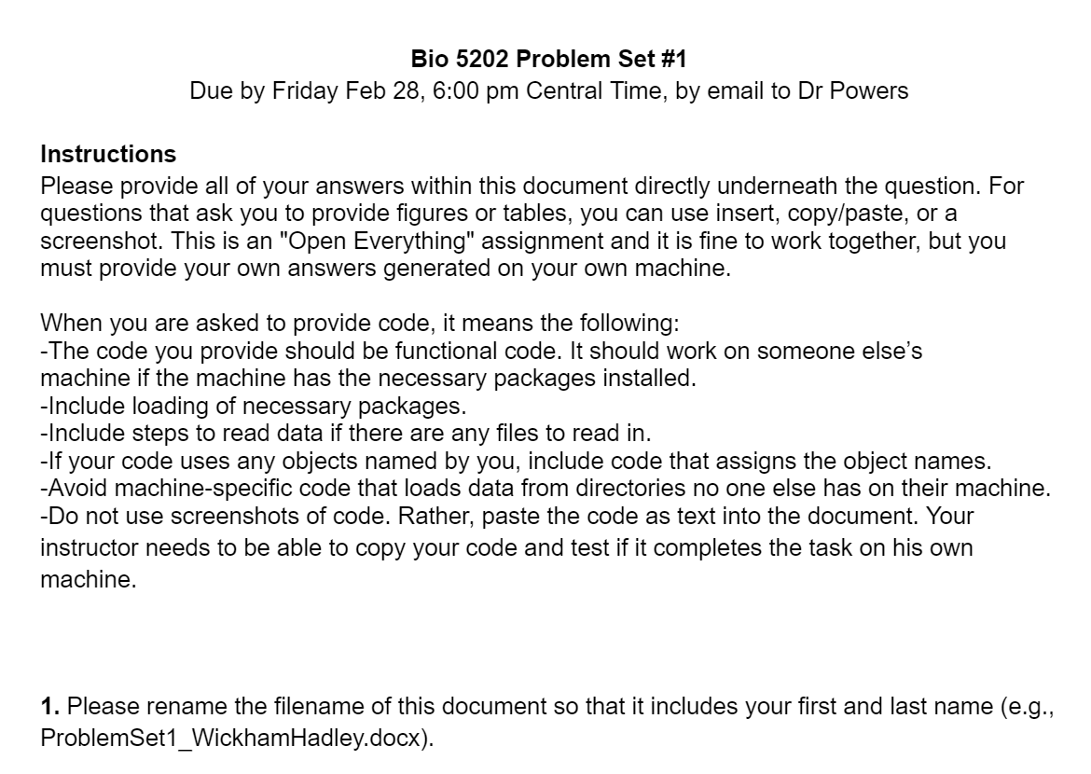

Slide 20
