Slide 1
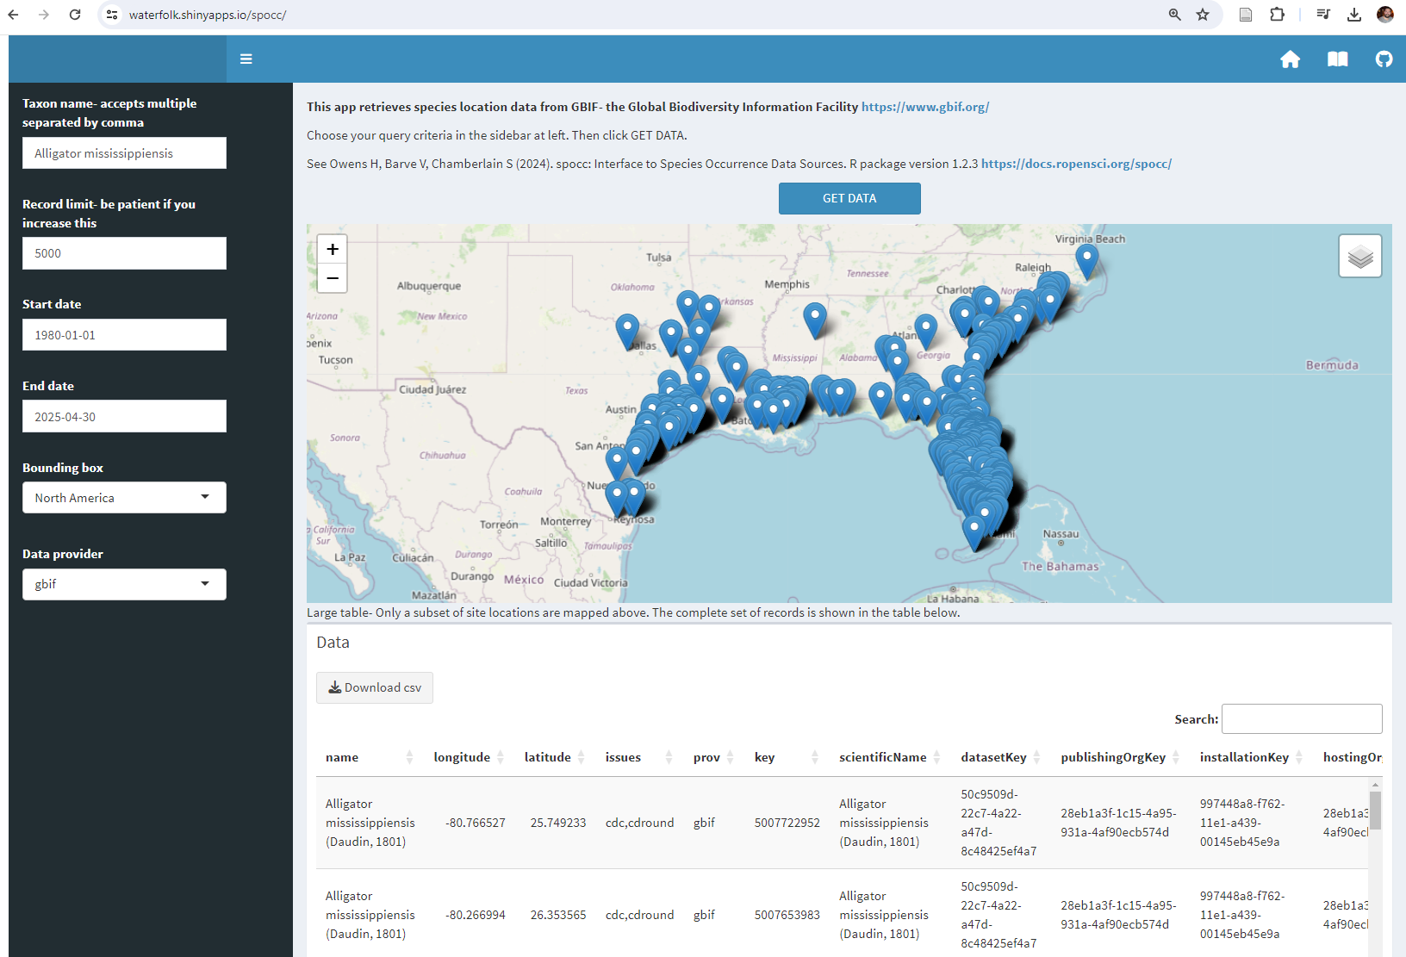
Powers SM. A shiny application for rapid visualization of species occurrence databases.

Slide 2
Earth's biodiversity evolved over eons. Global change demands understanding of questions about the biosphere and all creatures in it.
As a basic question: Where do different species occur and how are these distributions changing?
On the applied side: How can we develop a tool that helps visualize, track, and forecast species distributions?

Slide 3
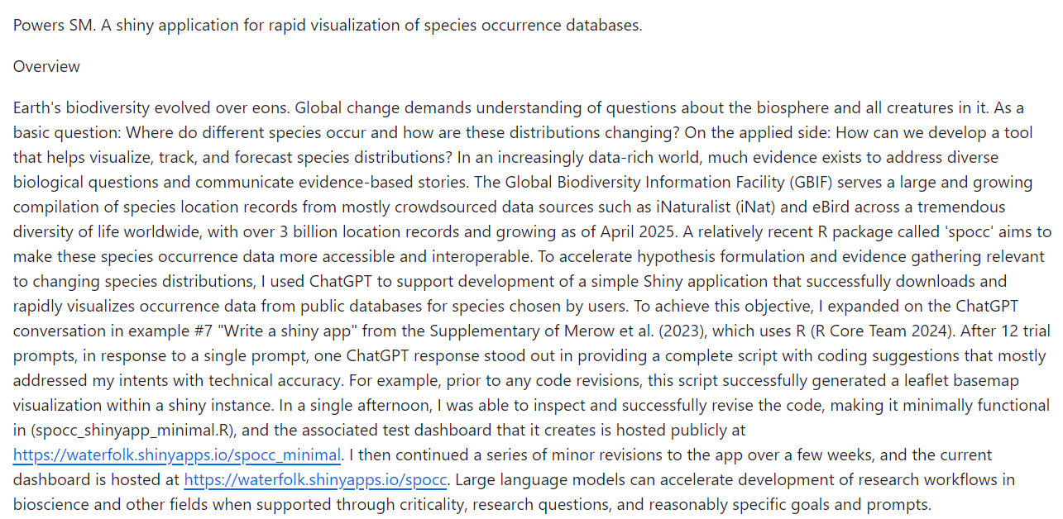

Slide 4
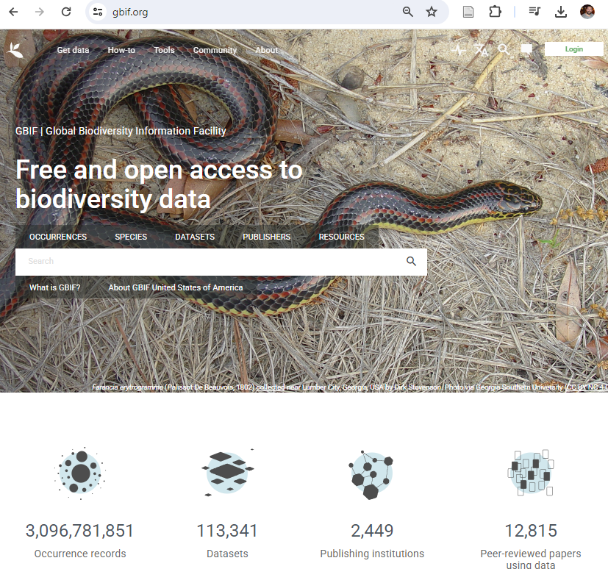

Slide 5
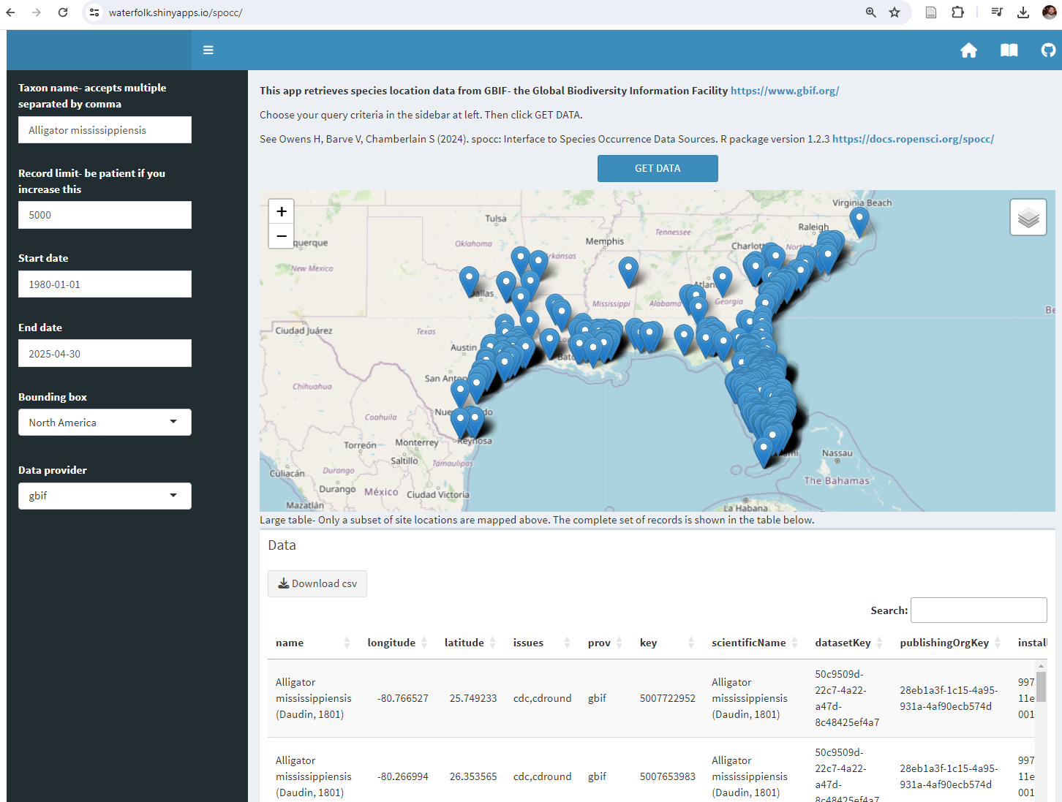

Slide 6
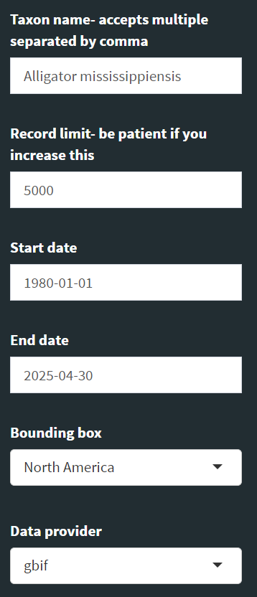

Slide 7
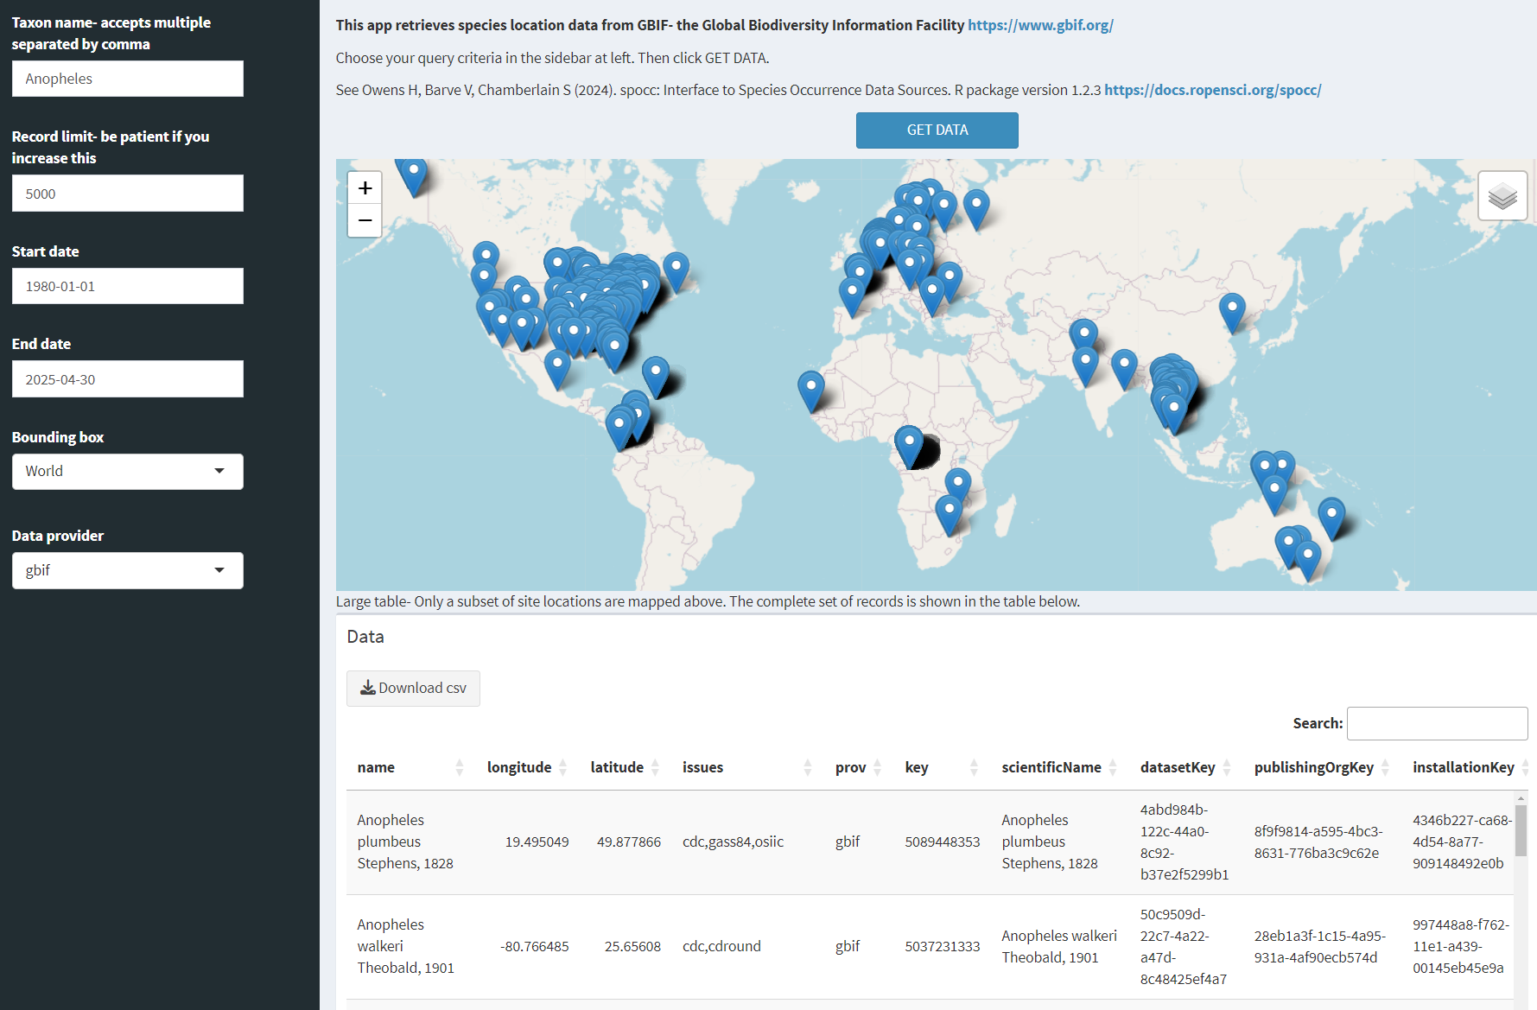
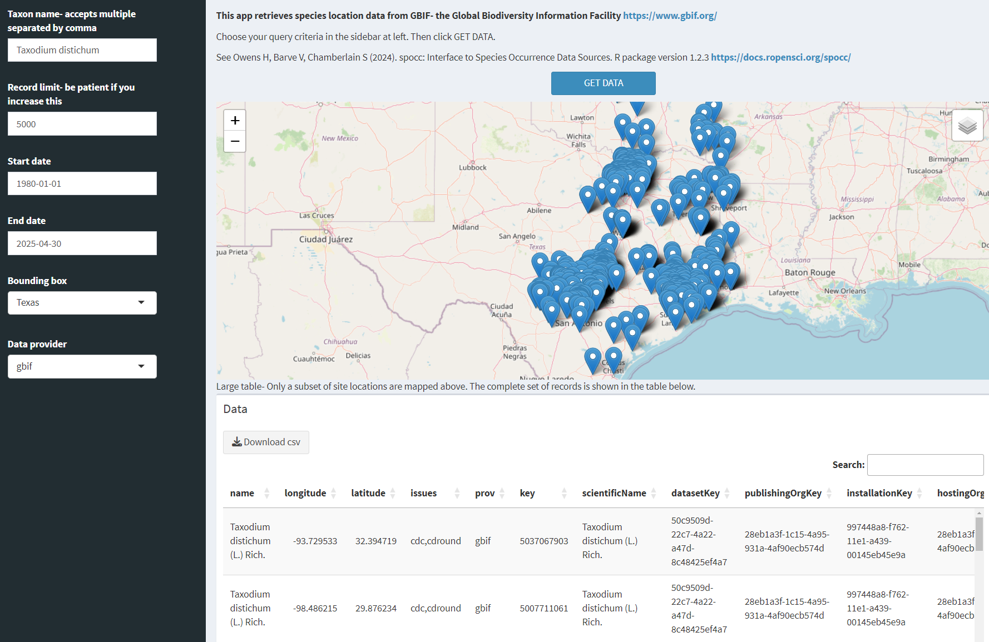
American alligator
Anopheles mosquito
Bald cypress

Slide 8
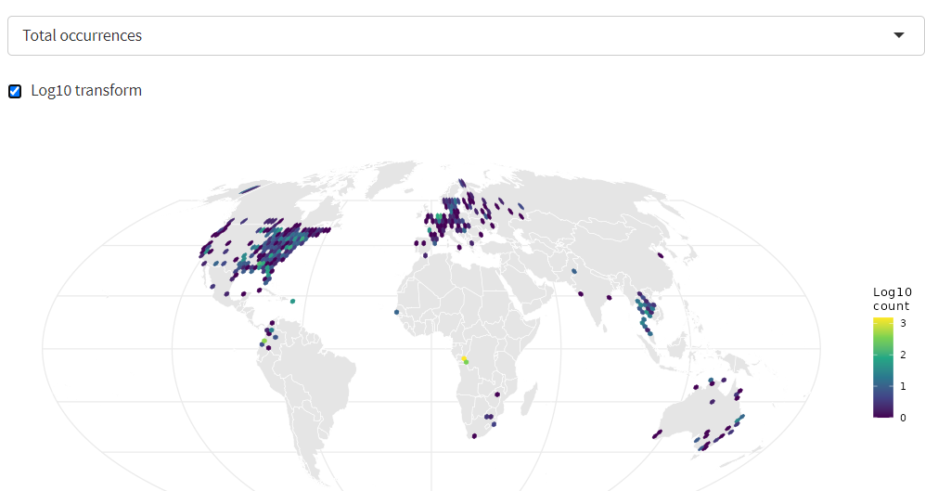
Anopheles mosquito

Slide 9
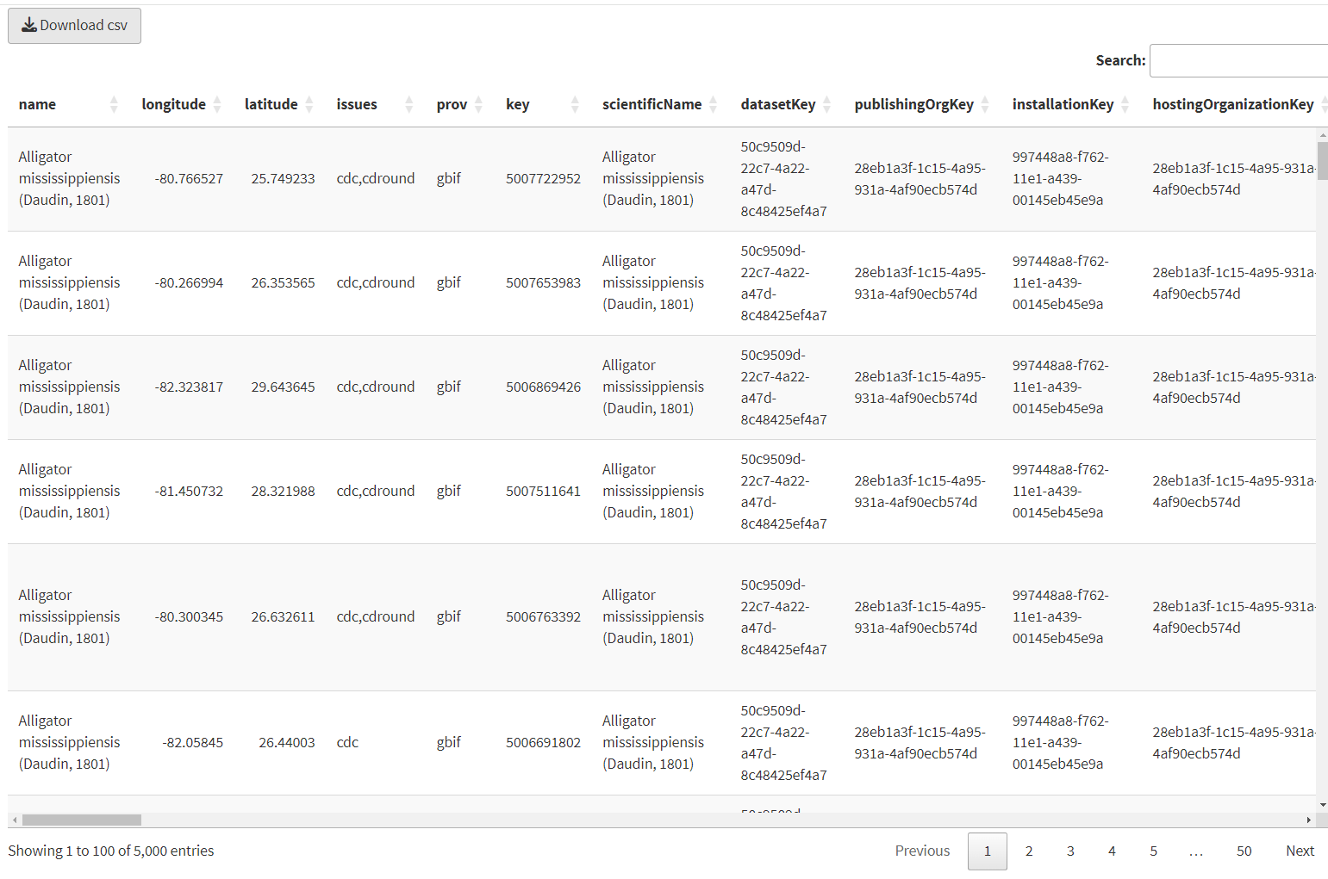

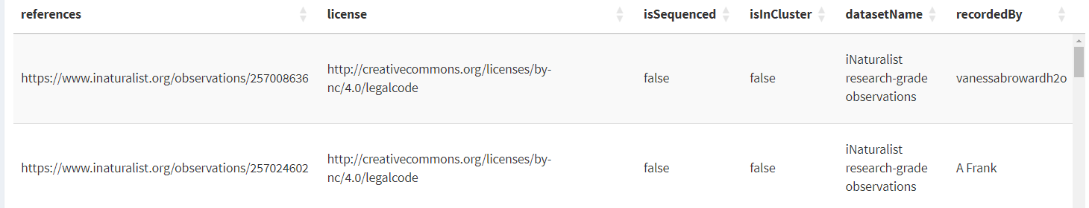

Slide 10
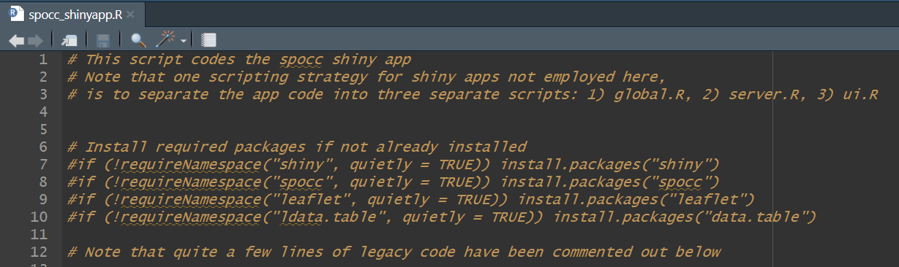

Slide 11
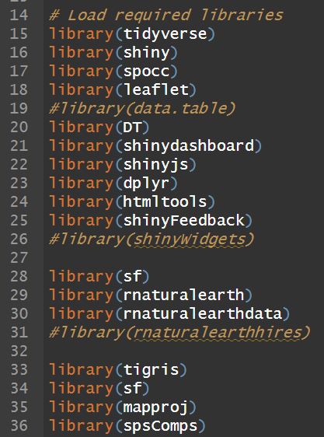

Slide 12
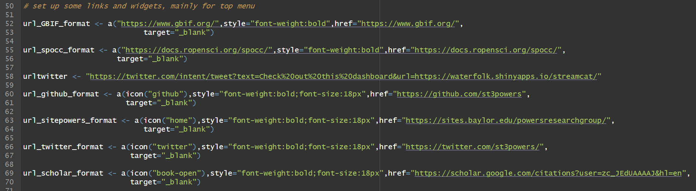

Slide 13
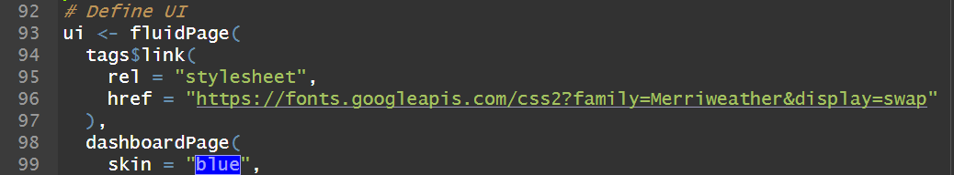

Slide 14
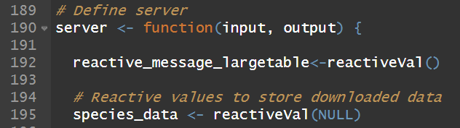

Slide 15


Slide 16
Thanks!
Questions?

