Slide 1
DSL Final Project
---- Lunch-Decider
TEAM 14
b02902055趙子為b02902023陳文晧 b02902011黃泓硯b02902093謝承榮 b02902059陳柏翰

Slide 2

WHY DO WE MAKE THIS APP?
Always have no idea about what for lunch

Slide 3
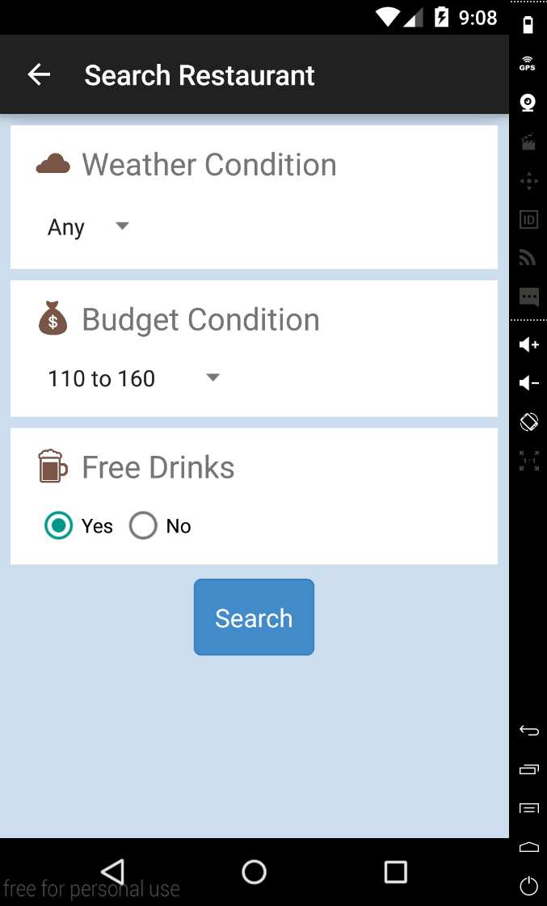

SEARCH FOR RESTAURANT
Three conditions:
  Weather
  Budget
  Free Drinks

Slide 4
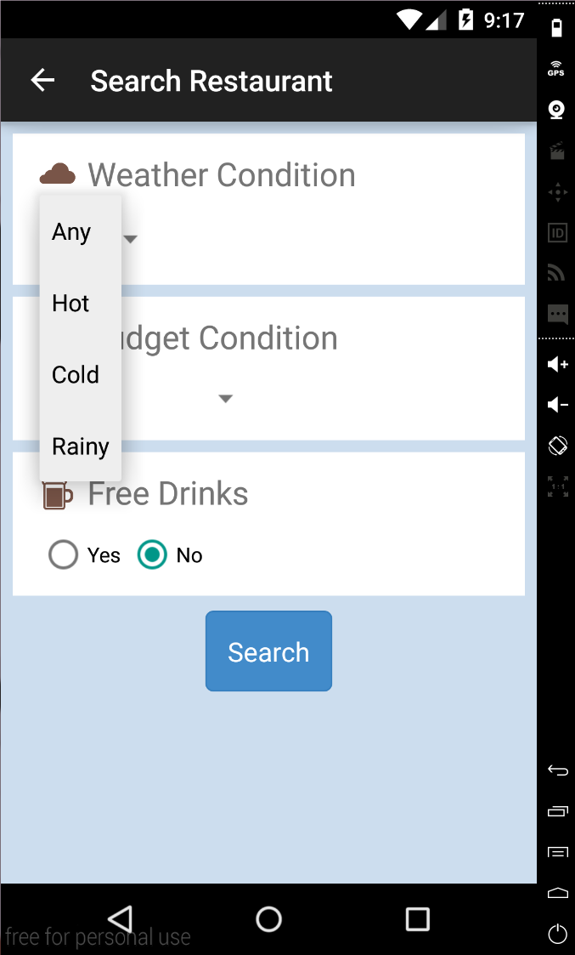
Choose weather condition
Four choice
      ANY
      Hot
      Cold
      Rainy

Slide 5
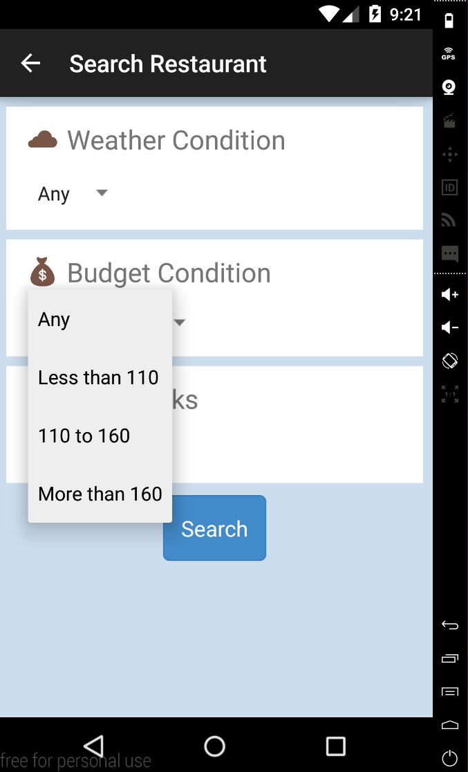
Choose budget condition
Four choice
      ANY
      < 110
      110 <, <160
      160 <

Slide 6
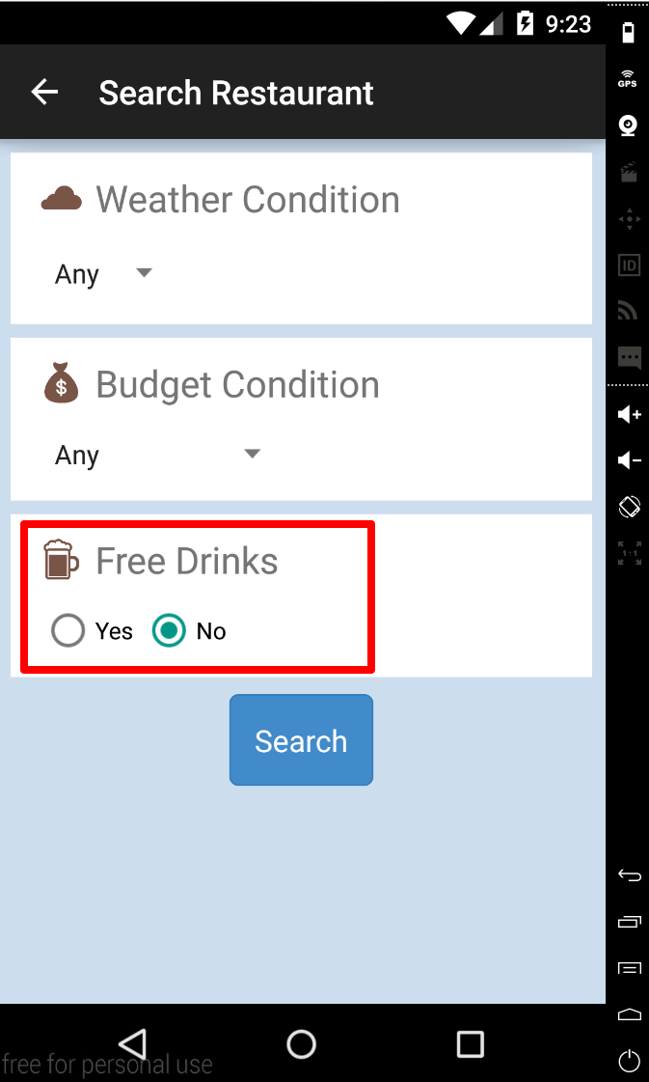
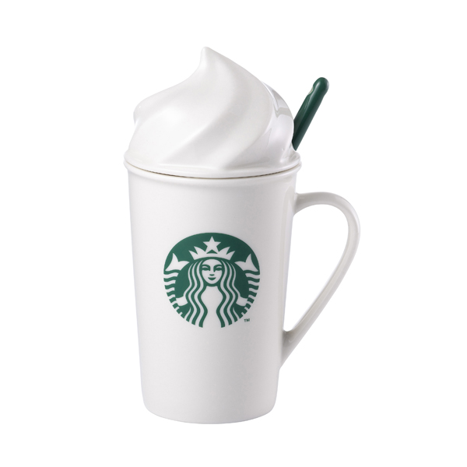
Free Drinks?
Yes
No

Slide 7
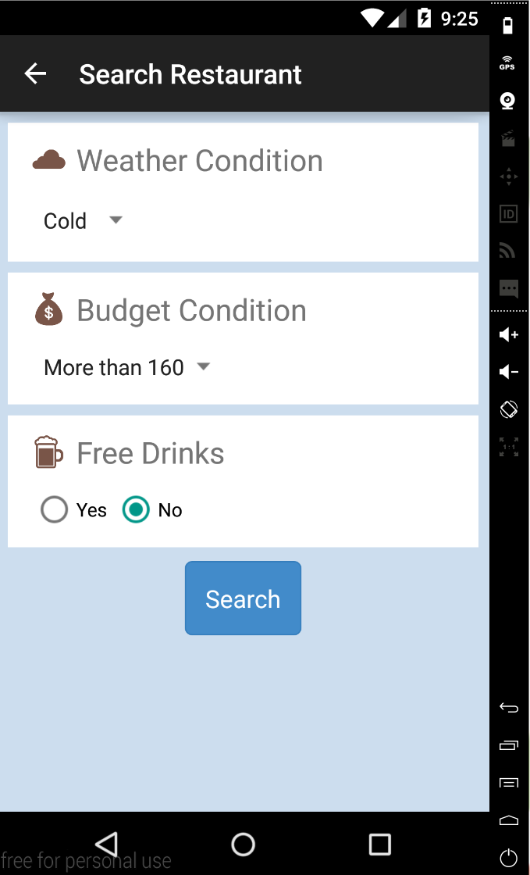
EXAMPLE
Condition
  Weather: Cold
  Budget: 160 <
  Free Drinks: NO

Slide 8
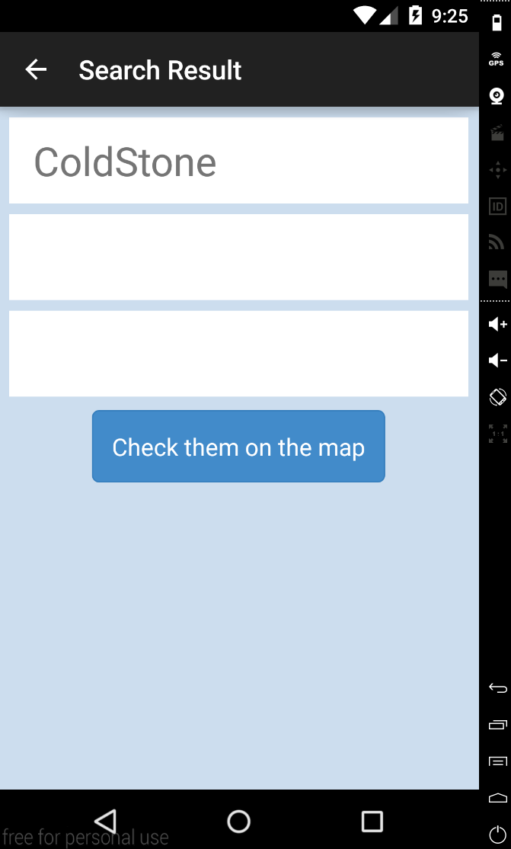
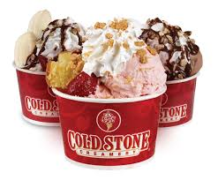
Result
You find COLDSTONE

Slide 9
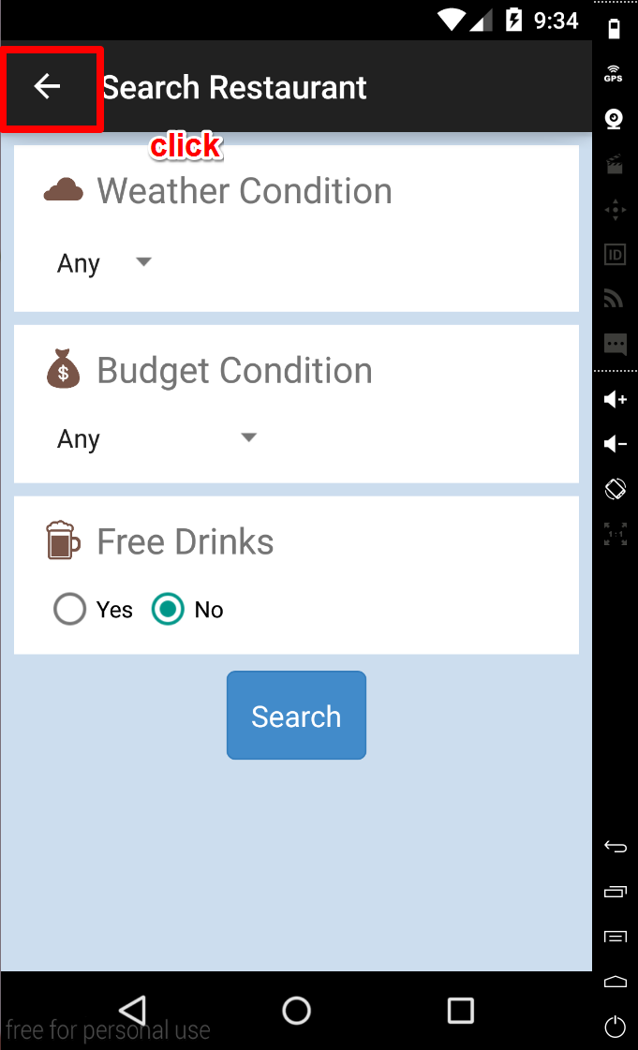
ADD RESTAURANT
Step 1
  Click the arrow and switch
  to the add restaurant mode

Slide 10
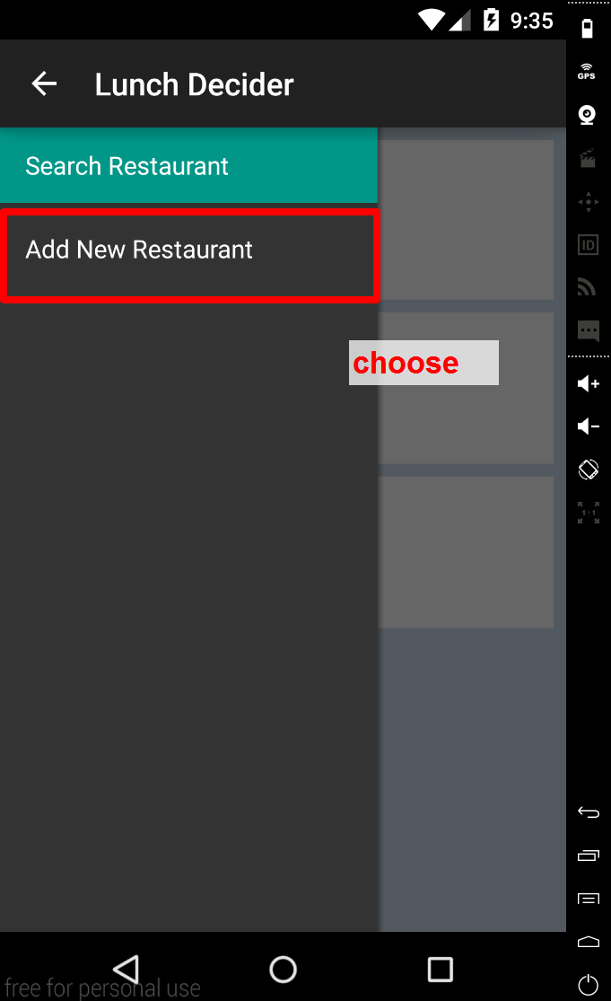
ADD RESTAURANT
Step 2
  Choose the
  “Add New Restaurant”

Slide 11
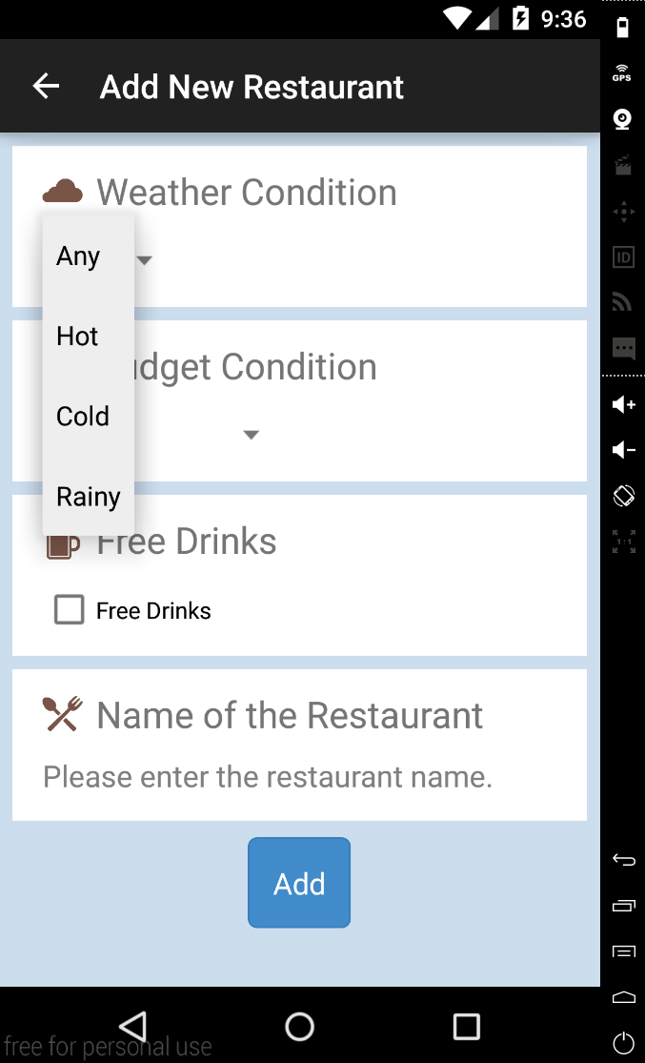
ADD RESTAURANT
Step 3
  Choose the weather when
  you want to come to
  this restaurant

Slide 12
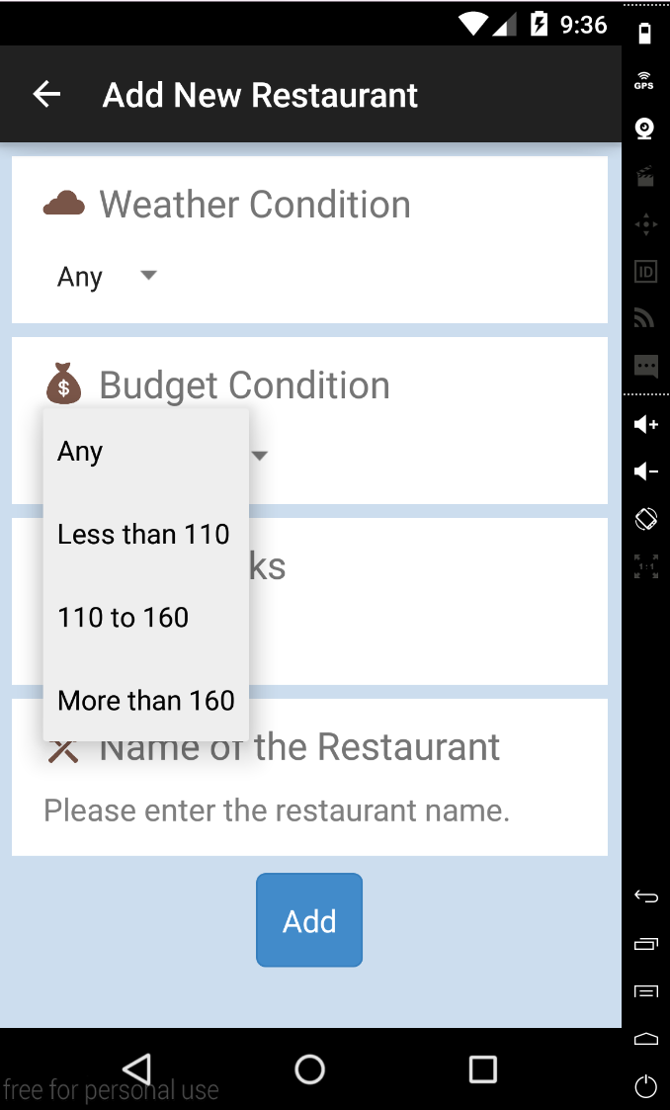
ADD RESTAURANT
Step 4
  Choose your budget

Slide 13
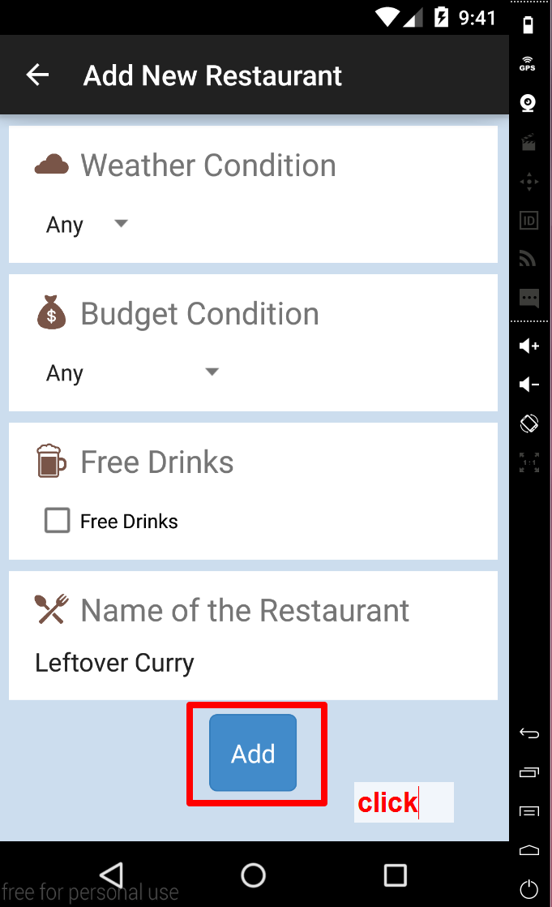
ADD RESTAURANT
Step 5
  Choose whether provide
  free drinks
Step 6
  Type the Restaurant name
Step 7
  Click “add” to add the
  restaurant

Slide 14
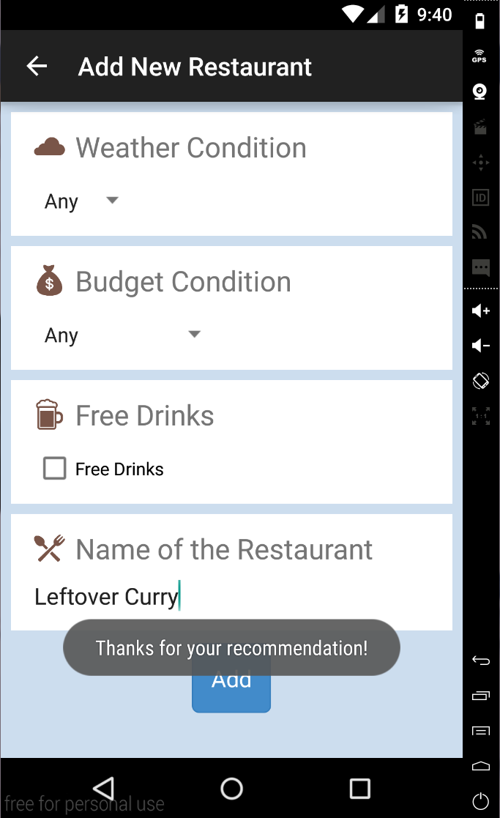
ADD RESTAURANT
Step 8
  Successfully add the
  Restaurant

Slide 15
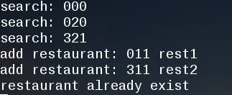
SERVER
用戶可以互相推薦餐廳的系統
用server來處理資料的儲存與運算
  Eg. 儲存新增的餐廳
  Eg. 擋掉用戶重複新增的同間餐廳
  Eg. 搜尋資料庫內存在的餐廳
Database增多的話 可以往big data發展

Slide 16
GOOGLE MAP
資料庫有衛星定位座標即可將餐廳標在
google map上

Slide 17
THANK YOU

