Slide 1
Last Note
Image file formats
Compression
Lossless
Lossy
GIF
JPEG
Project 1

Slide 2
This Note
Color Quantization
Uniform
Populosity
Median cut
Project 1

Slide 3
Discussion
What’s rasterization?
What’s pixel-to-pixel operation? Examples?
What’s block-to-block operation? Examples?
What’s neighborhood operation? Examples?

Slide 4
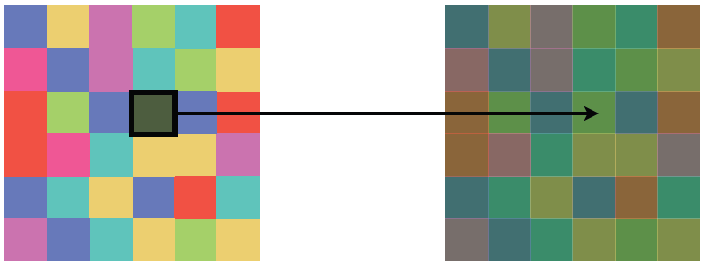
Pixel Operations

Slide 5
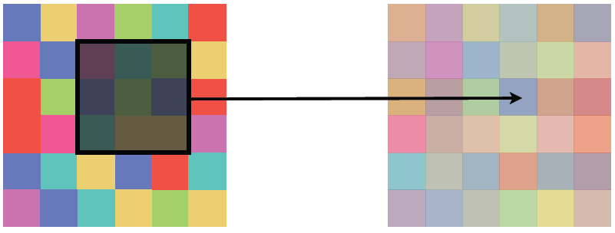
Block Operations

Slide 6
Neighborhood Operations

Slide 7
Discussion
What’s quantization?
Define the operation and its functionalities.
Why do we need it?
What’s the criteria for these operations?
What’s the process required for these operations?

Slide 8
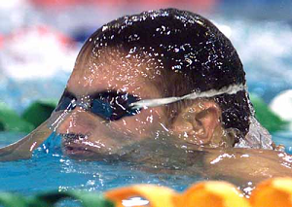
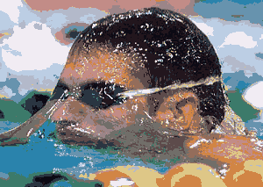
Color Quantization
Quantization: Mapping a continuous variable to a discrete set of values is called quantization, a concept Anton applies to the problem of how you go about mapping a true-color image to 256 colors.

Slide 9
Color Quantization
Common color resolution for high quality images is 256 levels for each Red, Green, Blue channels, or 256³ = 16777216 colors.
The problem of reducing the number of colors in an image with minimal impact on appearance
Extreme case: 24 bit color to black and white
Less extreme: 24 bit color to 256 colors, or 256 grays
Why do we care?
Sub problems:
Decide which colors to use in the output (if there is a choice)
Decide which of those colors should be used for each input pixel

Slide 10

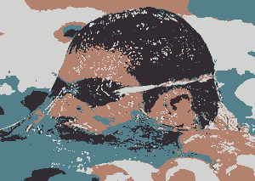
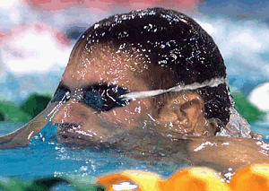
Color Quantization
2 colors
16 colors
4 colors
256 colors

Slide 11
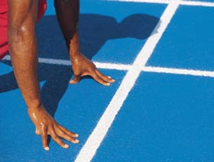

Quantization Phases
Sample the original image for color statistics
Select color map based on those statistics
Map the colors to their representative in the color map
By using the Euclidean distance
Redraw the image, quantizing each pixel
Algorithm
Mapping…

Slide 12
Discussion
What method can we quantize various colors?
Possible algorithms? To select various seeds for reduction of data storage.

Slide 13
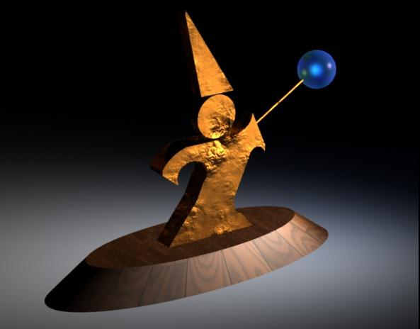
Example (24 bit color)

Slide 14
Uniform Quantization
Break the color space into uniform cells
Find the cell that each color is in, and map it to the center
Generally does poorly because it fails to capture the distribution of colors
Some cells may be empty, and are wasted

Slide 15
Uniform Quantization
Equivalent to dividing each color by some number and taking the integer part
Say your original image is 24 bits color (8 red, 8 green, 8 blue)
Say you have 256 colors available, and you choose to use 8 reds, 8 greens and 4 blues (8 × 8 × 4 = 256 )
Divide original red by 32, green by 32, and blue by 64
Some annoying details

Slide 16
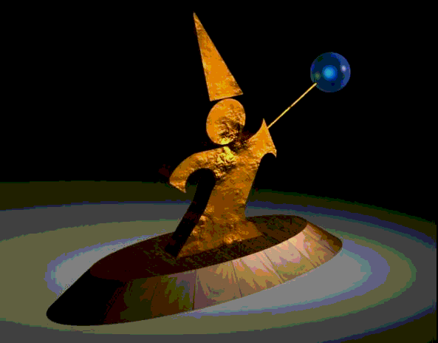
Uniform Quantization
8 bits per pixel in this image
Note that it does very poorly on smooth gradients
Normally the hardest part to get right, because lots of similar colors appear very close together
Does this scheme use information from the image?

Slide 17
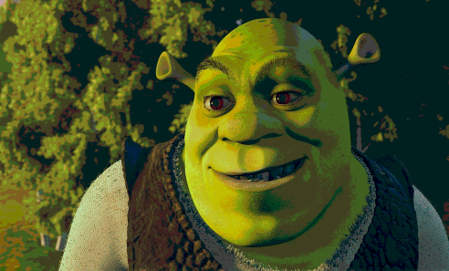
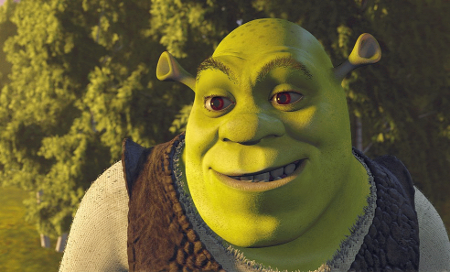
Example
Naïve Color Quantization
24 bit to 8 bit:
Retaining 3-3-2 most significant bits of the R,G and B components.

Slide 18
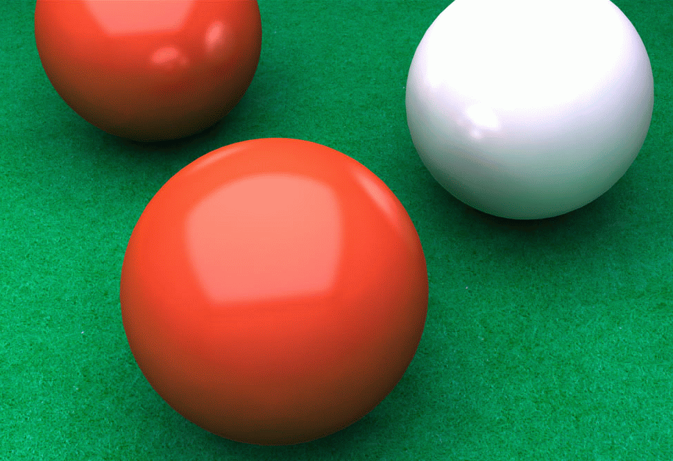
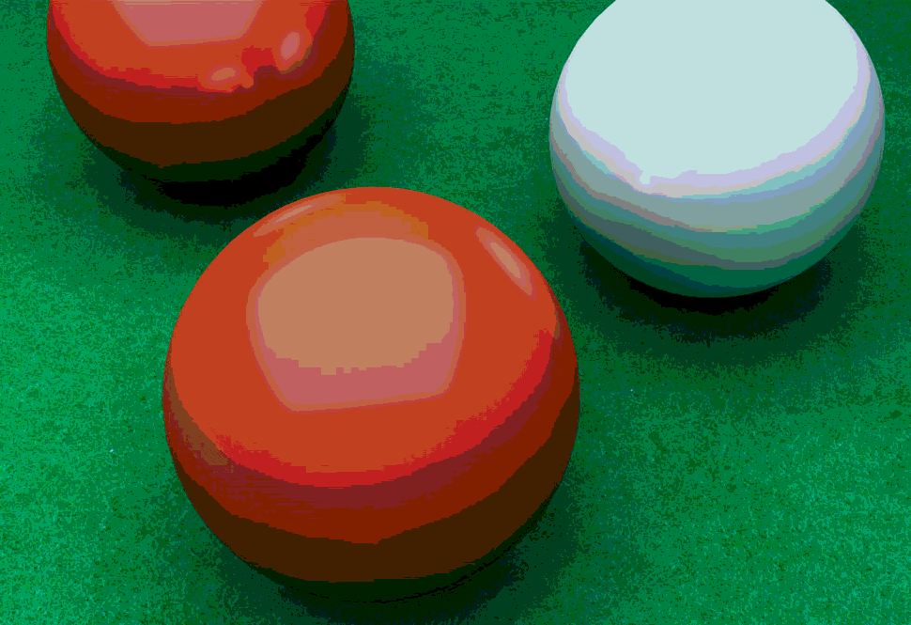
Example 3-3-2

Slide 19
Populosity Algorithm
Build a color histogram: count the number of times each color appears
Choose the n most commonly occurring colors
Typically group colors into small cells first using uniform quantization
Map other colors to the closest chosen color
Problem?

Slide 20
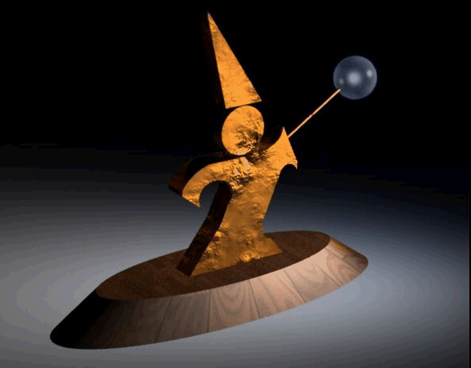
Populosity Algorithm
8 bit image, so the most popular 256 colors
Note that blue wasn’t very popular, so the crystal ball is now the same color as the floor
Populosity ignores rare but important colors!

Slide 21
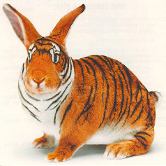
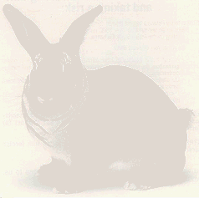
Popularity 16 colors…

Slide 22
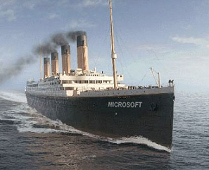
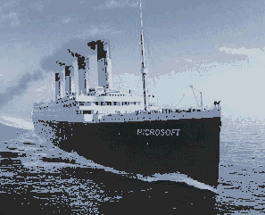
Popularity 16 colors…
The reds are not that popular…

Slide 23
Median Cut (Clustering)
View the problem as a clustering problem
Find groups of colors that are similar (a cluster)
Replace each input color with one representative of its cluster
Many algorithms for clustering
Median Cut is one: recursively
Find the “longest” dimension (r, g, b are dimensions)
Choose the median of the long dimension as a color to use
Split into two sub-clusters along the median plane, and recurse on both halves
Works very well in practice
Another way of kdtree

Slide 24
Median Cut
R
G
B

Slide 25
Median Cut

Slide 26
Median Cut

Slide 27
Median Cut

Slide 28
Median Cut

Slide 29
Median Cut

Slide 30
The Median Cut Algorithm
Color_quantization(Image, n){
For each pixel in Image with color C, map C in RGB space;
B = {RGB space};
While (n-- > 0) {
L = Heaviest (B);
Split L into L1 and L2;
Remove L from B, and add L1 and L2 instead;
}
For all boxes in B do
assign a representative (color centroid);
For each pixel in Image do
map to one of the representatives;
}

Slide 31
The Median Cut Algorithm
Is this algorithm image dependent?
What is the Heaviest(B) box?
Several factors have to be weighed:
The total number of image colors in the box.
The total number of DIFFERENT image colors in the box.
The physical size of the box.
Which representative should be chosen for a given color?
The representative of the box containing the color.
The closest representative under some metric.

Slide 32

Median Cut
8 bit image, so 256 colors
Now we get the blue
Median cut works so well because it divides up the color space in the “most useful” way

Slide 33
Optimization Algorithms
The quantization problem can be phrased as optimization
Find the set of colors and mapping that result in the lowest quantization error
Several methods to solve the problem, but of limited use unless the number of colors to be chosen is small
It’s expensive to compute the optimum
It’s also a poorly behaved optimization

Slide 34
Perceptual Problems
While a good quantization may get close colors, humans still perceive the quantization
Biggest problem: Mach bands
The difference between two colors is more pronounced when they are side by side and the boundary is smooth
This emphasizes boundaries between colors, even if the color difference is small
Rough boundaries are “averaged” by our vision system to give smooth variation

Slide 35
Mach Bands in Reality
The floor appears banded

Slide 36
Mach Bands in Reality
Still some banding even in this 24 bit image (the floor in the background)

Slide 37
Mach bands Emphasized
Note that each bar on the left appears to have color variation across it
Left edge appears darker than right
The effect is entirely due to Mach banding

Slide 38
Project 1
Due and Demo at Oct. 13
Implement a basic image editing program – Photoshop lite
The web site is long and detailed
Look for hints and notes on implementation on the web site
Start early: you have enough information to implement several operations already
Keep an eye out for hints and clarifications on the class mailing list

Slide 39
Project 1 Grading
Read very carefully the requirements for grading
You have to do the demo to show us your work at Oct. 13.
We will not tolerate programs that don’t compile or run
The aim is to implement 100 points worth of options
Different options have different point values
Some options are harder than others
The value of some options depends on whether you do other, similar options

