Slide 1
LastNote
Color Quantization
Uniform
Populosity
Median cut
Project 1

Slide 2
This Note
Dithering
Threshold
Brightness
Thresholding
Pattern
Diffusion
Color dithering
Project 1

Slide 3
Discussion
Why dithering (transform into black and white)?
What media uses this technique?
Possible requirements for it?
Different algorithms
How to do it?
What’s the pros and cons?

Slide 4
Dithering (Digital Halftoning)
Mach bands can be removed by adding noise along the boundary lines
General perceptive principle: replaced structured errors with noisy ones and people complain less
Old industry dating to the late 1800’s
Methods for producing grayscale images in newspapers and books
Compensates for lack of color resolution
Eye does spatial averaging
Black/white dithering to achieve gray scale
Each pixel is black or white
From far away, color determined by fraction of white

Slide 5
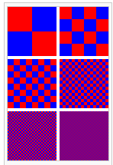
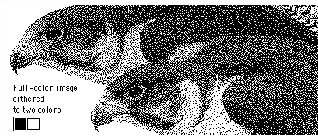
Dithering
Dithering takes advantage of the human eye's tendency to "mix“ two colors in close proximity to one another.

Slide 6
Dithering
Dithering takes advantage of the human eye's tendency to "mix“ two colors in close proximity to one another.
original
no dithering
with dithering
Colors = 2²⁴
Colors = 2⁸
Colors = 2⁸

Slide 7
Discussion
What techniques?
Naïve: transform to black and white? What’s the problem? How can we solve it?
Pattern-based methods? What’s the problem? How can we solve it?

Slide 8
Dithering to Black-and-White
To get color to black and white, first turn into grayscale: I=0.299R+0.587G+0.114B
This formula reflects the fact that green is more representative of perceived brightness than blue is
NOTE that it is not the equation implied by the RGB->XYZ color space conversion matrix
For all dithering we will assume that the image is gray and that intensities are represented as a value in [0, 1.0)
Define new array of floating point numbers
new_image[i] = old_image[i] / (float)256;
To get back: output[i]=(unsigned char)floor(new_image[i]*256)

Slide 9
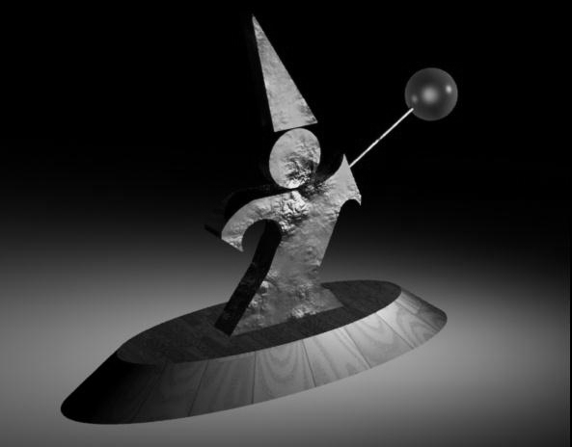

Sample Images

Slide 10
How Could We Do This?
Deterministic Thresholding
Random Thresholding
Threshold Patterns - Dithering Matrices
Ordered Dithering
Clustered Dithering
Dot Dispersion
Pattern Dithering
Diffusion

Slide 11
Threshold Dithering
For every pixel: If the intensity < 0.5, replace with black, else replace with white
0.5 is the threshold
This is the naïve version of the algorithm
To keep the overall image brightness the same, you should:
Compute the average intensity over the image
Use a threshold that gives that average

Slide 12
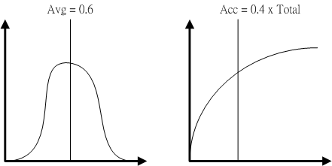
Examples
For example, if the average intensity is 0.6, use a threshold that is higher than 40% of the pixels, and lower than the remaining 60%

Slide 13
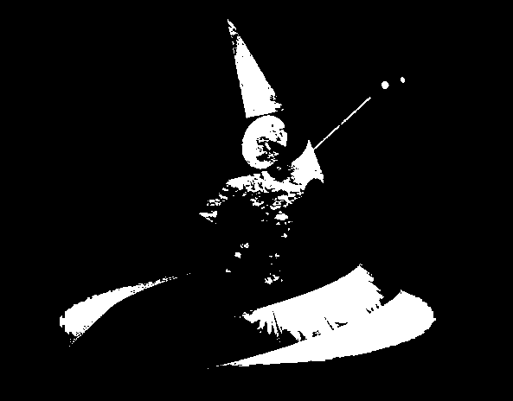

Naïve Threshold Algorithm

Slide 14
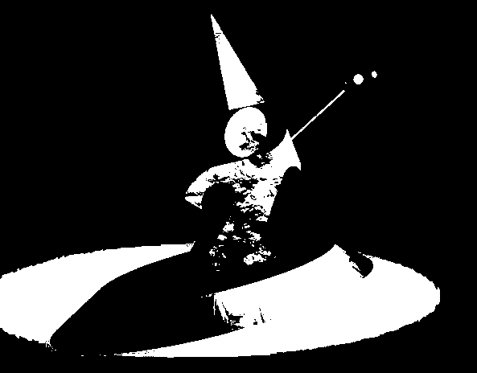

Brightness Preserving Algorithm

Slide 15
Random Modulation
Add a random amount to each pixel before thresholding
Typically add uniformly random amount from [-a,a]
Pure addition of noise to the image
For better results, add better quality noise
For instance, use Gaussian noise (random values sampled from a normal distribution)
Should use same procedure as before for choosing threshold
Not good for black and white, but OK for more colors
Add a small random color to each pixel before finding the closest color in the table

Slide 16
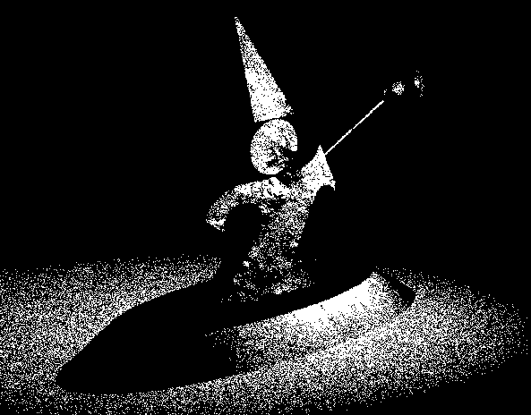

Random Modulation

Slide 17
Ordered Dithering
Break the image into small blocks
Define a threshold matrix
Use a different threshold for each pixel of the block
Compare each pixel to its own threshold
The thresholds can be clustered, which looks like newsprint
The thresholds can be “random” which looks better
Image block
Threshold matrix
Result

Slide 18
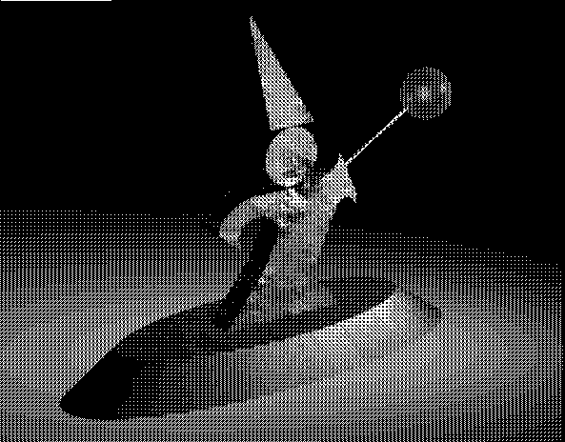

Clustered Dithering

Slide 19

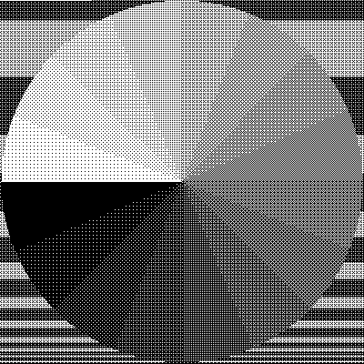
Dot Dispersion

Slide 20
Comparison
Clustered
Dot Dispersion

Slide 21
Pattern Dithering
Compute the intensity of each sub-block and index a pattern
NOT the same as before
Here, each sub-block has one of a fixed number of patterns – pixel is determined only by average intensity of sub-block
In ordered dithering, each pixel is checked against the dithering matrix before being turned on
Used when display resolution is higher than image resolution – not uncommon with printers
Use 3x3 output for each input pixel

Slide 22

Pattern Dither (1)

Slide 23
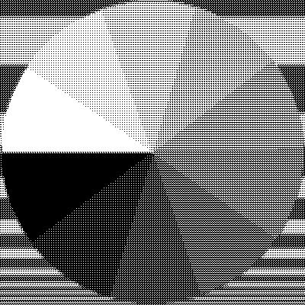
Pattern Dither (2)

Slide 24
Discussion
Floyd-Steinberg
Why?
What is it?

Slide 25
Floyd-Steinberg Dithering
Start at one corner and work through image pixel by pixel
Usually scan top to bottom in a zig-zag
Threshold each pixel
Compute the error at that pixel: The difference between what should be there and what you did put there
If you made the pixel 0, e = original; if you made it 1, e = original-1
Propagate error to neighbors by adding some proportion of the error to each unprocessed neighbor
A mask tells you how to distribute the error
Easiest to work with floating point image
Convert all pixels to 0-1 floating point
e
7/16
3/16
5/16
1/16

Slide 26
Floyd-Steinberg Dithering

Slide 27

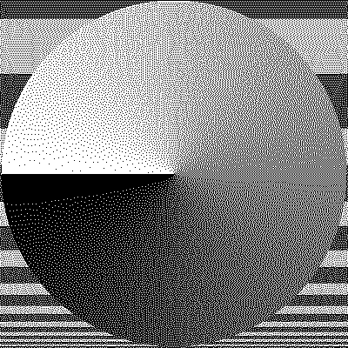
Floyd-Steinberg Dithering

Slide 28
Color Dithering
All the same techniques can be applied, with some modification
Example: 8 bit framebuffer
Set color map by dividing 8 bits into 3,3,2 for RGB
Blue is deemphasized because we see it less well
Dither RGB separately
Works well with Floyd-Steinberg
Generally looks good
Example is Floyd-Steinberg:
Uniform color table
Error is difference from nearest color in the color table
Error propagation same as that for greyscale
Each color channel treated independently

Slide 29
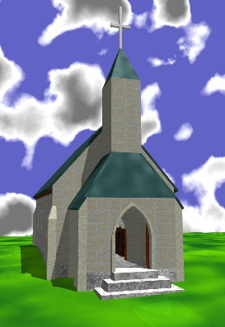
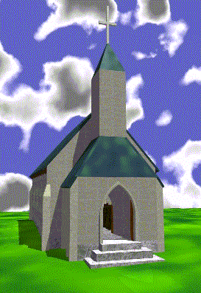
Color Dithering

Slide 30
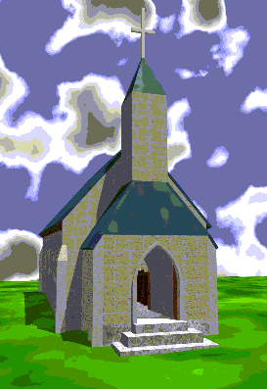
Comparison to Uniform Quant.
Same color table!

Slide 31
Project 1
Due and demo at Oct. 13.
Implement a basic image editing program – Photoshop lite
The web site is long and detailed
Look for hints and notes on implementation on the web site
Start early: you have enough information to implement several operations already
Keep an eye out for hints and clarifications on the class mailing list

Slide 32
Project 1 Grading
Read very carefully the requirements for grading
You have to do the demo to show us your work at Oct 13.
We will not tolerate programs that don’t compile or run
The aim is to implement 100 points worth of options
Different options have different point values
Some options are harder than others
The value of some options depends on whether you do other, similar options

