Slide 1
Last Note
Image Manipulation
Point operations
Neighboring operations: image mapping
NPR
Warping and NPR details in Prof. Yao’s Digital Meshes and Fundamental of CG
Filtering details in Prof. Hua’s class and Extra Note 1
Project 1: 10/17 due and demo

Slide 2
Discussion
What’s blue screen technique?
Where do you see this?

Slide 3
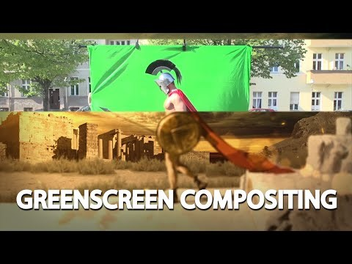
This Note
Compositing
Optical compositing and mattes
The alpha channel
Compositing operators
Premultiplied alpha
Matte extraction
Details are give in Prof. Yao’s Fundamental of Computer Graphics
Project 1

Slide 4
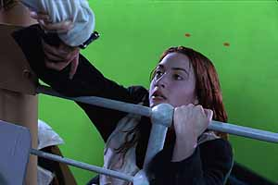
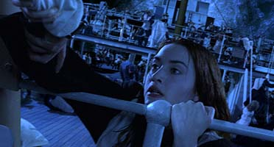
Compositing
Compositing combines components from two or more images to make a new image (example)
Special effects are easier to control when done in isolation
Even many all live-action sequences are more safely shot in different layers
Bad examples

Slide 5
Image Composition
Definition: Combine foreground element with background
Examples:
Graphics arts: Selections and masks, stencils, friskets and masking tape
Animation: cels, multiplane camera
Film: optical printing, blue screen matting
Video: chroma-keying
Computer graphics: alpha channel

Slide 6
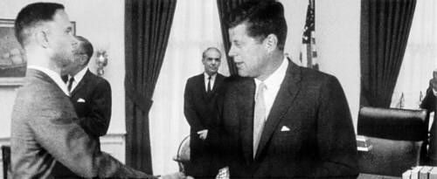
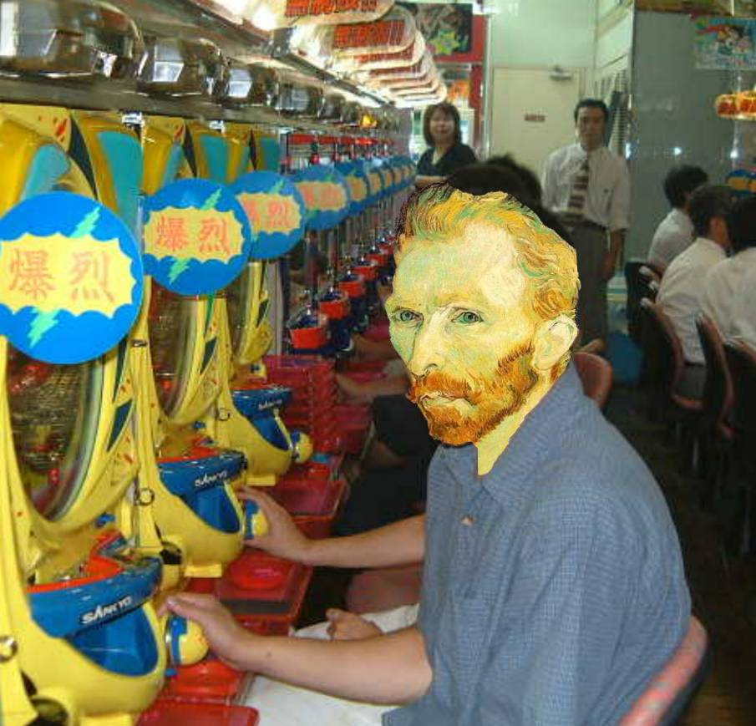
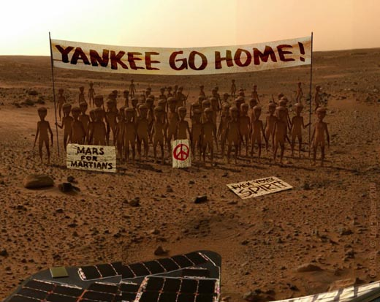
Image Compositing

Slide 7
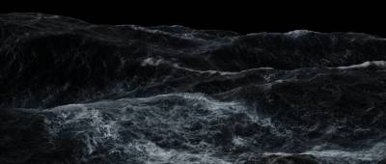
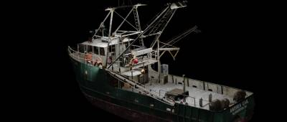
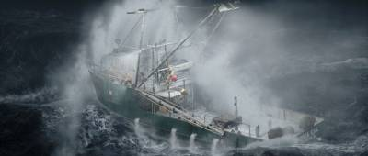
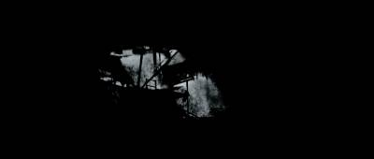

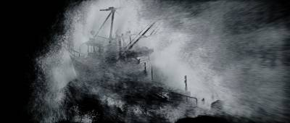
Perfect Storm

Slide 8

Animated Example
over
=

Slide 9
Discussion
How do we do it?
What’s the possible steps?
Foreground and background separation?
Put various foreground on various background?

Slide 10
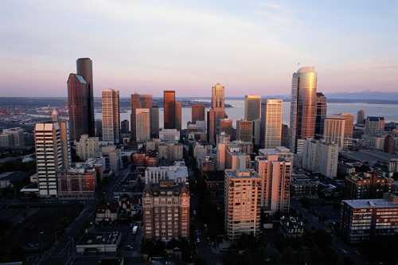

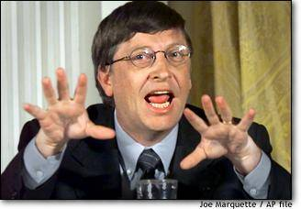

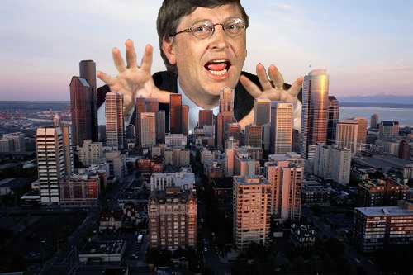
Compositing Procedure
1. Extract Sprites (e.g using Intelligent Scissors in Photoshop)
2. Blend them into the composite (in the right order)
Composite by
David Dewey

Slide 11
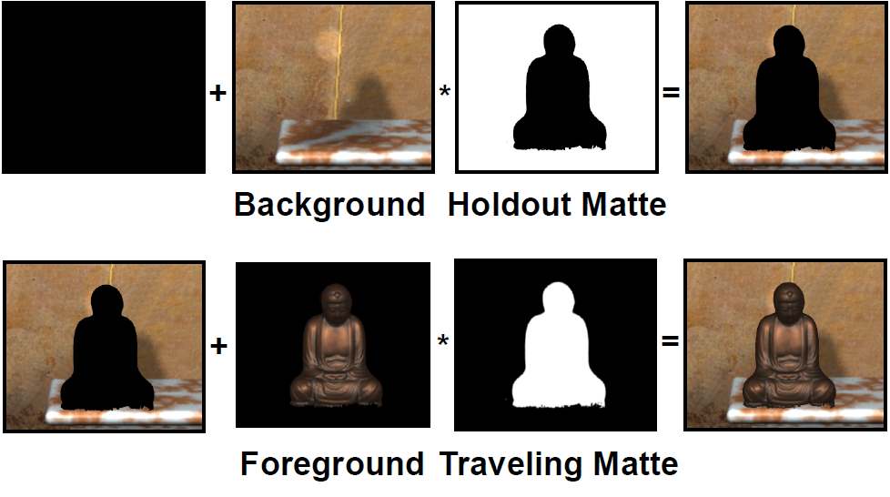
Composing Two Elements

Slide 12
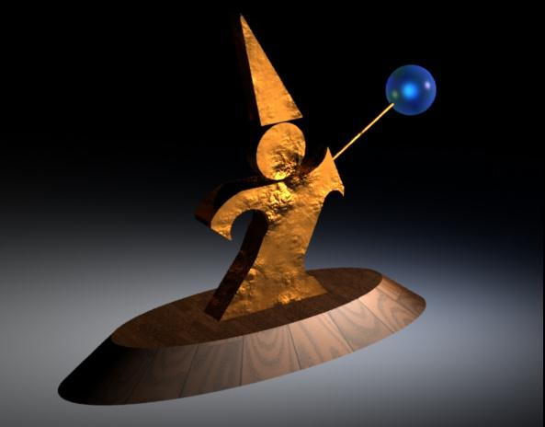

Mattes
A matte is an image that shows which parts of another image are foreground objects
Term dates from film editing and cartoon production
How would I use a matte to insert an object into a background?
How are mattes usually generated for television?

Slide 13
Working with Mattes
To insert an object into a background
Call the image of the object the source
Put the background into the destination
For all the source pixels, if the matte is white, copy the pixel, otherwise leave it unchanged
To generate mattes:
Use smart selection tools in Photoshop or similar
They outline the object and convert the outline to a matte
Blue Screen: Photograph/film the object in front of a blue background, then consider all the blue pixels in the image to be the background

Slide 14
Alpha
Basic idea: Encode opacity information in the image
Add an extra channel, alpha, to each image i.e each pixel stores R, G, B, A
Binary masks: all or none
The presence or absence of imagery
Geometric coverage: soft-edge
alpha = 1 implies full opacity at a pixel
alpha = 0 implies completely clear pixels
Mattes: 0.0 to 1.0 (0 to 255): There are many interpretations of alpha => RGBA format and typically 32 bits (8 bits for alpha)
Is there anything in the image at that point (web graphics)
Transparency (real-time OpenGL) or opacity of an image
Or both coverage and transparency

Slide 15




Sample Images
Images
Alphas

Slide 16
Basic Compositing Operation
At each pixel, combine the pixel data from f and the pixel data from g with the equation:
F and G describe how much of each input image survives, and c_{f} and c_{g} are pre-multiplied pixels, and all four channels are calculated
To define a compositing operation, define F and G

Slide 17
Basic Compositing Operation
F and G are simple functions of the alpha values
F and G are chosen (independently)
Different choices give different operations
To code it, you can write one compositor and give it 6 numbers (3 for F, 3 for G) to say which function
Constant of 0 or 1
α_{f} is multiplied by -1, 0 or 1. Similar for α_{g}

Slide 18
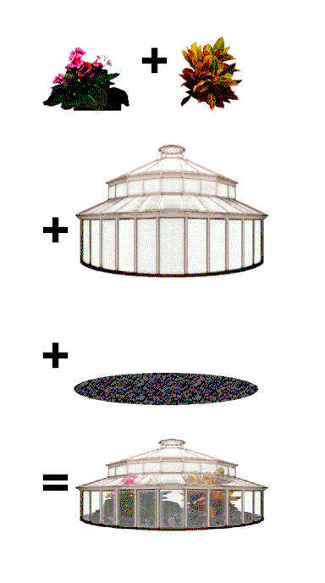
Multiple Alpha Blending
So far we assumed that one image (background) is opaque.
If blending semi-transparent sprites (the “A over B” operation):
I_{comp} = α_{a}I_{a} + (1-α_{a})α_{b}I_{b}
α_{comp} = α_{a} + (1-α_{a})α_{b}
Note: sometimes alpha is premultiplied: im(αR,αG,αB,α):
I_{comp} = I_{a} + (1-α_{a})I_{b}
(same for alpha!)

Slide 19
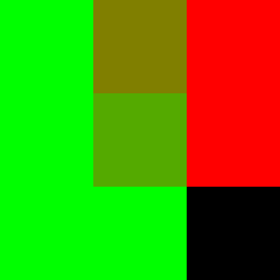

“Over” Operator
If there’s some f, get f, otherwise get g
over
=

Slide 20
“Over” Operator
Computes composite with the rule that f covers g

Slide 21
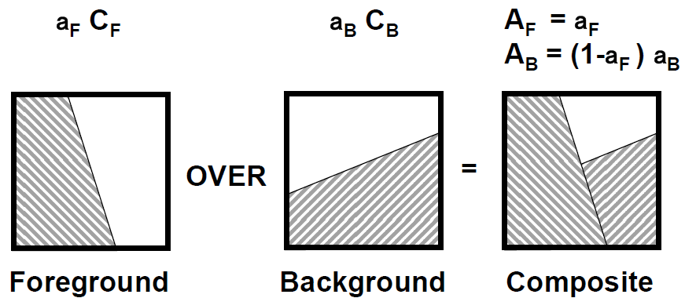
Over Operator
Composite color: c = A_{F}C_{F} + A_{B}C_{B} = (a_{F}C_{F} )+ (1-a_{F}) (a_{B}C_{B})
Composite alpha: a = A_{F} + A_{B} = a_{F} + (1-a_{F} ) a_{B}

Slide 22


“Inside” Operator
Get f to the extent that g is there, otherwise nothing
inside
=

Slide 23
“Inside” Operator
Computes composite with the rule that only parts of f that are inside g contribute

Slide 24


“Outside” Operator
Get f to the extent that g is not there, otherwise nothing
outside
=

Slide 25
“Outside” Operator
Computes composite with the rule that only parts of f that are outside g contribute

Slide 26

“Atop” Operator
Get f to the extent that g is there, otherwise g
inside
=

Slide 27
“Atop” Operator
Computes composite with the over rule but restricted to places where there is some g

Slide 28
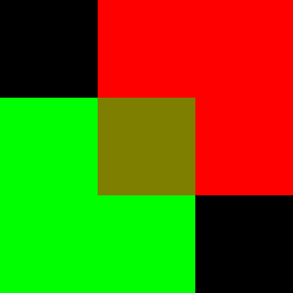

“Xor” Operator
Get f to the extent that g is not there, and g to extent of no f
xor
=

Slide 29
“Xor” Operator
Computes composite with the rule that f contributes where there is no g, and g contributes where there is no f

Slide 30
“Clear” Operator
Computes a clear composite
Note that (0,0,0,α > 0) is a partially opaque black pixel, whereas (0,0,0,0) is fully transparent, and hence has no color

Slide 31
“Set” Operator
Computes composite by setting it to equal f
Copies f into the composite

Slide 32
Compositing Operations
F and G describe how much of each input image survives, and c_{f} and c_{g} are pre-multiplied pixels, and all four channels are calculated
Operation | F | G
Over
Inside
Outside
Atop
Xor
Clear
Set

Slide 33
Unary Operators
Darken: Makes an image darker (or lighter) without affecting its opacity
Dissolve: Makes an image transparent without affecting its color

Slide 34
“PLUS” Operator
Computes composite by simply adding f and g, with no overlap rules
Useful for defining cross-dissolve in terms of compositing:

Slide 35
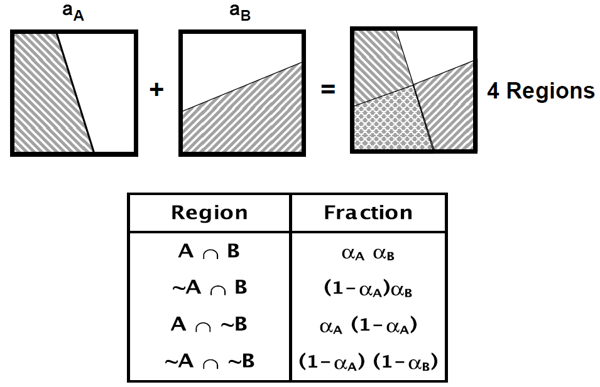
Region Coverage

Slide 36
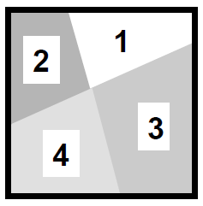
Porter-Duff Compositing Algebra
How many ways can two pixels be combined?
Region 1: 1 possibility - 0
Region 2: 2 possibilities - A or 0
Region 3: 2 possibilities - B or 0
Region 4: 3 possibilities - A, B or 0
4 Regions
Operators: 12 total possibilities

Slide 37
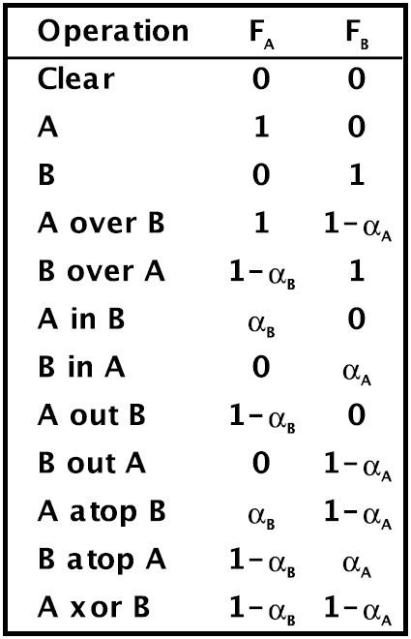
Porter-Duff Compositing Algebra
c = F_{A}c_{A}+F_{B}c_{B}

Slide 38
OpenGL Blending Modes
Specify src (foreground) and dst (background) F’s
Porter-Duff
0, 1,
A_{s}, A_{d}, 1-A_{s}, 1-A_{d},
Other useful modes
min(A_{s},1-A_{d}) – Why?

Slide 39
Pre-Multiplied Alpha
Instead of storing (R,G,B,α), store (αR,αG,αB,α)
The compositing operations in the next several slides are easier with pre-multiplied alpha
To display and do color conversions, must extract RGB by dividing out α
α=0 is always black
Some loss of precision as α gets small, but generally not a big problem

Slide 40
Pre-Multiplied Alpha
Represent as c = a C = (a r, a g, a b, a)
Advantages
Closure
Recovering C from c would require divide by a
Display c ; c over K = c + (1 - a_{C} ) K = c
One formula for compositing color and alpha
c = c_{F} + (1 - a_{F}) c_{B}
Less arithmetic
Associated: OVER (1 sub, 4 muls, 4adds)
Unassociated: OVER (1 sub, 7 muls, 4 adds)

Slide 41
Interpolating RGBA
Two ways of interpolating an image
Interpolate a and C; then multiply c = a*C
Interpolate premultiplied colors c
These lead to different answers
For example, suppose we interpolate (C, a) = (1,0,0,0) and (0,1,0,1) at .
(1/2(1+0),1/2(0+1),1/2(0+0),1/2(0+1)) = (1/2,1/2,0,1/2); then we multiply by a to get (1/4,1/4,0,1/2)
First we multiply to get (0,0,0,0) and (0,1,0,1); then we interpolate to get (0,1/2,0,1/2)

Slide 42
Which Way is Correct?
Interpolating composited images
Composite foreground over the background and then interpolate
Interpolate foreground and background and then composite
These should yield the same result!
Only true if we interpolate c (method 2 on prev. slide)
Notes:
Transition from one to the other, we should first interpolate foreground to that value and back ground to that value and then interpolate.

Slide 43
Compositing With Depth
Can store pixel “depth” instead of alpha
Then, compositing can truly take into account foreground and background
Generally only possible with synthetic imagery
Image Based Rendering is an area of graphics that, in part, tries to composite photographs taking into account depth

Slide 44
Obtaining α Values
Hand generate (paint a grayscale image)
Automatically create by segmenting an image into foreground background:
Blue-screening is the analog method
Remarkably complex to get right
“Lasso” is the Photoshop operation
With synthetic imagery, use a special background color that does not occur in the foreground
Brightest blue or green is common

Slide 45
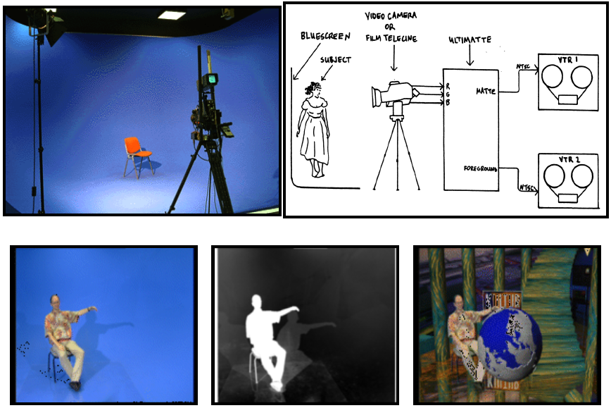
Blue Screen

