Slide 1
智慧型管理決策系統
2017.10.18

Slide 2
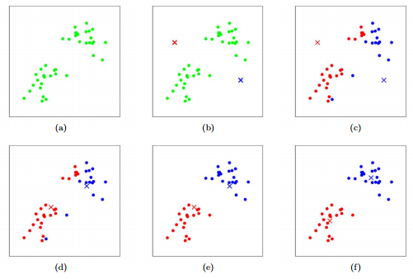
K-means clustering algorithm

Slide 3
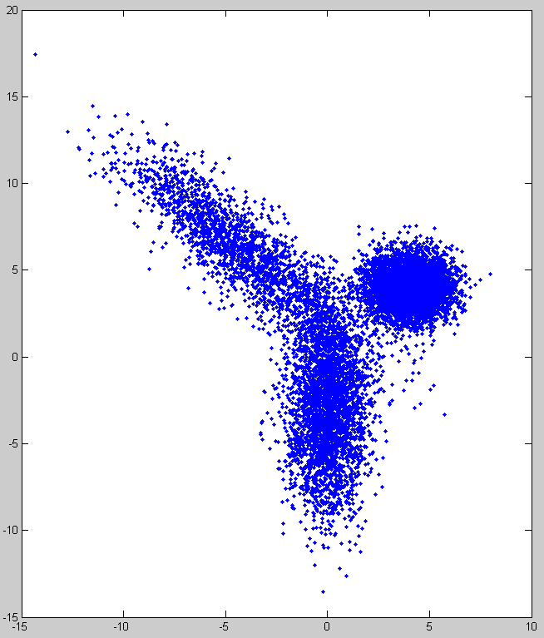
Simulated data
The location of each sample in the group follows the normal distribution.
G1: mean=[4 4], std=[1,1]
5000 samples
G2: mean=[0,-3], std=[1,3]
3000 samples
G3: mean=[-4,6], std=[1,4], rotation = 45 degree counterclockwise
2000 samples

Slide 4

Program practice #1
15 mins
Hint 1:
Mean : global shift
Std : global scaling
Hint 2:
Rotation first and then shift
math.cosd(45/180*math.pi)

Slide 5
K-means pseudo code
Input:
Cluster no. : K
Max_iteration : max_iter
Algorithm:
Randomly select K samples as the initial center
Repeat the following steps until clustering results convergence or iteration_num > max_iter
Calculate the distances between the sample location and group centers
Label each sample into K groups with the minimum distance measurement
Estimate the new center position of each group by averaging the locations of all the samples within the same group label
Output:
K center positions
The clustering label of each sample

Slide 6
Program practice #2
Keep a series of figures to display the convergence process of 3-means
Display the final results of 3-means
Requirements
Draw the sample as circle (.) and draw the center as cross (x)
Use three different color to represent each group
Hint
plt.plot(x[:,0],’r.’,x[:,1],’g.’,x[:,2],’b.’)
plt.show()

Slide 7
Program practice #3
Load IRIS
from sklearn import datasets
iris = datasets.load_iris()
Use K-means algorithm to cluster these data into three categories
Design an experiment to evaluate the clustering results

Slide 8


Data Pre-processing
Normalization
Adjust the sample features and let the feature representation normally distributed
Standard score
Scaling

Slide 9
Program practice #4
Improve the previous k-means clustering (practice #3)
Apply standard score normalization or scaling normalization to each feature space
Calculate the sum of with-in class difference
Repeat the k-means algorithm for several times to find the best solution which has the smallest sum of with-in class difference

Slide 10
K-nearest neighbors algorithm
In normalized spaces, calculate the similarity measurements of testing sample and training samples
Similarity measurement
SAD: Sum of absolute differences
SSD: Sum of squared differences
For each testing sample, find the K nearest samples in the training datasets and use their label information to make the decision

Slide 11
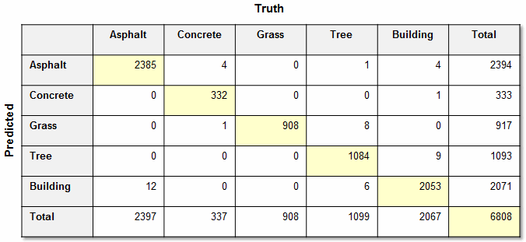
Program practice #5
Calculate the confusion matrix of IRIS prediction from 1-NN to 10-NN

Slide 12
Homework
Practice #4
Practice #5

