Slide 1
智慧型管理決策系統
20171115

Slide 2
Linear Regression
Signal generator
F1(t) = 0.063 t³ – 5.284 t² + 4.887 t + 412 + noise
Problem settings
Input: a series of F1 signal with t in [0.0 100.0]
Prior knowledge: F1 is a linear equation of t
Goal: Reverse the original equation of F1(t)

Slide 3
Non-linear cases
Signal generator
F2(t) = 0.6 t^{1.2} + 100 cos(0.4t) + noise;
Assume
Given: F2(t) = A*t^{B} + C*cos(D*t) + noise;
Find the best parameters A,B,C, and D
Fitness function
Energy(A,B,C,D) = | F2(t) – (A*t^{B} + C*cos(D*t)) |
Exhaustive search 窮取法
A = -5.11 : 0.01 : 5.12
B = -5.11 : 0.01 : 5.12
C = -511 : 512
D = -5.11 : 0.01 : 5.12 #每0.01跳跳跳到5.12

Slide 4
Exhaustive Search
Experiment 1
Fix A,B,C to ground truth and estimate the fitness under different D settings
Plot the curve where Y axis is the Energy and X axis is the D value
Experiment 2
Fix B,D and estimate the fitness under different combination of A and C settings
Plot the surface

Slide 5
Problem
Exhaustive Search
It requires 2⁴⁰ function calls
If the computational time of experiment 2 in previous slides is around 30 seconds, to examine 4 variables requires 364 days
Solution
Model the candidate solution and apply evolutionary algorithm, such as genetic algorithm, to find the optimal solution.

Slide 6
Genetic algorithm
定義基因
For example, 在我們的問題中使用一組40 bits code來代表4個變數
初代
利用亂數或expert knowledge產生一群初始的族群
複製 (reproduction)
計算fitness
利用fitness決定適者生存
輪盤式選擇 (roulette wheel selection)
依照fitness分割輪盤大小，面積比例越大越容易被選中
競爭式選擇 (tournament selection)
只留fitness最高的一小群人survive，淘汰適應不佳的

Slide 7
Genetic algorithm
交配 (crossover)
單點交配
此點以後的基因互換
雙點交配
兩點間的基因互換
遮罩交配
產生一個0/1 mask或filter，mask為1的bit互換
突變
少數bit 0->1或1->0

Slide 8
Exercise
2017.11.15

Slide 9
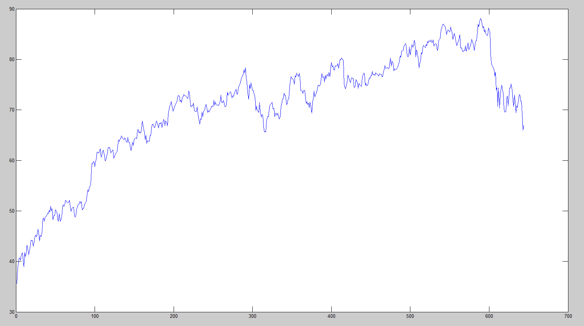
Financial Application (Bubble modeling)
The adjusted closing stock price of 3M Co.
2009/3/9 ~ 2011/9/23
Notes:
真實的股價資料

Slide 10
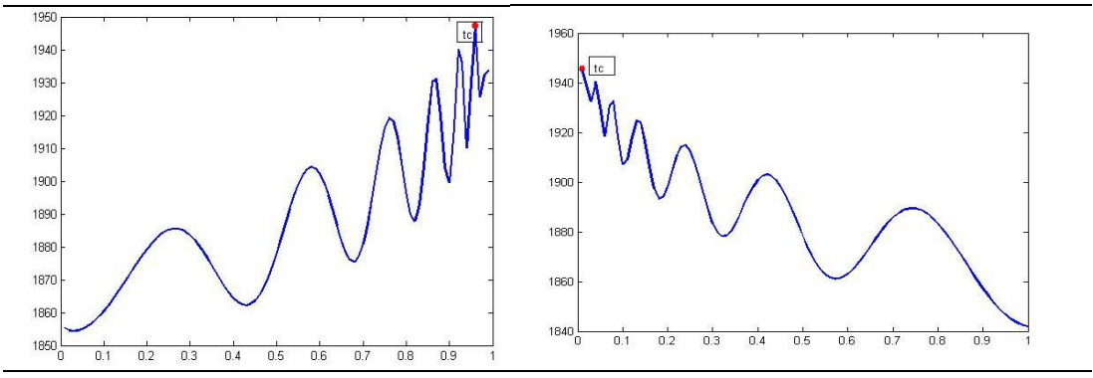
圖一 泡沫
圖二 反泡沫
資料來源：國泰君安證券研究所
Notes:
圖會有真實的跟你的signal

Slide 11
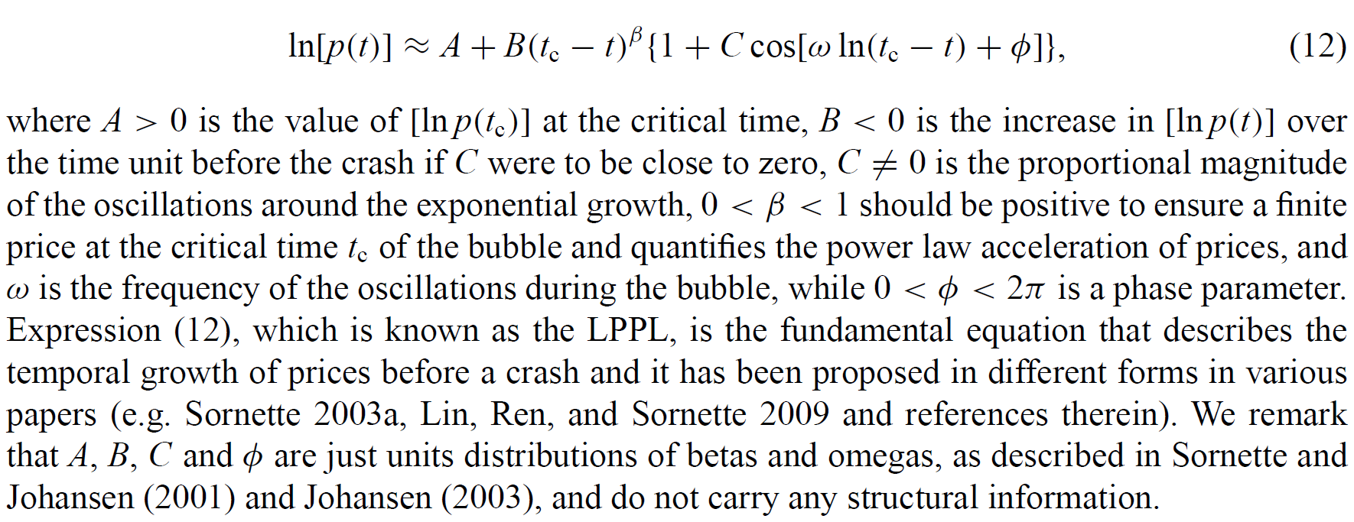
log-periodic power laws (LPPL) for bubble modeling
T會從0一直到Tc
Tc是泡沫化破掉的那個時間點(是整數) 550~600
Notes:
把equation分成線性跟非線性
Beta omega phi 還有 tc 是非線性的 （從基因換算出來）
再用這組解 兩個矩陣
去解出 A B C （線性回歸）

Slide 12
1.將基因換成四個參數 2.固定這四個參數下，用線性迴歸求當時最好的A,B,C參數 3.再利用這七個參數求合成signal與真實signal的平均誤差 (一連串t下兩訊號的平均誤差)
Two step algorithm
Each gene includes 4 non-linear variables t_{c}, β, ω, Φ
Use linear regression to estimate best A, B, C
Try to find optimal solution by genetic algorithm to minimize the error between synthetic signals and real financial time-series data
Homework: 再用7個參數去找出error
Plot the curve in Experiment 1 in page 4
Plot the surface in Experiment 2 in page 4
LPPL 找出最佳的一組參數 7個
Find the optimal LPPL parameters
Plot the synthetic signals and real time-series data with different colors in a figure

